Slide 1

Imūnā aizsardzība pret infekcijām: notikumu secība, limfocītu migrācija, aktivācija un efektorās funkcijas
Dr. Aija Linē, BMC

Slide 2
Iepriekšējās lekcijās:
Imūnsistēmas komponenti
Nespecifiskās imūnaizsardzības darbības mehānismi
MHC un antigēnu prezentēšana T šūnām
Kā T šūnas nobriest un pazīst antigēnu?
Kā B šūnas nobriest un pazīst antigēnu?

Slide 3
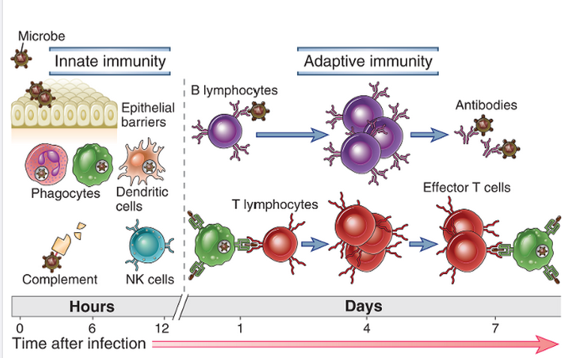
Pirmajās stundās pēc infekcijas tiek aktivēta nespecifiskā imūnaizsardzība; adaptīvā imūnā aizsardzība sāk darboties ~ nedēļas laikā

Slide 4


Slide 5
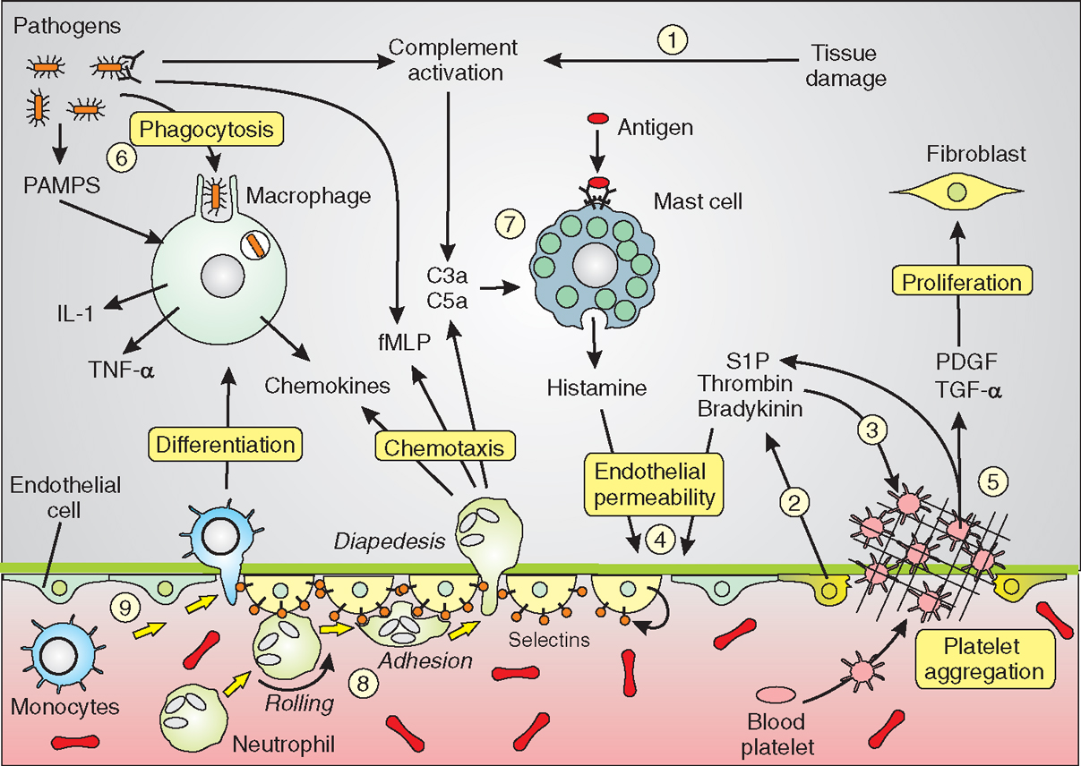
Akūta iekaisuma procesa iniciācija – leikocītu un plazmas proteīnu rekrutēšana un uzkrāšanās audos
Notes:
The innate immune system is triggered by signals derived from tissue damage and invading pathogens to activate cells such as the macrophages, neutrophils, mast cells, blood platelets and endothelial cells that contribute to a co-ordinated series of responses to both remove the pathogens and to repair damaged tissues. The endothelial cells are shown in three states: normal flattened shape (blue), contracted to increase endothelial permeability (light yellow) and damaged cells (bright yellow), where platelet aggregation occurs during formation of the haemostatic plug. Details of these responses are described in the text.
The leukocytes and plasma proteins normally circulate in the blood and are recruited to sites of infection and injury, where they perform various effector functions that serve to kill microbes and begin to repair tissue damage. Typically, the most abundant leukocyte that is recruited from the blood into acute inflammatory sites is the neutrophil, but blood monocytes, which become macrophages in the tissue, become increasingly prominent over time and may be the dominant population in some reactions. Among the important plasma proteins that enter inflammatory sites are complement proteins, antibodies, and acute-phase reactants. The delivery of these blood-derived components to the inflammatory site is dependent on reversible changes in blood vessels in the infected or damaged tissue. These changes include increased blood flow into the tissue due to arteriolar dilation, increased adhesiveness of circulating leukocytes to the endothelial lining of venules, and increased permeability of the capillaries and venules to plasma proteins and fluid.

Slide 6
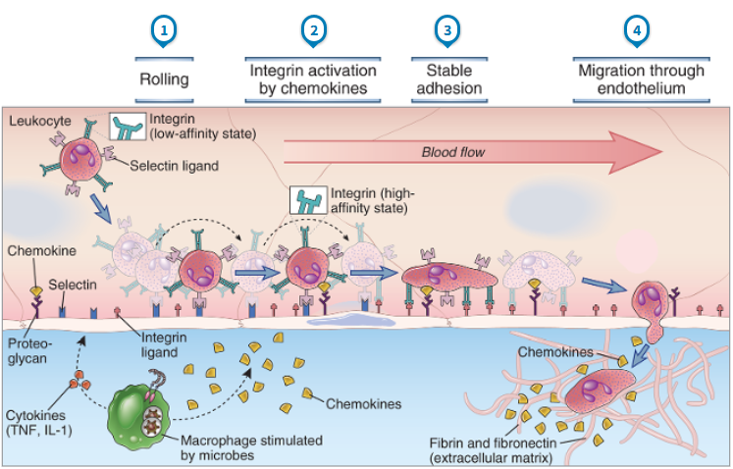
Endotēlija reakcija un leikocītu/limfocītu migrācija uz infekcijas vai ievainojuma vietu
Abbas AK et al, Cellular and Molecular Immunology, 2012
Notes:
At sites of infection, macrophages that have encountered microbes produce cytokines (such as TNF and IL-1) that activate the endothelial cells of nearby venules to produce selectins, ligands for integrins, and chemokines. Selectins mediate weak tethering and rolling of blood leukocytes on the endothelium, and the shear force of blood flow causes the leukocytes to roll along the endothelial surface. Chemokines produced in the surrounding infected tissues or by the endothelial cells are displayed on the endothelial surface and bind to receptors on the rolling leukocytes, which results in activation of the leukocyte integrins to a high-affinity binding state. The activated integrins bind to their Ig superfamily ligands on the endothelial cells, and this mediates firm adhesion of leukocytes. The leukocytes then crawl to junctions between endothelial cells and migrate through the venular wall. Neutrophils, monocytes, and T lymphocytes use essentially the same mechanisms to migrate out of the blood.

Slide 7
Selektīni – nodrošina zemas afinitātes adhēziju
P-selektīns: tiek uzglabāts endotēlija šūnu citoplazmatiskās granulās; saņemot signālu (citokīni, m/o produkti, histamīns), momentā tiek transportēts uz šūnas virsmu
E-selektīns: sintēze endotēlija šūnās sākas 1-2 stundu laikā, pēc IL-1, TNF u.c. signālu saņemšanas
P un E-selektīnu ligandi: kompleksi ogļihidrātu atlikumi (Lewis X, Lewis A) uz granulocītu, monocītu un aktivētu T šūnu virsmas
L-selektīns: ekspresēts uz leikocītiem; ligandi – sialomucīni uz endoteliālo šūnu virsmas
Notes:
The integrins on blood leukocytes are normally in a low-affinity state. If a leukocyte comes close to endothelial cells, such as when selectin-dependent rolling of leukocytes occurs, then chemokines displayed on the endothelial surface can bind chemokine receptors on the leukocyte. Chemokine receptor signaling then occurs, which activates the leukocyte integrins, increasing their affinity for their ligands on the endothelial cells. B, Ribbon diagrams are shown of bent and extended conformations of a leukocyte integrin, corresponding to low- and high-affinity states, respectively.

Slide 8
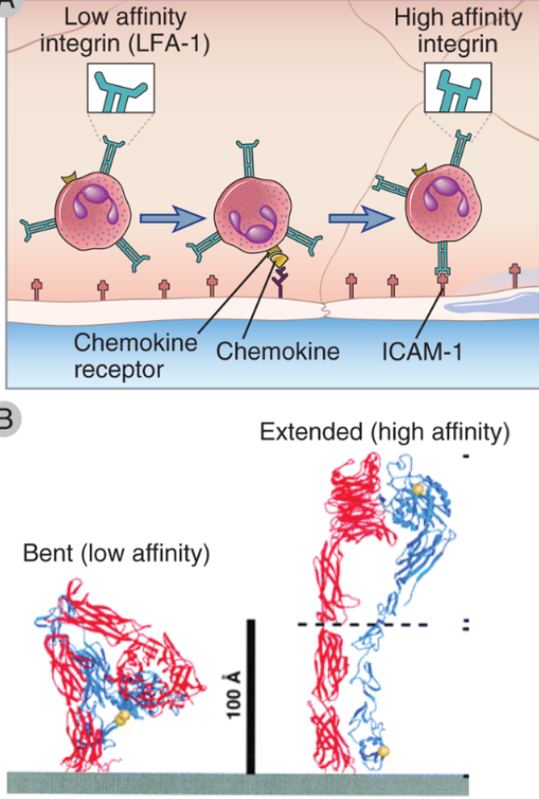
Integrīni – nodrošina augstas afinitātes saistību
Integrīni: ~30 dažādas heterodimēriskas adhēzijas molekulas, veido α un β ķēdes
Ekspresēti uz dažādiem šūnu tipiem, ieskaitot leikocītus un endotēliju
Ekstracelulārais domēns – globulārs, līdzīgs Ig domēnam, uz leikcītiem parasti neaktivētā stāvoklī; hemokīnu vai antigēnu receptoru aktivācija, izraisa šī domēna konformācijas maiņu un pāreju aktīvā stāvoklī
Integrīnu saistība ar ligandiem, izraisa izmaiņas citoskeletā un veicina šūnu kustību
Notes:
The integrins on blood leukocytes are normally in a low-affinity state. If a leukocyte comes close to endothelial cells, such as when selectin-dependent rolling of leukocytes occurs, then chemokines displayed on the endothelial surface can bind chemokine receptors on the leukocyte. Chemokine receptor signaling then occurs, which activates the leukocyte integrins, increasing their affinity for their ligands on the endothelial cells. B, Ribbon diagrams are shown of bent and extended conformations of a leukocyte integrin, corresponding to low- and high-affinity states, respectively.

Slide 9
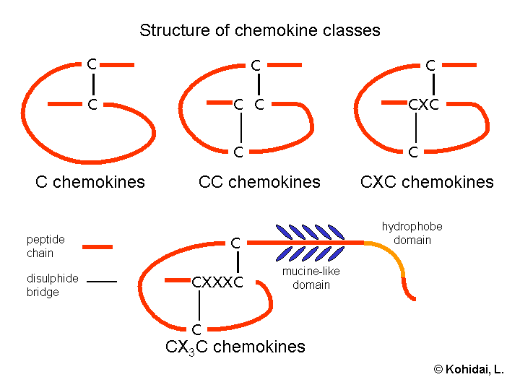
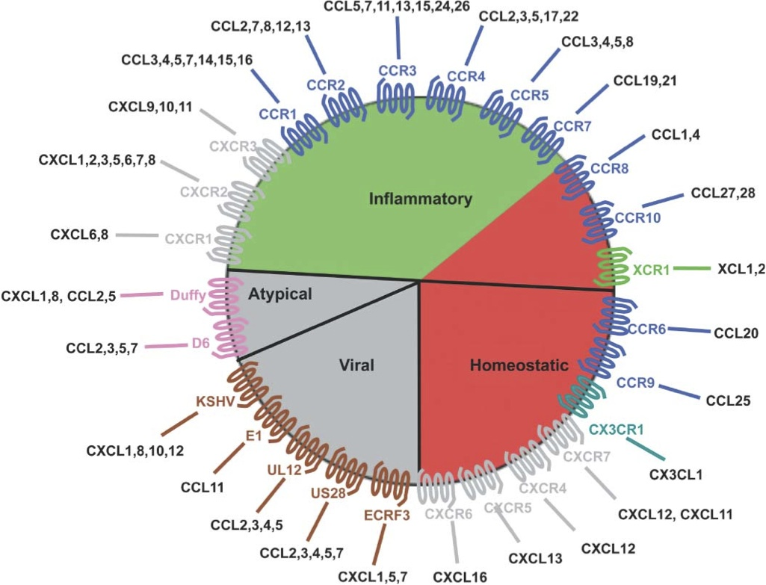
Hemokīni un hemokīnu receptori
Hemokīni – strukturāli līdzīgu ~50 citokīnu grupa, kas stimulē leikocītu kustību un migrāciju no asinīm uz audiem.
8-12 kDa proteīni, kas satur 2 disulfīdu tiltiņus; atkarībā no Cys izvietojuma, iedala vairākās klasēs: C, CC, CXC, CX3C
Pēc funkcijas: homeostatiski un iekaisuma hemokīni
Receptori: G-proteīna saistītie receptori; to aktivācija izraisa citoskeleta re-modelēšanu un šūnas kustību

Slide 10
Nespecifiskās imūnaizsardzības efektorie mehānismi

Slide 11
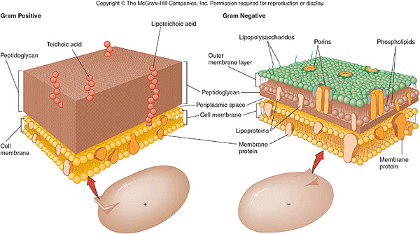
Nespecifiskā imūnaizsardzība pret ekstracelulārām baktērijām
Komplementa aktivācija: Klasiskais un alternatīvais ceļš
  Alternatīvais ceļš - Gram pos. baktēriju gadījumā aktivē peptidoglikāni; Gram neg. - LPS
  Efektorie mehānismi: bakteriolīze, opsonizācija (veicina fagocitozi)
Fagocitoze: neitrofili, makrofāgi. Receptori: TLRs, C-tipa lektīni, scavenger, N-formilMet-Leu-Phe receptori

Slide 12
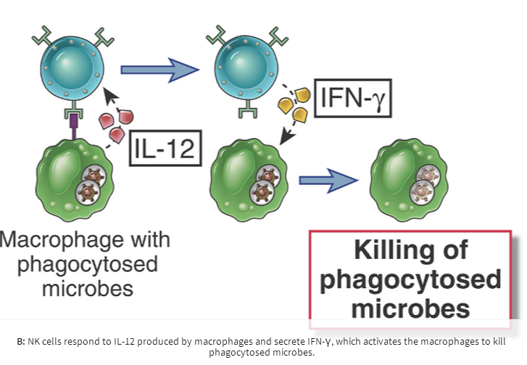
Nespecifiskā imūnaizsardzība pret intracelulārām baktērijām
NK šūnas: intracelulāras baktērijas aktivē NK šūnas, inducējot NK-aktivējošo ligandu ekspresiju uz inficētajām šūnām. NK šūnas nogalina inficētās cilvēka šūnas, izmantojot granzīmu/perforīnu. Turklāt, aktivētas NK šūnas producē IFN-γ, kas savukārt, stimulē makrofāgus.
Peles, kurām nav funkcionālu T un B šūnu spēj (kādu laiku) kontrolēt Listeria monocytogenes infekciju, tomēr pilnīga infekcijas iznīcināšanai ir nepieciešama adaptīvā imūnā atbilde.
Fagocitoze
Intracelulāro TLR un NOD-like receptoru aktivācija stimulē fagocītus iznīcināt fagocitētās baktērijas

Slide 13
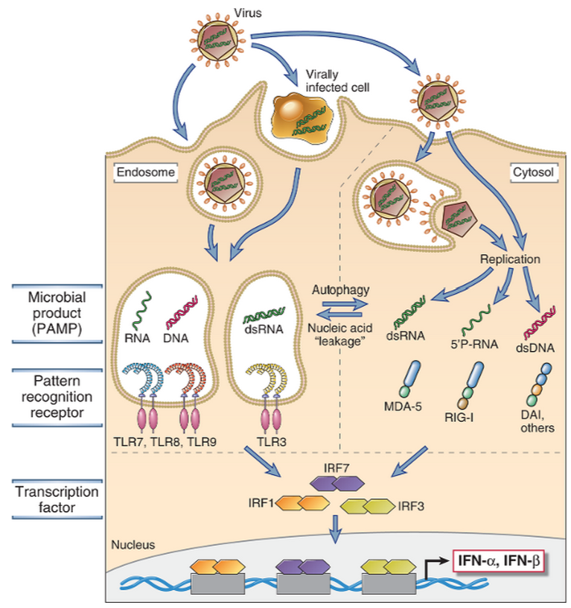
Nespecifiskā imūnaizsardzība pret vīrusiem
(I) 1. tipa interferonu produkcija
Endosomālo TLR un RIG-like receptoru aktivācija inducē IFN-α un β produkciju vīrusu inficētajās šūnās
Notes:
Viral nucleic acids and proteins are recognized by several cellular receptor families (TLRs and the family of cytosolic RIG-like receptors, or RLRs, which include MDA-5, RIG-I, DAI and others), which activate transcription factors (the IRF proteins) that stimulate the production of type I interferons, IFN-α and IFN-β.

Slide 14
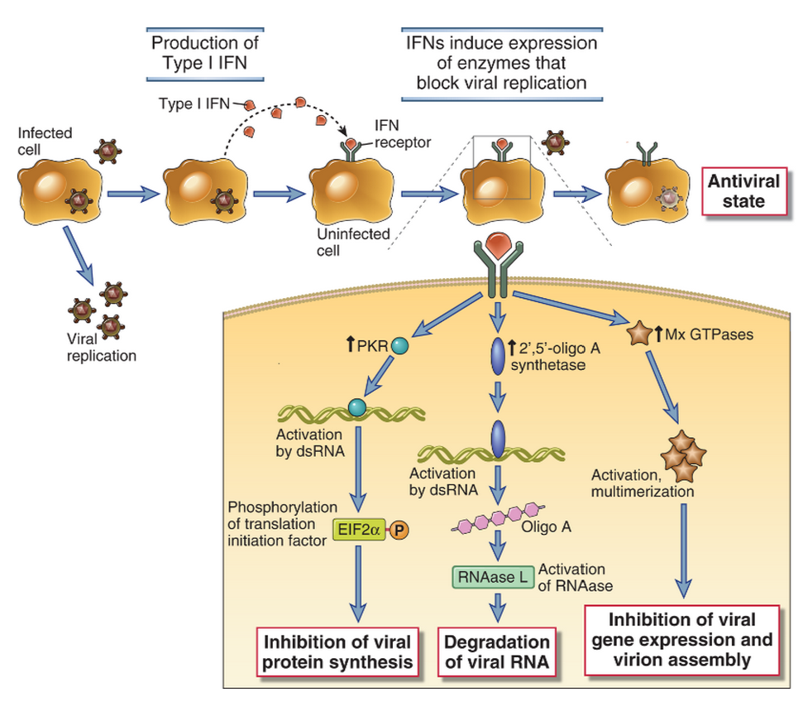
I. tipa interferonu pret-vīrusu aktivitāte
Notes:
Type I interferons (IFN-α, IFN-β) are produced by virus-infected cells in response to intracellular TLR signaling and other sensors of viral RNA. Type I interferons bind to receptors on neighboring uninfected cells and activate JAK-STAT signaling pathways, which induce expression of genes whose products interfere with viral replication. Type I interferons also bind to receptors on infected cells and induce expression of genes whose products enhance the cell’s susceptibility to CTL-mediated killing. PKR, double stranded RNA-activated protein kinase.

Slide 15
Nespecifiskā imūnaizsardzība pret vīrusiem
(II) NK šūnas
NK šūnas var aktivēt:
Vīruss inhibē MHC I ekspresiju – NK šūna nesaņem inhibējošo signālu
Vīruss inducē NK šūnu aktivējošo ligandu ekspresiju – aktivējošo receptoru aktivācija

Slide 16
Sēnīšu infekcijas (mikozes)
Dabā ir vairāk kā 70 000 sugu sēņu; tikai dažas ir patogēnas.
Ādas, zemādas, sistēmiskas infekcijas un kandidozes (Candida albicans)
Nav vakcīnu un efektīvu antibiotiku (eikarioti ar līdzīgu proteīnu sintēzes un replikācijas mašinēriju)
Lielākā daļa sēnīšu infekciju izraisa spēcīgu imūno atbildi veseliem cilvēkiem
Oportuniskas infekcijas – veseliem cilvēkiem neizraisa patoloģiju, bet cilvēkiem ar dažāda veida imunosupresiju (HIV, transplantācijas, ķīmijterapija, imunosupresīvi medikamenti artrītu ārstēšanai u.c.) izraisa smagas saslimšanas. Piemēram, Pneumocystis jiroveci izraisīta pneimonija

Slide 17
Nespecifiskā imūnaizsardzība pret sēnīsu infekcijām
Fagocitoze: neitrofili, makrofāgi
Receptori: TLRs, C-tipa lektīni (dectīni)
Rezistences mehānismi: dažas sēnītes spēj inhibēt TNF un IL-12 produkciju makrofāgos un stimulē IL-10 produkciju
Notes:
The principal mediators of innate immunity against fungi are neutrophils and macrophages. Patients with neutropenia are extremely susceptible to opportunistic fungal infections. Phagocytes and dendritic cells sense fungal organisms by TLRs and lectin-like receptors called dectins. Neutrophils presumably liberate fungicidal substances, such as reactive oxygen species and lysosomal enzymes, and phagocytose fungi for intracellular killing. Virulent strains of Cryptococcus neoformans inhibit the production of cytokines such as TNF and IL-12 by macrophages and stimulate production of IL-10, thus inhibiting macrophage activation.

Slide 18
Nespecifiskā imūnaizsardzība pret parazītiem
Galvenais nespecifiskās imūnaizsardzības mehānisms pret parazītiskiem vienšūņiem – fagocitoze
Daudzi intracelulāri parazīti ir rezistenti pret degradāciju un spēj vairoties makrofāgos.
Fagocīti sekretē anti-mikrobiālus peptīdus, taču lielai daļai parazītu ir specifiski aizsardzības mehānismi
Notes:
Although different protozoan and helminthic parasites have been shown to activate different mechanisms of innate immunity, these organisms are often able to survive and replicate in their hosts because they are well adapted to resisting host defenses. The principal innate immune response to protozoa is phagocytosis, but many of these parasites are resistant to phagocytic killing and may even replicate within macrophages. Some protozoa express surface molecules that are recognized by TLRs and activate phagocytes. Plasmodium species (the protozoa that are responsible for malaria), Toxoplasma gondii (the agent that causes toxoplasmosis), and Cryptosporidium species (the major parasite that causes diarrhea in HIV-infected patients) all express glycosyl phosphatidylinositol lipids that can activate TLR2 and TLR4. Phagocytes may also attack helminthic parasites and secrete microbicidal substances to kill organisms that are too large to be phagocytosed. However, many helminths have thick teguments that make them resistant to the cytocidal mechanisms of neutrophils and macrophages, and they are too large to be ingested by phagocytes. Some helminths may activate the alternative pathway of complement, although as we shall discuss later, parasites recovered from infected hosts appear to have developed resistance to complement-mediated lysis.

Slide 19
Kā tiek aktivēta adaptīvā imūnā sistēma?

Slide 20
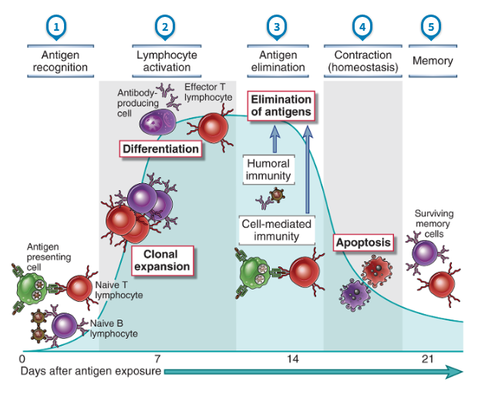
Adaptīvās imūnās atbildes aktivācijas laikaposms
Notes:
Adaptive immune responses consist of distinct phases, the first three being the recognition of antigen, the activation of lymphocytes, and the elimination of antigen (the effector phase). The response contracts (declines) as antigen-stimulated lymphocytes die by apoptosis, restoring homeostasis, and the antigen-specific cells that survive are responsible for memory. The duration of each phase may vary in different immune responses. The y-axis represents an arbitrary measure of the magnitude of the response. These principles apply to humoral immunity (mediated by B lymphocytes) and cell-mediated immunity (mediated by T lymphocytes).

Slide 21
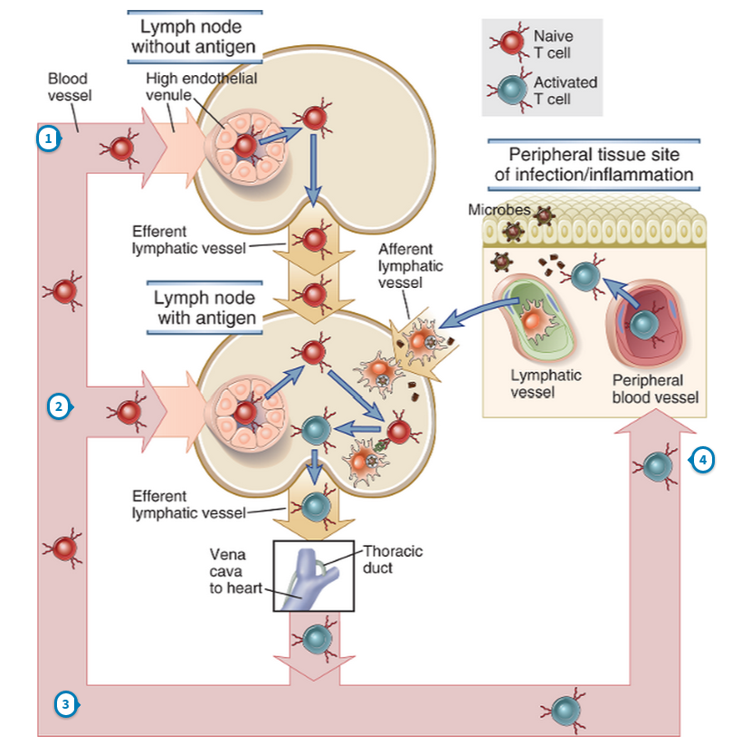
Limfocītu recirkulācija
Naïvi nobrieduši limfocīti organismā recirkulē starp asinīm, limfu, limfmezgliem, liesu un gļotādu sekundārajiem limfoīdajiem orgāniem (SLO).
Caur katru limfmezglu dienā iziet ~25X10⁹ limfocītu
Ja limfocīts SLO sastop antigēnu, ko pazīst – aktivējas
Aktivēti limfocīti dodas uz infekcijas/iekaisuma vietu perifērajos audos vai uz kaulu smadzenēm (B šūnas)
Notes:
Lymphocyte recirculation
The continuous movement of lymphocytes through the blood stream and lymphatics, between the lymph nodes or spleen and, if activated, peripheral inflammatory sites.

Slide 22
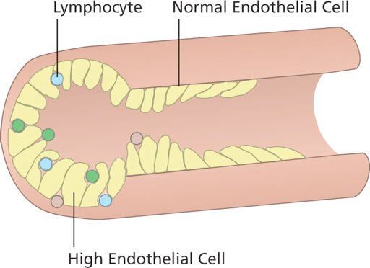
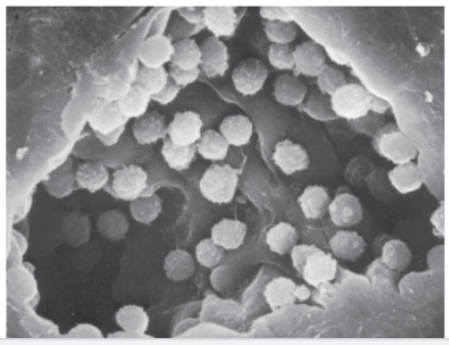
Limfocīti iekļūst limfmezglā caur HEV (high endothelial venules)
Rolling: L selektīns – ogļhidrātu ligands uz HEC
Adhēzija: integrīni (LFA1)
Limfocītu migrācija caur HEV
B šūnu migrācijā galvenā loma ir hemokīnam CXCL13, ko producē HEC un stroma limfmezglā un CXCR5 uz B šūnu virsmas
Notes:
Naive T cell migration out of the blood through the HEVs into the lymph node parenchyma is a multistep process consisting of selectin-mediated rolling of the cells, chemokine-induced integrin activation, integrin-mediated firm adhesion, and transmigration through the vessel wall (Fig. 3-6). This process is similar to the migration of other leukocytes, described earlier. The adhesion molecules expressed on lymphocytes are often called homing receptors, and the adhesion molecules that the homing receptors bind to on the endothelial cells are called addressins. The sequential events involved in homing of naive T cells to lymph nodes and the molecules involved are the following.
The rolling of naive T cells on HEVs in peripheral lymphoid organs is mediated by L-selectin on the lymphocytes binding to its carbohydrate ligand on HEVs called peripheral node addressin (PNAd). The PNAd carbohydrate groups that bind L-selectin may be attached to different sialomucins on the HEV in different tissues. For example, on lymph node HEVs, the PNAd is displayed by two sialomucins, called GlyCAM-1 (glycan-bearing cell adhesion molecule 1) and CD34. In Peyer’s patches in the intestinal wall, the L-selectin ligand is a molecule called MadCAM-1 (mucosal addressin cell adhesion molecule 1).
The subsequent firm adhesion of the T cells to the HEVs is mediated by integrins, mainly LFA-1. The affinity of these integrins on naive T cells is rapidly increased by CCL19 and CCL21, which we introduced in Chapter 2 as chemokines required for the maintenance of T cell zones in lymph nodes. CCL19 is constitutively produced by HEVs and is bound to glycosaminoglycans on the cell surface for display to rolling lymphocytes. CCL21 is produced by other cell types in the lymph node and is displayed by HEVs in the same fashion as CCL19. Recall that both these chemokines bind to the chemokine receptor called CCR7, which is highly expressed on naive lymphocytes. This interaction of the chemokines with CCR7 ensures that naive T cells increase integrin avidity and are able to adhere firmly to HEVs.
The firmly adherent T cells are no longer subject to dislodgment by the blood flow, but they are capable of crawling on the endothelial surfaces toward intercellular junctions. At these junctions, the T cells move through the vessel wall into the extravascular tissue. This process is likely dependent on other adhesion molecules on the T cell binding to HEV adhesion molecules whose expression is restricted to intercellular junctions.

Slide 23
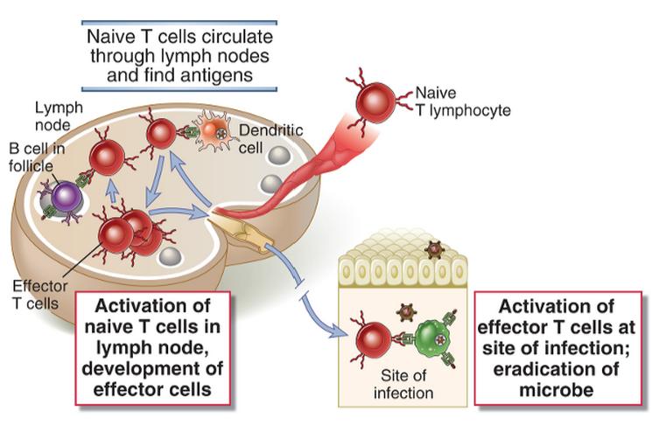
Naïvo limfocītu aktivācija notiek sekundārajos limfoīdajos orgānos (SLO) – limfmezglos, liesā, Peijera mezglos; atmiņas T šūnu re-stimulācija var notikt audos
Notes:
Antigens that are transported by dendritic cells to lymph nodes are recognized by naive T lymphocytes that recirculate through these lymph nodes. The T cells are activated to differentiate into effector and memory cells, which may remain in the lymphoid organs or migrate to nonlymphoid tissues. At sites of infection, the effector cells are again activated by antigens and perform their various functions, such as macrophage activation.
Antigen recognition and other activating stimuli induce several responses: cytokine secretion from the T cells; proliferation of the antigen-specific lymphocytes, leading to an increase in the numbers of cells in the antigen-specific clones (called clonal expansion); and differentiation of the naive cells into effector and memory lymphocytes

Slide 24
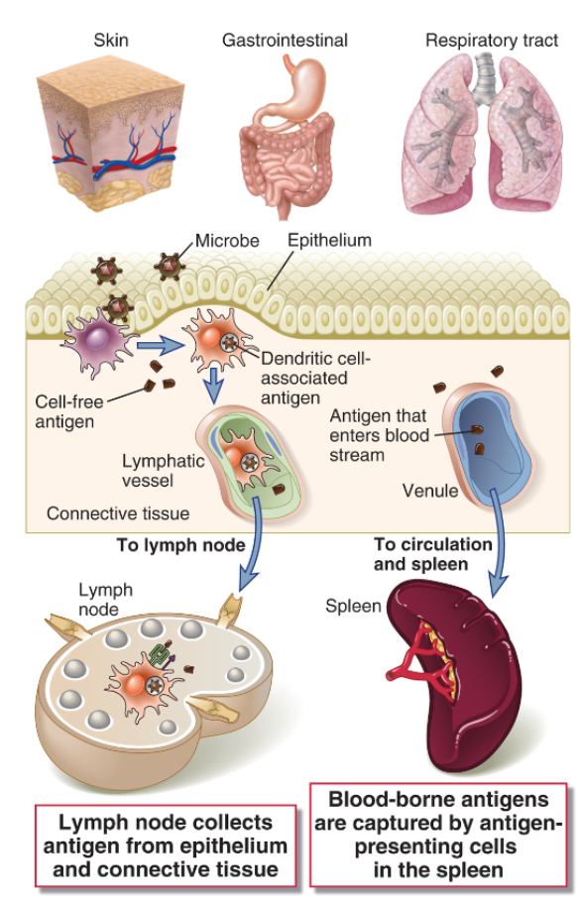
Veidi kā antigēni nokļūst SLO
Dendrītiskās šūnas infekcijas vietā uzņem antigēnu (visbiežāk m/o fagocitozes ceļā), nobriest un migrē uz tuvākajiem limfmezgliem pa limfvadiem
Antigēni, kas iekļuvuši asinsritē nonāk liesā , kur tos uzņem APCs
Notes:
Microbial antigens commonly enter through the skin and gastrointestinal and respiratory tracts, where they are captured by dendritic cells and transported to regional lymph nodes. Antigens that enter the blood stream are captured by APCs in the spleen.

Slide 25
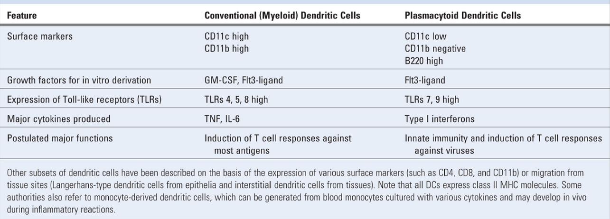
Dendrītisko šūnu (DC) veidi
Klasiskās (conventional / myeloid) DCs: veidojas kaulu smadzenēs, rezidē audos, perifērajos audos uzņem antigēnus, nobriest un migrē uz limfmezgliem, kur tās aktivē T šūnas.
Iedala:
Langerhansa šūnas – ādas DCs;
Interstitālās (interstitial) – citos audos
Plasmacitoīdās DCs: morfoloģiski atgādina plazmas šūnas, DC morfoloģiju un funkcijas iegūst tikai pēc aktivācijas; cirkulē asinīs un limfoīdajos orgānos

Slide 26
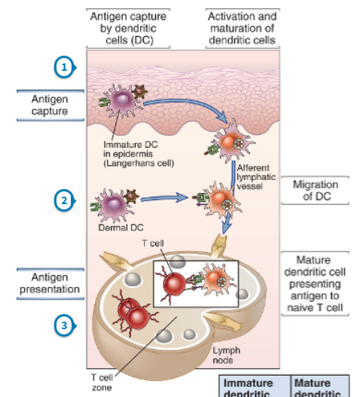
Antigēnu uzņemšana DCs un DC migrācija
Nenobriedušas DC Ag var uzņemt endocitozes, fagocitozes vai pinocitozes ceļā
DCs aktivējas/nobriest, saņemot signālus no TLR un citokīnu receptoriem
Zaudē kontaktus ar epitēlija šūnām, migrē uz limfmezgliem
Sāk ekspresēt hemokīnu receptorus, kas tās novirza uz T šūnu zonu limfmezglā

Slide 27
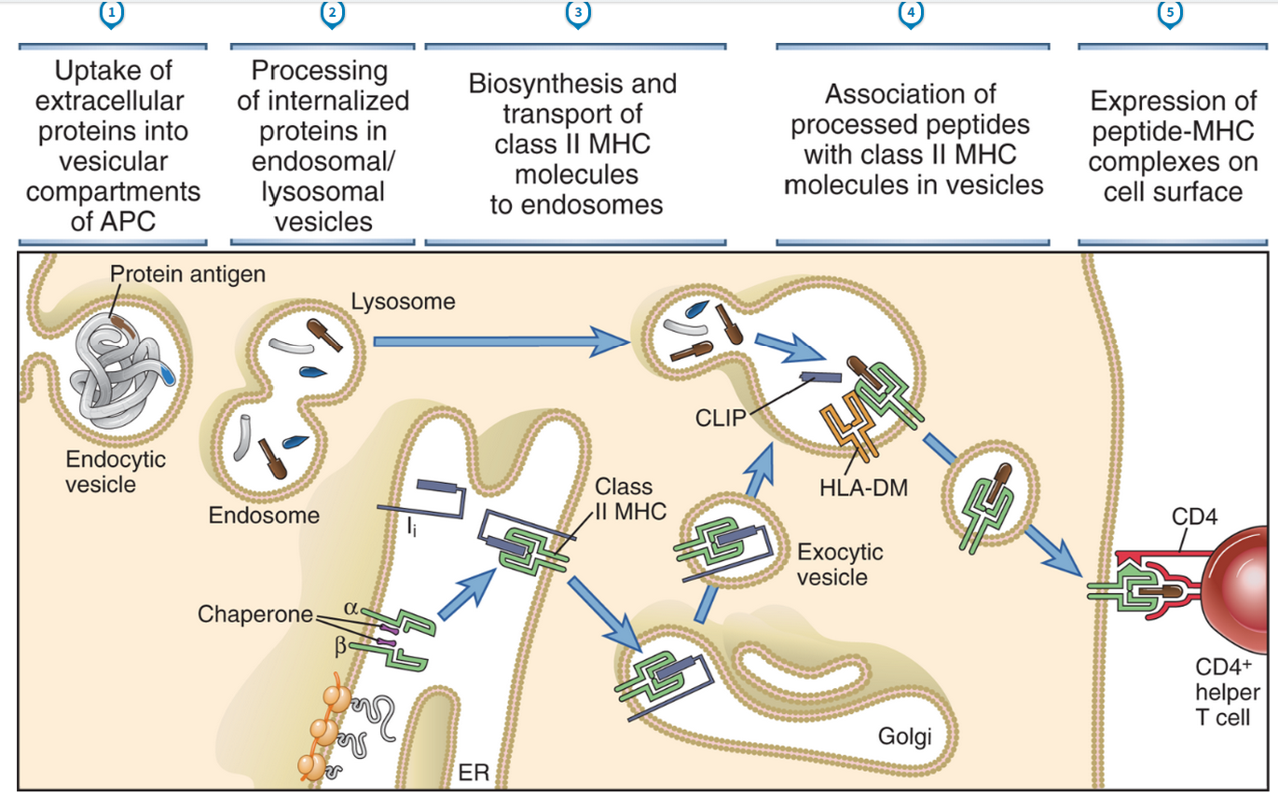
DCs procesē un prezentē antigēnus uz MHCII

Slide 28
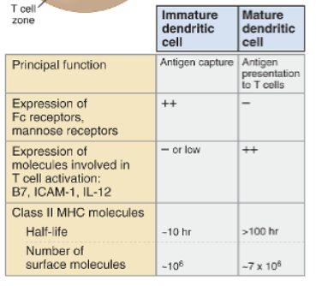
Nobriedušu un nenobriedušu DC atšķirības

Slide 29
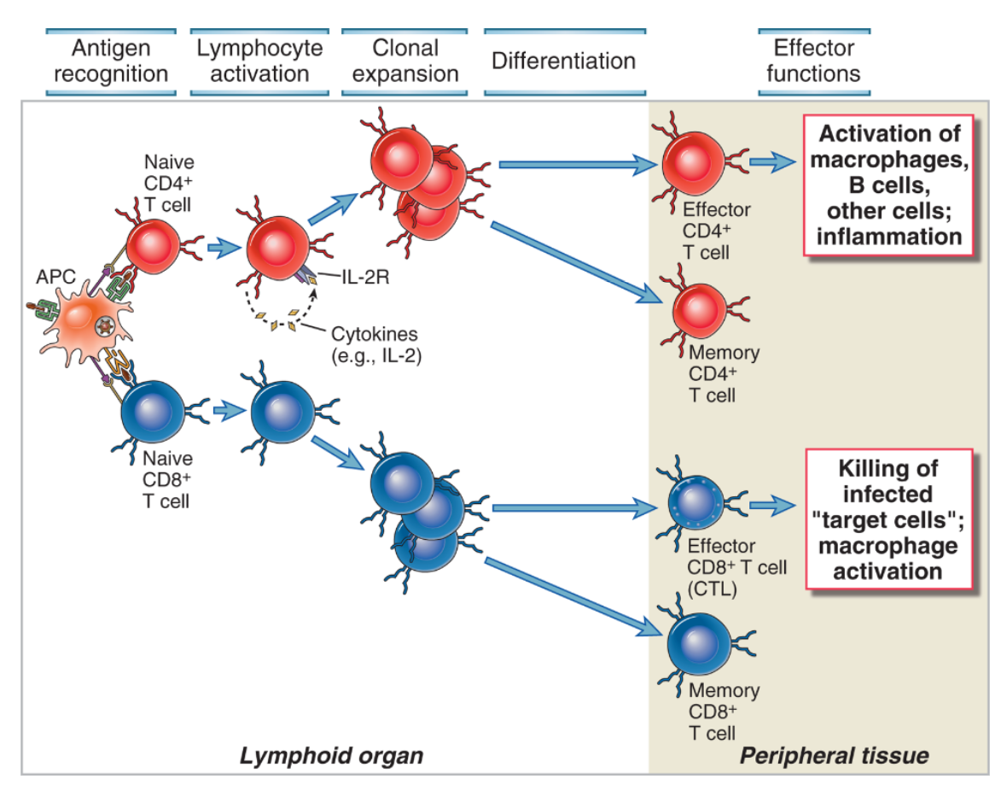
Limfmezglu T šūnu zonā DCs mijiedarbojas ar T šūnām

Slide 30
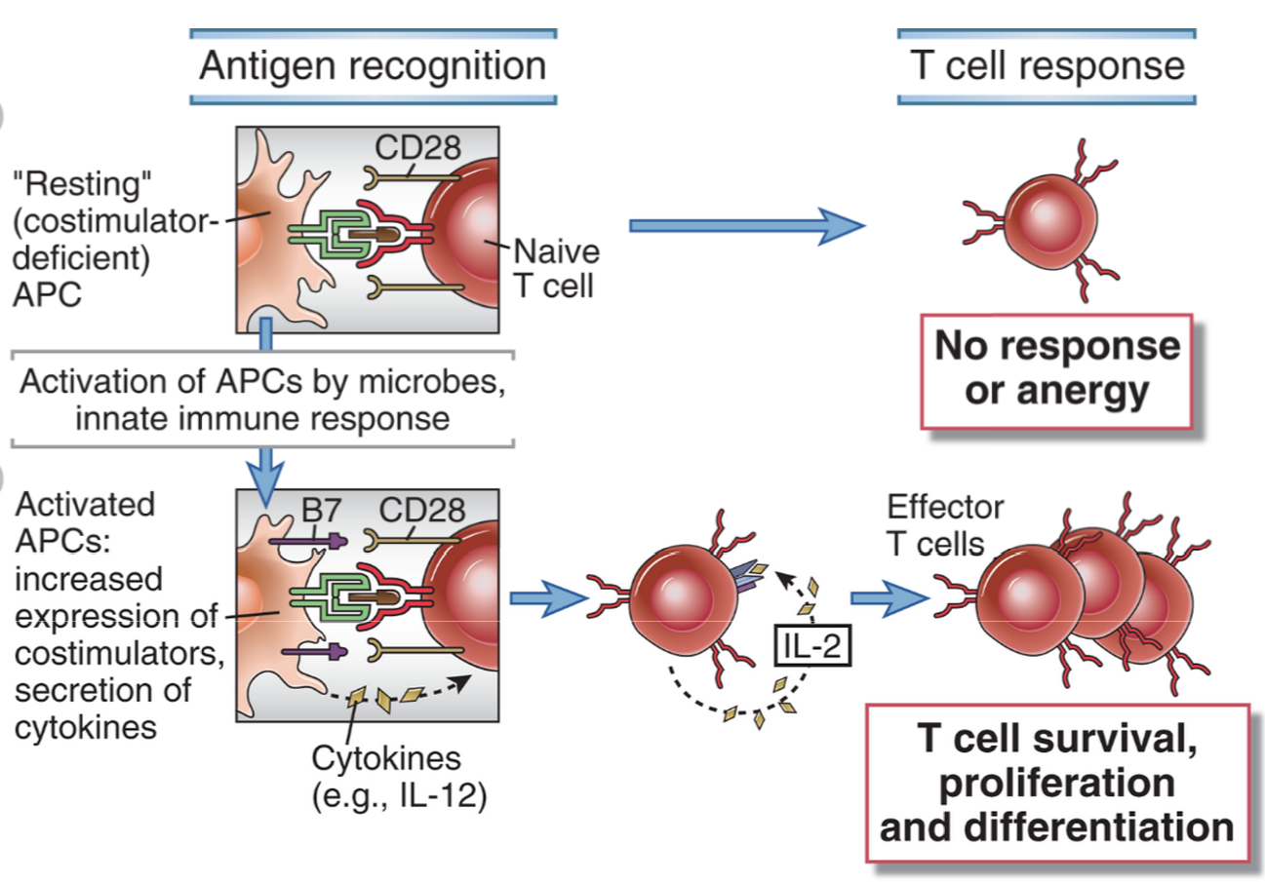
T šūnu aktivācijai ir nepieciešami 2 signāli:
1. signāls – antigēns; 2. signāls – ko-stimulējošā molekula (B7-1, B7-2)
Notes:
The resting APC expresses few or no costimulators and fails to activate naive T cells. (Antigen recognition without costimulation may make T cells anergic; this phenomenon will be discussed in Chapter 14.) B, Microbes and cytokines produced during innate immune responses activate APCs to express costimulators, such as B7 molecules. The APCs then become capable of activating naive T cells. Activated APCs also produce cytokines such as IL-12, which stimulate the differentiation of naive T cells into effector cells.

Slide 31
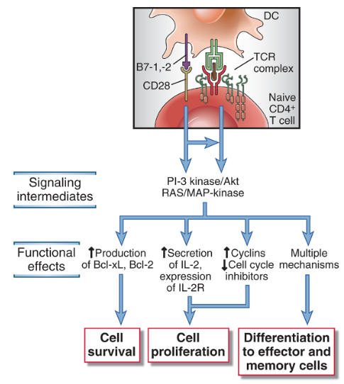
Signāli no TCR un CD28 T šūnās aktivē virkni signālceļu, kas izraisa proliferāciju, veicina izdzīvošanu, diferenciāciju un efektorās funkcijas
Notes:
In lymphoid organs, dendritic cells present peptides derived from endocytosed protein antigens in association with class II MHC molecules to naive CD4⁺ T cells and peptides derived from cytosolic proteins displayed by class I MHC molecules to CD8⁺ T cells. CD4⁺ T cell–mediated immune reactions are elicited by protein antigens of microbes that are ingested by dendritic cells or by soluble protein antigens that are administered with adjuvants, in the case of vaccinations, and taken up by dendritic cells.
IL-2 stimulates the survival, proliferation, and differentiation of antigen-activated T cells. IL-2 promotes survival of cells by inducing the antiapoptotic protein Bcl-2. It stimulates cell cycle progression through the synthesis of cyclins and relieves a block in cell cycle progression through p27 degradation. In addition, IL-2 increases production of effector cytokines, such as IFN-γ and IL-4, by the T cells.
IL-2 is required for the survival and function of regulatory T cells,which suppress immune responses against self and other antigens. In fact, knockout mice lacking IL-2 or IL-2 receptors develop uncontrolled T and B cell proliferation and autoimmune disease because of a defect in regulatory T cells. These studies indicate that other growth factors can replace IL-2 for expansion of effector T cells, but no other cytokine can replace IL-2 for the maintenance of functional regulatory T cells.

Slide 32
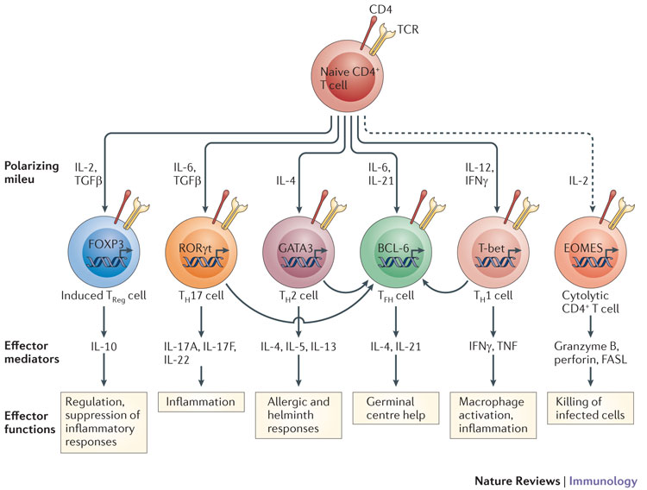
                Galvenie efektorie Th subtipi, kas veidojas no naïvām CD4+ T šūnām
Atkarībā no signāliem, kādus DC ir saņēmusi infekcijas vietā, tā producē dažādus citokīnus, kas nosaka Th šūnu polarizāciju. Tādējādi, DCs ir galvenais imūnās atbildes koordinators.

Slide 33
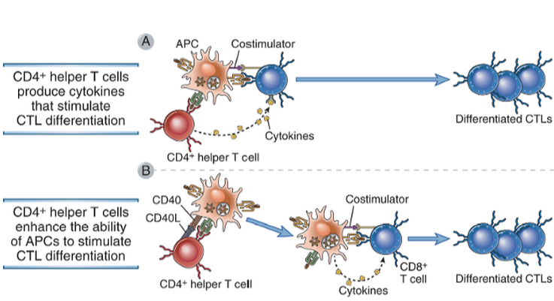
CD8+ citotoksisko T šūnu (CTL) aktivācija:
nobriedusi APC, kas prezentē Ag uz MHC I un nodrošina ko-stimulāciju (B7), aktivēta T šūna producē IL-2, kas izraisa to proliferāciju; atkarībā no antigēna, CD4+ Th1 var stimulēt CTL aktivāciju vai nu producējot citokīnus vai aktivējot APCs
Notes:
CD4⁺ helper T cells promote the development of CD8⁺ CTLs by secreting cytokines that act directly on the CD8⁺cells (A) or by activating APCs to become more effective at stimulating the differentiation of the CD8⁺ T cells(B).

Slide 34
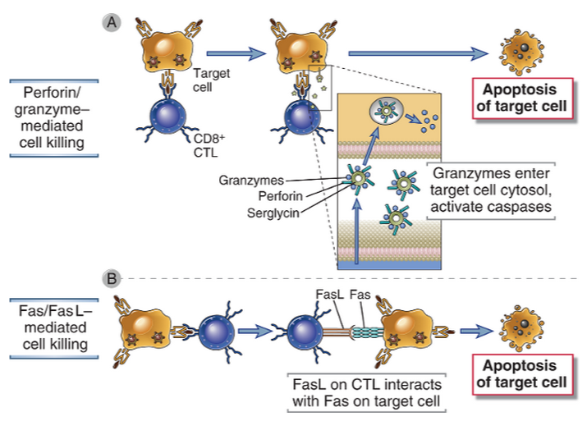
CTL efektorā funkcija – inficēto šūnu nogalināšana
Notes:
A CTL recognizes the antigen-expressing target cell and is activated. Activation results in the release of granule contents from the CTL into the target cell through the area of contact (the immunologic synapse). Granule contents deliver a lethal hit to the target. The CTL may detach and kill other target cells. The formation of conjugates between a CTL and its target and activation of the CTL also require interactions between accessory molecules (LFA-1, CD8) on the CTL and their specific ligands on the target cell; these are not shown.
Within a few minutes of a CTL’s antigen receptor recognizing its antigen on a target cell, the target cell undergoes changes that induce it to die by apoptosis. Target cell death occurs during the next 2 to 6 hours and proceeds even if the CTL detaches. Thus, the CTL is said to deliver a lethal hit to the target cell. The principal mechanism of CTL-mediated target cell killing is the delivery of cytotoxic proteins stored within cytoplasmic granules (also called secretory lysosomes) to the target cell, thereby triggering apoptosis of the target cell
CTLs kill target cells by two main mechanisms. A, Complexes of perforin and granzymes are released from the CTL by granule exocytosis and enter target cells. The granzymes are delivered into the cytoplasm of the target cells by a perforin-dependent mechanism, and they induce apoptosis.B, FasL is expressed on activated CTLs, engages Fas on the surface of target cells, and induces apoptosis.

Slide 35
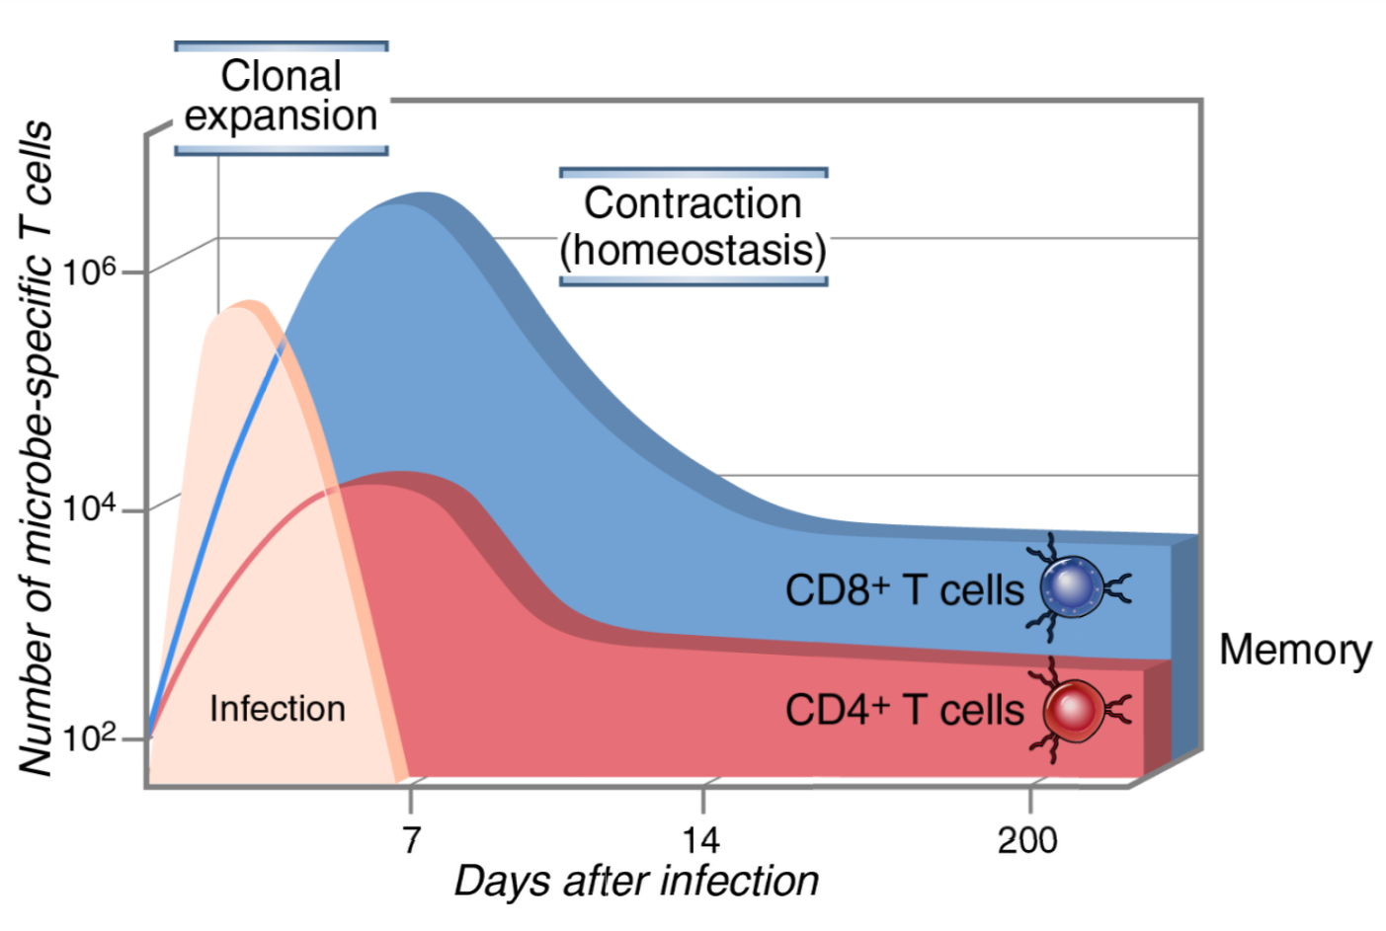
T šūnu klonāla ekspansija
Notes:
The numbers of CD4⁺ and CD8⁺ T cells specific for microbial antigens and the expansion and decline of the cells during immune responses are illustrated. The numbers are approximations based on studies of model microbial and other antigens in inbred mice.

Slide 36
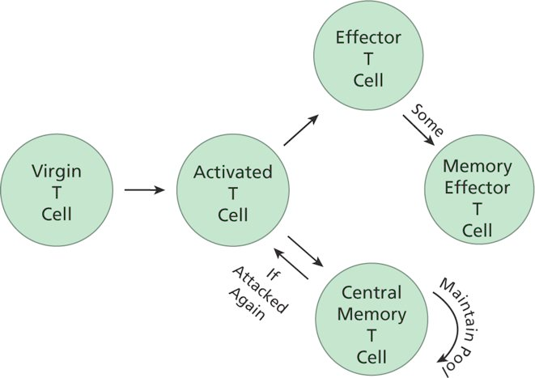
T šūnu atmiņas veidošanās
T šūnu atmiņa var saglabāties vairākus desmitus gadu. Lielākā daļa efektoro T šūnu iet bojā apoptozes ceļā, dažas kļūst par atmiņas efektorajām šūnām, kas rezidē audos: ātri re-aktivējamas, spēj proliferēt (nedaudz).
Centrālās atmiņas šūnas rezidē sekundārajps limfoīdajos orgānos; pēc re-aktivācijas daļa kļūst par efektoriem.

Slide 37
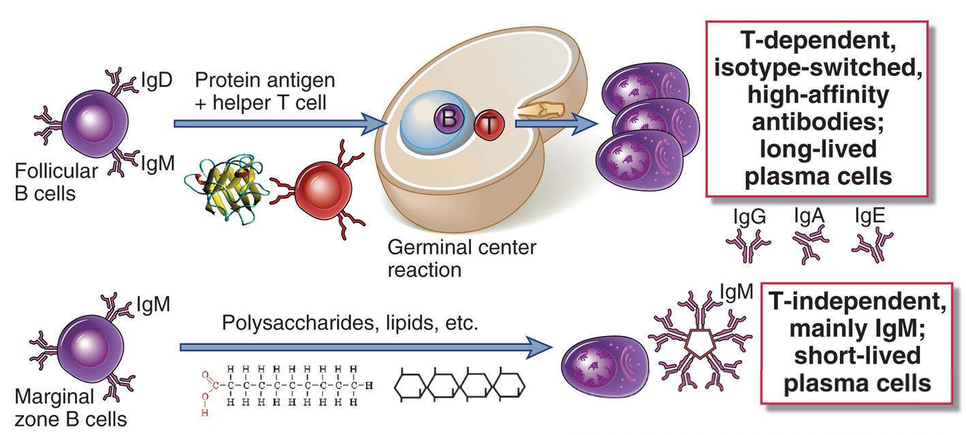
T šūnu atkarīgi un neatkarīgi B šūnu aktivācijas mehānismi
Notes:
Follicular B cells are recirculating cells that receive T cell help when they respond to protein antigens and thus initiate T-dependent antibody responses. These responses can lead to the formation of germinal centers, where class switching and somatic mutation of antibody gene occur, resulting in specialized high-affinity antibody responses. T-independent responses to multivalent antigens such as lipids, polysaccharides, and nucleic acids are mediated mainly by marginal zone B cells in the spleen and B-1 cells in mucosal sites.

Slide 38
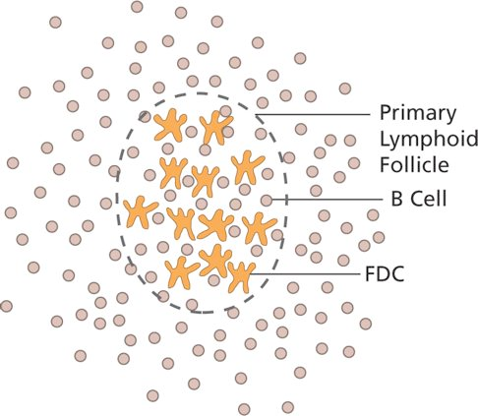
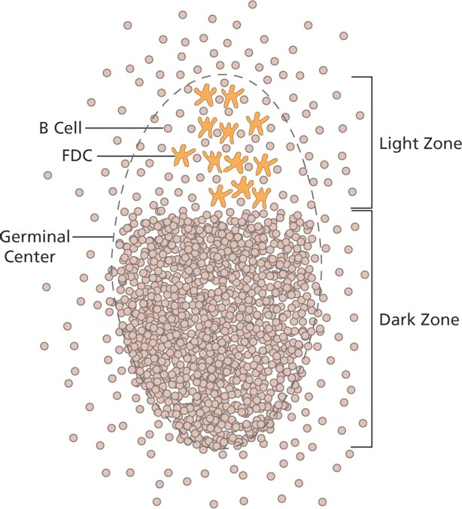
T šūnu atkarīga B šūnu aktivācija limfoīdajos folikulos
Folikulārās dendrītiskās šūnas rezidē LN, saista komplementa opsonizētus antigēnus; Ja B šūna pazīst šo antigēnu, tas izraisa BCR klasterēšanos; B šūnas sāk proliferēt, veidojas “Germinal centre”. Ja šajā laikā nesaņem ko-stimulējošo signālu (CD40L) no aktivētas Th šūnas – ieiet apoptozē.

Slide 39
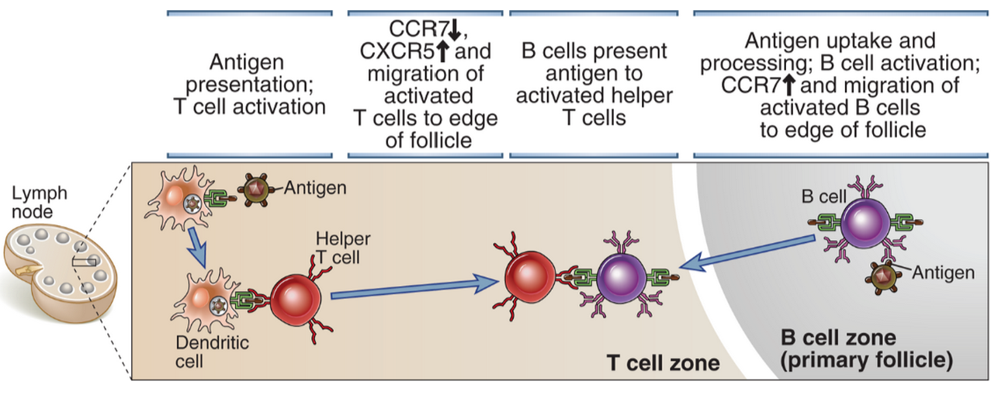
T un B šūnu migrācija limfmezglā un mijiedarbība
Notes:
Immune responses are initiated by the recognition of antigens by B cells and helper T cells. The activated lymphocytes migrate toward one another and interact, resulting in B cell proliferation and differentiation. Restimulation of B cells by helper T cells in extrafollicular sites leads to early isotype switching and short-lived plasma cell generation. The late events occur in germinal centers and include somatic mutation and the selection of high-affinity cells (affinity maturation), additional isotype switching, memory B cell generation, and the generation of long-lived plasma cells.

Slide 40
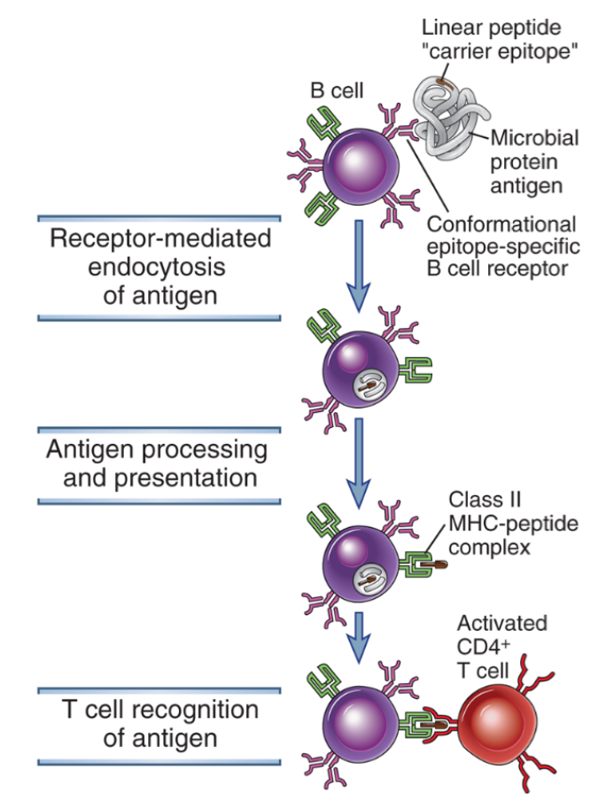
Aktivētas B šūnas procesē un prezentē antigēnu CD4+ T šūnām
Notes:
Protein antigens bound to membrane Ig are endocytosed and processed, and peptide fragments are presented in association with class II MHC molecules. Helper T cells that were previously activated by dendritic cells recognize the MHC-peptide complexes on the B cells and then stimulate B cell responses. Activated B cells also express costimulators (not shown) that enhance helper T cell responses.

Slide 41
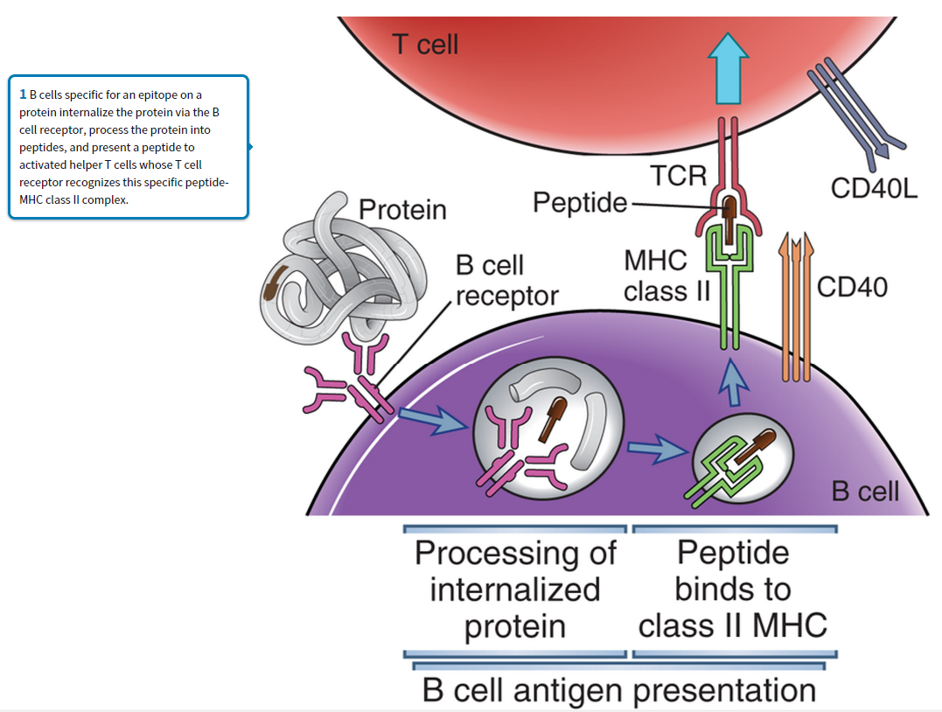

Slide 42
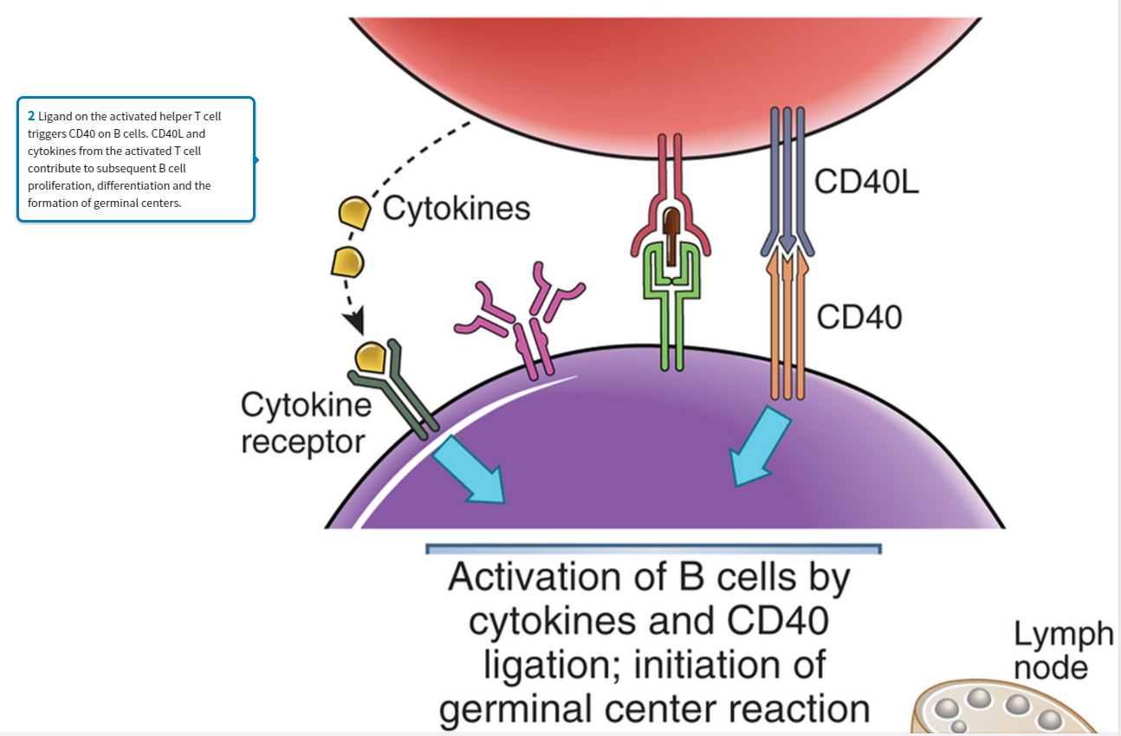

Slide 43
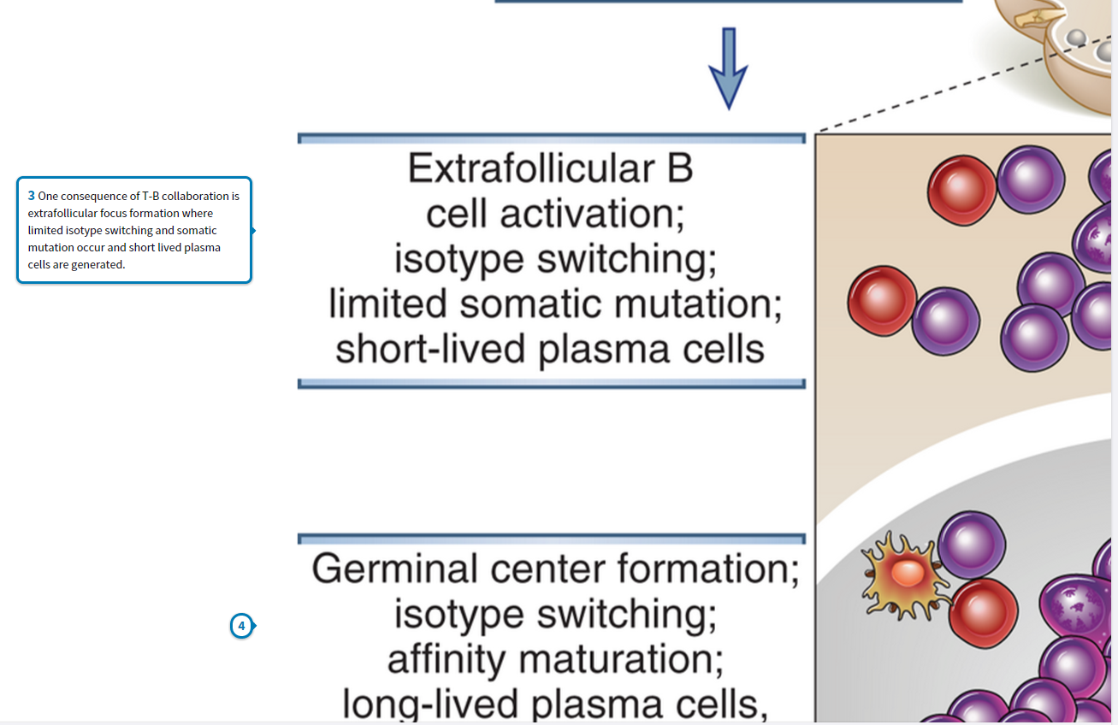

Slide 44
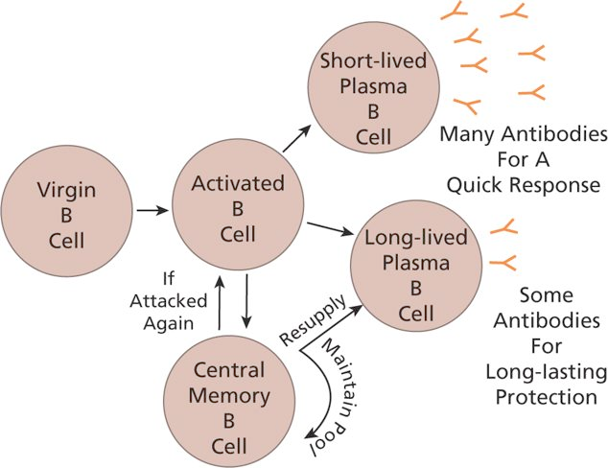
B šūnu atmiņas veidošanās
Short lived plazmas šūnas dzīvo dažas dienas kaulu smadzenēs un liesā; producē lielu daudzumu Ab
Ilgdzīvojošas plazmas šūnas – dzīvo kaulu smadzenēs vairākus mēnešus, vidējs daudzums Ab,
Centrālās atmiņas šūnas darbojas kā cilmes šūnas, kas lēni proliferē atjaunojot cilmes šūnu populāciju un ilgdzīvošās plazmas šūnas
Antivielas nonāk asinīs vai arī tiek transportētas cauri gļotādu epitēlijam vai placentai.

Slide 45
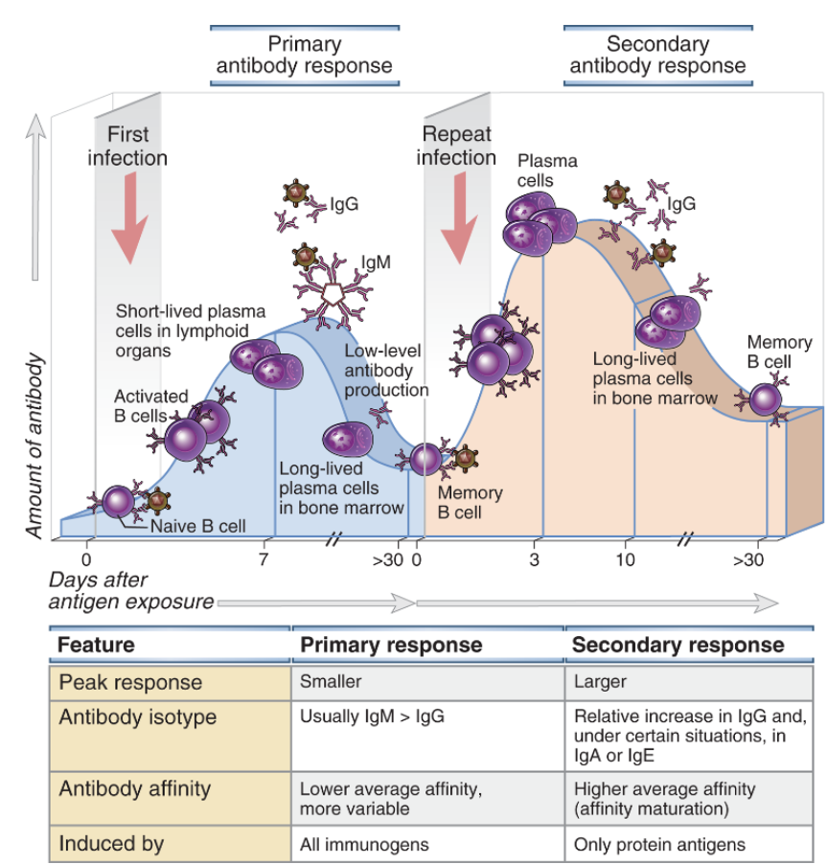
B šūnu primārā un sekundārā atbilde
Notes:
In a primary immune response, naive B cells are stimulated by antigen, become activated, and differentiate into antibody-secreting cells that produce antibodies specific for the eliciting antigen. Some of the antibody-secreting plasma cells migrate to and survive in the bone marrow, where they continue to produce antibodies for long periods. Long-lived memory B cells are also generated during the primary response. A secondary immune response is elicited when the same antigen stimulates these memory B cells, leading to more rapid proliferation and differentiation and production of greater quantities of specific antibody than are produced in the primary response. The principal characteristics of primary and secondary antibody responses are summarized in the table. These features are typical of T cell–dependent antibody responses to protein antigens.

Slide 46
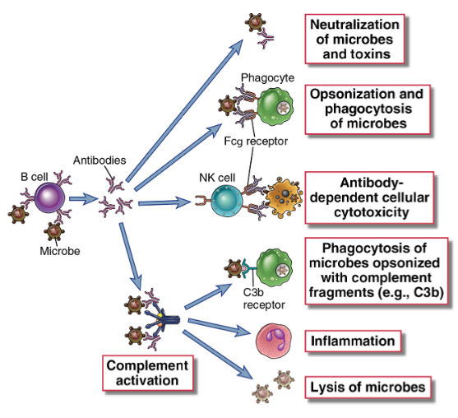
Antivielu efektorās funkcijas
Notes:
Antibodies against microbes (and their toxins, not shown here) neutralize these agents, opsonize them for phagocytosis, sensitize them for antibody-dependent cellular cytotoxicity, and activate the complement system. These various effector functions may be mediated by different antibody isotypes.

Slide 47
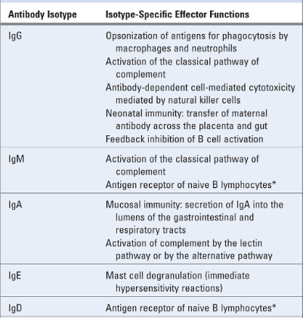
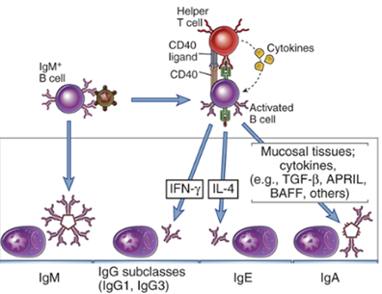
Antivielu klases un klašu-specifiskās efektorās funkcijas
Notes:
B cells activated by helper T cell signals (CD40L, cytokines) undergo switching to different Ig isotypes, which mediate distinct effector functions. Selected examples of switched isotypes are shown.

Slide 48
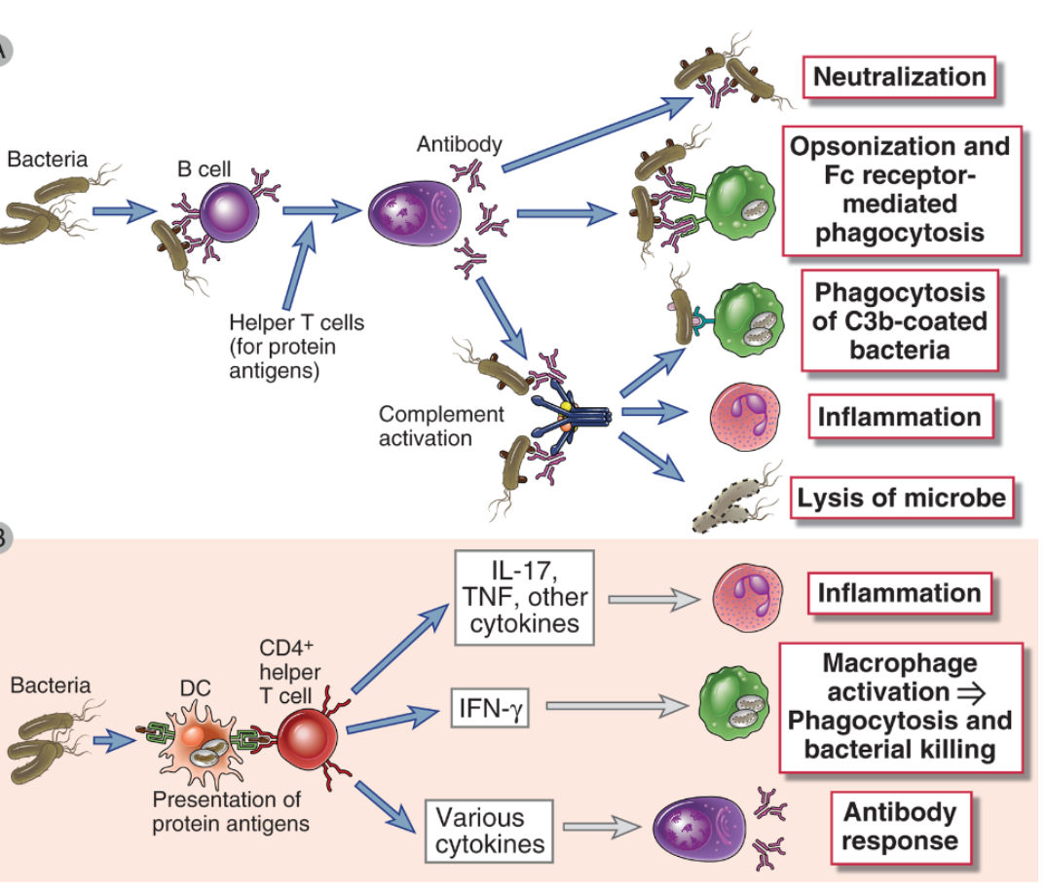
Adaptīvā imūnā atbilde pret ekstracelulārām baktērijām

Slide 49
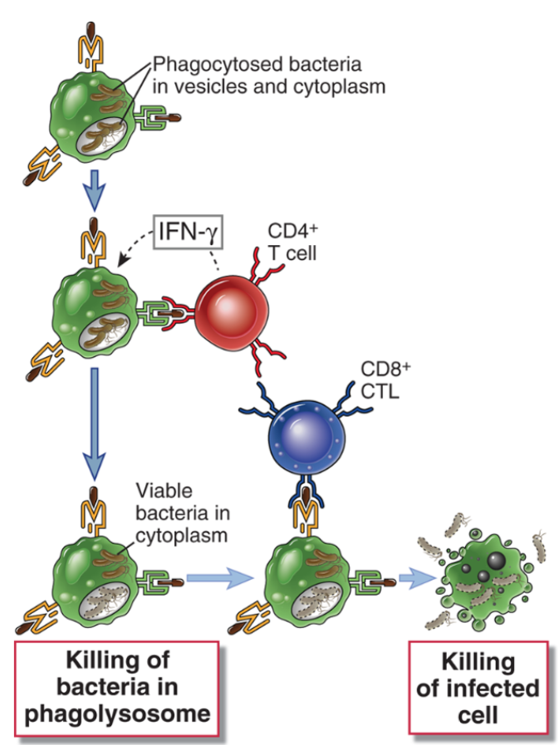
Adaptīvā imūnā atbilde pret intracelulārām baktērijām:
Noteicošā ir CTL un CD4+ T šūnu atbilde
Notes:
Intracellular bacteria such as L. monocytogenes are phagocytosed by macrophages and may survive in phagosomes and escape into the cytoplasm. CD4⁺ T cells respond to class II MHC–associated peptide antigens derived from the intravesicular bacteria. These T cells produce IFN-γ, which activates macrophages to destroy the microbes in phagosomes. CD8⁺ T cells respond to class I–associated peptides derived from cytosolic antigens and kill the infected cells.

Slide 50
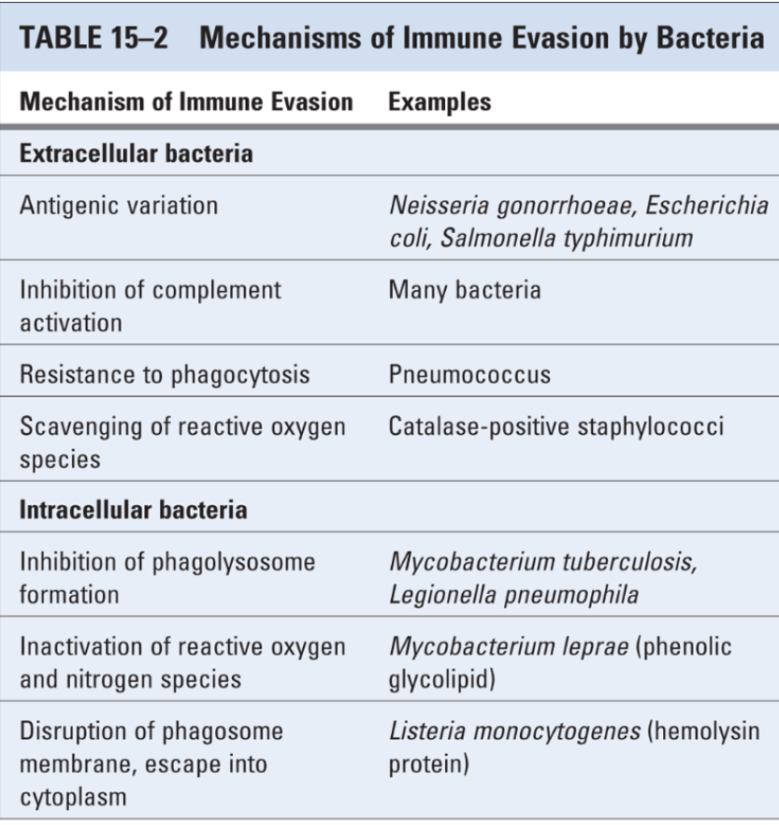

Slide 51
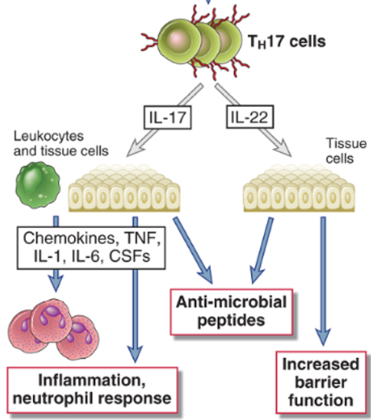
Adaptīvā imūnā atbilde pret sēnīšu infekcijām:
Pret intracelulārām sēnīšu infekcijām (piem, Histoplasma capsulatum) noteicošā ir CTL un CD4+ T šūnu atbilde
Ekstarcelulāras sēnītes izraisa spēcīgu Th17 atbildi:

Slide 52
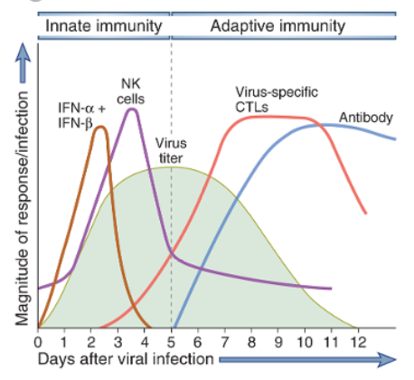
Pret-vīrusu imūnās atbildes kinētika

Slide 53
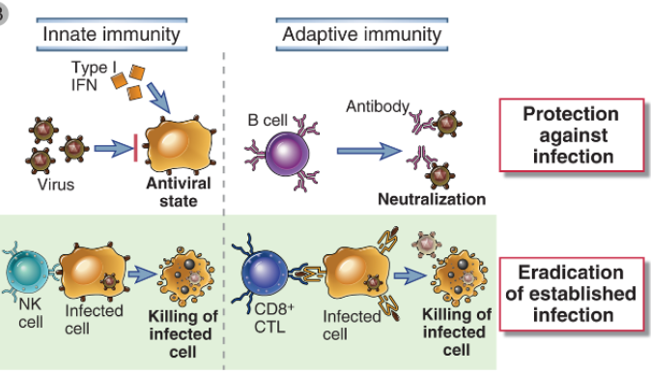
Adaptīvā un nespecifiskā imūnā atbilde pret vīrusu infekcijām:

Slide 54
