Slide 1
Biežāk izmantojamās imunoloģijas metodes
Principi un piemēri
Dr.biol. Zane Kalniņa
LU BF Imunoloģijas kurss maģistrantiem
20.05.2014

Slide 2
Laboratorijas metodes Uz antivielām balstītās
Antigēnu kvantificēšana
  RIA (radio-immuno assay)
  ELISA (enzyme-linked immunosorbent assay)
Proteīnu identificēšana un attīrīšana
  Imunoprecipitācija (IP)
  (Imuno)afīnā hromatogrāfija
  Western blots (WB)
Antigēnu iezīmēšana un detekcija šūnās un audos
  Imūnfluorescence (IF), imūnhistoķīmija (IHC) un imūnelektronmikroskopija
  Plūsmas citometrija (FC) un
  Fluorescences aktivēto šūnu šķirošana (FACS)
  Šūnu izolēšana/attīrīšana
Antigēna-antivielu mijiedarbības mērījumi (afinitātes un aviditātes testi)

Slide 3
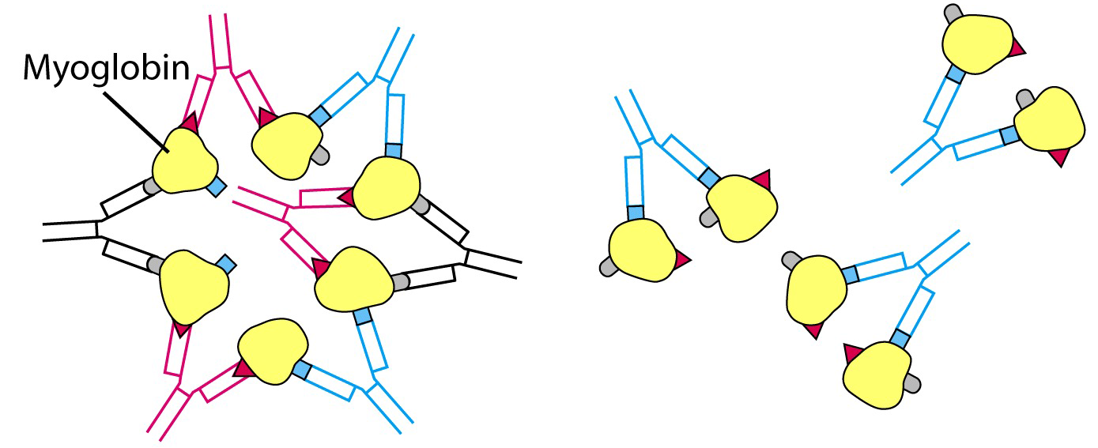
Antigēns (Ag) : Antiviela (Av) – pamats daudzām imunoloģiskajām metodēm
Lielākajai daļai Ag ir vairāki epitopi, kas izsauc poliklonālas dabas antivielu atbildi
Poliklonāls antiserums Monoklonālas antivielas
Notes:
Antigēnu-antivielu mijiedarbības testi

Slide 4
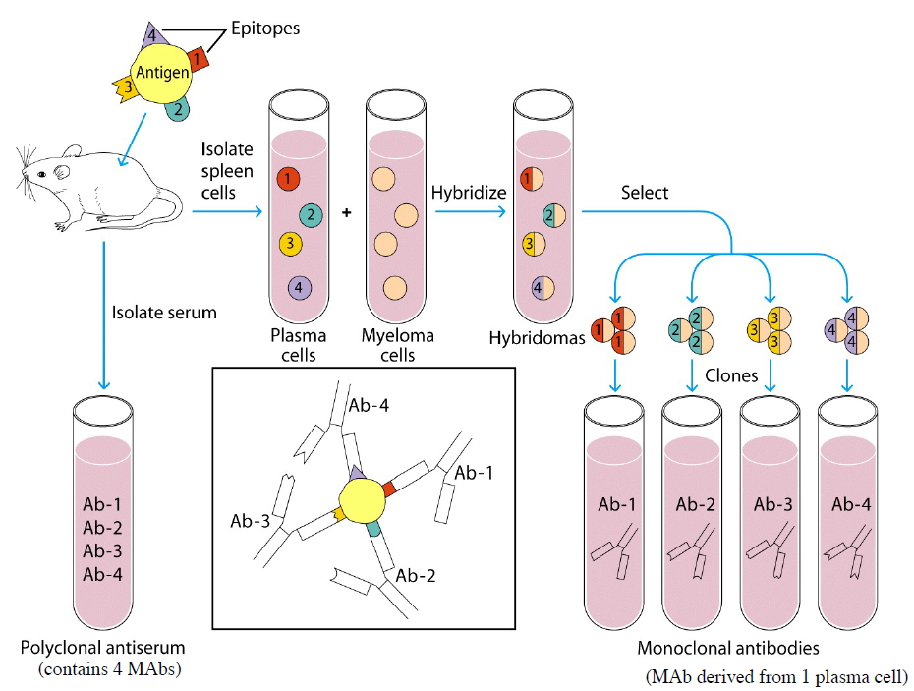
Trušu, kazu, aitu, peļu, cāļu, ēzeļu, žurku, jūrascūciņu, zirgu, kāmju, pīļu
Peļu, žurku, trušu, kazu, kāmju

Slide 5
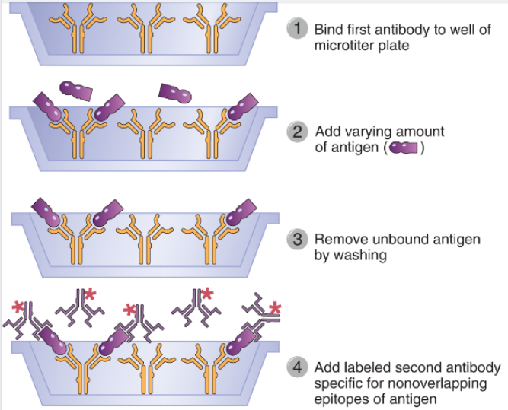
Antigēnu kvantificēšana – RIA & ELISA
Notes:
A fixed amount of one immobilized antibody is used to capture an antigen. The binding of a second, labeled antibody that recognizes a nonoverlapping determinant on the antigen will increase as the concentration of antigen increases and thus allow quantification of the antigen.
Immunologic methods of quantifying antigen concentration provide exquisite sensitivity and specificity and have become standard techniques for both research and clinical applications. All modern immunochemical methods of quantitation are based on having a pure antigen or antibody whose quantity can be measured by an indicator molecule (or a label). When the antigen or antibody is labeled with a radioisotope, as first introduced by Rosalyn Yalow and colleagues, it may be quantified by instruments that detect radioactive decay events; the assay is called aradioimmunoassay (RIA)
When the antigen or antibody is covalently coupled to an enzyme, it may be quantified by determining with a spectrophotometer the rate at which the enzyme converts a clear substrate to a colored product; the assay is called an enzyme-linked immunosorbent assay (ELISA

Slide 6
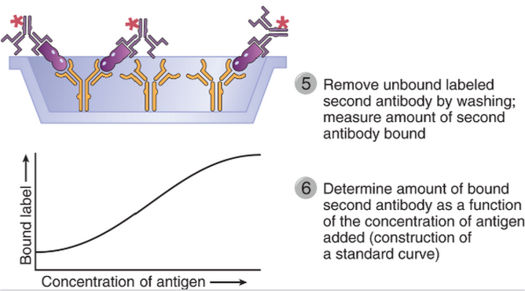
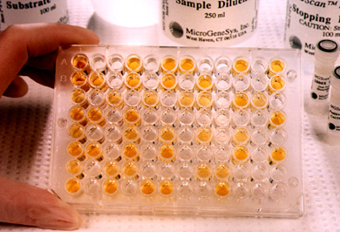
Notes:
3
Agglutination
Antibodies to sheep RBC agglutination
Haemagglutination Inhibition
Influenza virus agglutinates red blood cells
Influenza specific antibodies inhibit agglutination
Radioimmunoassay
• Introduced 1960 by SA Berson and Rosalyn Yalow to
measure insulin in plasma (Nobel prize 1977)
• I125 (γ emitting) also 3H (β emitting)
• Competitive binding of radiolabeled antigen and unlabeled
antigen
• Solution or solid phase assays
Enzyme Linked Immunosorbent Assay
(ELISA)
• Qualitative or quantitative measurement of
antigen or antibody
• Enzyme linked to detector antibody
• Soluble chromogenic substrate
Absorbance of product measured in
an ELISA(spectrophotometer)
• Chemiluminesence
Measurement of light instead of absorbance
Luxogenic substrate
Increased sensitivity (10-200 fold with
enhancers)

Slide 7
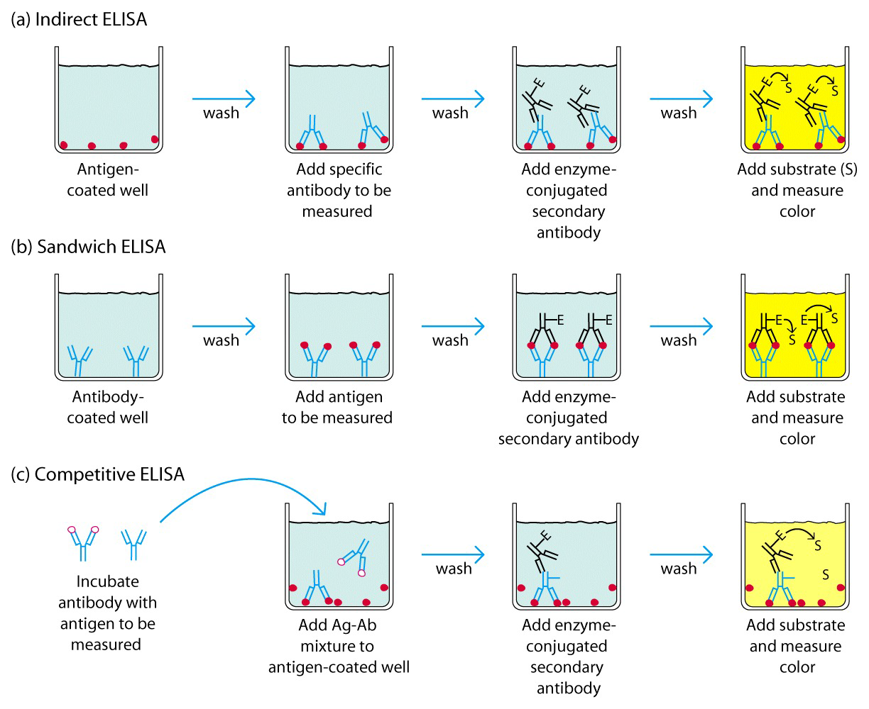
Biežāk izmantotās ELISA variācijas
Uzziņai: http://www.elisa-antibody.com/ELISA-Introduction/ELISA-types
Notes:
Several variations of RIA and ELISA exist, but the most commonly used version is the sandwich assay (Fig. A–1). The sandwich assay uses two different antibodies reactive with different epitopes on the antigen whose concentration needs to be determined. A fixed quantity of one antibody is attached to a series of replicate solid supports, such as plastic microtiter wells. Test solutions containing antigen at an unknown concentration or a series of standard solutions with known concentrations of antigen are added to the wells and allowed to bind. Unbound antigen is removed by washing, and the second antibody, which is enzyme linked or radiolabeled, is allowed to bind. The antigen serves as a bridge, so the more antigen in the test or standard solutions, the more enzyme-linked or radiolabeled second antibody will bind. The results from the standard solutions are used to construct a binding curve for the second antibody as a function of antigen concentration, from which the quantities of antigen in the test solutions may be inferred. When this test is performed with two monoclonal antibodies, it is essential that these antibodies see nonoverlapping determinants on the antigen; otherwise, the second antibody cannot bind.
In an important clinical variant of immunobinding assays, samples from patients may be tested for the presence of antibodies that are specific for a microbial antigen (e.g., antibodies reactive with proteins from human immunodeficiency virus [HIV] or hepatitis B virus) as indicators of infection. In this case, a saturating quantity of antigen is added to replicate wells containing plate-bound antibody or the antigen is attached directly to the plate, and serial dilutions of the patient’s serum are then allowed to bind. The amount of the patient’s antibody bound to the immobilized antigen is determined by use of an enzyme-linked or radiolabeled second anti-human immunoglobulin (Ig) antibody.

Slide 8
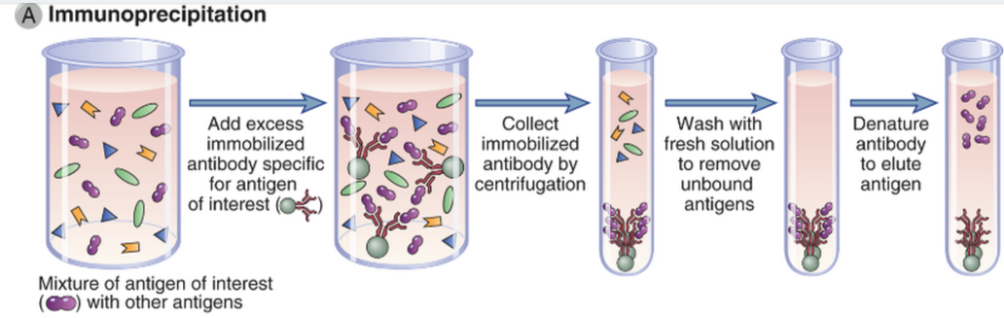
Proteīnu identificēšana un attīrīšana Imūnprecipitācija
Notes:
Antibodies can be used to identify and characterize proteins and to purify specific proteins from mixtures. Two commonly used methods to identify and purify proteins are immunoprecipitation and immuno–affinity chromatography. Western blotting is a widely used technique to determine the presence and size of a protein in a biologic sample.
Immunoprecipitation is a technique in which an antibody specific for one protein antigen in a mixture of proteins is used to identify this specific antigen (Fig. A–2A). The antibody is typically added to a protein mixture (usually a detergent lysate of specific cells), and staphylococcal protein A (or protein G) covalently attached to agarose beads is added to the mixture. The Fab portions of the antibody bind to the target protein, and the Fc portion of the antibody is captured by the protein A or protein G on the beads. Unwanted proteins that do not bind to the antibody are then removed by washing the beads (by repeated detergent addition and centrifugation). The specific protein that is recognized by and now bound to the antibody may be eluted from the beads and dissociated from the antibody by use of a harsh denaturant (such as sodium dodecyl sulfate), and the proteins are separated by sodium dodecyl sulfate–polyacrylamide gel electrophoresis (SDS-PAGE). Proteins may be detected after electrophoresis by staining the polyacrylamide gel with a protein stain or by a Western blot analysis (described later). If the original mixture contained radioactively labeled proteins, specific proteins immunoprecipitated by the antibody may be revealed by autofluorography or autoradiography, protein bands being captured on x-ray film placed on the dried SDS–polyacrylamide gel containing separated proteins.

Slide 9
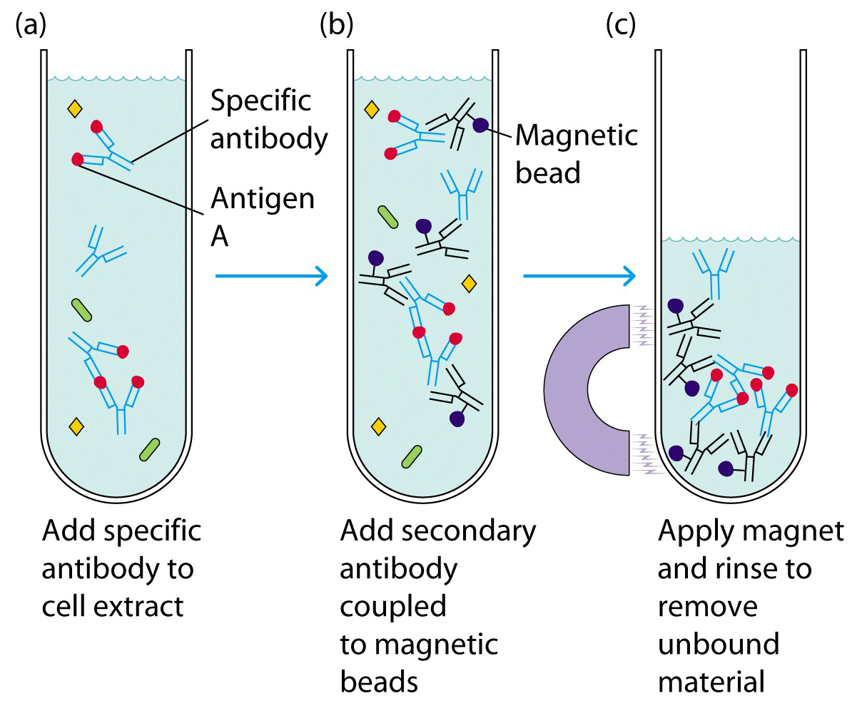
Imūnprecipitātu savākšana ar magnētiskām lodītēm

Slide 10
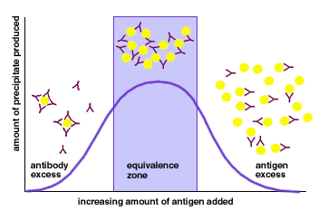
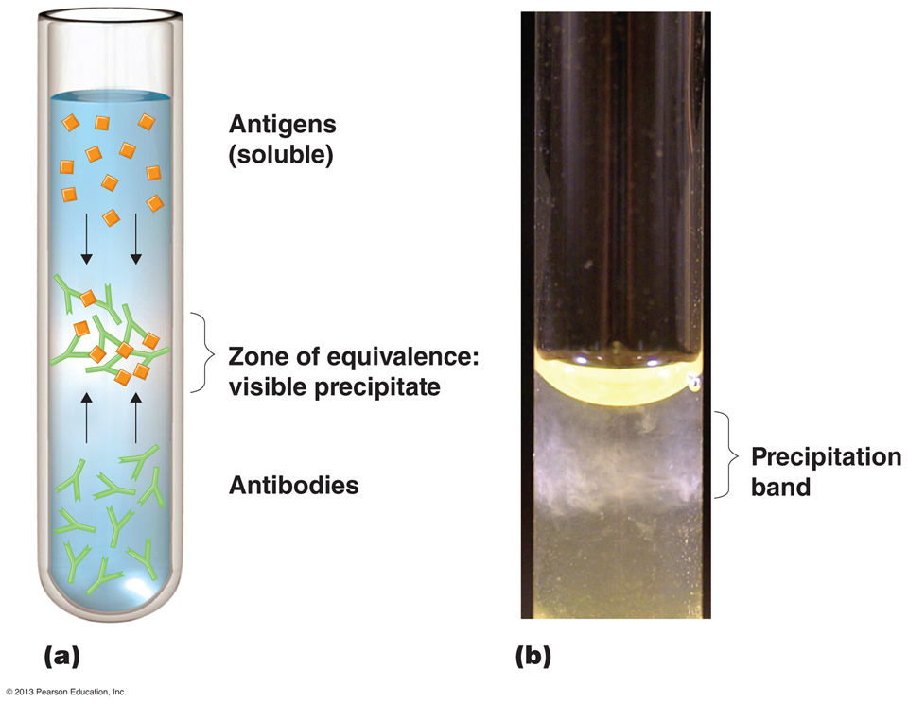
Imūnprecipitācija
Ag & Av veido precipitātu ekvivalencē
Ag
Ag
Ag

Slide 11
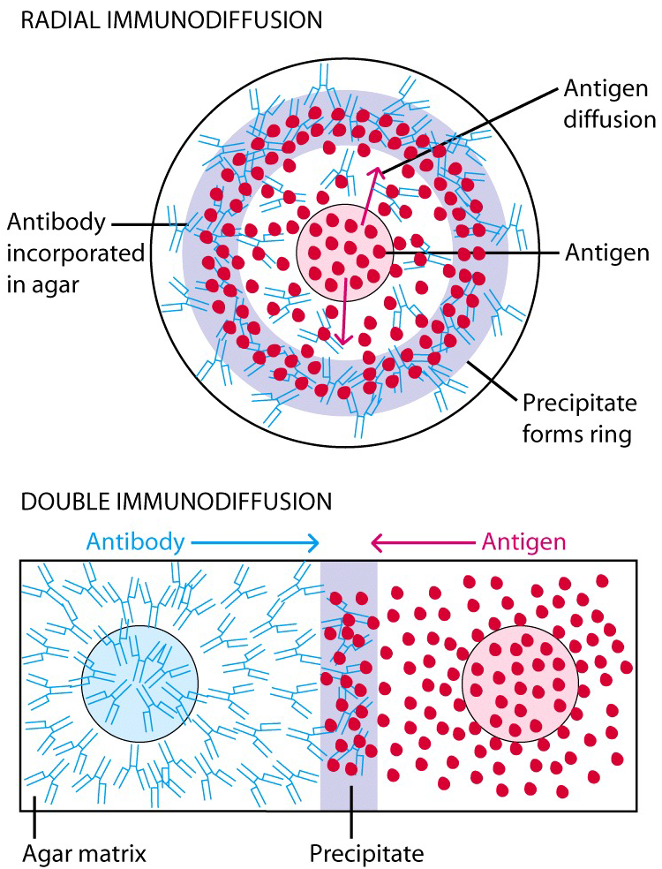
Imūnprecipitācija gelā
Radiālā imūndifūzija
Antigēns bedrītē, antiviela gelā
Gredzens veidojas vietā, kur Av & Ag sasniedz ekvivalenci
Precipitācijas laukums proporcionāls antigēna koncentrācijai
Ag un Av difundē viens otram pretī
Precipitācijas līnija vietā, kur Av & Ag sasniedz ekvivalenci
Dubultā imūndifūzija
Detalizēti:www.slideshare.net/suniu/immunodiffusion-principles-and-application

Slide 12
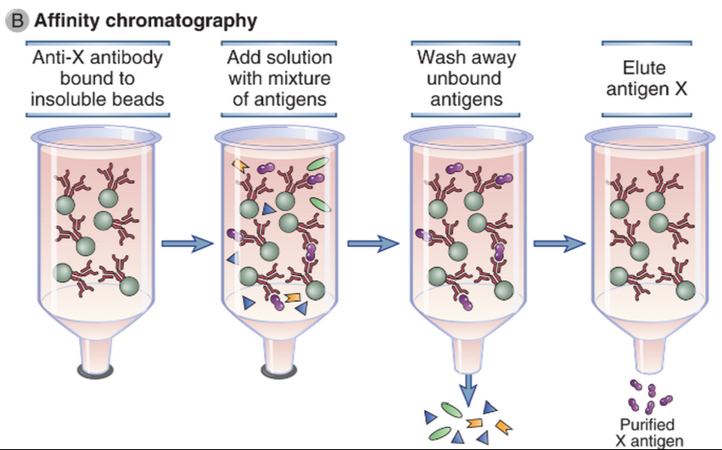
Proteīnu identificēšana un attīrīšana
Afīnā hromatogrāfija
Antigēna X attīrīšana no proteīnu maisījuma
Notes:
Immuno–affinity chromatography, a variant of affinity chromatography, is a purification method that relies on antibodies attached to an insoluble support to purify antigens from a solution (Fig. A–2B). Antibodies specific for the desired antigen are typically covalently attached to a solid support, such as agarose beads, and packed into a column. A complex mixture of antigens is passed through the beads to allow the antigen that is recognized by the antibody to bind. Unbound molecules are washed away, and the bound antigen is eluted by changing the pH or by exposure to high salt or other chaotropic conditions that break antigen-antibody interactions. A similar method may be used to purify antibodies from culture supernatants or natural fluids, such as serum, by first attaching the antigen to beads and passing the supernatants or serum through.

Slide 13
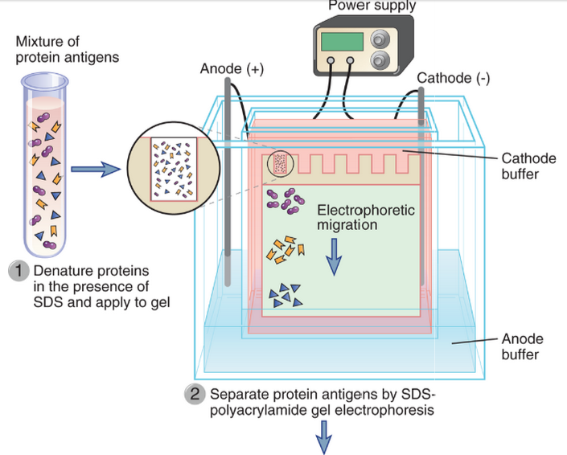
Western blots (1) - proteīnu elektroforēze

Slide 14
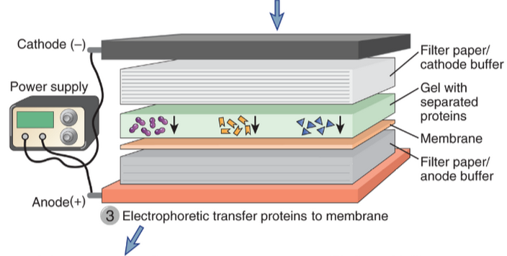
Western blots (2) – proteīnu pārnese

Slide 15
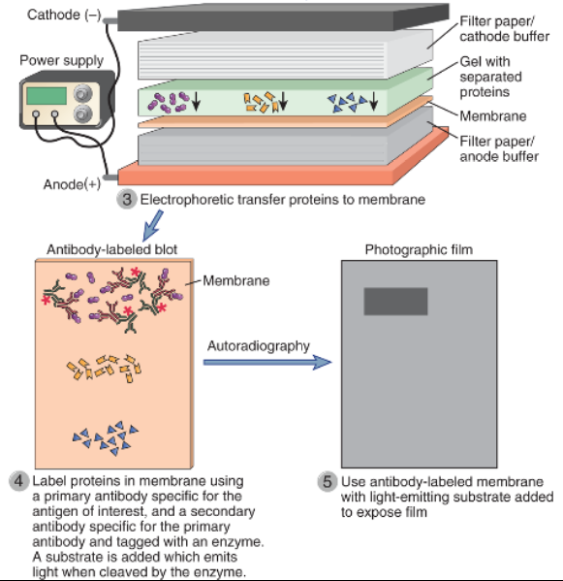
Western blots (3)
Western blots (3) – specifisku proteīnu detekcija

Slide 16
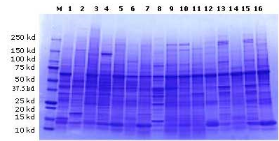
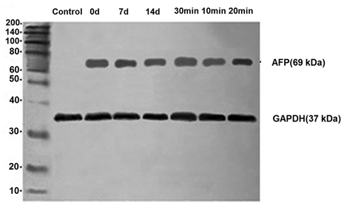
Visu proteīnu sadalījums SDS-PAGE gelā
WB rezultāts

Slide 17
Imūnfluorescence & Imūnhistoķīmija
  Izmanto:
  molekulu detekcijai šūnās/audu griezumos
  Molekulu iekššūnas lokalizācijas vizualizēšanai & molekulu ko-lokalizācijas pētīšanai
Balstās uz mikroskopisku audu griezumu vai šūnu analīzi
  gaismas mikroskopija – galvenokārt IHC
  Fluorescences vai konfokālā mikroskopija – IF, arī IHC
Iezīmētas antivielas (vai antigēni) ar:
  Enzīmu (IHC)
  Fluorescentām krāsām (IF)
Notes:
Immunohistochemistry or IHC refers to the process of detecting antigens (e.g., proteins) in cells of a tissue section by exploiting the principle of antibodies binding specifically to antigens in biological tissues
Antibodies can be used to identify the anatomic distribution of an antigen within a tissue or within compartments of a cell. To do so, the tissue or cell is incubated with an antibody that is labeled with a fluorochrome or enzyme, and the position of the label, determined with a suitable microscope, is used to infer the position of the antigen. In the earliest version of this method, called immunofluorescence, the antibody was labeled with a fluorescent dye and allowed to bind to a monolayer of cells or to a frozen section of a tissue. The stained cells or tissues were examined with a fluorescence microscope to locate the antibody. Although sensitive, the fluorescence microscope is not an ideal tool to identify the detailed structures of the cell or tissue because of a low signal-to-noise ratio. This problem has been overcome by new technologies including confocal microscopy, which uses optical sectioning technology to filter out unfocused fluorescent light, and two-photon microscopy, which prevents out-of-focus light from forming. Alternatively, antibodies may be coupled to enzymes that convert colorless substrates to colored insoluble substances that precipitate at the position of the enzyme. A conventional light microscope may then be used to localize the antibody in a stained cell or tissue. The most common variant of this method uses the enzyme horseradish peroxidase, and the method is commonly referred to as the immunoperoxidase technique. Another commonly used enzyme is alkaline phosphatase. Different antibodies coupled to different enzymes may be used in conjunction to produce simultaneous two-color localizations of different antigens. In other variations, antibody can be coupled to an electron-dense probe such as colloidal gold, and the location of antibody can be determined subcellularly by means of an electron microscope, a technique called immunoelectron microscopy. Different-sized gold particles have been used for simultaneous localization of different antigens at the ultrastructural level.
In all immunomicroscopic methods, signals may be enhanced by use of sandwich techniques. For example, instead of attaching horseradish peroxidase to a specific mouse antibody directed against the antigen of interest, it can be attached to a second anti-antibody (e.g., rabbit anti-mouse Ig antibody) that is used to bind to the first, unlabeled antibody. When the label is attached directly to the specific, primary antibody, the method is referred to as direct; when the label is attached to a secondary or even tertiary antibody, the method is indirect. In some cases, molecules other than antibody can be used in indirect methods. For example, staphylococcal protein A, which binds to IgG, or avidin, which binds to primary antibodies labeled with biotin, can be coupled to fluorochromes or enzymes.

Slide 18
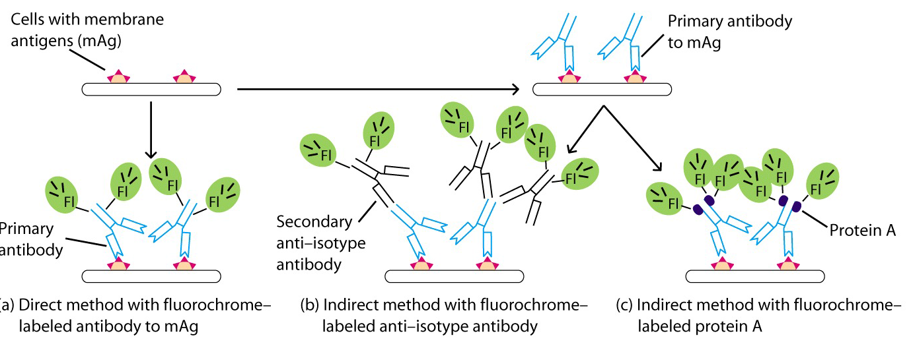
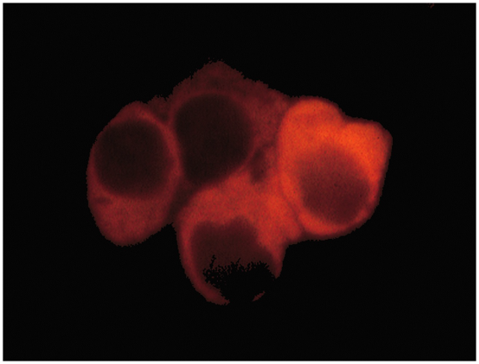
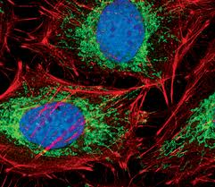
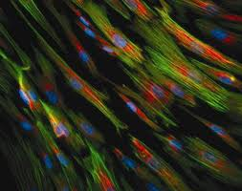
Tiešā & netiešā IF

Slide 19
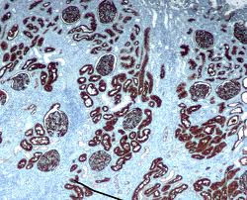
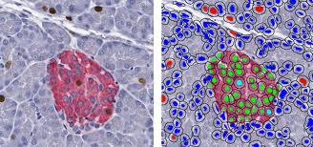
Imūnhistoķīmija
Nosaka molekulas anatomisko izvietojumu audu griezumos – šūnu tipu, kurā tās ekspresētas, iekššūnas lokalizāciju
Noteiktu audu kontekstā
(parafīnā ieslēgti vai sasaldēti)
Fluorescentā IHC
HRP
HRP + AP

Slide 20
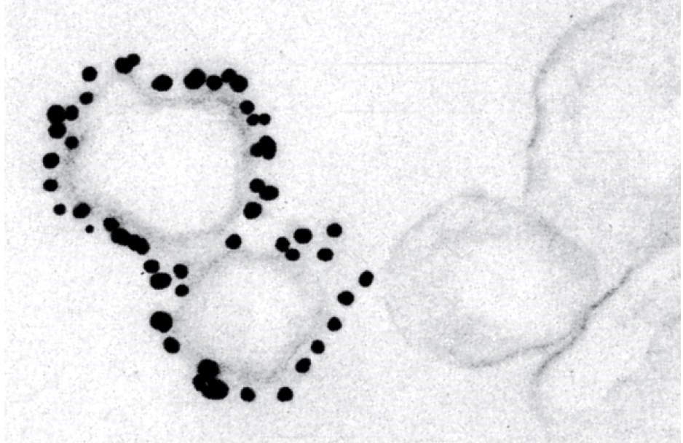
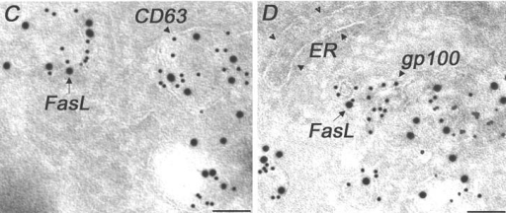
Imūn-elektronmikroskopija
Collidal Immunogold staining in electron microscopy
Molekulu ekspresijas pētīšana ultrastruktūru līmenī
Dažāda izmēra zelta daļiņas dažādu molekulu kolokalizācijas pētījumiem

Slide 21
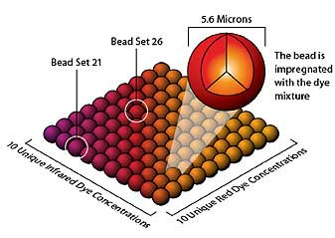
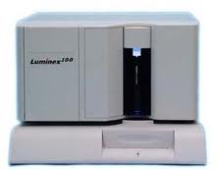
Multipleksas antigēnu detekcijas metodes
Uz lodītēm balstītās – Luminex xMAP tehnoloģija
Pilnībā automatizēta 96-plašu formāta platforma
Iespējams izmērīt līdz pat 100 (500) dažādām molekulām (analītiem) bedrītē (klīnikā – citokīnu mērījumiem pacientu asinīs)
Katrai no 5,5 mkm lodītēm unikāla infrasarkanās un sarkanās fluorescentās krāsas kombinācija, ko izmanto tās identifikācijai
https://www.luminexcorp.com/TechnologiesScience/xMAPTechnology/

Slide 22

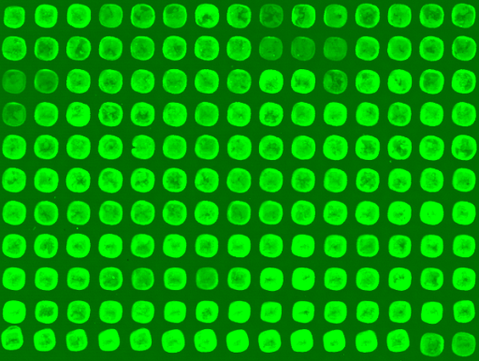
Multipleksas antigēnu detekcijas metodes
Mikrorindas/mikročipi
  Imobilizētas mAv – antigēnu detekcijai
  Imobilizēti Ag – antivielu detekcijai

Slide 23
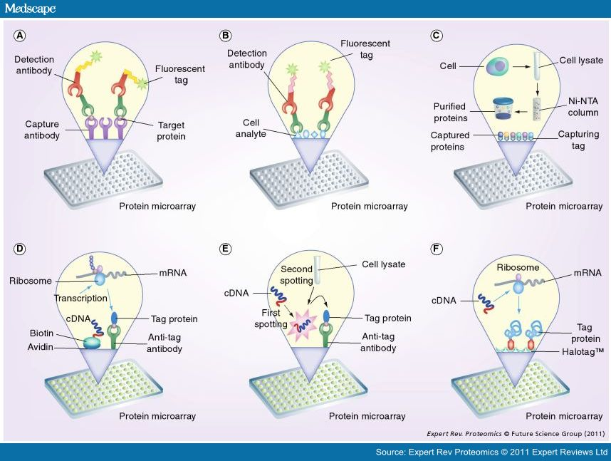
Notes:
Different protein microarray formats employed for proteomic studies. (A) Capture arrays, wherein antibodies are immobilized on the array surface and incubated with test sample; detection is carried out by means of a labeled secondary antibody. (B) Reverse-phase arrays: test sample is immobilized on the array surface and probed using a suitable detection antibody.(C) Cell-based protein microarrays: the protein of interest is expressed in a heterologous host system, purified using Ni-NTA affinity column and then printed on the array surface for further studies. (D) Cell-free nucleic acid programmable protein array: the cDNA of interest is immobilized on the array slide and protein expression carried out by addition of cell-free lysate. The expressed protein is colocalized on the array through a tag-capturing agent. (E) Multiple spotting technique: the first step involves the spotting of template DNA followed by cell-free extract in the second spotting step. Expressed protein is captured on the array surface. (F)HaloTag™: proteins fused with HaloTag are expressed and covalently immobilized through the HaloTag ligand. Covalent capture ensures firm protein immobilization.
Ni-NTA: Nickel-nitrilotriacetic acid.

Slide 24
Antigēnu iezīmēšana un detekcija šūnās
Plūsmas citometrija
Plūsmas citometrija – FC, flow cytometry – metode šūnu skaitīšanai un šūnas virsmas (un iekšūnas) marķieru analīzēm
FC var nodrošināt kvantitatīvu informāciju par šūnas virsmas (un ieksšūnas) marķieriem
Balstīta uz imūnfluorescences tehniku un datroprogrammatūras veiktu analīzi
Pieļauj vienlaicīgi analizēt vairākus parametrus šūnā (multipleksēšana)
Pielietojums: šūnas cikla analīze, apoptotisku šūnu proporcijas, šūnu diferenciācijas pakāpes un līnijas piederības, šūnas aktivācijas statusa noteikšana u.c.
Notes:
Antibodies specific for antigens expressed on or in particular cell types are commonly used to identify these cells in tissues or cell suspensions and to separate these cells from mixed populations. In these methods, the antibody can be radiolabeled, enzyme linked, or, most commonly, fluorescently labeled, and a detection system is used that can identify the bound antibody. Antibodies attached to magnetic beads can be used to physically isolate cells expressing specific antigens.

Slide 25
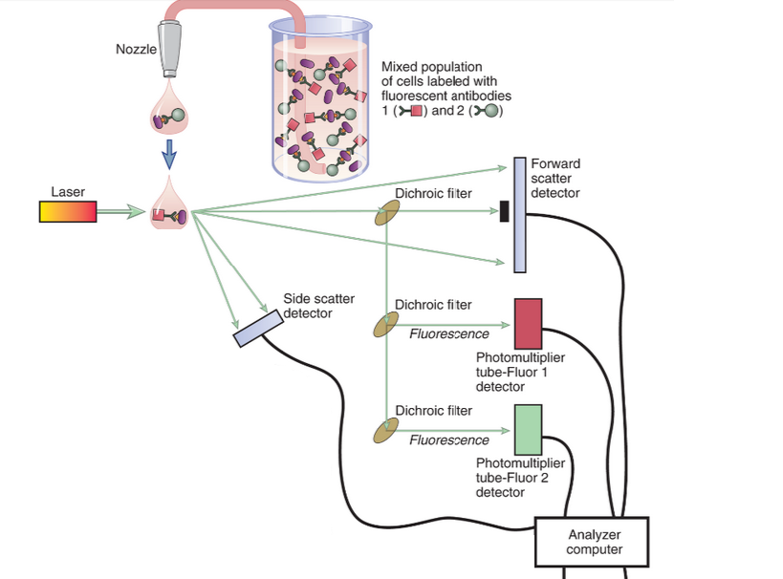
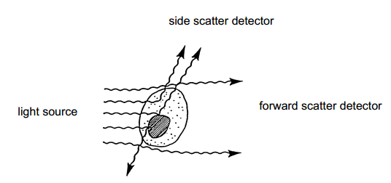
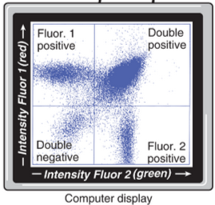

Slide 26
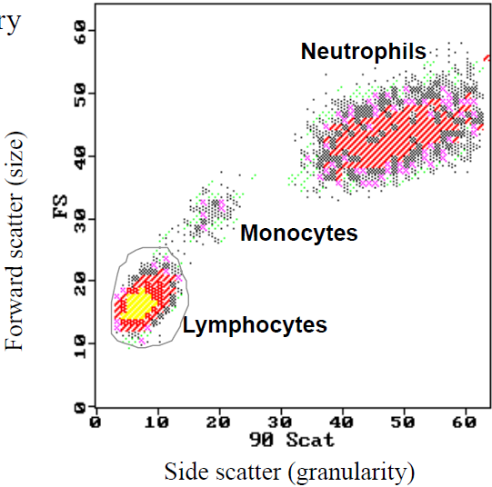

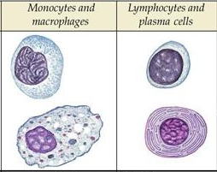
Izkliedes struktūra cilvēka leikocītiem
Plūsmas citometrijas izkliedes
diagramma asins leikocītiem
Gaismas izkliedi (scatter) nosaka daļiņu fizikālās īpašības
FS: proporcionāls šūnas virsmas laukumam vai izmēram
SS: proporcionāls šūnas granularitātei vai iekššūnas morfoloģijai
Notes:
In addition to detecting fluorescent signals, flow cytometers also measure the forward and side light-scattering properties of cells, which reflect cell size and internal complexity, respectively. This information is often used to distinguish different cell types. For example, compared with lymphocytes, neutrophils cause greater side scatter because of their cytoplasmic granules, and monocytes cause greater forward scatter because of their size.

Slide 27
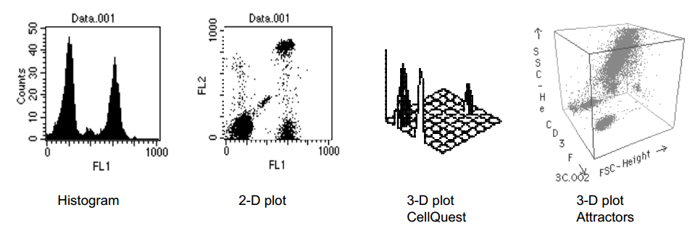
Plūsmas citometrijas datu vizualizācija

Slide 28
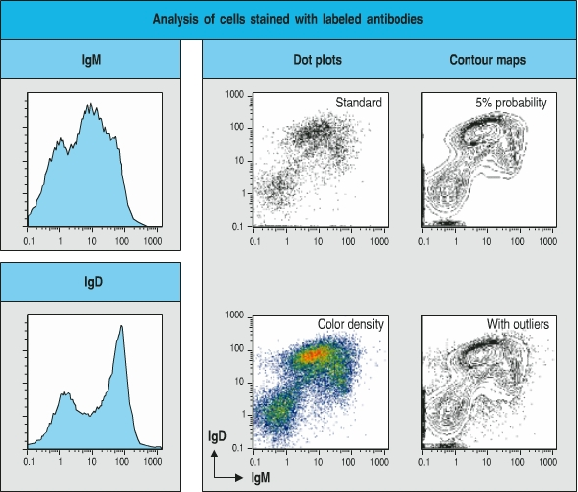
Plūsmas citometrijas datu vizualizācija

Slide 29
FACS - fluorescences aktivēto šūnu šķirošana
FC adaptācija, kas nodrošina dažādu šūnu populāciju atdalīšanu, balstoties uz to, kādas un cik daudz fluorescentas iezīmes tās saista
Individuālas šūnas tiek pozitīvi vai negatīvi lādētas, bastoties uz to fluorescento iezīmi
Atšķirīgi lādētās šūnas šķērso elektrisko lauku un ieņem tajā atšķirīgu virzību, tādējādi sadaloties
Notes:
A fluorescent-activated cell sorter is an adaptation of the flow cytometer that allows one to separate cell populations according to which and how much fluorescent probe they bind. This technique is accomplished by differentially deflecting the cells with electromagnetic fields whose strength and direction are varied according to the measured intensity of the fluorescent signal (see Fig. A–4).
The cells may be labeled with fluorescently tagged antibodies ex vivo, or, in the case of experimental animal studies, labeling may be accomplished in vivo by expression of transgenes that encode fluorescent proteins, such as green fluorescent protein.
Another commonly used technique to purify cells with a particular phenotype relies on antibodies that are attached to magnetic beads. These “immunomagnetic reagents” will bind to certain cells, depending on the specificity of the antibody used, and the bound cells can then be pulled out of suspension by a strong magnet

Slide 30
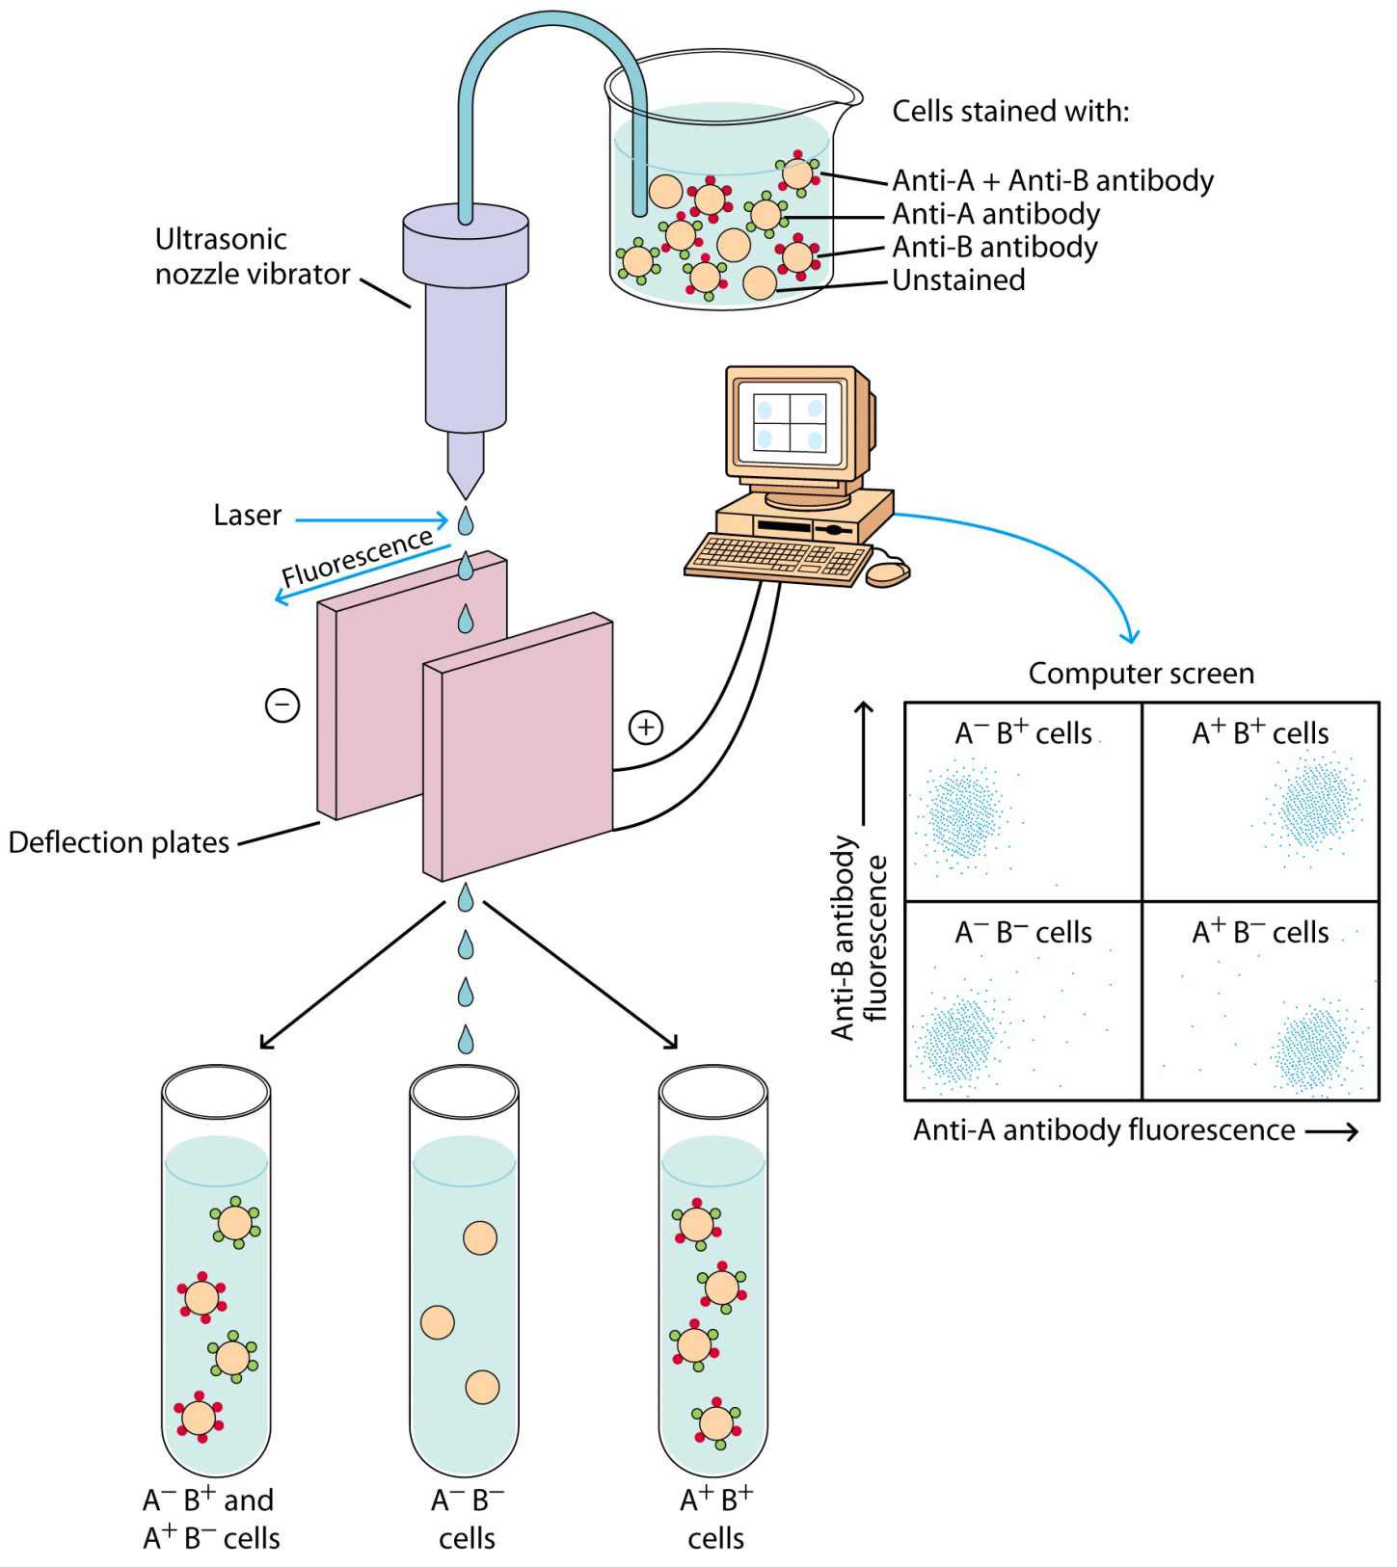
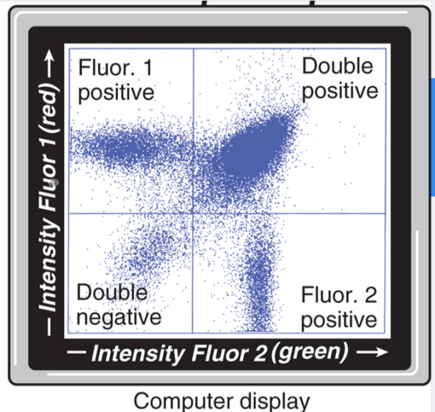

Slide 31
Metodes T šūnu (atbildes reakciju) raksturošanai
T šūnu izolēšana, kultivēšana & raksturošana (fenotipēšana)
T šūnu aktivācijas testi
T šūnu proliferācijas testi
Citokīnu sekrēcijas testi
Peptīda- MHC tetramēru analīze

Slide 32
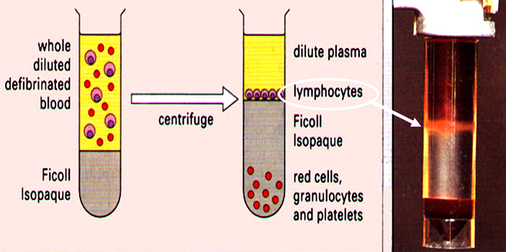
T šūnu izolēšana no asinīm

Slide 33
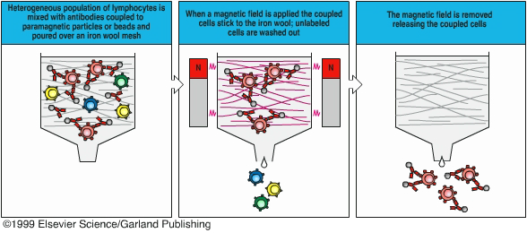
Specifisku T šūnu subpopulāciju selekcija
Ar specifiskām antivielām klātu magnētisko lodīšu palīdzību
– pozitīva vai negatīva selekcija no limfocītu maisījuma

Slide 34
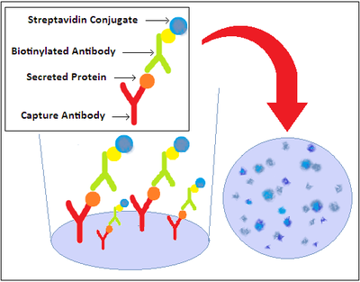
ELISPOT - Enzyme linked Immunospot Assay
ELISA modifikācija (1983)
Kvantificē šūnu skaitu, kas producē noteiktas antivielas vai antigēnu, piem., citokīnu
Rezultātu vizualizē, pateicoties nešķīstošam hromogēnam vai hemiluminiscentam substrātam
Reakciju veic 96-bedrīšu platē, rezultātu detektē ar automatizētiem ELISpot lasītājiem
PVDF membrane
Notes:
Either a monoclonal (preferred for greater specificity) or polyclonalcapture antibody is coated aseptically onto a PVDF (polyvinylidene fluoride) -backed microplate. These antibodies are chosen for their specificity for the analyte in question.
The plate is blocked, usually with a serum protein that is non-reactive with any of the antibodies in the assay.
After this, cells of interest are plated out at varying densities, along with antigen or mitogen, and then placed in a humidified 37°C CO₂ incubatorfor a specified period of time.
Cytokine (or other cell product of interest) secreted by activated cells is captured locally by the coated antibody on the high surface area PVDF membrane.
washing the wells to remove cells, debris, and media components,
a biotinylated polyclonal antibody specific for the chosen analyte is added to the wells. This antibody is reactive with a distinct epitope of the target cytokine and thus is employed to detect the captured cytokine.
wash to remove any unbound biotinylated antibody,
the detected cytokine is then visualized using streptavidin conjugated to an enzyme — horseradish peroxidase (HRP) or alkaline phosphatase (AP) — and a precipitating substrate (e.g., AEC, BCIP/NBT).
The colored end product (a spot, usually red (for HRP) or a blackish blue (for AP)) typically represents an individual cytokine-producing cell.
The spots can be counted manually (e.g., with a dissecting microscope) or using an automated reader to capture the microwell images and to analyze spot number and size. ELISPOT can also be used to quantitate the number of T cells producing Interferon-gamma.

Slide 35
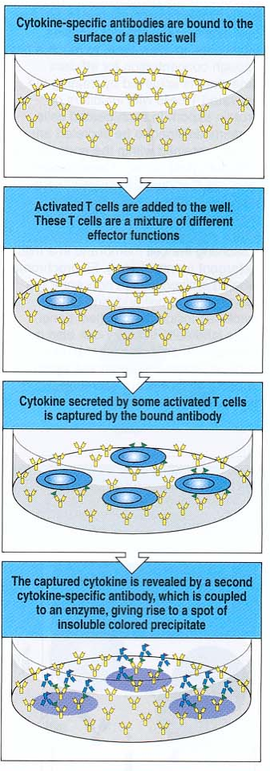
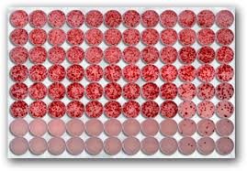

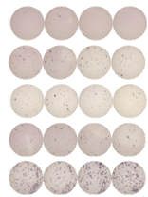
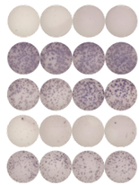
ELISPOT – rezultātu vizualizācija
Cycle 3 cycle 11
Medium
Ag1
Ag2
Ag3
Ag4
Notes:
Either a monoclonal (preferred for greater specificity) or polyclonalcapture antibody is coated aseptically onto a PVDF (polyvinylidene fluoride) -backed microplate. These antibodies are chosen for their specificity for the analyte in question.
The plate is blocked, usually with a serum protein that is non-reactive with any of the antibodies in the assay.
After this, cells of interest are plated out at varying densities, along with antigen or mitogen, and then placed in a humidified 37°C CO₂ incubatorfor a specified period of time.
Cytokine (or other cell product of interest) secreted by activated cells is captured locally by the coated antibody on the high surface area PVDF membrane.
washing the wells to remove cells, debris, and media components,
a biotinylated polyclonal antibody specific for the chosen analyte is added to the wells. This antibody is reactive with a distinct epitope of the target cytokine and thus is employed to detect the captured cytokine.
wash to remove any unbound biotinylated antibody,
the detected cytokine is then visualized using streptavidin conjugated to an enzyme — horseradish peroxidase (HRP) or alkaline phosphatase (AP) — and a precipitating substrate (e.g., AEC, BCIP/NBT).
The colored end product (a spot, usually red (for HRP) or a blackish blue (for AP)) typically represents an individual cytokine-producing cell.
The spots can be counted manually (e.g., with a dissecting microscope) or using an automated reader to capture the microwell images and to analyze spot number and size. ELISPOT can also be used to quantitate the number of T cells producing Interferon-gamma.

Slide 36
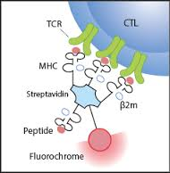
MHC: tetramēru analīze
Metodi (1996) izmanto lai detektētu un kvantificētu T šūnas, kas ir specifiskas noteiktam antigēnam asins paraugā
MHC tetramēri (atšķirībā no monomēriem) novērš disociācijas problēmu un paaugstina piesaistes aviditāti
Antigēna peptīdam specifiskās T šūnas tiek detektētas, skaitītas izmantojot FC

Slide 37
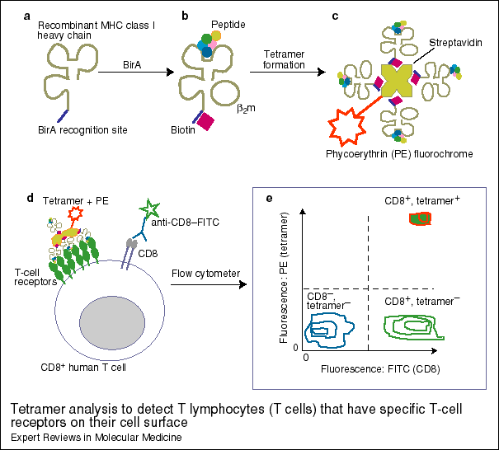

Slide 38
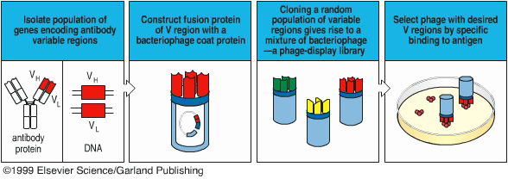
Recombinant expression cloning
Fāgu displeja bibliotēkas
Antigēn-specifisko antivielu variablo reģionu selekcija

Slide 39
Imunoloģijas metodes klīnikā un pētniecībā
Klīnikā
Rutīnas diagnostika
Pētniecībā

Slide 40
Imūndiagnostika
Vispārējs imūnsistēmas parametru raksturojums:
  Šūnu imunitāte - limfocītu subpopulāciju raksturojums (CD3, 4, 8, 16, 19, 25)
  Humorālā imunitāte
    Imūnglobulīnu klases & apakšklases
    Cirkulējošie imūnkompleksi
    C3 un C4 komplementa koponentes u.c.
HIV/AIDS primārā diagnostika
Audzēju marķieru noteikšana
(Auto)antivielu noteikšana
  Alergēni
  Autoantigēni
  Infekciju izraisītāji

Slide 41
Metožu pamatprincipi – interneta resursi/video
Western Blots http://www.youtube.com/watch?v=ikVsaRaFAYU
Flow Cytometry http://www.youtube.com/watch?v=2P7YsJ0Zkio
FACS http://www.bd.com/videos/bdb/training/itf/sorting/player.html
ELISA http://www.youtube.com/watch?v=lNxZxJtvB94
MHC:Tetramēru analīze http://www.youtube.com/watch?v=PfenDW9_1cg
Protokoli un ceļveži (metodes, kurās tiek izmantotas antivielas): http://www.abcam.com/index.html?pageconfig=resource&rid=11276&pid=11287

