Slide 1

Imūnā aizsardzība pret infekcijām
Dr. Aija Linē, BMC

Slide 2
Nozīmīgākās bakteriālas infekcijas
Slimība | Izraisītājs
Tuberkuloze | Mycobacterium tuberculosis
Pneimonija un meningīts | Streptococcus pneumoniae
Salmoneloze | Salmonella typhimurium
Stingumkrampji | Clostridium tetani
Tīfs | Salmonella enterica
Holēra | Vibrio cholerae
Laima slimība | Borrelia burgdorferi
Gonoreja | Neisseria gonorrhoeae
Kuņģa čūla | Helicobacter pylori
Buboņu mēris | Yersinia pestis
Anthrax | Bacillus anthracis utt....
Ārstēšana – antibiotikas, antitoksīni
Prevencija – vakcīnas, ierosinātāja izplatības novēršana

Slide 3
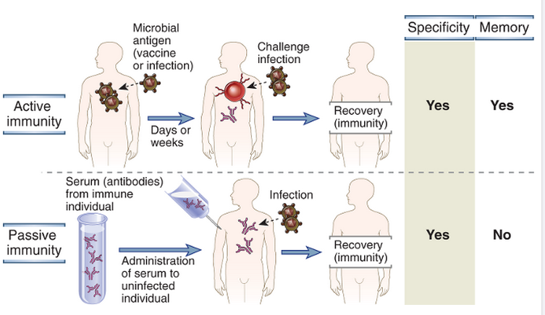
Aktīvā vs pasīvā imunitāte
Abbas AK et al, Cellular and Molecular Immunology, 2012
Notes:
Active immunity is conferred by a host response to a microbe or microbial antigen, whereas passive immunity is conferred by adoptive transfer of antibodies or T lymphocytes specific for the microbe. Both forms of immunity provide resistance to infection and are specific for microbial antigens, but only active immune responses generate immunologic memory. Cell transfers can be done only between genetically identical donor and recipient (e.g., inbred mice) to avoid rejection of the transferred cells.

Slide 4
Imūnās atbildes mehānismi pret bakteriālām infekcijām ir atkarīgi no:
Baktērijas šūnas apvalka/ kapsulas uzbūves
Patogenitātes mehānisma
Lokalizācijas (ekstracelulāra/intracelulāra)

Slide 5
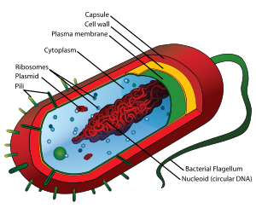
Pēc šūnas apvalka tipa baktērijas var iedalīt trīs grupās:
Gram-pozitīvas baktērijas
Gram-negatīvas baktērijas
Atipiskas – piemēram, mikobaktērijas, spirohētas

Slide 6
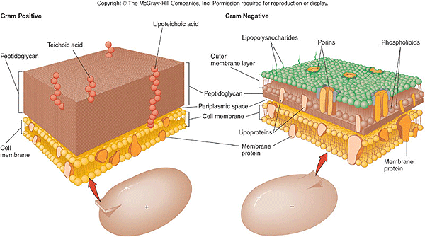
Gram-pozitīvu vs Gram-negatīvu baktēriju šūnu apvalki
Lizocīms un lizosomu enzīmi noārda Gram-pozitīvo baktēriju peptidoglikānu slāni;
Komplements darbojas pret Gram-negatīvo baktēriju ārējo lipīdu dubultslāni; LPS ir viens no PAMPs, ko pazīst makrofāgi un DCs

Slide 7
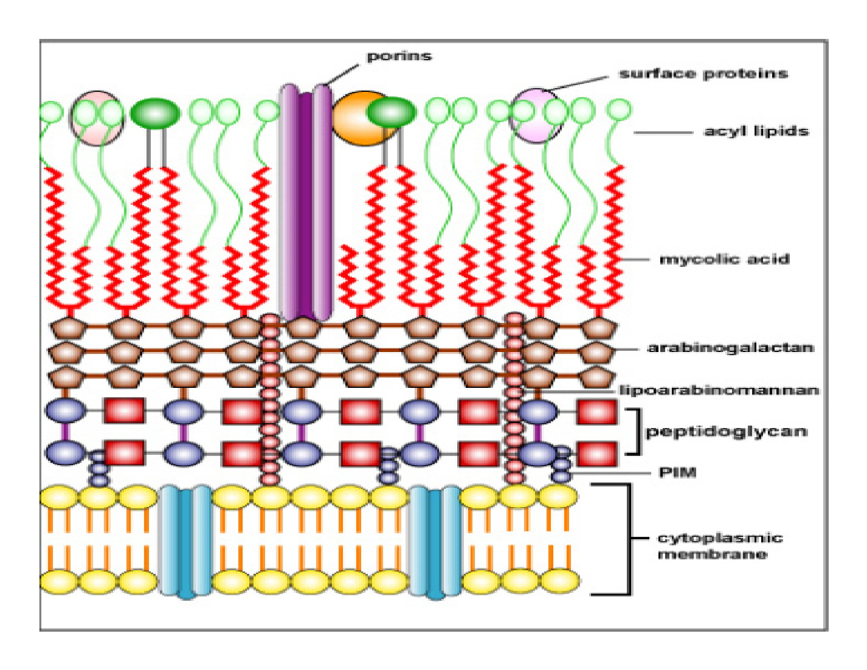
Mikobaktēriju baktēriju šūnu apvalki
Komplekss šūnas apvalks, ļoti izturīgs pret noārdīšanu
Mikolīnskābe (mycolic acid) - hidrofoba, veicina izdzīvošanu makrofāgos, novērš komplementa saistīšanos; Arabinogalaktāns – kavē dezinfekcijas līdzekļu un antibiotiku iekļūšanu;
Inhibē fagosomu-lizosomu saplūšanu

Slide 8
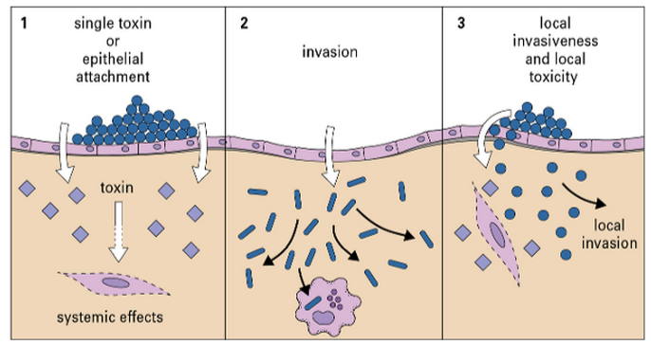
Patogenitātes mehānismi
Male D et al, Immunology, 2013
Corynebacterium diphtheriae, Clostridium tetani, Vibrio cholerae
lepromatous leprosy
Staphylococcus aureus, Clostridium perfringens (gangrēna, pārtikas saindēšanās)

Slide 9
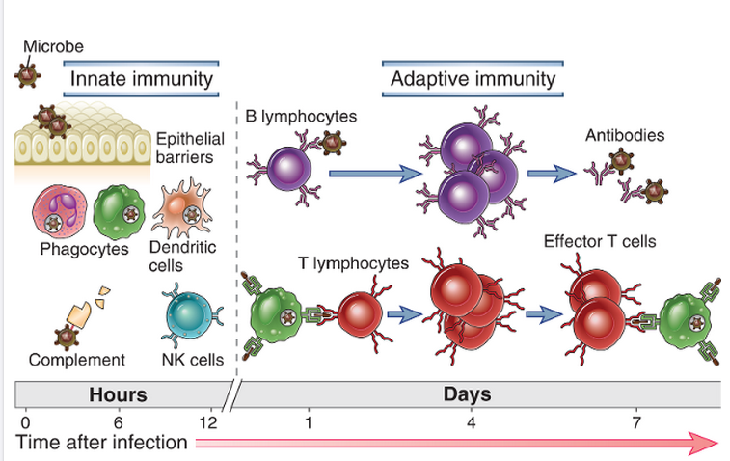
Pirmajās stundās pēc infekcijas tiek aktivēta nespecifiskā imūnaizsardzība; adaptīvā imūnā aizsardzība sāk darboties ~ nedēļas laikā

Slide 10
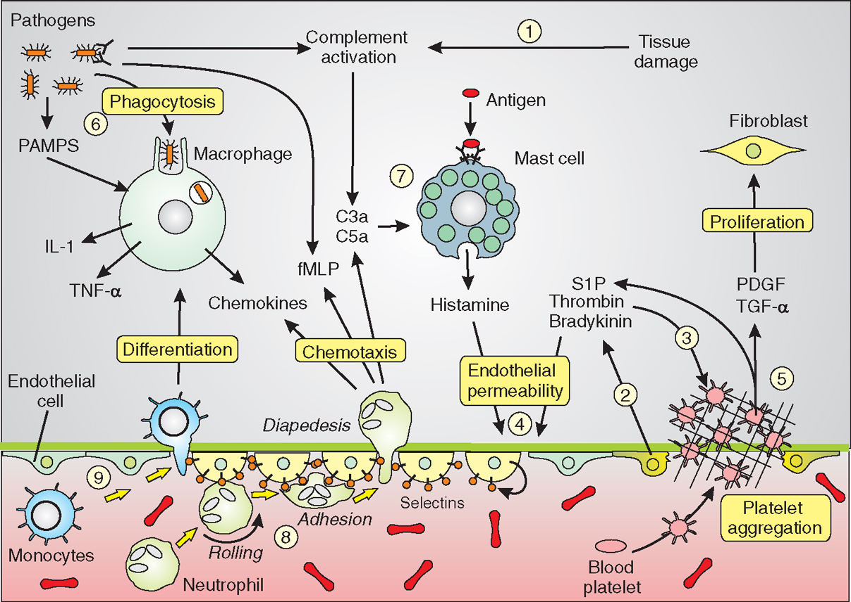
Akūta iekaisuma procesa iniciācija – leikocītu un plazmas proteīnu rekrutēšana un uzkrāšanās audos
Notes:
The innate immune system is triggered by signals derived from tissue damage and invading pathogens to activate cells such as the macrophages, neutrophils, mast cells, blood platelets and endothelial cells that contribute to a co-ordinated series of responses to both remove the pathogens and to repair damaged tissues. The endothelial cells are shown in three states: normal flattened shape (blue), contracted to increase endothelial permeability (light yellow) and damaged cells (bright yellow), where platelet aggregation occurs during formation of the haemostatic plug. Details of these responses are described in the text.
The leukocytes and plasma proteins normally circulate in the blood and are recruited to sites of infection and injury, where they perform various effector functions that serve to kill microbes and begin to repair tissue damage. Typically, the most abundant leukocyte that is recruited from the blood into acute inflammatory sites is the neutrophil, but blood monocytes, which become macrophages in the tissue, become increasingly prominent over time and may be the dominant population in some reactions. Among the important plasma proteins that enter inflammatory sites are complement proteins, antibodies, and acute-phase reactants. The delivery of these blood-derived components to the inflammatory site is dependent on reversible changes in blood vessels in the infected or damaged tissue. These changes include increased blood flow into the tissue due to arteriolar dilation, increased adhesiveness of circulating leukocytes to the endothelial lining of venules, and increased permeability of the capillaries and venules to plasma proteins and fluid.

Slide 11
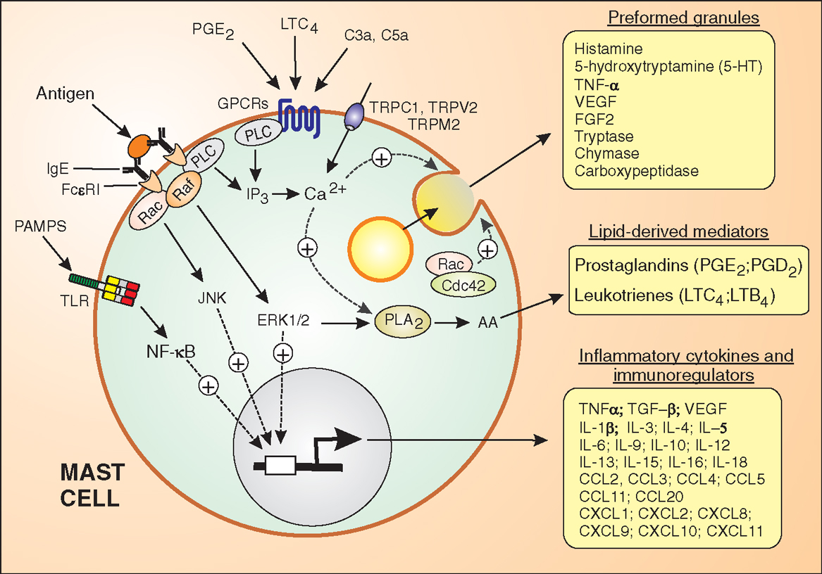
Tuklo šūnu loma akūta iekaisuma procesa iniciācijā
Tuklās šūnas ir galvenais histamīna, heparīna un serīna proteāžu avots iekaisuma vietā – tās atrodas gļotādās un audos un to degrenulāciju inducē fizikāls vai ķīmisks ievainojums, komplements un IgE receptoru aktivācija
Notes:
Mast cells release an enormous number of components that fall into three separate groups that are controlled by different signalling mechanisms. The preformed granules are released quickly through a typical Ca²⁺-dependent exocytotic mechanism. The lipid-dependent mediators that are produced from the arachidonic acid (AA) following stimulation of phospholipase A₂ (PLA₂). Finally, a whole range of inflammatory cytokines and immunoregulators are produced and released as a result of increases in gene transcription.

Slide 12
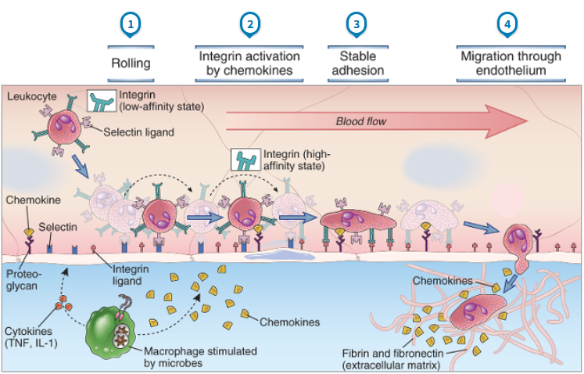
Endotēlija reakcija un leikocītu/limfocītu migrācija uz infekcijas vai ievainojuma vietu
Abbas AK et al, Cellular and Molecular Immunology, 2012
Notes:
At sites of infection, macrophages that have encountered microbes produce cytokines (such as TNF and IL-1) that activate the endothelial cells of nearby venules to produce selectins, ligands for integrins, and chemokines. Selectins mediate weak tethering and rolling of blood leukocytes on the endothelium, and the shear force of blood flow causes the leukocytes to roll along the endothelial surface. Chemokines produced in the surrounding infected tissues or by the endothelial cells are displayed on the endothelial surface and bind to receptors on the rolling leukocytes, which results in activation of the leukocyte integrins to a high-affinity binding state. The activated integrins bind to their Ig superfamily ligands on the endothelial cells, and this mediates firm adhesion of leukocytes. The leukocytes then crawl to junctions between endothelial cells and migrate through the venular wall. Neutrophils, monocytes, and T lymphocytes use essentially the same mechanisms to migrate out of the blood.

Slide 13
Pirmie audu bojājuma vai infekcijas vietā ierodas neitrofili (pirmajās minūtēs – stundā); monocīti vairākas stundas-dienas vēlāk (kad monocīti no asinsrites izkļūst audos, tie kļūst par makrofāgiem). Turklāt ir iekaisuma vietas, kur tiek rekrutēti monocīti, bet ne neitrofili.
Q: kas nosaka atšķirības neitrofilu un monocītu migrācijā?
Notes:
The chemokine receptors expressed on neutrophils and monocytes are also different, which is probably the major determinant of the divergent migratory behavior of each cell type. Neutrophils express CXCR1 and CXCR2, which bind GRO family chemokines including CXCL8 (IL-8), the major chemokine supporting neutrophil migration into tissues (see Table 3-2). Thus, early neutrophil recruitment reflects early and abundant CXCL8 production by tissue resident macrophages in response to infections. There are at least two populations of monocytes in the blood, and in both humans and mice, the populations are defined, in part, by chemokine receptor expression. Inflammatory monocytes, which are the main type recruited to inflammatory sites, express CCR2 in both mice and humans. This receptor binds several chemokines, but the most important one for monocyte recruitment is CCL2 (MCP-1). Thus, monocyte recruitment occurs when resident tissue cells express CCL2 in response to infection. The other population of monocytes, sometimes called nonclassical, lacks CCR2 but expresses CX₃CR1. The ligand for this receptor, CX₃CL1, is expressed both in soluble form and as a membrane-bound molecule that can support adhesion of monocytes to endothelium.

Slide 14
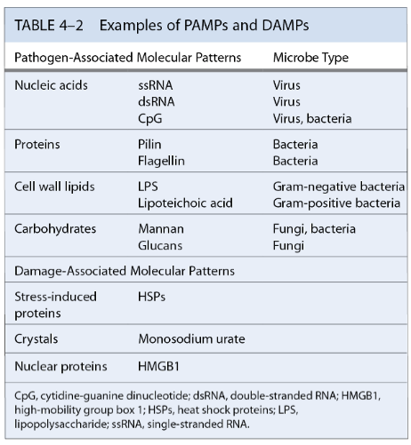
Ko fagocīti pazīst/ierauga?
PAMPs – pathogen-associated molecular patterns
DAMPs – damage-associated molecular patterns
DAMPs var rasties gan infekciju, gan dažādu traumu, toksīnu, apdegumu vai hipoksijas rezultātā., bet neveidojas no apoptotiskām šūnām!
LPS saistās pie TLR4 – inducē proinflamatoro citokīnu (TNFα, IL-1, IL-6 u.c.) produkciju. Var izraisīt šoka stāvokli (endotēlija reakcija – vaskulārā adhēzija, vazoaktīvi peptīdi – krītas asins spiediens)

Slide 15
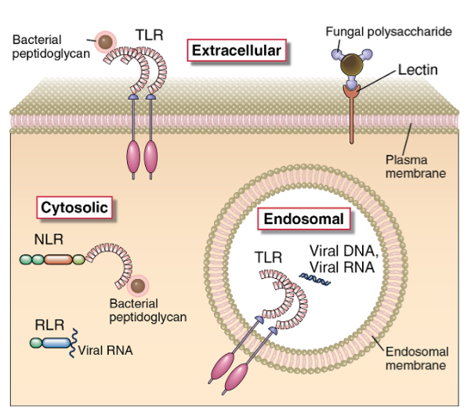
Fagocītu receptori, kas pazīst PAMPs
Toll-like receptoru (TLR) saime: ~10 dažādi receptori uz fagocītiem, DCs un epiteliālajām šūnām. Ligandi: LPS, peptidoglikāni, vīrusu DNS, RNS
NOD-like receptoru (NLRs) saime: atrodas fagocītu un epiteliālo šūnu citoplazmā. Ligandi: flagelīns, LPS, ureāta kristāli, bojātu šūnu produkti u.c.
C-type lectin-like receptori (Mannozes receptori): fagocītu membrānā. Ligandi: mannozi, fruktozi saturoši ogļhidrāti
Scavenger receptori: fagocītu membrānā. Ligandi: diacilgricerīdi
Abbas AK et al, Cellular and Molecular Immunology, 2012
Notes:
Some pattern recognition molecules of the TLR family (see Fig. 4-2) are expressed on the cell surface, where they may bind extracellular pathogen-associated molecular patterns. Other TLRs are expressed on endosomal membranes and recognize nucleic acids of microbes that have been phagocytosed by cells. Cells also contain cytoplasmic sensors of microbial infection (discussed later in the chapter), including the NLR family of proteins, which recognize bacterial peptidoglycans, RIG-like receptors, which bind viral RNA, and plasma membrane lectin-like receptors that recognize fungal glycans.

Slide 16
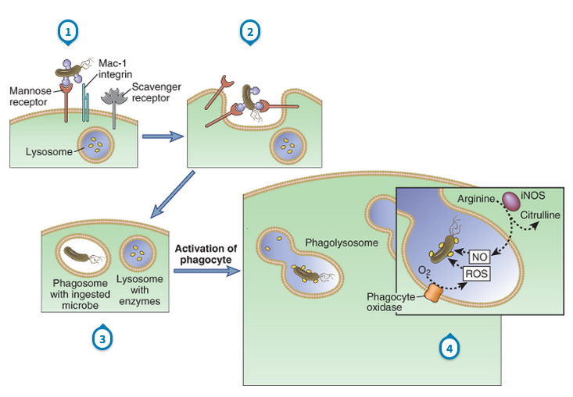
Fagocitoze
Fagocitozes process ir līdzīgs neitrofilos un makrofāgos. ROS, NO un lizosomālās proteāzes noārda mikroorganismus.
Neitrofili aktivējas izkļūstot audos, ir ieprogrammēti ieiet apoptozē 5 dienu laikā; makrofāgu dzīves ilgums ir variabls – no 6 dienām līdz vairākiem mēnešiem, ir nepieciešami aktivācijas signāli.
Notes:
Microbes may be ingested by different membrane receptors of phagocytes; some directly bind microbes, and others bind opsonized microbes. (Note that the Mac-1 integrin binds microbes opsonized with complement proteins, not shown.) The microbes are internalized into phagosomes, which fuse with lysosomes to form phagolysosomes, where the microbes are killed by reactive oxygen and nitrogen species and proteolytic enzymes. iNOS, inducible nitric oxide synthase; NO, nitric oxide; ROS, reactive oxygen species.

Slide 17
Audu makrofāgu aktivācijas stāvokļi
Neaktivēts (resting) – fagocitē šūnu atlikumus; zema MHCII ekspresija; šādā stāvoklī var dzīvot vairākus mēnešus
Aktivēts – piemēram, ar IFN-γ. Paaugstina MHCII ekspresju, var kalpot kā APC, vidēji augsta fagocitozes aktivitāte
Hiperaktivēts – piemēram, ar LPS vai mannozi. Ļoti augsta fagocitozes aktivitāte, producē TNF un IL12.
Makrofāgi, atšķirībā no DC, neceļo uz limfmezgliem, toties var re-stimulēt T šūnas audos.
Notes:
Macrophages are activated by microbial products such as LPS and by NK cell–derived IFN-γ (described earlier in the chapter). The process of macrophage activation leads to the activation of transcription factors, the transcription of various genes, and the synthesis of proteins that mediate the functions of these cells. In adaptive cell-mediated immunity, macrophages are activated by stimuli from T lymphocytes (CD40 ligand and IFN-γ) and respond in essentially the same way

Slide 18
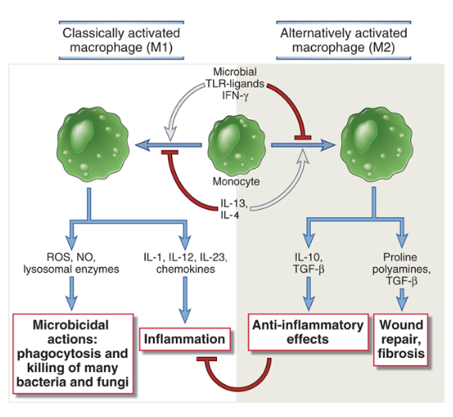
Makrofāgu polarizācija (M1 vs M2)
Notes:
Subsets of activated macrophages. Different stimuli activate monocytes-macrophages to develop into functionally distinct populations. Classically activated macrophages are induced by microbial products and cytokines, particularly IFN-γ, and are microbicidal and involved in potentially harmful inflammation. Alternatively activated macrophages are induced by IL-4 and IL-13 produced by T_{H}2 cells and other leukocytes and are important in tissue repair and fibrosis.

Slide 19
Q: Kāda ir galvenā atšķirība starp makrofāgiem un dendrītiskajām šūnām?

Slide 20
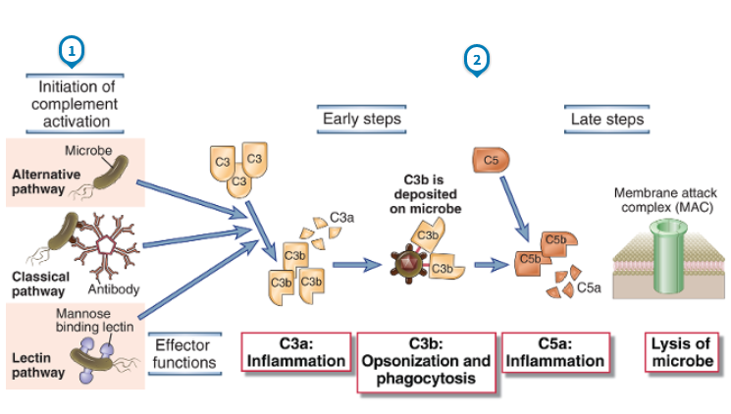
Komplementa aktivācijas ceļi un efektorās funkcijas
Notes:
The activation of the complement system may be initiated by three distinct pathways, all of which lead to the production of C3b (the early steps). C3b initiates the late steps of complement activation, culminating in the production of peptides that stimulate inflammation (C5a) and polymerized C9, which forms the membrane attack complex, so called because it creates holes in plasma membranes.

Slide 21
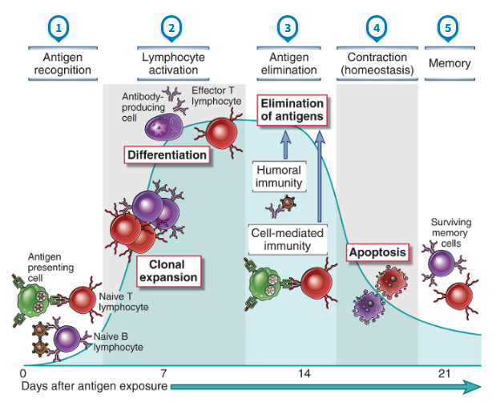
Adaptīvās imūnās atbildes aktivācijas laikaposms

Slide 22
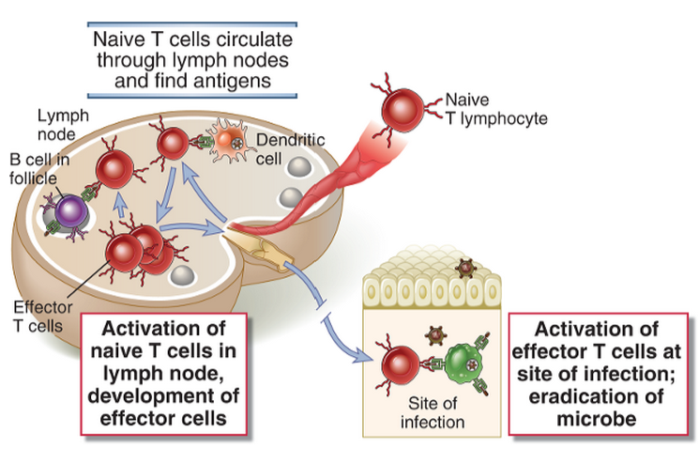
Naïvo limfocītu aktivācija notiek sekundārajos limfoīdajos orgānos – limfmezglos, liesā, Peijera mezglos; atmiņas T šūnu re-stimulācija var notikt audos
Notes:
Antigens that are transported by dendritic cells to lymph nodes are recognized by naive T lymphocytes that recirculate through these lymph nodes. The T cells are activated to differentiate into effector and memory cells, which may remain in the lymphoid organs or migrate to nonlymphoid tissues. At sites of infection, the effector cells are again activated by antigens and perform their various functions, such as macrophage activation.
Antigen recognition and other activating stimuli induce several responses: cytokine secretion from the T cells; proliferation of the antigen-specific lymphocytes, leading to an increase in the numbers of cells in the antigen-specific clones (called clonal expansion); and differentiation of the naive cells into effector and memory lymphocytes

Slide 23
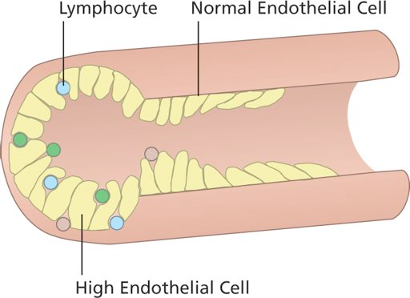
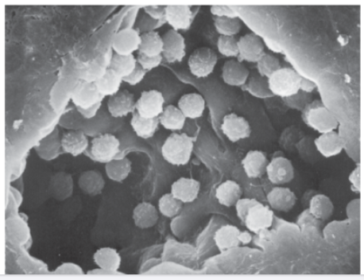
Limfocīti iekļūst limfmezglā caur HEV (high endothelial venules)

Slide 24
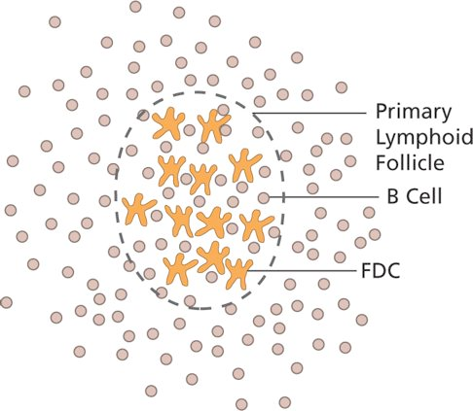
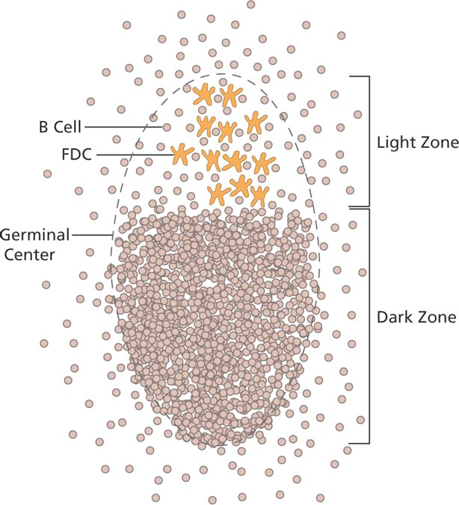
B šūnu aktivācija limfoīdajos folikulos
Folikulārās dendrītiskās šūnas rezidē LN, saista komplementa opsonizētus antigēnus; Ja B šūna pazīst šo antigēnu, tas izraisa BCR klasterēšanos; B šūnas sāk proliferēt, veidojas “Germinal centre”. Ja šajā laikā nesaņem ko-stimulējošo signālu (CD40L) no aktivētas Th šūnas – ieiet apoptozē.

Slide 25
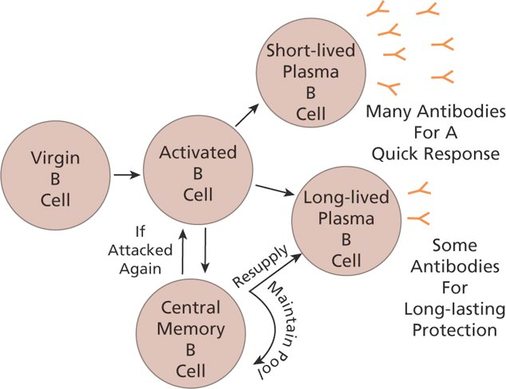
B šūnu atmiņas veidošanās
Short lived plazmas šūnas dzīvo dažas dienas kaulu smadzenēs un liesā; producē lielu daudzumu Ab
Ilgdzīvojošas plazmas šūnas – dzīvo kaulu smadzenēs vairākus mēnešus, vidējs daudzums Ab,
Centrālās atmiņas šūnas darbojas kā cilmes šūnas, kas lēni proliferē atjaunojot cilmes šūnu populāciju un ilgdzīvošās plazmas šūnas
Antivielas nonāk asinīs vai arī tiek transportētas cauri gļotādu epitēlijam vai placentai.

Slide 26
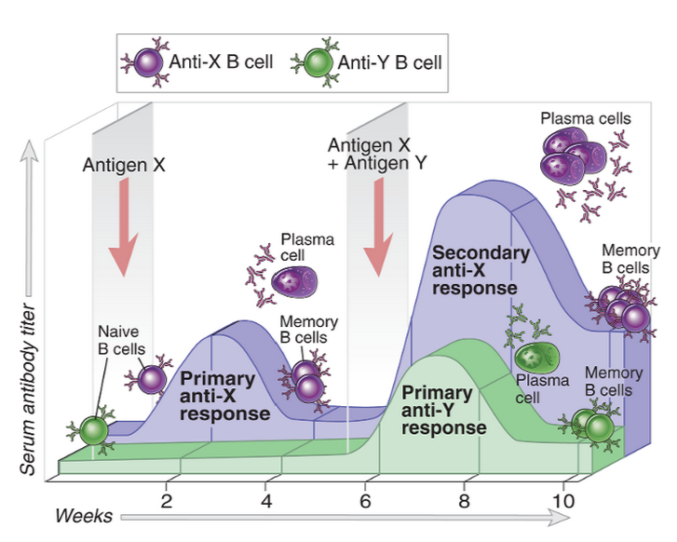
B šūnu primārā un sekundārā atbilde
Notes:
Antigens X and Y induce the production of different antibodies (specificity). The secondary response to antigen X is more rapid and larger than the primary response (memory). Antibody levels decline with time after each immunization (contraction, the process that maintains homeostasis). The same features are seen in cell-mediated immune responses.

Slide 27
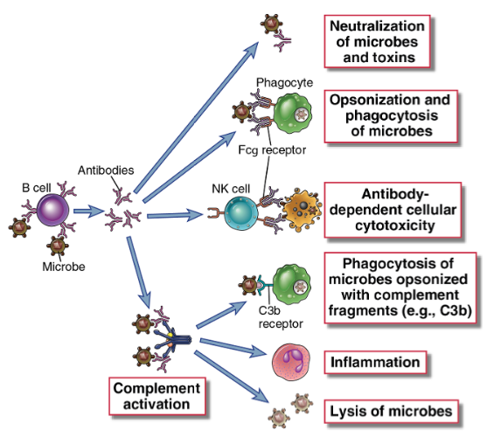
Antivielu efektorās funkcijas
Notes:
Antibodies against microbes (and their toxins, not shown here) neutralize these agents, opsonize them for phagocytosis, sensitize them for antibody-dependent cellular cytotoxicity, and activate the complement system. These various effector functions may be mediated by different antibody isotypes.

Slide 28
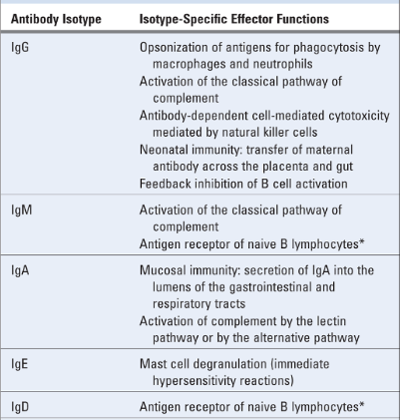
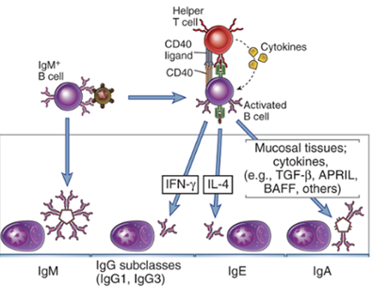
Antivielu klases un klašu-specifiskās efektorās funkcijas
Notes:
B cells activated by helper T cell signals (CD40L, cytokines) undergo switching to different Ig isotypes, which mediate distinct effector functions. Selected examples of switched isotypes are shown.

Slide 29
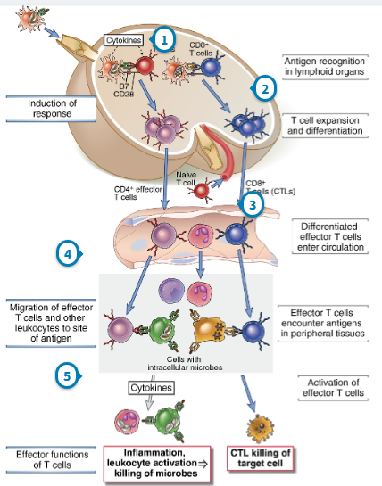
T šūnu aktivācija un efektorās funkcijas
Notes:
Effector T cells recognize antigens in lymphoid organs or in peripheral nonlymphoid tissues and are activated to perform functions that are responsible for the elimination of microbes and, in disease states, for inflammation and tissue damage. Whereas naive cells are activated mainly in lymphoid organs, differentiated effector cells may function in any tissue (see Fig. 9-1). The process of differentiation from naive to effector cells is associated with acquisition of the capacity to perform these specialized functions and the ability to migrate to any site of infection or inflammation. At these sites, the effector cells again encounter the antigen for which they are specific and respond in ways that serve to eliminate the source of the antigen. Effector T cells of the CD4⁺ helper lineage are classified into several subsets on the basis of their cytokine profiles and functions. Some of these differentiated helper cells express membrane molecules and secrete cytokines that activate (help) macrophages to kill phagocytosed microbes; others secrete cytokines that recruit leukocytes and thus stimulate inflammation; others enhance mucosal barrier functions; and yet others remain in lymphoid organs and help B cells to differentiate into cells that secrete antibodies. CD8⁺ cytotoxic T lymphocytes (CTLs), the effector cells of the CD8⁺ lineage, kill infected cells and tumor cells that display class I MHC–associated antigens.
Memory T cells that are generated by T cell activation are long-lived cells with an enhanced ability to react against the antigen. These cells are present in the recirculating lymphocyte pool and are abundant in mucosal tissues and the skin as well as in lymphoid organs. After a T cell response wanes, there are many more memory cells of the responding clone that persist than there were naive T cells before the response. These memory cells respond rapidly to subsequent encounter with the antigen and generate new effector cells that eliminate the antigen.
T cell responses decline after the antigen is eliminated by effector cells. This process of contraction is important for returning the immune system to a state of equilibrium, or homeostasis. It occurs mainly because the majority of antigen-activated effector T cells die by apoptosis. One reason for this is that as the antigen is eliminated, lymphocytes are deprived of survival stimuli that are normally provided by the antigen and by the costimulators and cytokines produced during inflammatory reactions to the antigen. It is estimated that more than 90% of the antigen-specific T cells that arise by clonal expansion die by apoptosis as the antigen is cleared.
With this overview, we proceed to a discussion of the signals required for T cell activation and the steps that are common to CD4⁺ and CD8⁺ T cells. We then describe effector and memory cells in the CD4⁺ and CD8⁺ lineages, with emphasis on subsets of CD4⁺ helper T cells and the cytokines they produce. We conclude with a discussion of the decline of immune responses.

Slide 30
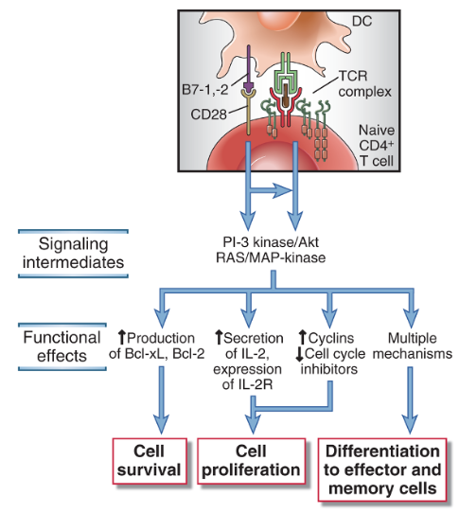
Naïvu T šūnu aktivācijai ir nepieciešamas “profesionālas” APCs – aktivētas dendrītiskās šūnas
Infekcijas/iekaisuma vietā DCs aktivējas, saņemot signālus no PAMPs un citokīnu receptoriem, pa limfvadiem migrē uz tuvāko limfmezglu, kur tās satiekas ar naivām CD4+ un CD8+ T šūnām. Tikai aktivētas DCs ekspresē B7-1 un B7-2, kas nepieciešamas T šūnu ko-stimulācijai. Ja T šūna nesaņem ko-stimulējošo signālu, tā nereaģē vai kļūst anerģiska. Atkarībā no signāliem, kādus DC ir saņēmusi infekcijas vietā, tā producē dažādus citokīnus, kas nosaka Th šūnu polarizāciju. Tādējādi, DCs ir galvenais imūnās atbildes koordinators.
Notes:
In lymphoid organs, dendritic cells present peptides derived from endocytosed protein antigens in association with class II MHC molecules to naive CD4⁺ T cells and peptides derived from cytosolic proteins displayed by class I MHC molecules to CD8⁺ T cells. CD4⁺ T cell–mediated immune reactions are elicited by protein antigens of microbes that are ingested by dendritic cells or by soluble protein antigens that are administered with adjuvants, in the case of vaccinations, and taken up by dendritic cells.
IL-2 stimulates the survival, proliferation, and differentiation of antigen-activated T cells. IL-2 promotes survival of cells by inducing the antiapoptotic protein Bcl-2. It stimulates cell cycle progression through the synthesis of cyclins and relieves a block in cell cycle progression through p27 degradation. In addition, IL-2 increases production of effector cytokines, such as IFN-γ and IL-4, by the T cells.
IL-2 is required for the survival and function of regulatory T cells,which suppress immune responses against self and other antigens. In fact, knockout mice lacking IL-2 or IL-2 receptors develop uncontrolled T and B cell proliferation and autoimmune disease because of a defect in regulatory T cells. These studies indicate that other growth factors can replace IL-2 for expansion of effector T cells, but no other cytokine can replace IL-2 for the maintenance of functional regulatory T cells.

Slide 31
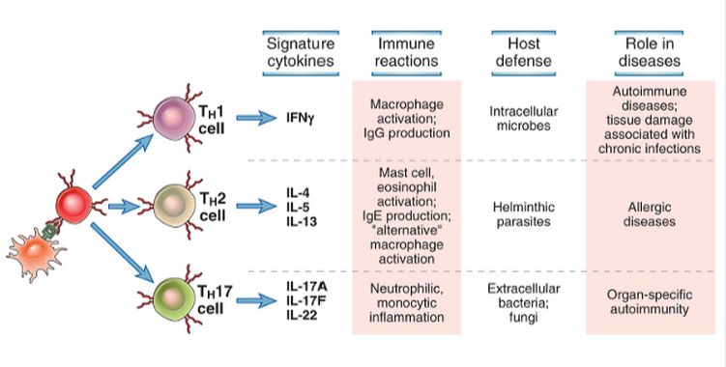
Galvenie efektorie Th subtipi, kas veidojas no naïvām CD4+ T šūnām un nodrošina aizsardzību pret infekciozajiem aģentiem
Notes:
Differentiated T_{H}1, T_{H}2, and T_{H}17 cells all develop from naive CD4⁺ T lymphocytes, mainly in response to cytokines present early during immune responses, and differentiation involves transcriptional activation and epigenetic modification of cytokine genes. The process of differentiation, which is sometimes referred to aspolarization of T cells, can be divided into induction, stable commitment, and amplification
Naive CD4⁺ T cells may differentiate into distinct subsets of effector cells in response to antigen, costimulators, and cytokines. The columns to the right list the major differences between the best-defined subsets.
There are three distinct subsets of CD4⁺ T cells, called T_{H}1, T_{H}2, and T_{H}17, that function in host defense against different types of infectious pathogens and are involved in different types of tissue injury in immunologic diseases (Fig. 9-13). A fourth population, called follicular helper T cells, is important in antibody responses and is described in Chapter 11. Regulatory T cells are another distinct population of CD4⁺ T cells. Their function is to control immune reactions to self and foreign antigens, and they are described in Chapter 14 in the context of immunologic tolerance. Although these subsets are identifiable in immune reactions (and can often be generated in cell culture), many effector CD4⁺ T cells produce various combinations of cytokines or only some of the cytokines characteristic of a particular subset and are not readily classifiable into separable populations. Whether these populations with mixed or limited cytokine patterns are intermediates in the development of the polarized effector cells or are themselves fixed populations is not known. It is also clear that some of these differentiated T cells may convert from one population into another by changes in activation conditions. The extent and significance of such “plasticity” are topics of active research.

Slide 32
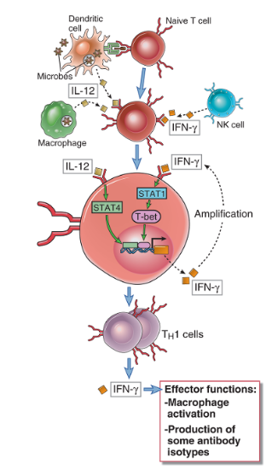
Th1 polarizācija:
Nepieciešams IL-12, IFN-γ
Transcripcijas faktori: STAT1, 4, T-bet
Notes:
IL-12 produced by dendritic cells and macrophages in response to microbes, including intracellular microbes, and IFN-γ produced by NK cells (all part of the early innate immune response to the microbes) activate the transcription factors T-bet, STAT1, and STAT4, which stimulate the differentiation of naive CD4⁺ T cells to the T_{H}1 subset. IFN-γ produced by the T_{H}1 cells amplifies this response and inhibits the development of T_{H}2 and T_{H}17 cells.
CD4⁺ T cells that differentiate into T_{H}1 cells secrete IFN-γ, which acts on macrophages to increase phagocytosis and killing of microbes in phagolysosomes and on B lymphocytes to stimulate production of IgG antibodies that opsonize microbes for phagocytosis. The cells also produce TNF, which activates neutrophils and promotes inflammation (not shown).

Slide 33
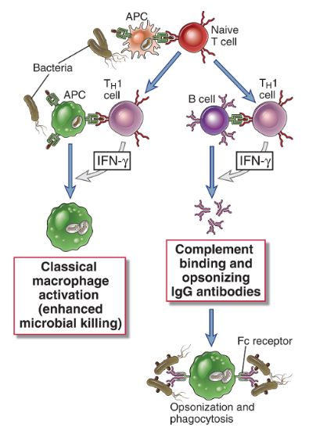
Th1 efektorās funkcijas
Notes:
CD4⁺ T cells that differentiate into T_{H}1 cells secrete IFN-γ, which acts on macrophages to increase phagocytosis and killing of microbes in phagolysosomes and on B lymphocytes to stimulate production of IgG antibodies that opsonize microbes for phagocytosis. The cells also produce TNF, which activates neutrophils and promotes inflammation (not shown).

Slide 34
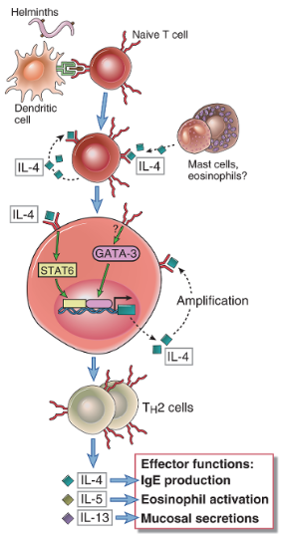
Th2 polarizācija
Nepieciešams IL4
Transcripcijas faktori: STAT6, GATA-3
Notes:
IL-4 produced by activated T cells themselves or by mast cells and eosinophils, especially in response to helminths, activates the transcription factors GATA-3 and STAT6, which stimulate the differentiation of naive CD4⁺ T cells to the T_{H}2 subset. IL-4 produced by the T_{H}2 cells amplifies this response and inhibits the development of T_{H}1 and T_{H}17 cells.
CD4⁺ T cells that differentiate into T_{H}2 cells secrete IL-4, IL-5, and IL-13. IL-4 (and IL-13) act on B cells to stimulate production of antibodies that bind to mast cells, such as IgE. IL-4 is also an autocrine growth and differentiation cytokine for T_{H}2 cells. IL-5 activates eosinophils, a response that is important for defense against helminthic infections. IL-4 and IL-13 are involved in barrier immunity, induce an alternative pathway of macrophage activation, and inhibit classical, T_{H}1-mediated macrophage activation.

Slide 35
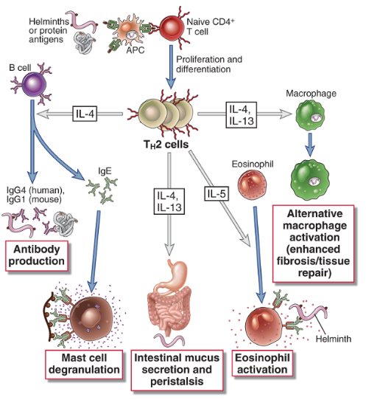
Th2 efektorās funkcijas
Notes:
CD4⁺ T cells that differentiate into T_{H}2 cells secrete IL-4, IL-5, and IL-13. IL-4 (and IL-13) act on B cells to stimulate production of antibodies that bind to mast cells, such as IgE. IL-4 is also an autocrine growth and differentiation cytokine for T_{H}2 cells. IL-5 activates eosinophils, a response that is important for defense against helminthic infections. IL-4 and IL-13 are involved in barrier immunity, induce an alternative pathway of macrophage activation, and inhibit classical, T_{H}1-mediated macrophage activation.

Slide 36
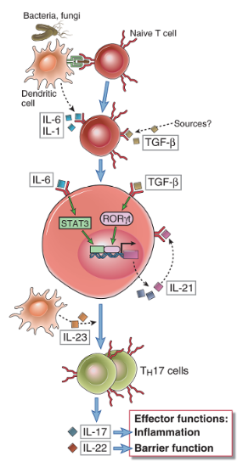
Th17 polarizācija:
Nepieciešams IL-6, TGFβ
Transcripcijas faktori: STAT3, ROR-γt
Notes:
IL-1 and IL-6 produced by APCs and transforming growth factor-β (TGF-β) produced by various cells activate the transcription factors RORγt and STAT3, which stimulate the differentiation of naive CD4⁺ T cells to the T_{H}17 subset. IL-23, which is also produced by APCs, especially in response to fungi, stabilizes the T_{H}17 cells. TGF-β may promote T_{H}17 responses indirectly by suppressing T_{H}1 and T_{H}2 cells, both of which inhibit T_{H}17 differentiation (not shown in the figure). IL-21 produced by the T_{H}17 cells amplifies this response.
The development of T_{H}17 cells is dependent on the transcription factors RORγt and STAT3 (see Fig. 9-17). TGF-β and the inflammatory cytokines, mainly IL-6 and IL-1, work cooperatively to induce the production of RORγt, a transcription factor that is a member of the retinoic acid receptor family. RORγt is a T cell–restricted protein encoded by the RORC gene, so sometimes the protein may be referred to as RORc. The inflammatory cytokines, notably IL-6, activate the transcription factor STAT3, which functions with RORγt to drive the T_{H}17 response.
Cytokines produced by T_{H}17 cells stimulate local production of chemokines and inflammation and the production of antimicrobial peptides (defensins) and promote epithelial barrier functions.

Slide 37
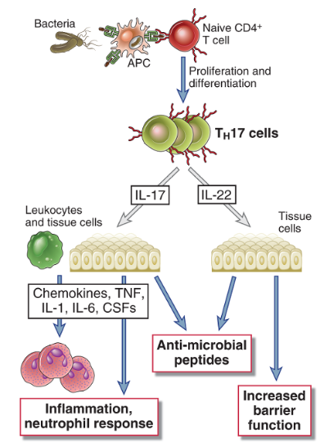
Th17 efektorās funkcijas
Notes:
Cytokines produced by T_{H}17 cells stimulate local production of chemokines and inflammation and the production of antimicrobial peptides (defensins) and promote epithelial barrier functions.
T_{H}17 cells are also important in the pathogenesis of to many inflammatory diseases, such as psoriasis, inflammatory bowel disease, rheumatoid arthritis, and multiple sclerosis. Antibodies that block the development or functions of T_{H}17 cells are in clinical trials for several of these diseases. T_{H}1 and T_{H}17 cells may both be present in the lesions in these diseases, and their relative contribution to the development and propagation of the disorders is an area of active research. T_{H}17 cells may also serve to maintain normal epithelial function in the gut and skin, mainly by virtue of the actions of IL-22.

Slide 38
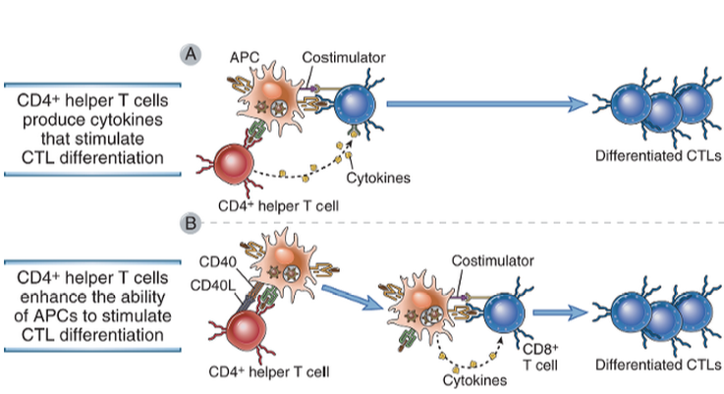
CD8+ citotoksisko T šūnu (CTL) aktivācija:
aktivēta APC, kas prezentē Ag uz MHC I un nodrošina ko-stimulāciju (B7), aktivēta T šūna producē IL-2, kas izraisa to proliferāciju; atkarībā no antigēna, CD4+ Th var stimulēt CTL aktivāciju vai nu producējot citokīnus vai aktivējot APCs
Notes:
CD4⁺ helper T cells promote the development of CD8⁺ CTLs by secreting cytokines that act directly on the CD8⁺cells (A) or by activating APCs to become more effective at stimulating the differentiation of the CD8⁺ T cells(B).

Slide 39
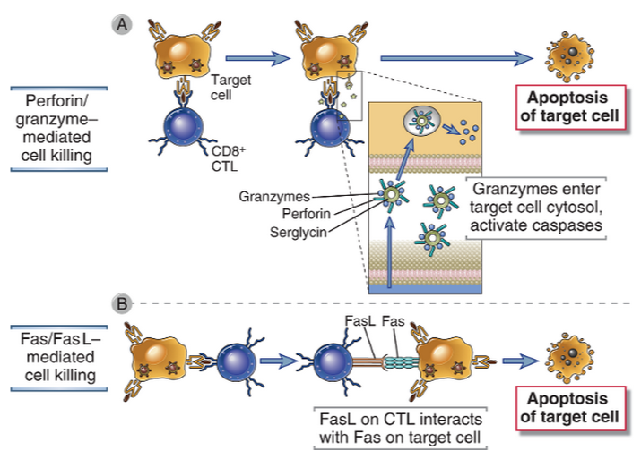
CTL efektorā funkcija – inficēto šūnu nogalināšana
Notes:
A CTL recognizes the antigen-expressing target cell and is activated. Activation results in the release of granule contents from the CTL into the target cell through the area of contact (the immunologic synapse). Granule contents deliver a lethal hit to the target. The CTL may detach and kill other target cells. The formation of conjugates between a CTL and its target and activation of the CTL also require interactions between accessory molecules (LFA-1, CD8) on the CTL and their specific ligands on the target cell; these are not shown.
Within a few minutes of a CTL’s antigen receptor recognizing its antigen on a target cell, the target cell undergoes changes that induce it to die by apoptosis. Target cell death occurs during the next 2 to 6 hours and proceeds even if the CTL detaches. Thus, the CTL is said to deliver a lethal hit to the target cell. The principal mechanism of CTL-mediated target cell killing is the delivery of cytotoxic proteins stored within cytoplasmic granules (also called secretory lysosomes) to the target cell, thereby triggering apoptosis of the target cell
CTLs kill target cells by two main mechanisms. A, Complexes of perforin and granzymes are released from the CTL by granule exocytosis and enter target cells. The granzymes are delivered into the cytoplasm of the target cells by a perforin-dependent mechanism, and they induce apoptosis.B, FasL is expressed on activated CTLs, engages Fas on the surface of target cells, and induces apoptosis.

Slide 40
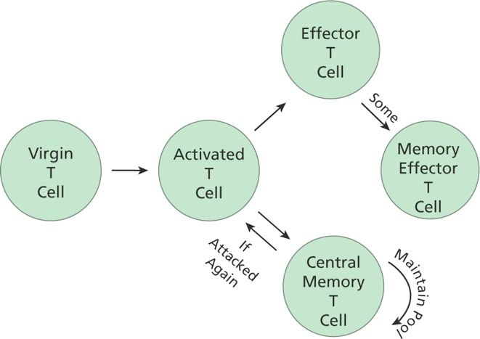
T šūnu atmiņas veidošanās
T šūnu atmiņa var saglabāties vairākus desmitus gadu. Lielākā daļa efektoro T šūnu iet bojā apoptozes ceļā, dažas kļūst par atmiņas efektorajām šūnām, kas rezidē audos: ātri re-aktivējamas, spēj proliferēt (nedaudz).
Centrālās atmiņas šūnas rezidē sekundārajps limfoīdajos orgānos; pēc re-aktivācijas daļa kļūst par efektoriem.

Slide 41
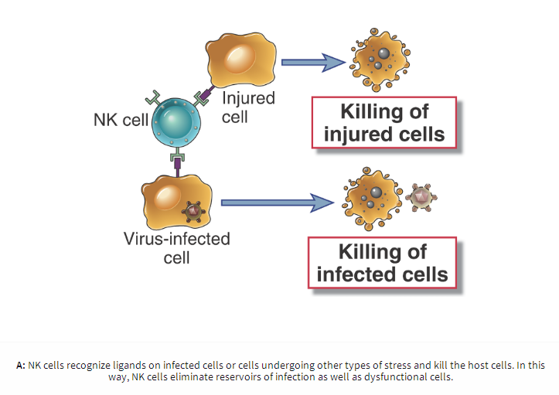
NK efektorās funkcijas: nogalināt bojātas (stressed) vai vīrusu inficētas šūnas, kas neekspresē MHC

Slide 42
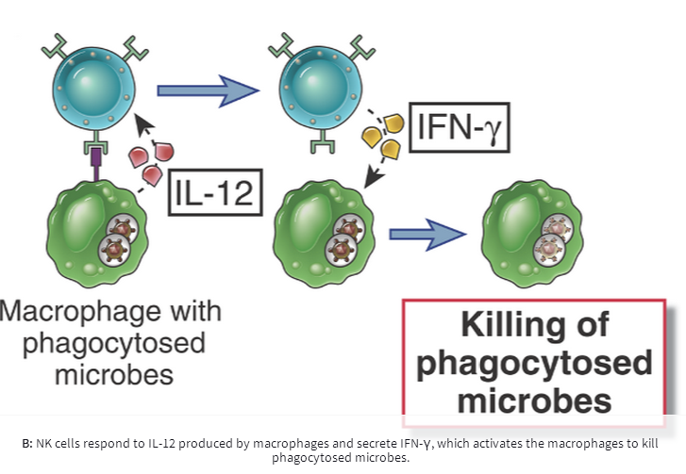
NK producē IFN-γ, kas aktivē makrofāgus

Slide 43
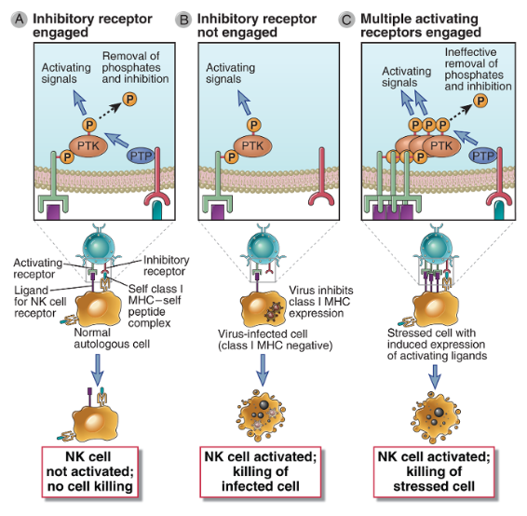
Aktivējošie un inhibējošie receptori uz NK šūnām
Notes:
Activating receptors of NK cells recognize ligands on target cells and activate protein tyrosine kinase (PTK), whose activity is inhibited by inhibitory receptors that recognize class I MHC molecules and activate protein tyrosine phosphatases (PTP). NK cells do not efficiently kill class I MHC–expressing healthy cells. B, If a virus infection or other stress inhibits class I MHC expression on infected cells and induces expression of additional activating ligands, the NK cell inhibitory receptor is not engaged and the activating receptor functions unopposed to trigger responses of NK cells, such as killing of target cells and cytokine secretion. C,Cells stressed by infection or neoplastic transformation may express increased amounts of activating ligands, which bind NK cell activating receptors and induce more tyrosine phosphorylation than can be removed by inhibitory receptor associated phosphatases, resulting in killing of the stressed cells.
The largest group of NK inhibitory receptors are the killer cell immunoglobulin-like receptors (KIRs), which are members of the immunoglobulin (Ig) superfamily. Members of this family all contain a structural domain called an Ig fold, first identified in antibody (also known as Ig) molecules, discussed in Chapter 5. KIRs bind a variety of class I MHC molecules.
Activating receptors on NK cells recognize a heterogeneous group of ligands, some of which may be expressed on normal cells and others of which are expressed mainly on cells that have undergone stress, are infected with microbes, or are transformed. The molecular features of the ligands for many of these receptors are not well characterized. The induced expression of ligands on unhealthy cells that bind to activating receptors on NK cells may lead to signals that overwhelm the signals from inhibitory receptors, especially if class I MHC is also reduced or lost on the unhealthy cell

Slide 44
Q: Kurš no šiem procesiem nepiedalās nespecifiskajā imūnajā atbildē pret ekstracelulārām baktērijām?
Komplementa aktivācija ar peptidoglikāniem
Komplementa aktivācija ar mannozi
Fagocītu aktivācija caur Toll-like receptoriem
Baktēriju lizēšana ar NK šūnu palīdzību
Akūts iekaisums

Slide 45
Kā organisms saglabā normālo mikrofloru?

Slide 46
Dabīgā mikroflora
Cilvēka organismā ir 10 reizes vairāk baktēriju kā cilvēka šūnu.
Aizsardzības mehānismi: konkurence par barības vielām, antibakteriālu proteīnu produkcija, imūnās atbildes stimulēšana.
Normālās mikrofloras bojājums, piemēram antibiotiku lietošanas gadījumā, dod iespēju savairoties patogēnai mikroflorai (piem. Candida spp., Clostridium difficile)

Slide 47
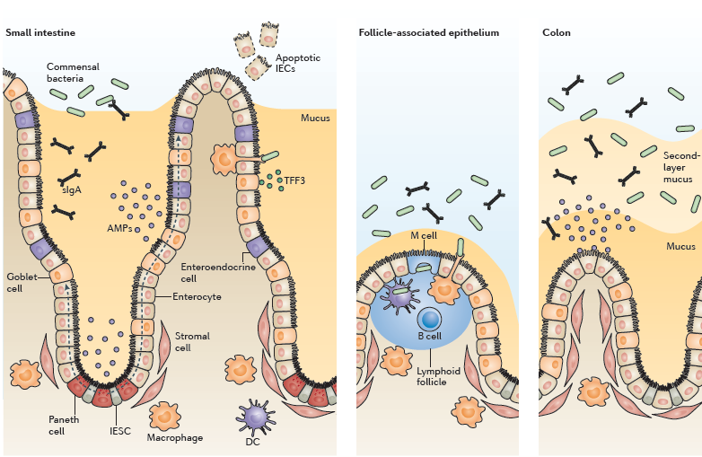
Zarnu epitēlija šūnu loma homeostāzes nodrošināšanā
Barjerfunkcija: mucīni, antimikrobiālie proteīni un IgA transcitoze
Peterson & Artis, NatRevImmunol, 2014
Notes:
The intestinal epithelium is the largest of the body’s mucosal surfaces, covering ~400 m2 of surface area with a single layer of cells organized into crypts and villi (FIG. 1).
Figure 1 | The IEC barrier. Intestinal epithelial cells (IECs) form a biochemical and physical barrier that maintains segregation between luminal microbial communities and the mucosal immune system. The intestinal epithelial stem cell (IESC) niche, containing epithelial, stromal and haematopoietic cells, controls the continuous renewal of the epithelial cell layer by crypt-resident stem cells. Differentiated IECs — with the exception of Paneth cells — migrate up the crypt–villus axis, as indicated by the dashed arrows. Secretory goblet cells and Paneth cells secrete mucus and antimicrobial proteins (AMPs) to promote the exclusion of bacteria from the epithelial surface. The transcytosis and luminal release of secretory IgA (sIgA) further contribute to this barrier function. Microfold cells (M cells) and goblet cells mediate transport of luminal antigens and live bacteria across the epithelial barrier to dendritic cells (DCs), and intestine-resident macrophages sample the lumen through transepithelial dendrites. TFF3, trefoil factor 3.
Enterocytes are capable of producing some AMPs, such as the C‑type lectin regenerating islet-derived protein IIIγ (REGIIIγ), throughout the small intestine and colon. By contrast, Paneth cells are uniquely adapted for the secretion of many additional AMPs, including defensins (cryptdins in mice), cathelicidins and lysozyme, in the crypts of the small intestine18,26. These AMPs disrupt highly conserved and essential features of bacterial biology, such as surface membranes, which are targeted by pore-forming defensins and cathelicidins, and Gram-positive cell wall peptidoglycans, which are targeted by C‑type lectins18,27
Finally, IECs directly transport secretory immunoglobulins across the epithelial barrier. Following their production by plasma cells in the lamina propria, dimeric IgA complexes are bound by the polymeric immunoglobulin receptor (pIgR) on the basolateral membrane of IECs and actively transcytosed into the intestinal lumen40. The collaboration between IgA-secreting B cells and IECs provides an adaptive immune component to the epithelial barrier that regulates commensal bacterial populations to maintain IEC and immune cell homeostasis41–43

Slide 48
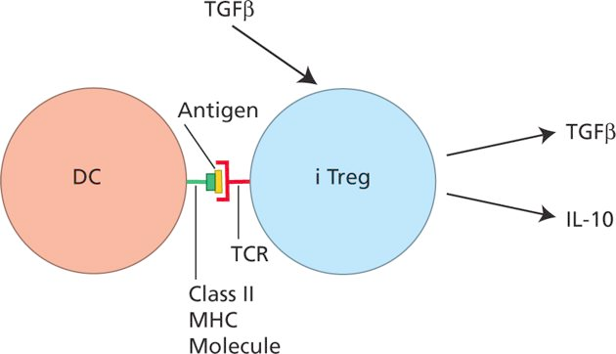
Zarnu epitēlija šūnu (IECs) loma homeostāzes nodrošināšanā
M šūnu (microfold cells) funkcija – zarnu lumena antigēnu “ievākšana” un nodošana gļotādas imūnsistēmai (galvenokārt transcitoze)
IECs ekspresē PRRs (Pattern-recognition receptors), kas tām ļauj darboties kā mikrobioloģiskās vides monitoriem, taču to izraisītie efekti ir atšķirīgi kā imūnšūnās – regulē homeostāzi un imūno toleranci (piemēram, TLR k/o pele iznīcina dabīgo mikrofloru); IECs šo signālceļu aktivitāte ir atšķirīga un/vai pazemināta, lai pasargātu no iekaisuma procesa. IECs producē TGFβ, kas veicina naivo Th šūnu polarizāciju par iTregs.
Notes:
Sampling of luminal contents by IECs. Despite the barrier function supported by IECs (BOX 2), the intestinal epithelium includes specialized adaptations that conflict with the concept of complete segregation between host immune cells and microorganisms. Specialized IECs, called microfold cells (M cells), mediate the sampling of luminal antigens and intact microorganisms for presentation to the underlying mucosal immune system44. These specialized IECs are concentrated in the follicle-associated epithelium overlaying the luminal surface of intestinal lymphoid structures, including Peyer’s patches and isolated lymphoid follicles44,45
Evidence of a role for PRRs in the protection against intestinal inflammation and repair of epithelial damage emerged from studies of mice deficient in TLRs and signalling adaptors or depleted of key commensal microorganisms56.
The proximity of IECs to an abundance of luminal microbial signals necessitates specialized mechanisms for maintaining altered or hyporesponsive PRR signalling in response to commensal bacteria-dependent stimuli83,84. In support of this, IECs express negative regulators of PRR-dependent pro-inflammatory signalling75,83,85,86 (see Supplementary information S1 (table)). The disruption of these regulatory pathways or constitutive activation of NF‑κB predispose mice to dysregulated epithelial homeostasis and exaggerated inflammation72,75,85,87.

Slide 49
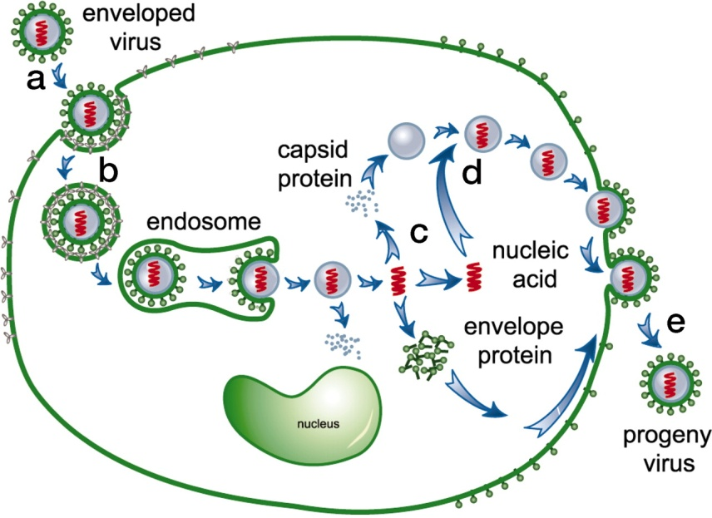
Vīrusu infekcijas
Vīrusi var replicēties tikai dzīvās šūnās
Virionu veido: ģenētiskais materiāls, apvalks (coat), ±ārējais apvalks (envelope)
Vīrusiem var būt RNS vai DNS genoms; ss vai ds RNS/DNS
Dažādi dzīves cikli un citopātiskie efekti (latentas vs lītiskas infekcijas)
Ārstēšana: antibiotikas pret vīrusu infekcijām nedarbojas! Galvenā loma ir imunitātei un vakcīnām. Pret-vīrusu zāles, piem, RT inhibitori

Slide 50
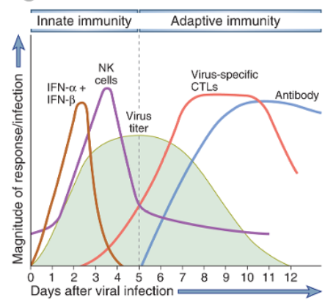
Pret-vīrusu imūnās atbildes kinētika

Slide 51
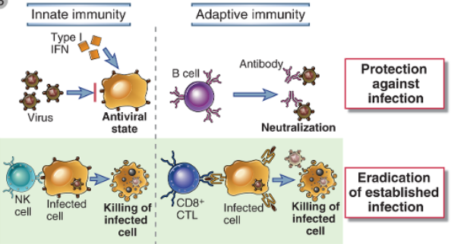
Prevencija vs infekcijas apkarošana
Antivielu galvenā funkcija ir vīrusu neitralizēšana (bloķē vīrusa saistīšanos vai iekļūšanu šūnā), CTL - vīrusa inficēto šūnu iznīcināšanā
Notes:
Mechanisms by which innate and adaptive immunity prevent and eradicate virus infections. Innate immunity is mediated by type I interferons, which prevent infection, and NK cells, which eliminate infected cells. Adaptive immunity is mediated by antibodies and CTLs, which also block infection and kill infected cells, respectively.

Slide 52
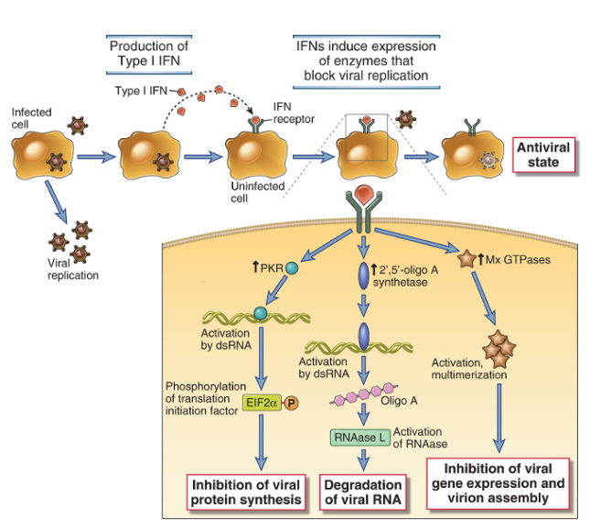
tipa interferonus (IFN-α un β) galvenokārt producē inficētā šūna.
IFN-α un β produkciju inducē intracelulārie TLR, kas detektē PAMPs.
Tie darbojas parakrīni, inducējot tādu gēnu ekspresiju, kas traucē vīrusa replikācijai vai degradē vīrusa RNS
Notes:
The type I interferons are secreted from these cells and act on other cells to prevent spread of viral infection.
Type I interferons (IFN-α, IFN-β) are produced by virus-infected cells in response to intracellular TLR signaling and other sensors of viral RNA. Type I interferons bind to receptors on neighboring uninfected cells and activate JAK-STAT signaling pathways, which induce expression of genes whose products interfere with viral replication. Type I interferons also bind to receptors on infected cells and induce expression of genes whose products enhance the cell’s susceptibility to CTL-mediated killing. PKR, double stranded RNA-activated protein kinase.

Slide 53
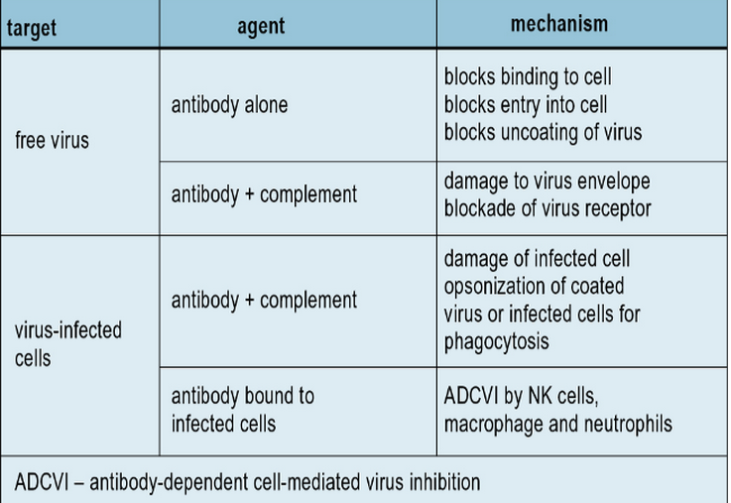
Antivielām galvenā loma ir brīvu vīrusa daļiņu neitralizēšanā, taču tās var arī palīdzēt nogalināt vīrusu inficētas šūnas
Antivielu pret-vīrusu efekti:
Notes:
Defense against free virus particles involves neutralization of infectivity, which can occur in various ways (Fig. 13.4). Such mechanisms are likely to operate in vivo because injection of neutralizing monoclonal antibodies is highly effective at inhibiting virus replication. The presence of circulating virus-neutralizing antibodies is an important factor in the prevention of reinfection. Passively-administered monoclonal antibodies have been used therapeutically to inhibit respiratory syncytial virus and influenza virus infections.
Antibodies are also effective in mediating the destruction of virus-infected cells. This can occur by antibody-mediated activation of the complement system, leading to the assembly of the membrane attack complex and lysis of the infected cell (see Chapter 4). This process requires a high density of viral antigens on the membrane (about 5 × 10⁶/cell) to be effective. In contrast, ADCC mediated by NK cells requires as few as 10³ IgG molecules in order to activate NK cell binding to and lysis of the infected cell.

Slide 54
Latentas infekcijas – līdzsvars starp infekciju un imūno atbildi
Vīrusa genoms saglabājas saimnieka šūnās, bet vīruss nereplicējas vai nenogalina saimnieka šūnu. Piemēram, Epšteina-Barra vīruss vai herpesvīruss
Persistentas infekcijas var saglabāties organismā visa mūža garumā; Vīruss var re-aktivēties jebkurā brīdī.
Dažos gadījumos, patoloģiju izraisa nevis vīrusa replikācija, bet CTL atbilde pret inficētajām šūnām vai “citokīnu vētra”
Piemēram, horiomeningīta vīruss (LCMV) vai hepatīts B izraisa spēcīgu CTL atbildi; hroniska aktīva hepatīta gadījumā aknās ir liels daudzums vīrusa specifisku CTL.
SARS vai H5N1 gripas vīruss var izraisīt citokīnu vētru (cytokine storm), kas noved pie nāvējošas pneimonijas

Slide 55
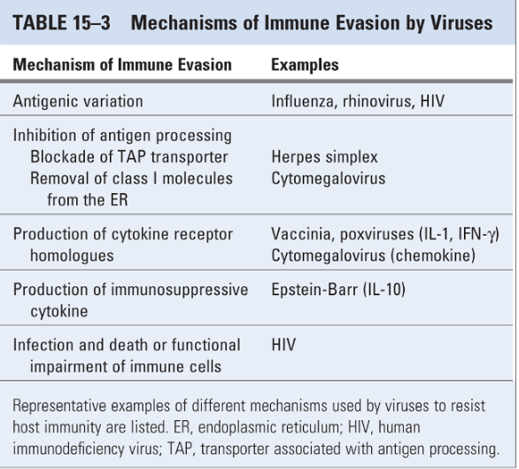
Izvairīšanās no imūnās atbildes
Notes:
Some viruses inhibit class I MHC–associated presentation of cytosolic protein antigens. Viruses make a variety of proteins that block different steps in antigen processing, transport and presentation (Fig. 15-9). Inhibition of antigen presentation blocks the assembly and expression of stable class I MHC molecules and the display of viral peptides. As a result, cells infected by such viruses cannot be recognized or killed by CD8⁺ CTLs. However, it is difficult to prove that the viral genes encoding proteins that inhibit antigen presentation are actually virulence genes, required for the infectivity or pathogenicity of the viruses. NK cells may have evolved as an adaptation to this viral evasion strategy because NK cells are activated by infected cells, especially in the absence of class I MHC molecules. There is emerging evidence that some viruses may produce proteins that act as ligands for NK cell inhibitory receptors and thus inhibit NK cell activation. These are excellent examples of the constant evolutionary struggle between microbes and host immunity.
Some viruses produce molecules that inhibit the immune response.Poxviruses encode molecules that are secreted by infected cells and bind to several cytokines, including IFN-γ, TNF, IL-1, IL-18, and chemokines. The secreted cytokine-binding proteins may function as competitive antagonists of the cytokines. Epstein-Barr virus produces a protein that is homologous to the cytokine IL-10, which inhibits activation of macrophages and dendritic cells and may thus suppress cell-mediated immunity. These examples probably represent a small fraction of immunosuppressive viral molecules. Identification of these molecules raises the intriguing possibility that viruses have acquired genes encoding endogenous inhibitors of immune responses during their passage through human hosts and have thus evolved to infect and colonize humans.
Some chronic viral infections are associated with failure of CTL responses, which allows viral persistence. Studies of a chronic infection with lymphocytic choriomeningitis in mice have shown that this type of immune deficit may result from activation of inhibitory T cell pathways, such as the PD-1 pathway, which normally functions to maintain T cell tolerance to self antigens (see Chapter 14). Reduced T cell responses resulting from HIV infection may also be partly because of PD-1–mediated T cell unresponsiveness. Thus, viruses may have evolved to exploit normal mechanisms of immune regulation and to activate these pathways in T cells. This phenomenon has been called exhaustion, implying that immune responses against the virus are initiated but then shut off prematurely.
Viruses may infect and either kill or inactivate immunocompetent cells. The obvious example is HIV, which survives by infecting and eliminating CD4⁺ T cells, the key inducers of immune responses to protein antigens.

Slide 56
Sēnīšu infekcijas (mikozes)
Dabā ir vairāk kā 70 000 sugu sēņu; tikai dažas ir patogēnas.
Ādas, zemādas, sistēmiskas infekcijas un kandidozes (Candida albicans)
Oportuniskas infekcijas – veseliem cilvēkiem neizraisa patoloģiju, bet cilvēkiem ar dažāda veida imunosupresiju (HIV, transplantācijas, ķīmijterapija, imunosupresīvi medikamenti artrītu ārstēšanai u.c.) izraisa smagas salimšanas. Piemēram, Pneumocystis jiroveci izraisīta pneimonija.
Nav vakcīnu un efektīvu antibiotiku (eikarioti ar līdzīgu proteīnu sintēzes un replikācijas mašinēriju)
Lielākā daļa sēnīšu infekciju izraisa spēcīgu imūno atbildi veseliem cilvēkiem;
Galvenie efektori: neitrofili, makrofāgi, Th17 T šūnas, CTLi.

Slide 57
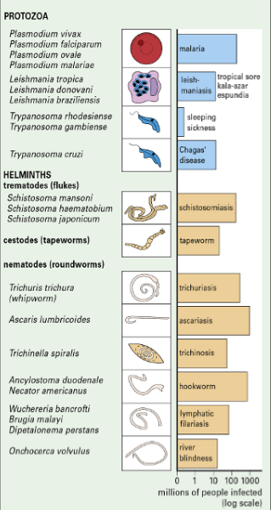
Parazītu infekcijas
Protozoji, parazītiskie tārpi, ektoparazīti (piemēram, ērces).
Skar ~30% pasaules iedzīvotāju (piemēram, ar malāriju ir inficēti ~ 100 miljoni cilvēku)

Slide 58
Parazītu infekcijas
Kompleksi dzīves cikli; stadijas specifiski antigēni.
Vāja nespecifiskā imūnā aizsardzība – daudzi parazīti ir rezistenti pret fagocitozi vai pat dzīvo makrofāgos
Galvenie efektori cīņā pret intracelulāriem parazītiem – CTLs
Galvenie efektori cīņā pret extracelulāriem parazītiem asinīs - antivielas
Galvenā loma aizsardzībā pret cermēm, apaļtārpiem un lenteņiem ir Th2 polarizācijai → IL4, IL-5 → eozinofilu aktivācija, IgE produkcija un tuklo šūnu degranulācija; zarnu peristaltika
Dažādi mehānismi izbēgšanai no imūnās atbildes

Slide 59
Q: Kuram no šiem T šūnu subtipiem ir nozīmīgākā loma aizsardzībā pret ekstracelulārām baktērijām un sēnīšu infekcijām?
Th1
Th2
Th17
CTL
Treg

