Slide 1
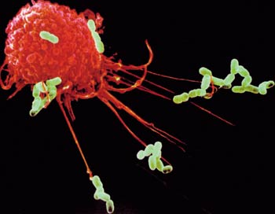
Nespecifiskā
imūnaizsardzība
Dr. Aija Linē, aija@biomed.lu.lv

Slide 2
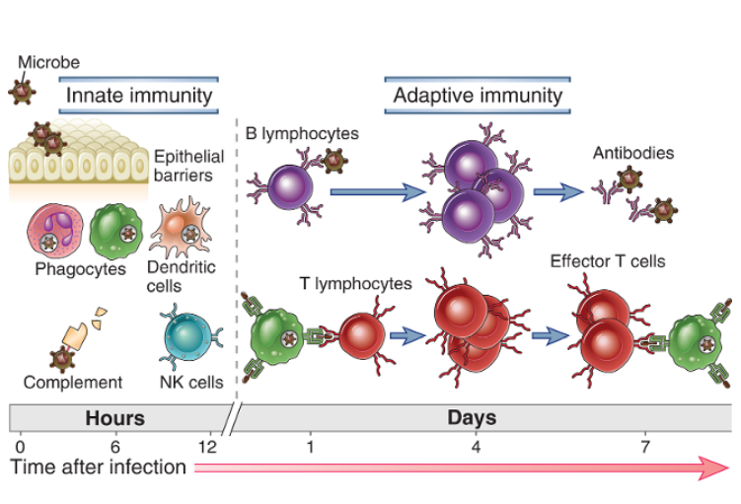
Nespecifiskā un adaptīvā imunitāte
Abbas AK, Cellular and Molecular Immunology, 2012
Notes:
The innate immune system blocks the entry of microbes and eliminates or limits the growth of many microbes that are able to colonize tissues. The main sites of interaction between individuals and their environment—the skin and gastrointestinal and respiratory tracts—are lined by continuous epithelia, which serve as barriers to prevent the entry of microbes from the external environment. If microbes successfully breach the epithelial barriers, they encounter the cells of innate immunity. The cellular innate immune response to microbes consists of two main types of reactions—inflammation and antiviral defense.
In contrast to innate immunity, there are other immune responses that are stimulated by exposure to infectious agents and increase in magnitude and defensive capabilities with each successive exposure to a particular microbe. Because this form of immunity develops as a response to infection and adapts to the infection, it is called adaptive immunity. The defining characteristics of adaptive immunity are exquisite specificity for distinct molecules and an ability to “remember” and respond more vigorously to repeated exposures to the same microbe. The adaptive immune system is able to recognize and react to a large number of microbial and nonmicrobial substances. In addition, it has an extraordinary capacity to distinguish between different, even closely related, microbes and molecules, and for this reason it is also called specific immunity. It is also sometimes called acquired immunity, to emphasize that potent protective responses are “acquired” by experience. The main components of adaptive immunity are cells called lymphocytes and their secreted products, such as antibodies. Foreign substances that induce specific immune responses or are recognized by lymphocytes or antibodies are called antigens.
It consists of cellular and biochemical defense mechanisms that are in place even before infection and are poised to respond rapidly to infections. These mechanisms react to microbes and to the products of injured cells, and they respond in essentially the same way to repeated infections. The principal components of innate immunity are (1) physical and chemical barriers, such as epithelia and antimicrobial chemicals produced at epithelial surfaces; (2) phagocytic cells (neutrophils, macrophages), dendritic cells, and natural killer (NK) cells; (3) blood proteins, including members of the complement system and other mediators of inflammation; and (4) proteins called cytokines that regulate and coordinate many of the activities of the cells of innate immunity. The mechanisms of innate immunity are specific for structures that are common to groups of related microbes and may not distinguish fine differences between microbes.

Slide 3
Nespecifiskās imunitātes galvenās funkcijas:
Kavēt mikroorganismu iekļūšanu organismā un nodrošināt ātru organisma reakciju, kavējot to izplatīšanos organismā un (iespēju robežās) iznīcinot mikroorganismus
Savākt bojātās vai mirušās šūnas un iniciēt brūču dzīšanu un audu reparāciju
Stimulēt un regulēt adaptīvo imūno reakciju.
Galvenās nespecifiskās imūnās atbildes reakcijas: iekaisums un pret-vīrusu reakcija (IFNi un vīrusu inficēto šūnu nogalināšana)
Notes:
The two major types of responses of the innate immune system that protect against microbes are inflammation and antiviral defense. Inflammation is the process by which leukocytes and circulating plasma proteins are brought into sites of infection and activated to destroy and eliminate the offending agents. Inflammation is also the major reaction to damaged or dead cells and to accumulations of abnormal substances in cells and tissues. Antiviral defense consists of changes in cells that prevent virus replication and increase susceptibility to killing by lymphocytes, thus eliminating reservoirs of viral infection. In addition to these reactions, innate immune mechanisms include physical and chemical defense at epithelial barriers and activation of several circulating cells and proteins that can eliminate microbes in the blood independent of inflammation. Antiviral defense consists of a cytokine-mediated reaction in which cells acquire resistance to viral infection and killing of virus-infected cells by NK cells.

Slide 4
Nespecifiskās imūnaizsardzības komponenti:
Epiteliālās barjeras
Imūnšūnas:
  Tuklās šūnas
  Neitrofili
  Makrofāgi
  Dendrītiskās šūnas
  NK šūnas
Šķīstošie mediatori:
  Naturālās antivielas
  Komplements
  Pentraksīni (CRP, SAP)
  Kollektīni un fikolīni

Slide 5
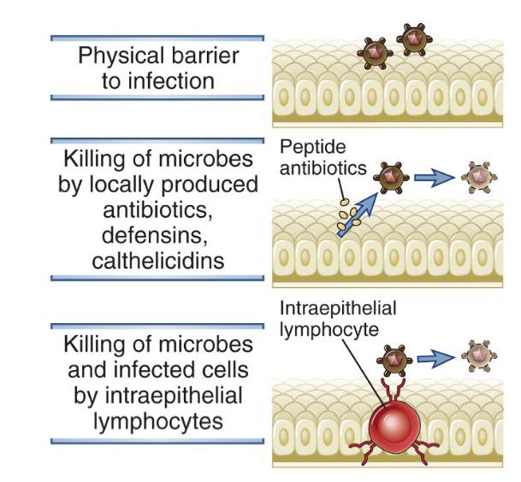
Epiteliālās barjeras
Antimikrobiālie peptīdi
Defensīni: 29-34aa gari, Cys-bagāti peptīdi, ko producē epiteliālās šūnas ādā, plaušās un gremošanas trakta gļotādā; toksiski mikroorganismiem un stimulē iekaisuma reakciju.
Katelicidīni: peptīdi, ko producē neitrofili, makrofāgi un epitēlija šūnas. Toksiski mikroorganismiem, aktivē leikocītus.
Notes:
Epithelia at the portals of entry of microbes provide physical barriers, produce antimicrobial substances, and harbor intraepithelial lymphocytes that are believed to kill microbes and infected cells.

Slide 6
Kā nespecifiskā imūnsistēmas šūnas pazīst mikroorganismus un bojātas šūnas?

Slide 7
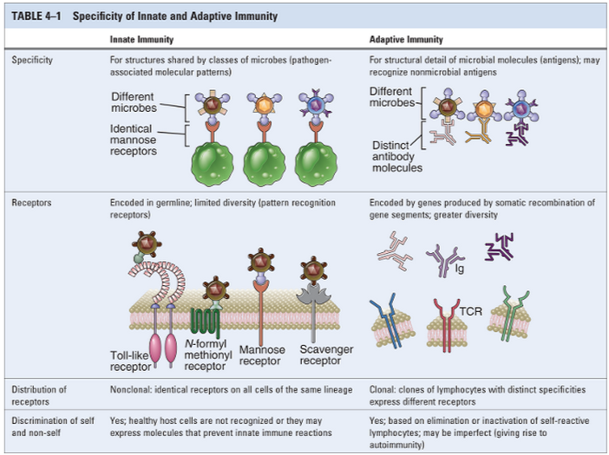

Slide 8
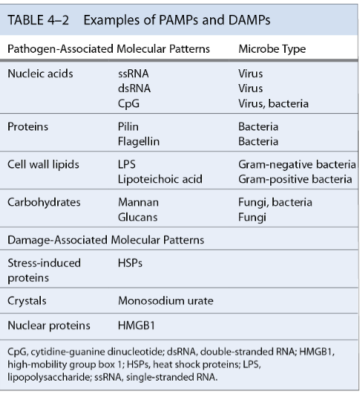
Patogēnu asociētie molekulārie paterni (PAMPs) un bojājumu asociētie molekulārie paterni (DAMPs)
PAMPs - baktērijām un vīrusiem tipiskas molekulāras struktūras; to skaits ir ierobežots, tomēr bieži tās ir mikroorganismu izdzīvošanai svarīgas molekulas (dsRNS, LPS)
DAMPi veidojas no bojātām vai mirušām šūnām (infekcijas, toksīni, traumas, apdegumi), bet ne apoptotiskām šūnām
Notes:
The innate immune system recognizes molecular structures that are characteristic of microbial pathogens but not mammalian cells. The microbial substances that stimulate innate immunity are called pathogen-associated molecular patterns (PAMPs). Different classes of microbes (e.g., viruses, gram-negative bacteria, gram-positive bacteria, fungi) express different PAMPs. These structures include nucleic acids that are unique to microbes, such as double-stranded RNA found in replicating viruses and unmethylated CpG DNA sequences found in bacteria; features of proteins that are found in microbes, such as initiation by N-formylmethionine, which is typical of bacterial proteins; and complex lipids and carbohydrates that are synthesized by microbes but not by mammalian cells, such as lipopolysaccharide (LPS) in gram-negative bacteria, lipoteichoic acid in gram-positive bacteria, and mannose-rich oligosaccharides found in microbial but not in mammalian glycoproteins (Table 4-2). In actuality, there are only a limited number of fundamental differences between microbial molecules and the molecules that higher organisms produce. Thus, the innate immune system has evolved to recognize only a limited number of molecules, most of which are unique to microbes, whereas the adaptive immune system is capable of recognizing a much wider array of foreign substances whether or not they are products of microbes.
The innate immune system recognizes microbial products that are often essential for survival of the microbes. This feature of innate immune recognition is important because it ensures that the targets of innate immunity cannot be discarded by microbes in an effort to evade recognition by the host. An example of a target of innate immunity that is essential for microbes is double-stranded viral RNA, which plays a critical role in the replication of certain viruses. Similarly, LPS and lipoteichoic acid are structural components of bacterial cell walls that are recognized by innate immune receptors; both are required for bacterial survival and cannot be discarded. In contrast, as we shall see in Chapter 15, microbes may mutate or lose many of the antigens that are recognized by the adaptive immune system, thereby enabling the microbes to evade host defense without compromising their own survival.
The innate immune system also recognizes endogenous molecules that are produced by or released from damaged and dying cells. These substances are called damage-associated molecular patterns (DAMPs) (see Table 4-2). DAMPs may be produced as a result of cell damage caused by infections, but they may also indicate sterile injury to cells caused by any of myriad reasons, such as chemical toxins, burns, trauma, or decreased blood supply. DAMPs are generally not released from cells dying by apoptosis. In some cases, healthy cells of the immune system are stimulated to produce and release DAMPs, which enhances an innate immune response to infections.

Slide 9
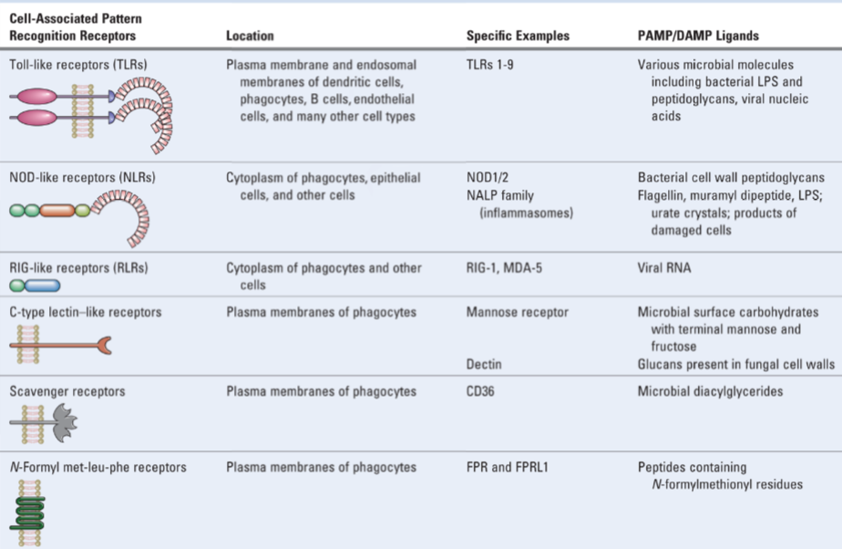
PAMP/DAMP receptori uz nespecifiskās imūnsistēmas šūnām

Slide 10
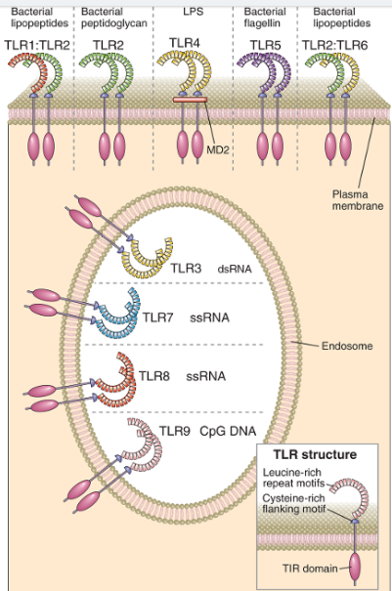
Toll-like receptori (TLRs)
Cilvēkam – 9 dažādi TLRs
Šūnu tipi: DCs, makrofāgi, neitrofili, B šūnas, endotēlija šūnas u.c.
Membrānā integrēti glikoproteīni (gan plazmas membrānā, gan ER un endosomu membrānās)
Ligandi: LPS, baktēriju šūnu sienas komponenti (piem, flagelīns), dsRNS, ssRNS
Ligands saistās pie ekstracelulārā domēna, ko veido leicīna bagāti atkārtojumi un cisteīna-bagāts motīvs.
Citoplazmatiskajā daļā – TIR domēns (līdzīgi kā IL receptoriem)

Slide 11
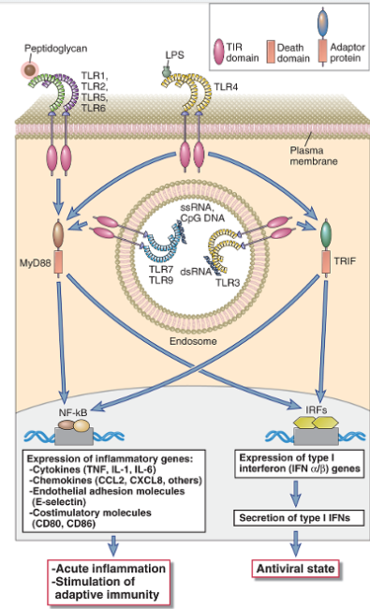
Toll-like receptoru aktivācija izraisa
NF-κB un/vai IRF signālceļu aktivāciju.
NF-κB aktivē virkni gēnu, kas stimulē akūtu iekaisumu;
IRFs - I tipa IFN produkciju, kas iniciē pret-vīrusu atbildi (vīrusu RNS degradāciju, proteīnu sintēzes inhibīciju, virionu savākšanos u.c.)
Notes:
TLRs 1, 2, 5, and 6 use the adaptor protein MyD88 and activate the transcription factors NF-κB and AP-1. TLR3 uses the adaptor protein TRIF and activates the IRF3 and IRF7 transcription factors. TLR4 can activate both pathways. TLRs 7 and 9 in the endosome use MyD88 and activate both NF-κB and IRF7 (not shown).

Slide 12
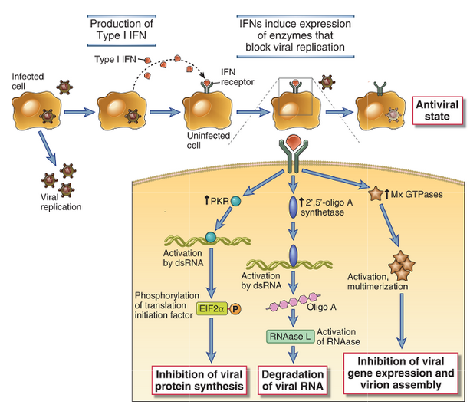
I tipa interferonu bioloģiskā darbība
Notes:
Type I interferons (IFN-α, IFN-β) are produced by virus-infected cells in response to intracellular TLR signaling and other sensors of viral RNA. Type I interferons bind to receptors on neighboring uninfected cells and activate JAK-STAT signaling pathways, which induce expression of genes whose products interfere with viral replication. Type I interferons also bind to receptors on infected cells and induce expression of genes whose products enhance the cell’s susceptibility to CTL-mediated killing. PKR, double stranded RNA-activated protein kinase.

Slide 13
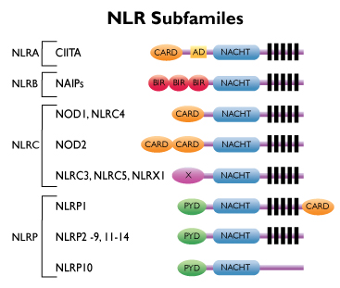
NOD-like receptori (NLRs) – citoplazmatiski PAMP/DAMP receptori
~20 dažādi receptori
Ekspresēti epitēlija šūnās, fagocītos
Detektē infekciju vai stresu, saistoties ar citoplazmatiskiem PAMP vai DAMP
Ligands saistās pie leicīna atkārtojumiem bagāta domēna (līdzīgi TLRs)
NACHT – oligomerizācijas domēns; atšķiras N gala efektorie domēni, kas nosaka, kādi signāli šūnā tiks aktivēti
NLR aktivācija var izraisīt iekaisuma reakciju, autofāgiju vai šūnas nāvi
Mutācijas NLR gēnos saistītas ar dažādām iekaisuma un autoimūnām slimībām (Krona slimību, hronisku zarnu iekaisumu u.c.)
Notes:
NOD-like receptors (NLRs) are a family of more than 20 different cytosolic proteins, some of which sense cytoplasmic PAMPs and DAMPs and recruit other proteins to form signaling complexes that promote inflammation. This family of proteins is named after NOD (nucleotide oligomerization domain–containing protein). Typical NLR proteins contain at least three different domains with distinct structures and functions. These include a leucine-rich repeat domain that senses the presence of ligand, similar to the leucine-rich repeats of TLRs; a NACHT (neuronal apoptosis inhibitory protein [NAIP], CIITA, HET-E, and TP1) domain, which allows NLRs to bind to one another and form oligomers; and an effector domain, which recruits other proteins to form signaling complexes. There are three NLR subfamilies, the members of which use different effector domains to initiate signaling, called CARD, Pyrin, and BIR domains. NLRs are found in a wide variety of cell types, although some NLRs have restricted tissue distributions. Some of the best studied NLRs are found in immune and inflammatory and epithelial barrier cells.
NOD1 and NOD2, members of the CARD domain–containing NOD subfamily of NLRs, are expressed in the cytoplasm of several cell types including mucosal epithelial cells and phagocytes, and they respond to bacterial cell wall peptidoglycans. NOD2 is particularly highly expressed in intestinal Paneth cells, where it stimulates expression of antimicrobial substances called defensins in response to pathogens. NOD1 recognizes substances derived mainly from gram-negative bacteria, whereas NOD2 recognizes a distinct molecule called muramyl dipeptide from both gram-negative and gram-positive organisms. These peptides are released from intracellular or extracellular bacteria; in the latter case, their presence in the cytoplasm requires specialized mechanisms of delivery of the peptides into host cells. These mechanisms include type III and type IV secretion systems, which have evolved in pathogenic bacteria as a means of delivering toxins into host cells. When oligomers of NODs recognize their peptide ligands, including bacterial toxins, a conformational change occurs that allows the CARD effector domains of the NOD proteins to recruit multiple copies of the kinase RIP2, forming a signaling complex that has been called the NOD signalosome. The RIP2 kinases in these complexes activate NF-κB, which promotes inflammatory gene expression, similar to TLRs that signal through MyD88, discussed earlier. Both NOD1 and NOD2 appear to be important in innate immune responses to bacterial pathogens in the gastrointestinal tract, such as Helicobacter pylori and Listeria monocytogenes. There is great interest in the finding that certain NOD2 polymorphisms increase the risk for an inflammatory disease of the bowel called Crohn’s disease, probably because of a defective innate response to commensal and pathogenic organisms in the intestine. Also, mutations of NOD2 that cause increased NOD signaling lead to a systemic inflammatory disease called Blau’s syndrome.

Slide 14
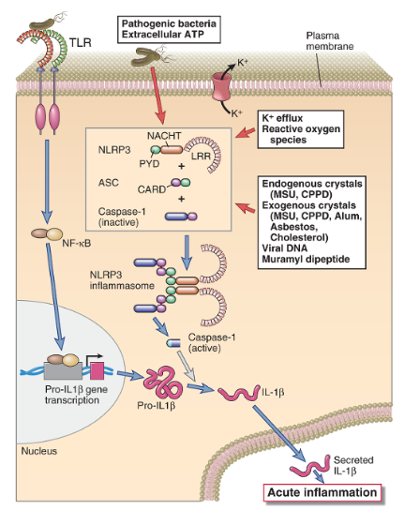
NLRPs - NOD-like receptori, kas satur PYD domēnu veido inflamasomas
Ja NLRPs citoplazmā detektē infekciju, kristālus, vīrusu DNS u.c., tie oligomerizējas (izveido infamasomu) un aktivē kaspāzi 1, kas šķeļ IL1β prekursoru un atbrīvo aktīvu IL1β.
Ja inflamasomu aktivitāte ir pastiprināti stimulēta, IL-1 var izraisīt audu bojājumu. NLRP3 gēna aktivējošas mutācijas ir saistītas ar autoinflamatoriem sindromiem.
Notes:
The activation of the NLRP3 inflammasome, which processes pro–IL-1β to active IL-1, is shown. Inflammasomes with other NLRP proteins function in a similar way. Pro–IL-1β expression is induced by various PAMPs or DAMPs through pattern recognition receptor signaling, such as a TLR, as shown. CPPD, calcium pyrophosphate dihydrate; MSU, monosodium urate.

Slide 15
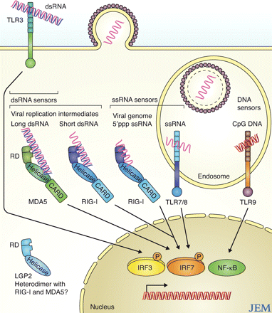
RIG-like receptori (RLRs) – galvenie citoplazmatiskie vīrusu RNS sensori
Citoplazmatiskas helikāzes, kas saistās ar dsRNS, ssRNS
Savu no vīrusa RNS atšķir pēc 5’ gala struktūras: pazīst 5’ trifosfātu, kāds nav procesētām šūnas RNS
RIG aktivācija iniciē pie vairāku transkripcijas faktoru aktivāciju: IRF3 un IRF7 – palaiž I tipa INF produkciju
NFkB – iekaisuma reakciju
Saito T , and Gale M J Exp Med 2008;205:1523-1527
Notes:
Nucleic acid sensor molecules induce type I IFN and proinflammatory cytokines. PRRs occupy specific intracellular sites that associate with the niche of different microbial pathogens. MDA5 and RIG-I both serve as cytoplasmic dsRNA receptors but distinguish their ligands in part by size; MDA5 binds to long dsRNA, whereas RIG-I binds short dsRNA. Among the TLRs, TLR3 recognizes dsRNA, TLR7/8 recognizes endosomal ssRNA, and TLR9 binds to endosomal CpG DNA. PRR activation initiates downstream signaling that in turn activates transcription factors, including IRF-3, IRF-7, and NF-κB. The resulting expression of type I IFNs, proinflammatory cytokines, and IFN-stimulated genes affect the innate immune response to confer pathogen resistance and enhance the adaptive immune response to infection.

Slide 16
Ogļhidrātu receptori – C-tipa lektīni
C-tipa: Ca 2+ atkarīgi; saista m.o. ogļhidrātus Ca2+ atkarīgā veidā
Lielākā daļa – membrānā integrēti receptori (daži var būt šķīstoši)
Šūnu tipi: makrofāgi, dendrītiskās šūnas
Ligandi: ogļhidrātu struktūras, kas raksturīgas baktēriju šūnu sienām, bet ne zīdītāju šūnām
Piemēri:
Mannozes receptori – saistās pie D-mannozes, L-fucozes, N-acetil-D-glikozamīna. Galvenā funkcija – aktivēt fagocitozi!
Dektīni (dectins, dendrītisko šūnu asociēti C-tipa lektīni) – saistās ar β glikāniem, kas ir viena no galvenajām sēnīšu (piem, Candida albicans) virsmas struktūrām. Receptoru aktivācija inducē DC citokīnu produkciju, kas nepieciešami Th17 šūnu diferenciācijai.

Slide 17
Scavenger receptori:
Ligandi – oksidēti lipoproteīni
Šūnas – makrofāgi
Efekts – veicina fagocitozi, darbojas kā TLRs ko-receptori
N-Formil Met-Leu-Phe receptori:
Ar G-proteīnu saistītie receptori
Ligandi – baktēriju peptīdi, kas satur N-formilmetionīnu
Šūnas – makrofāgi, neitrofili
Efekts – hemoattraktanti; veicina šūnu migrāciju
Notes:
Scavenger Receptors
Scavenger receptors comprise a structurally and functionally diverse collection of cell surface proteins that were originally grouped on the basis of the common characteristic of mediating the uptake of oxidized lipoproteins into cells. Some of these scavenger receptors, including SR-A and CD36, are expressed on macrophages and mediate the phagocytosis of microorganisms. In addition, CD36 functions as a coreceptor in TLR2/6 recognition and response to bacterially derived lipoteichoic acid and diacylated lipopeptides. There is a wide range of molecular structures that bind to each scavenger receptor, including LPS, lipoteichoic acid, nucleic acids, β-glucan, and proteins. The significance of scavenger receptors in innate immunity is highlighted by increased susceptibility to infection in gene knockout mice lacking the receptors and by the observations that several microbial pathogens express virulence factors that block scavenger receptor–mediated recognition and phagocytosis.
N-Formyl Met-Leu-Phe Receptors
N-Formyl met-leu-phe receptors, including FPR and FPRL1 expressed by neutrophils and macrophages, respectively, recognize bacterial peptides containing N-formylmethionyl residues and stimulate directed movement of the cells. Because all bacterial proteins and few mammalian proteins (only those synthesized within mitochondria) are initiated by N-formylmethionine, FPR and FPRL1 allow phagocytes to detect and respond preferentially to bacterial proteins. The bacterial peptide ligands that bind these receptors are some of the first identified and most potent chemoattractants for leukocytes. Chemoattractants include several types of diffusible molecules, often produced at sites of infection, that bind to specific receptors on cells and direct their movement toward the source of the chemoattractant. Other chemoattractants, such as the chemokines discussed in Chapter 3, are made by host cells. FPR and FPRL1, along with all other chemoattractant receptors, belong to the seven-transmembrane, guanosine triphosphate (GTP)–binding (G) protein–coupled receptor (GPCR) superfamily. These receptors initiate intracellular responses through associated trimeric G proteins (see Chapter 7). The G proteins stimulate many types of cellularresponses, including cytoskeletal changes, resulting in increased cell motility.

Slide 18
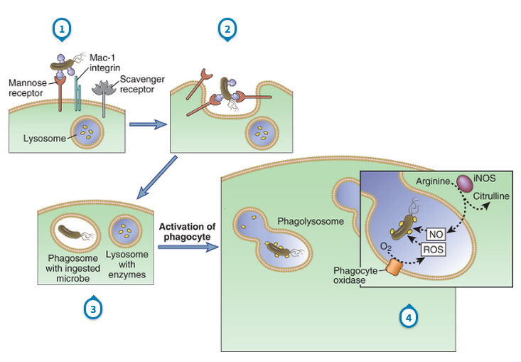
Fagocitozes process
Fagocitoze: aktīvs, enerģijas atkarīgs process; līdzīgs neitrofilos un makrofāgos. Galvenie līdzekļi baktēriju nogalināšanai – proteolītiskie enzīmi, aktīvie skābekļa savienojumi (ROS) un NO.
Notes:
Microbes may be ingested by different membrane receptors of phagocytes; some directly bind microbes, and others bind opsonized microbes. (Note that the Mac-1 integrin binds microbes opsonized with complement proteins, not shown.) The microbes are internalized into phagosomes, which fuse with lysosomes to form phagolysosomes, where the microbes are killed by reactive oxygen and nitrogen species and proteolytic enzymes. iNOS, inducible nitric oxide synthase; NO, nitric oxide; ROS, reactive oxygen species.
Key Concepts related to phagocytosis:
Opsonization: soluble immune recognition elements tag a particle for phagocytosis (opsonins include: IgG, C3b, Mannose-binding lectin, etc.)
Interferon-γ from NK cell or Th1 cell promotes killing of internalized microbes by monocytes/macrophages
Killing mechanisms: ROI, NO, proteases, anti-microbial peptides

Slide 19
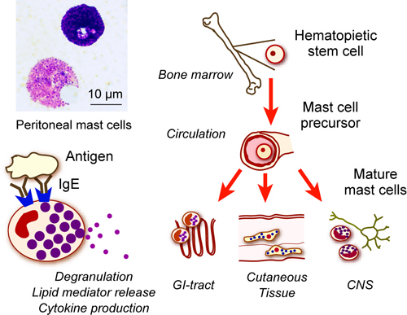
Tuklās šūnas (mast cells)
Tuklās šūnas veidojas kaulu smadzenēs, tad migrē uz perifērajiem audiem un rezidē ādā un gļotādās. Satur citoplazmatiskas granulas ar histamīnu un proteolītiskiem enzīmiem (izsauc vazodilatāciju un paaugstina kapilāru caurlaidību), ko var sekretēt momentā. Pēc aktivācijas producē prostaglandīnus un dažādus IL, TNFα un hemokīnus.
Satoshi Tanaka, Okayama Univ.

Slide 20
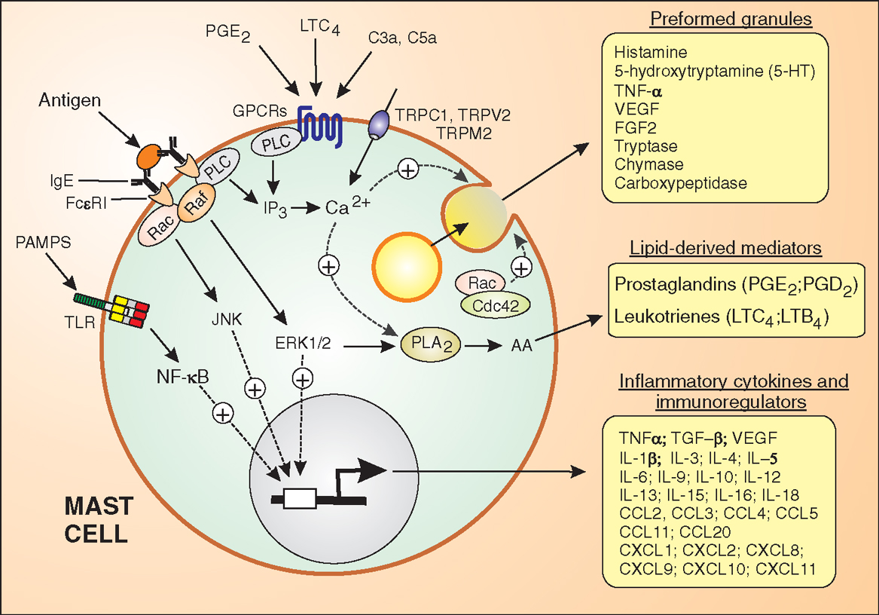
Tuklo šūnu aktivācijas signāli:
PAMPS
Komplements: C3a, C5a
Prostaglandīni
Ar IgE saistīts antigēns
Efekti:
Degranulācija – iniciē iekaisuma procesu
Fosfolipīdu metabolisms – PGE produkcija
Kodols – gēnu ekspresija stimulēšana (ILs, TNF, CCLs)

Slide 21
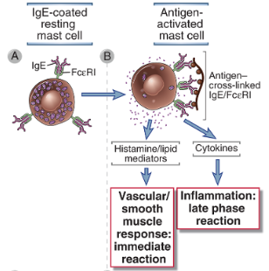
Tuklās šūnas - alerģisko reakciju efektori
Alerģiskiem cilvēkiem veidojas IgE klases antivielas pret vidē esošiem alrgēniem (visbiežāk, vidē esoši proteīni, ķīmiski modificēti proteīni)
Uz tuklajām šūnām ir FcεRI pie kā saistās IgE
Alerģiskam cilvēkam tuklās šūnas ir pārklātas ar IgE, pret vienu konkrētu antigēnu (alergēnu)
Attiecīgais antigēns izraisa FcεRI receptoru klāsterēšanos un tuklo šūnu aktivāciju
Aktivācija noved pie degranulācijas un pro-inflamatoro citokīnu produkcijas: vazodilatācija, kapilāru caurlaidības palielināšanās, iekaisums, bronhu spazmas, audu bojājums

Slide 22
Neitrofili
Neitrofili: sastāda 40-75% no baltajām asins šūnām, cirkulē asinsritē un audu infekcijas/traumas vietā ierodas pirmajās minūtēs – aktivējas izkļūstot audos un uzsāk fagocitēt; fagocitozei nav nepieciešami specifiski aktivācijas signāli; var izraisīt arī normālo audu bojājumus
Morfoloģija: sfēriskas, 12-15µm lielas šūnas, segmentēts kodols (tādēļ nosaukums: polimorfonukleārie leikocīti), citoplazmā granulas, kas nekrāsojas ar H&E. Granulas satur lizozīmu, kollagenāzi, elastāzi; lizosomas satur arī defensīnus un katelicidīnus, laktoferrīnu.
Cilvēka organismā tiek producēti ~1X10¹¹ neitrofili dienā; Ja ~5 dienu laikā netiek rekrutēti iekaisuma vietā, iet bojā apoptozes ceļā. Audos funkcionē dažas stundas un iet bojā.
Zems neitrofilu skaits – neitropēnija; var būt iedzimta vai attīstīties dzīves laikā; biežs ķīmijterapijas blakusefekts; cilvēks kļūst ļoti uzņēmīgs pret infekcijām.
Notes:
Natural anti-microbial expression in the human neutrophil. Neutrophils contain two types of granules that contain natural anti-microbials. The azurophil granules contain α-defensins while specific granules contain lactoferrin and the cathelicidin, hCAP-18. Lysozyme is present in both granule types.

Slide 23
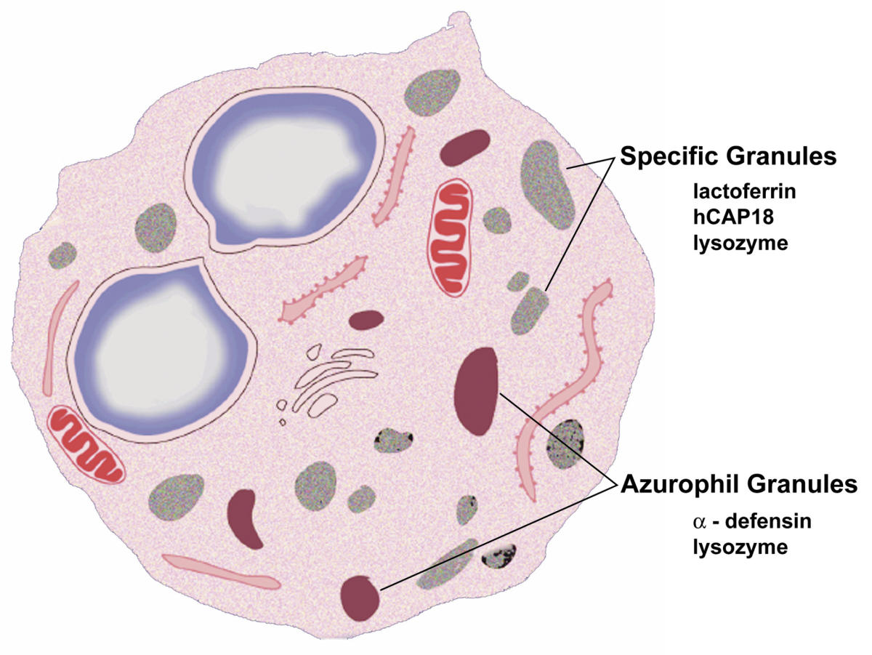
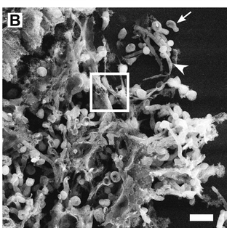
Neitrofilu darbības mehānismi:
Fagocitoze
Degranulācija
  primārajās (azurofilajās) granulās: anti-mikrobiālie peptīdi defensīni, elastāze, lizocīms u.c.
  Specifiskajās granulās: kollagenāze, katelicidīns, laktoferīns u.c.
Neitrofilu ekstracelulārie tīkli:
DNS tīkls ar serīna proteāzēm, kas sasaista/ierobežo pārvietošanos un nogalina mikroorganismus; veidojas pret lieliem, ekstracelulāriem patogēniem, piem. Candida albicans hifām.
Notes:
Natural anti-microbial expression in the human neutrophil. Neutrophils contain two types of granules that contain natural anti-microbials. The azurophil granules contain α-defensins while specific granules contain lactoferrin and the cathelicidin, hCAP-18. Lysozyme is present in both granule types.

Slide 24
Makrofāgi
Asinīs cirkulējošās šūnas – monocīti; cirkulē asinīs ~24h, iziet no cirkulācijas un infiltrējas audos – kļūst par makrofāgiem.
Galvenās funkcijas: fagocitē mikroorganismus; savāc mirušo šūnu atliekas; producē citokīnus un regulē iekaisuma procesu un adaptīvo imūno atbildi; darbojas kā APC audos (atšķirībā no DC, neceļo uz limfmezgliem, toties var re-stimulēt T šūnas audos); stimulē angioģenēzi.
Atšķirībā no neitrofiliem, audu makrofāgiem var būt dažādi aktivācijas stāvokļi:
Neaktivēts (resting) – fagocitē šūnu atlikumus; zema MHCII ekspresija; šādā stāvoklī var dzīvot vairākus mēnešus
Aktivēts – piemēram, ar IFN-γ. Paaugstina MHCII ekspresiju, var kalpot kā APC, vidēji augsta fagocitozes aktivitāte
Hiperaktivēts – piemēram, ar LPS vai mannozi. Ļoti augsta fagocitozes aktivitāte, producē TNF un IL12.
Notes:
Macrophages are activated by microbial products such as LPS and by NK cell–derived IFN-γ (described earlier in the chapter). The process of macrophage activation leads to the activation of transcription factors, the transcription of various genes, and the synthesis of proteins that mediate the functions of these cells. In adaptive cell-mediated immunity, macrophages are activated by stimuli from T lymphocytes (CD40 ligand and IFN-γ) and respond in essentially the same way

Slide 25
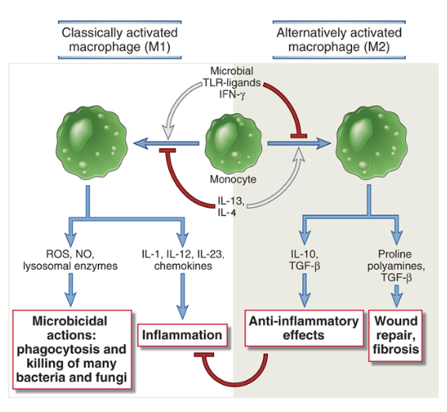
Makrofāgu polarizācija (M1 vs M2)
Notes:
Subsets of activated macrophages. Different stimuli activate monocytes-macrophages to develop into functionally distinct populations. Classically activated macrophages are induced by microbial products and cytokines, particularly IFN-γ, and are microbicidal and involved in potentially harmful inflammation. Alternatively activated macrophages are induced by IL-4 and IL-13 produced by T_{H}2 cells and other leukocytes and are important in tissue repair and fibrosis.

Slide 26
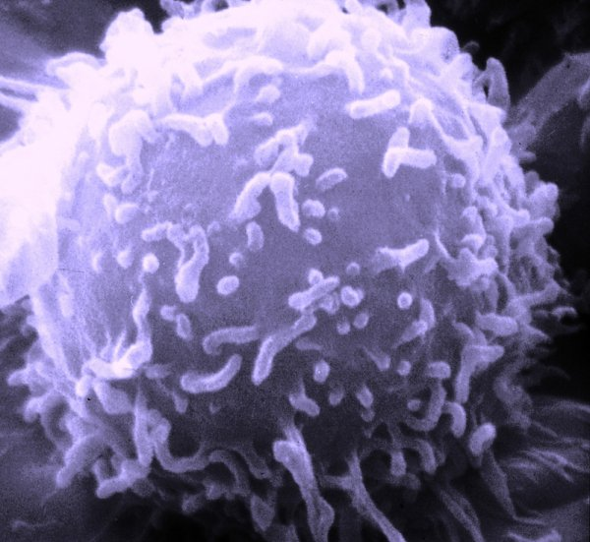
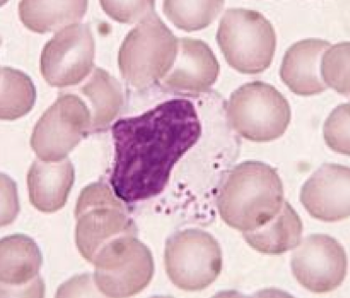
NK (Natural Killer) šūnas
Pēc izcelsmes – limfocīti (sastāda ~15% no limfocītiem), taču nav antigēnu-specifisku receptoru, būtisks nespecifiskās imūnās atbildes komponents. Veidojas kaulu smadzenēs, morfoloģiski – lieli granulāri limfocīti. Virsmas marķieri – CD16 un CD56.
Galvenās funkcijas: vīrusu inficētu šūnu un vēža šūnu iznīcināšana.

Slide 27
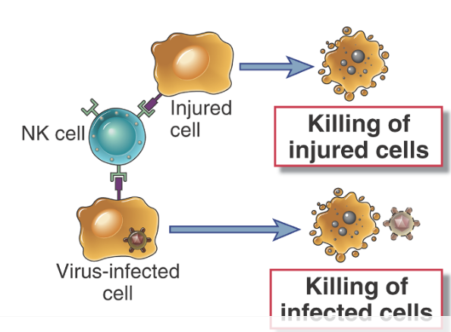
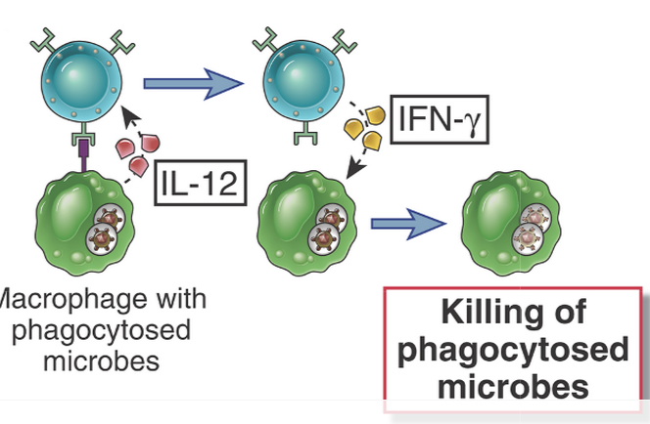
NK šūnu efektorās funkcijas
(I) Nogalina bojātās vai vīrusu inficētās šūnas, izmantojot perforīnu un granzīmu
(II) Producē IFN-γ, kas stimulē fagocitozi makrofāgos

Slide 28
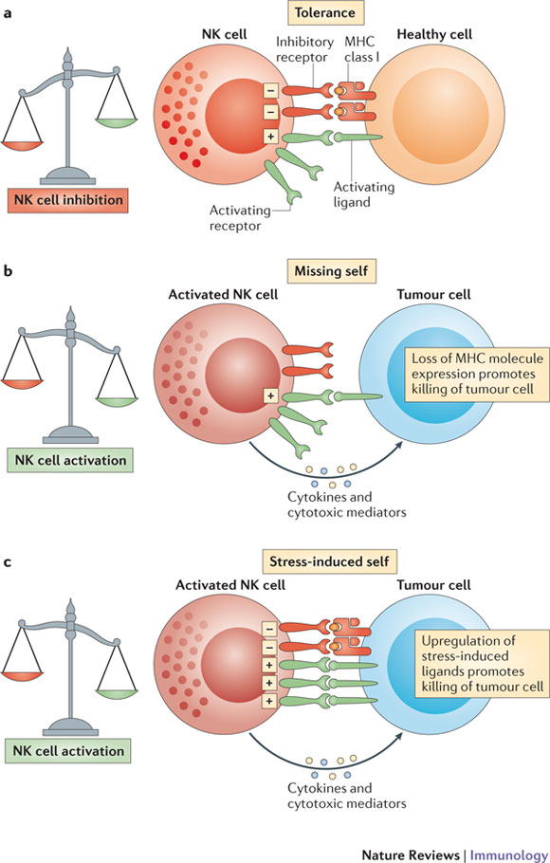
NK šūnu aktivācijas signāli
Aktivāciju nosaka signāli no aktivējošiem un inhibējošiem receptoriem
Aktivējošie receptori saista ligandus uz inficētām vai bojātām šūnām
Inhibējošie receptori saistās pie normālām šūnām (MHCI)
Notes:
Natural killer (NK) cells are tolerant to healthy host cells, as the strength of the activating signals they receive on encountering these cells is dampened by the engagement of inhibitory receptors (tolerance). b | Tumour cells may lose expression of MHC class I molecules. NK cells become activated in response to these cells, as they are no longer held in check by the inhibitory signal delivered by MHC class I molecule engagement. This is known as 'missing-self' triggering of NK cell activation. c | In addition, NK cells are selectively activated by 'stressed' cells, which upregulate activating ligands for NK cells and thereby overcome the inhibitory signalling delivered by MHC class I molecules. This is known as 'stress-induced self' triggering of NK cell activation. In both conditions, NK cell activation leads to tumour elimination directly (through NK cell-mediated cytotoxicity) or indirectly (through the production of pro-inflammatory cytokines, such as interferon-γ).

Slide 29
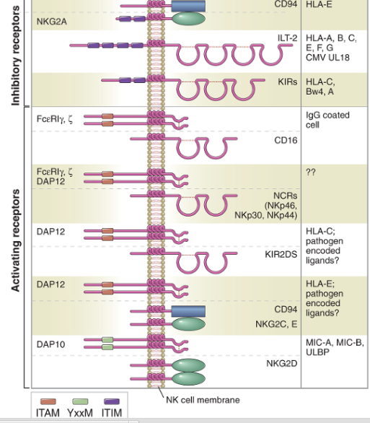
NK šūnu aktivējošie un inhibējošie receptori
Aktivējošie receptori pazīst heterogēnu ligandu grupu – dažādas molekulas, kas šūnā veidojas stresa, infekcijas vai onkogēnas transformācijas rezultātā. Piemēram, MICA/B – MHCI līdzīgi proteīni, kas ir ekspresēti uz vīrusu inficētām un vēža šūnām
Inhibitoro receptoru (KIR) aktivācija izraisa fosfatāžu aktivāciju, kas savukārt inhibē aktivējošo receptoru signālus
Notes:
NK cell activation is mediated by a variety of cell surface inhibitory and activating receptors that recognize cell surface ligands on target cells. Viral infection, oncogenic transformation, and cellular stressors result in the downregulation in ligands for NK inhibitory receptors while concomitantly increasing the expression of NK activating ligands. Despite the presence of both activating and inhibitory signals on target cells, the overall balance of these signals dictates NK activation and target cell clearance.
Inhibitory receptors of NK cells share the common feature of a structural motif in their cytoplasmic tails, called an immunoreceptor tyrosine-based inhibition motif (ITIM), which engages molecules that block the signaling pathways of activating receptors (see Figs. 4-6 and 4-7). ITIMs contain tyrosine residues that are phosphorylated on ligand binding to the inhibitory receptor. This leads to the recruitment and activation of phosphatases, which remove phosphates from several signaling proteins or lipids generated by the signaling pathways downstream of NK activating receptors. The end result is blocking of the signaling functions of activating receptors. ITIMs are found in cytoplasmic tails of other receptors besides NK inhibitory receptors, and their structure and signaling functions are discussed in more detail in Chapter 7.
The largest group of NK inhibitory receptors are the killer cell immunoglobulin-like receptors (KIRs), which are members of the immunoglobulin (Ig) superfamily. Members of this family all contain a structural domain called an Ig fold, first identified in antibody (also known as Ig) molecules, discussed in Chapter 5. KIRs bind a variety of class I MHC molecules. A second important group of NK inhibitory receptors belong to the C-type lectin family, which includes proteins with carbohydrate-binding properties, as discussed earlier. One of these receptors is a heterodimer called CD94/NKG2A, which recognizes a class I MHC molecule called HLA-E. Interestingly, HLA-E displays peptides derived from other class I MHC molecules, so in essence, CD94/NKG2A is a surveillance receptor for several different class I MHC molecules. A third family of NK inhibitory receptors, called the leukocyte Ig-like receptors (LIRs), are also Ig superfamily members that bind class I MHC molecules, albeit with lower affinity than the KIRs, and are more highly expressed on B cells than on NK cells.
Activating receptors on NK cells recognize a heterogeneous group of ligands, some of which may be expressed on normal cells and others of which are expressed mainly on cells that have undergone stress, are infected with microbes, or are transformed. The molecular features of the ligands for many of these receptors are not well characterized. The induced expression of ligands on unhealthy cells that bind to activating receptors on NK cells may lead to signals that overwhelm the signals from inhibitory receptors, especially if class I MHC is also reduced or lost on the unhealthy cell

Slide 30
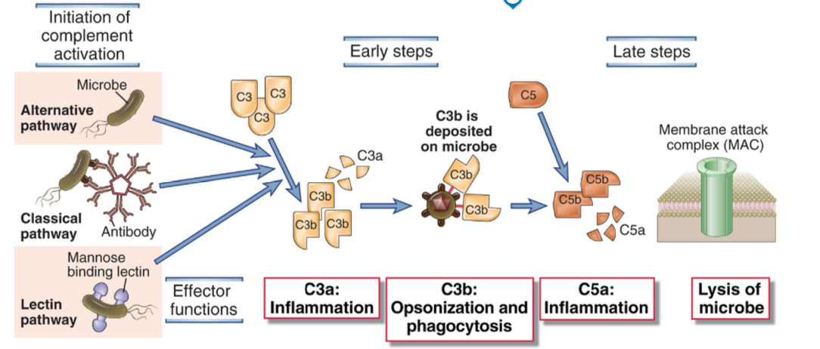
Komplementa sistēma
~20 plazmā esošu proteīnu sistēma; saistās pie mikroorganismu virsmas
Efekti: mikroorganismu opsonizēšna, fagocītu hemotakse, bakteriolīze
Sistēmas aktivācija notiek proteolītiskas kaskādes ceļā
Notes:
The activation of the complement system may be initiated by three distinct pathways, all of which lead to the production of C3b (the early steps). C3b initiates the late steps of complement activation, culminating in the production of peptides that stimulate inflammation (C5a) and polymerized C9, which forms the membrane attack complex, so called because it creates holes in plasma membranes. The principal functions of major proteins produced at different steps are shown.

Slide 31
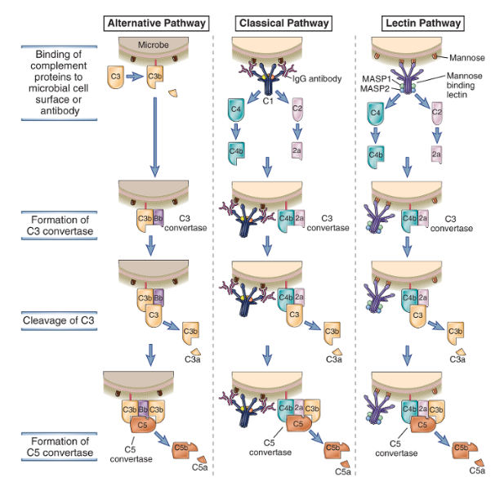
Komplementa aktivācijas ceļi
Klasiskais ceļš: antivielu atkarīgais ceļš; plazmas proteīns C1q saistās pie antivielu Fc daļas uz mikroorganisma virsmas, aktivē serīna proteāzes C1r un C1s, kas palaiž proteolītisko kaskādi – šķeļ C4 un C2, kas tālāk šķeļ C3.
Alternatīvais ceļš: C3 tieši saistās pie baktērijas virsmas, piem. LPS un spontāni aktivējas. Spontāna C3 šķelšana (ar zemu aktivitāti) notiek visu laiku, taču šķīdumā C3b ir nestabils un tiek hidrolizēts; uz baktērijas virsmas – stabilizējas un turpina kaskādes reakciju.
Lektīna ceļš: aktivē plazmas proteīns MBL – mannozes saistības lektīns, kas pazīst mannozi saturošus glikolipīdus vai glikoproteīnus uz baktēriju virsmas, piesaista MASP1/2, kas palaiž proteolītisko kaskādi.
Notes:
The alternative pathway is activated by C3b binding to various activating surfaces, such as microbial cell walls; the classical pathway is initiated by C1 binding to antigen-antibody complexes; and the lectin pathway is activated by binding of a plasma lectin to microbes. The C3b that is generated by the action of the C3 convertase binds to the microbial cell surface or the antibody and becomes a component of the enzyme that cleaves C5 (C5 convertase) and initiates the late steps of complement activation. The late steps of all three pathways are the same (not shown here), and complement activated by all three pathways serves the same functions.

Slide 32
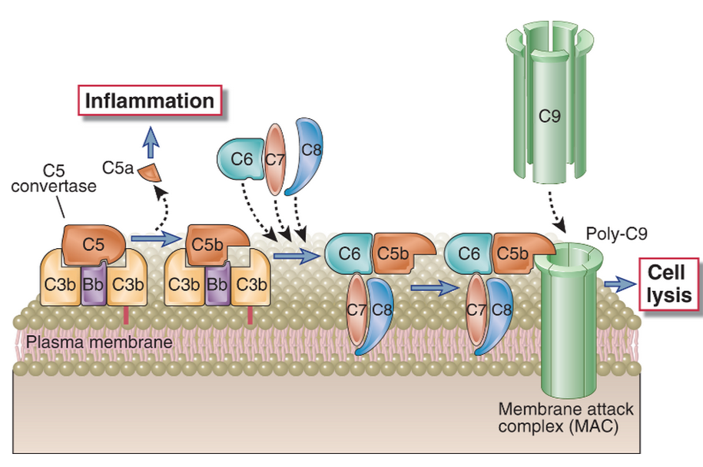
Komplementa aktivācijas noslēguma fāze – MAC (membrane attack complex) veidošanās
Notes:
The remaining components of the complement cascade, C6, C7, C8, and C9, are structurally related proteins without enzymatic activity. C5b transiently maintains a conformation capable of binding the next proteins in the cascade, C6 and C7. The C7 component of the resulting C5b,6,7 complex is hydrophobic, and it inserts into the lipid bilayer of cell membranes, where it becomes a high-affinity receptor for the C8 molecule. The C8 protein is a trimer composed of three distinct chains, one of which binds to the C5b,6,7 complex and forms a covalent heterodimer with the second chain; the third chain inserts into the lipid bilayer of the membrane. This stably inserted C5b,6,7,8 complex (C5b-8) has a limited ability to lyse cells. The formation of a fully active MAC is accomplished by the binding of C9, the final component of the complement cascades, to the C5b-8 complex. C9 is a serum protein that polymerizes at the site of the bound C5b-8 to form pores in plasma membranes. These pores are about 100 Å in diameter, and they form channels that allow free movement of water and ions. The entry of water results in osmotic swelling and rupture of the cells on whose surface the MAC is deposited.

Slide 33
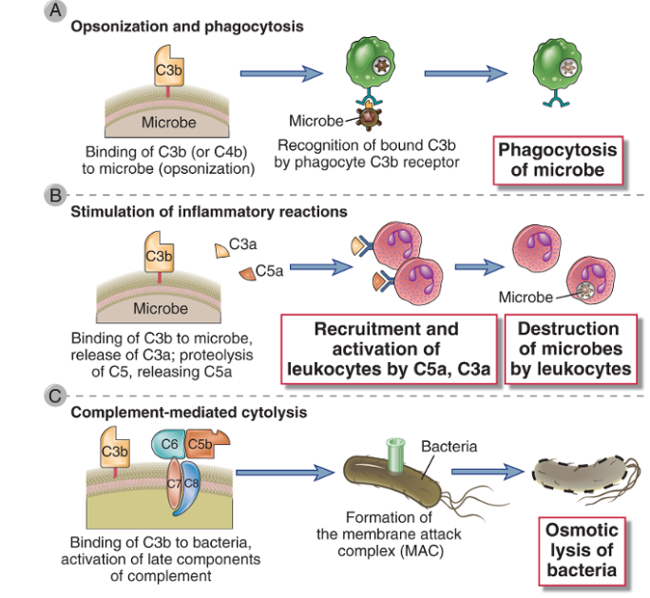
Komplementa efektorās funkcijas
Notes:
The major functions of the complement system in host defense are shown. Cell-bound C3b is an opsonin that promotes phagocytosis of coated cells (A); the proteolytic products C5a, C3a, and (to a lesser extent) C4a stimulate leukocyte recruitment and inflammation (B); and the MAC lyses cells (C).

Slide 34
Q1: Kā definēt – kas ir iekaisums?

Slide 35
Iekaisums – reakcija uz audu bojājumu
Process, kurā audu bojājuma vietā (infekcija, trauma, kristālu uzkrāšanās šūnās u.c.) tiek rekrutēti un aktivēti leikocīti un plazmas proteīni ar mērķi iznīcināt patogēnus, neitralizēt toksīnus, likvidēt šūnu atlikumus un reģenerēt audus un atjaunot to normālo struktūru un funkciju. Tā laikā palielinās asins apgāde bojājuma vietai, palielinās kapilāru caurlaidība un leikocītu migrācija audos.
Akūts iekaisums: rezultējas ar ierosinātāja pilnīgu iznīcināšanu, audu bojājuma novēršanu, leikocītu izzušanu no iekaisuma vietas un audu funkciju pilnīgu atjaunošanos. Dominē neitrofili, aktivētas Th šūnas.
Hronisks iekaisums: ierosinātājs netiek pilnībā iznīcināts, iekaisuma process turpinās ilgstoši. Atšķiras iesaistīto imūnšūnu tipi - dominē makrofāgi, CTLi, B šūnas. Noved pie audu bojājuma un funkcijas zuduma (piem, plaušu fibroze, locītavu bojājums). Pašlaik uzskata, ka tas ir pamatā daudzām slimībām – 2. tipa diabētam, neirodeģenerācijai, vēzim utt.
Notes:
Inflammationis the process of recruitment of leukocytes and plasma proteins from the blood, their accumulation in tissues, and their activation to destroy the microbes. Many of these reactions involve cytokines, which are produced by dendritic cells, macrophages, and other types of cells during innate immune reactions. The major leukocytes that are recruited in inflammation are the phagocytes, neutrophils (which have short life spans in tissues), and monocytes (which develop into tissue macrophages). These phagocytes express on their surfaces receptors that bind and ingest microbes and other receptors that recognize different microbial molecules and activate the cells. On engagement of these receptors, the phagocytes produce reactive oxygen and nitrogen species and lysosomal enzymes, which destroy the microbes that have been ingested. Resident macrophages in the tissues serve much the same functions.

Slide 36
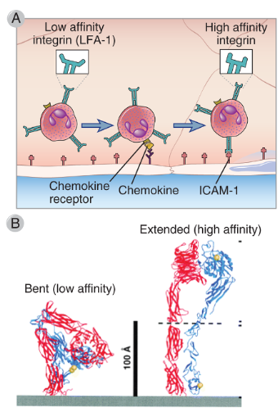
Neitrofilu un monocītu migrācija uz iekaisuma vietu
(I) Leikocītu un endotēlija šūnu adhēzija:
Selektīnu un to ligandu saistība. Uz endotēlija – P un E-selektīni, to ekspresiju stimulē mikroorganismu produkti, citokīni, histamīns; uz leikocītiem – L-selektīns. Saistība relatīvi vāja; izraisa leikocītu ripošanu.
Integrīnu un to ligandu saistība. >30 dažādi integrīni; sastāv no α un β ķēdes. Cirkulējošos leikocītos – zemas afinitātes stāvoklī; hemokīnu receptoru aktivācija izraisa pāreju uz augstas afinitātes konformāciju – stabila saistība, apstādina leikocītus.
Notes:
The integrins on blood leukocytes are normally in a low-affinity state. If a leukocyte comes close to endothelial cells, such as when selectin-dependent rolling of leukocytes occurs, then chemokines displayed on the endothelial surface can bind chemokine receptors on the leukocyte. Chemokine receptor signaling then occurs, which activates the leukocyte integrins, increasing their affinity for their ligands on the endothelial cells. B, Ribbon diagrams are shown of bent and extended conformations of a leukocyte integrin, corresponding to low- and high-affinity states, respectively.

Slide 37
Neitrofilu un monocītu migrācija uz iekaisuma vietu
(II) Hemotakse – šūnu migrācija hemoattraktanta gradienta virzienā. Galvenie hemoatraktanti:
Hemokīni (~50 dažādi 8-12kD peptīdi; satur Cys; klases: CC, CXC, CX3C), ko producē galvenokārt audu makrofāgi, arī – epitēlija, endotēlija šūnas un fibroblasti. Receptori – ar G-proteīnu saistītie receptori (~17 dažādi); to aktivācija izraisa citoskeleta izmaiņas un šūnu kustību.
  Komplementa faktori (C3a, C5a)
  fMLP – tripeptīds, baktēriju sabrukšanas produkts
  H₂O₂

Slide 38
Q1: Kas nosaka atšķirības neitrofilu un monocītu migrācijā?

Slide 39
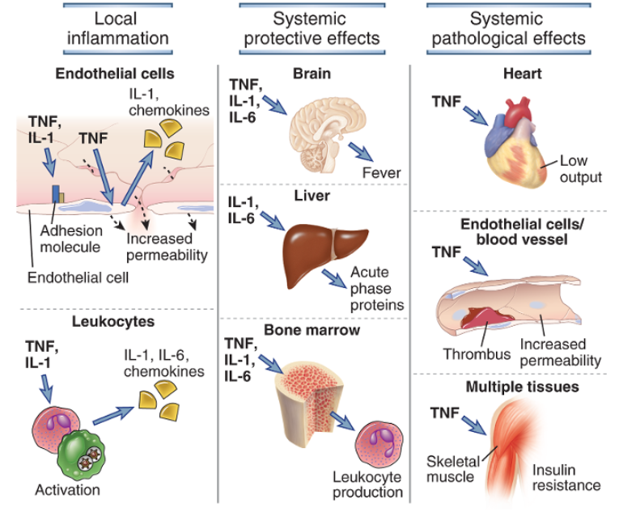
TNF, IL-1 un IL-6: galvenie pro-inflammatorie citokīni
Notes:
TNF, IL-1, and IL-6 have multiple local and systemic inflammatory effects. TNF and IL-1 act on leukocytes and endothelium to induce acute inflammation, and both cytokines induce the expression of IL-6 from leukocytes and other cell types. TNF, IL-1, and IL-6 mediate protective systemic effects of inflammation, including induction of fever, acute-phase protein synthesis by the liver, and increased production of leukocytes by the bone marrow. Systemic TNF can cause the pathologic abnormalities that lead to septic shock, including decreased cardiac function, thrombosis, capillary leak, and metabolic abnormalities due to insulin resistance.
TNF, IL-1 un IL-6 iedarbojas uz hipotalamu, stimulējot prostaglandīnu sintēzi; Prostaglandīni izraisa temperatūras paaugstināšanos – uzlabo imūnšūnu metabolismu, kavē m.o. Metabolismu un ietekmē inficētā cilvēka uzvedību.
The principal systemic actions of TNF are the following:
TNF inhibits myocardial contractility and vascular smooth muscle tone, resulting in a marked fall in blood pressure, or shock.
TNF causes intravascular thrombosis, mainly as a result of loss of the normal anticoagulant properties of the endothelium. TNF stimulates endothelial cell expression of tissue factor, a potent activator of coagulation, and inhibits expression of thrombomodulin, an inhibitor of coagulation. The endothelial alterations are exacerbated by activation of neutrophils, leading to vascular plugging by these cells. The ability of this cytokine to cause necrosis of tumors, which is the basis of its name, is mainly a result of thrombosis of tumor blood vessels.
Prolonged production of TNF causes wasting of muscle and fat cells, called cachexia. This wasting results from TNF-induced appetite suppression and reduced synthesis of lipoprotein lipase, an enzyme needed to release fatty acids from circulating lipoproteins so that they can be used by the tissues.
Tumor necrosis factor (TNF) is a mediator of the acute inflammatory response to bacteria and other infectious microbes. The name of this cytokine derives from its original identification as a serum substance (factor) that caused necrosis of tumors, now known to be the result of local inflammation and thrombosis of tumor blood vessels. TNF is also called TNF-α to distinguish it from the closely related TNF-β, also called lymphotoxin. TNF is produced by macrophages, dendritic cells, and other cell types. In macrophages, it is synthesized as a nonglycosylated type II membrane protein and is expressed as a homotrimer, which is able to bind to one form of TNF receptor. The membrane form of TNF is cleaved by a membrane-associated metalloproteinase, releasing a polypeptide fragment, and three of these polypeptide chains polymerize to form a triangular pyramid-shaped circulating TNF protein (Fig. 4-11). The receptor-binding sites are at the base of the pyramid, allowing simultaneous binding of the cytokine to three receptor molecules.
There are two distinct TNF receptors called type I (TNF-RI) and type II (TNF-RII). The affinities of TNF for its receptors are unusually low for a cytokine, the K_{d}being only ∼1 × 10⁻⁹ M for binding to TNF-RI and approximately 5 × 10⁻¹⁰ M for binding to TNF-RII. Both TNF receptors are present on most cell types. The TNF receptors are members of a large family of proteins called the TNF receptor superfamily, many of which are involved in immune and inflammatory responses. These receptors exist as trimers in the plasma membrane. Cytokine binding to some TNF receptor family members, such as TNF-RI, TNF-RII, and CD40, leads to the recruitment of proteins, called TNF receptor–associated factors (TRAFs), to the cytoplasmic domains of the receptors. The TRAFs activate transcription factors, notably NF-κB and AP-1. Cytokine binding to other family members, such as TNF-RI, leads to recruitment of an adaptor protein that activates caspases and triggers apoptosis. Thus, different members of the TNF receptor family can induce gene expression or cell death, and some can do both (see Chapter 7).
TNF production by macrophages is stimulated by PAMPs and DAMPs. TLRs, NLRs, and RLRs can all induce TNF gene expression, in part by activation of the NF-κB transcription factor. Many different microbial products can therefore induce TNF production. Large amounts of this cytokine may be produced during infections with gram-negative and gram-positive bacteria, which release the TLR ligands LPS and lipoteichoic acid, respectively, from their cell walls. Septic shock, a life-threatening condition caused when bacteria enter the blood stream, is mediated in large part by TNF. We will discuss septic shock later in this chapter.
Interleukin-1
Interleukin-1 (IL-1) is also a mediator of the acute inflammatory response and has many similar actions as TNF. The major cellular source of IL-1, like that of TNF, is activated mononuclear phagocytes. Unlike TNF, IL-1 is also produced by many cell types other than macrophages, such as neutrophils, epithelial cells (e.g., keratinocytes), and endothelial cells. There are two forms of IL-1, called IL-1α and IL-1β, that are less than 30% homologous to each other, but they bind to the same cell surface receptors and have the same biologic activities. The main biologically active secreted form is IL-1β.
IL-1 production usually requires two distinct signals, one that activates new gene transcription and production of a 33-kD precursor pro–IL-1β polypeptide, and a second signal that activates the inflammasome to proteolytically cleave the precursor to generate the 17-kD mature IL-1β protein (see Fig. 4-4). As discussed earlier in the chapter, IL-1β gene transcription is induced by TLR and NOD signaling pathways that activate NF-κB, whereas pro–IL-1β cleavage is mediated by the NLRP3 inflammasome. IL-1 is secreted by a nonclassical pathway because, unlike most secreted proteins, neither IL-1α nor IL-1β has hydrophobic signal sequences to target the nascent polypeptide to the endoplasmic reticulum membrane. One possibility is that mature IL-1 is released mainly when infected cells or activated macrophages die. Some pathogenic bacteria induce both inflammasome-mediated processing of IL-1β and IL-18 in macrophages and caspase-1–dependent cell death, which leads to the release of the inflammatory cytokines. TNF can also stimulate phagocytes and other cell types to produce IL-1. This is an example of a cascade of cytokines that have similar biologic activities.
IL-1 mediates its biologic effects through a membrane receptor called the type I IL-1 receptor, which is expressed on many cell types, including endothelial cells, epithelial cells, and leukocytes. This receptor is an integral membrane protein that contains an extracellular ligand-binding Ig domain and a Toll/IL-1 receptor (TIR) signaling domain in the cytoplasmic region, described earlier in reference to TLRs. The signaling events that occur when IL-1 binds to the type I IL-1 receptor are similar to those triggered by TLRs and result in the activation of NF-κB and AP-1 transcription factors (see Chapter 7). The type II IL-1 receptor appears incapable of activating downstream signals.
Interleukin-6
IL-6 is another important cytokine in acute inflammatory responses that has both local and systemic effects, including the induction of liver synthesis of a variety of other inflammatory mediators, the stimulation of neutrophil production in the bone marrow, and the differentiation of IL-17–producing helper T cells. IL-6 is synthesized by mononuclear phagocytes, vascular endothelial cells, fibroblasts, and other cells in response to PAMPs and in response to IL-1 and TNF. IL-6 is a homodimer of type I cytokine family polypeptides. The receptor for IL-6 consists of a cytokine-binding polypeptide chain and a signal-transducing subunit (called gp130) that is also the signaling component of receptors for other cytokines. The IL-6 receptor engages a signaling pathway that activates the transcription factor STAT3.

Slide 40
Sepse – sistēmiska iekaisuma reakcija
Potenciāli letāls klīnisks stāvoklis; to raksturo paaugstināta temperatūra (>38.3°C, paātrināts pulss >90 sitieni min, paātrināta elopošana >20 ieielpas/min, infekcija)
Pamatā – infekcijas atrašanās asinsritē; biežāk, bakterēmija (stafilokoku), bet var būt arī sēnītes vai vīrusi un spēcīga imūnsistēmas atbilde
Bakterēmija aktivē monocītu un DCs TLRs → sistēmiska TNF un IL-1 produkcija izraisa “iekaisumu” visā organismā
Septisko šoku (galējā sepses stadija) izraisa vazodilatācija un kapilāru caurlaidības palielināšanās, kā rezultātā strauji krītas asinsspiediens
TNF inducē koagulāciju un trombozi
Šo efektu kombinācija noved pie sistēmiskas vairāku orgānu disfunkcijas
To, cik strauji attīstās iekaisuma reakcija lielā mērā nosaka iedzimtība – polimorfismi citokīnu, citokīnu receptoru u.c. regulatoru gēnos
Notes:
Bacterial septicemia leads to activation of TLRs on monocytes in the blood, DCs in spleen
Systemic release of TNF and IL-1 leads to “inflammation” all over the body
Shock from loss of blood pressure (vasodilation and leakage of fluid into tissues)
TLRs also induce coagulation (via tissue factor)
Current therapy with some efficacy: “activated protein C”: promotes fibrinolysis, breaks down thrombi
The combination of effects frequently leads to multi-organ failure and death
A complication of severe bacterial sepsis is a syndrome called septic shock, which may be caused by LPS released from gram-negative bacteria (in which case it is called endotoxin shock) or lipoteichoic acid from gram-positive bacteria. Septic shock is characterized by vascular collapse, disseminated intravascular coagulation, and metabolic disturbances. This syndrome is due to LPS- or lipoteichoic acid–induced TLR signaling leading to the production of TNF and other cytokines, including IL-12, IFN-γ, and IL-1. The concentration of serum TNF may be predictive of the outcome of severe bacterial infections. Septic shock can be reproduced in experimental animals by administration of LPS, lipoteichoic acid, or TNF. Antagonists of TNF can prevent mortality in the experimental models, but clinical trials with anti-TNF antibodies or with soluble TNF receptors have not shown benefit in patients with sepsis. The cause of this therapeutic failure is not known, but it may be because other cytokines elicit the same responses as TNF, an example of redundancy.

