Slide 1

Molecular mechanisms of pathogenic microorganisms adaptation and resistance

Slide 2
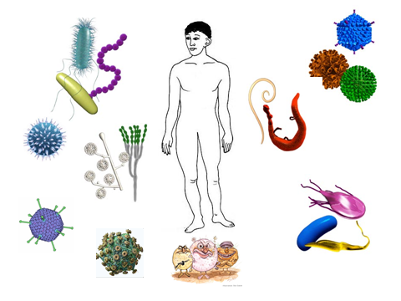
Human body have developed many different defenses against pathogens.
However pathogens have evolved elaborate strategies to evade these defenses.

Slide 3
Antimicrobials
The implementation of antimicrobial therapy in clinical practice has been one of the most successful advances of modern medicine.
The use of antimicrobials in clinical practice is a recent development in history compared to the emergence of bacterial organisms on our planet.
In order to survive, bacteria, have developed complex and creative strategies to circumvent the antibiotic attack.
Development of antibiotic resistance should be viewed as a “normal” adaptive response.

Slide 4
Antibiotic resistance
Antibiotic resistance has rapidly evolved in the last few decades.
The World Health Organization has named antibiotic resistance as one of the three most important public health threats of the 21st century.
Indeed, infections that are untreatable due to multidrug resistance of the infected organism have become more common in clinical settings.

Slide 5
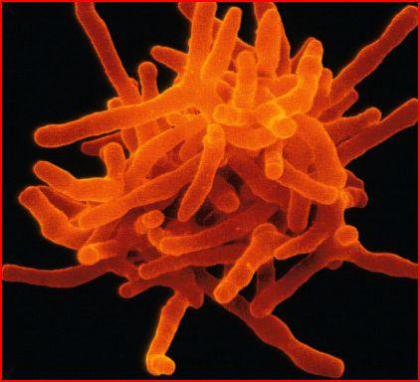
Antibiotics
Most antibiotics were originally isolated by screening soil-derived actinomycetes during the golden era of antibiotic discovery in the 1940s to 1960s.
The “golden” pipeline of antibiotic discovery rapidly dried up as
the identification of new compounds became more challenging.
Efforts to create a new platform based on target-focused screening
of large libraries of synthetic compounds failed, in part owing to the
lack of penetration of such compounds through the bacterial envelope

Slide 6
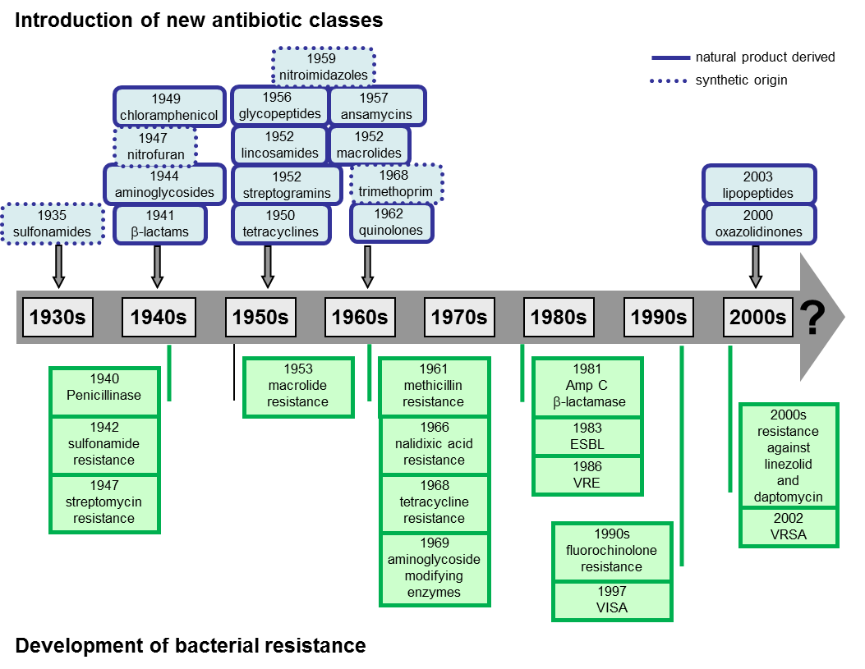
Timeline of antibiotics resistance

Slide 7
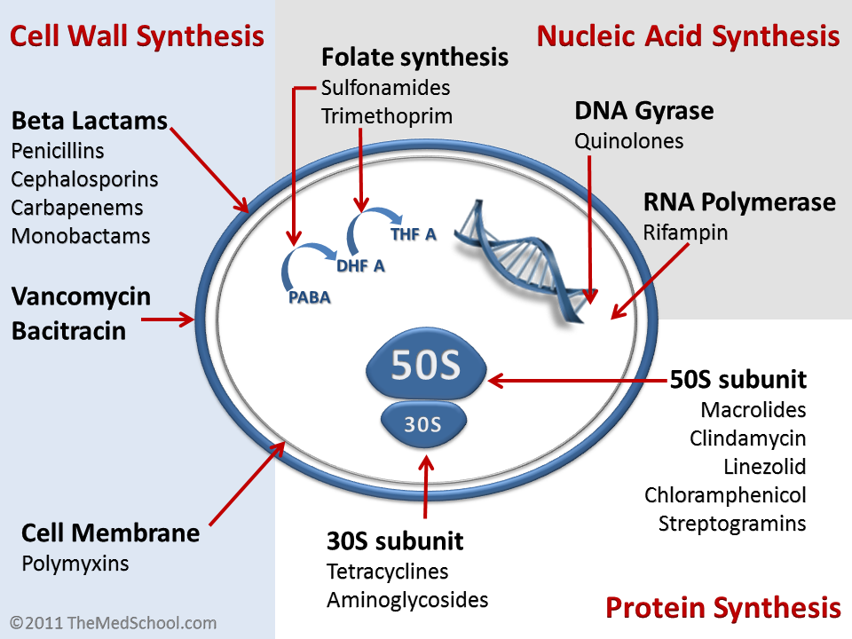
Antibiotic molecules mechanisms of action

Slide 8
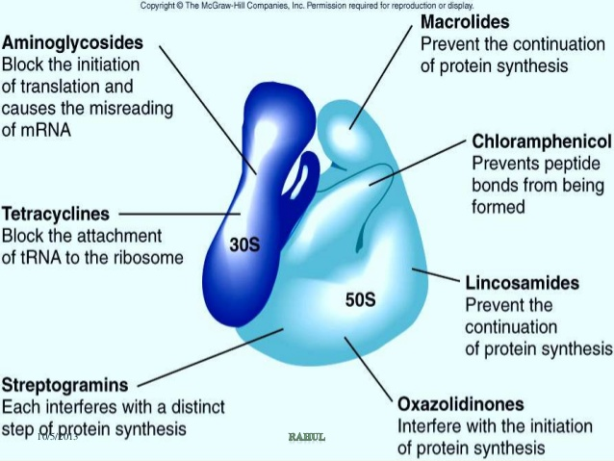
Antibiotic molecules mechanisms of action

Slide 9
Mechanisms of Antibiotic Resistance
Antimicrobial resistance is ancient and it is the expected result of the interaction of many organisms with their environment.
Most antimicrobial compounds are naturally-produced molecules. Bacteria sharing the same ecological niche with antimicrobial-producing organisms have evolved ancient mechanisms to withstand the effect of the harmful antibiotic molecule .
Thus, these organisms are often considered to be “intrinsically” resistant to one or more antimicrobials.
Bacteria harboring intrinsic determinants of resistance are not the main focus of the problem.
In clinical settings, we are typically referring to the expression of “acquired resistance” in a bacterial population that was originally susceptible to the antimicrobial compound.
The development of acquired resistance can be the result of mutations in chromosomal genes or due to the acquisition of external genetic determinants of resistance, likely obtained from intrinsically resistant organisms present in the environment.

Slide 10
Mechanisms of Antibiotic Resistance
Antibiotic resistance
Intrinsic
or Natural
Acquired
genetic methods
Chromosomal methods
Extra chromosomal
methods
mutations
plasmids

Slide 11
Genetic basis of antimicrobial resistance
Bacteria have a remarkable genetic plasticity that allows them to respond to the presence of antibiotic molecules.
Bacteria use two major genetic strategies to adapt to the antibiotic “attack”
mutations in gene(s) often associated with the mechanism of action of the compound, and
acquisition of foreign DNA coding for resistance determinants through horizontal gene transfer (HGT).

Slide 12
Acqiured resistance
Mutations
It refers to the change in DNA structure of the gene.
Occurs at a frequency of one per ten million cells.
Mycobacterium tuberculosis, M.lepra, MRSA.
Mutants have reduced susceptibility

Slide 13
Mobile genetic elements
Mobile genetic elements are sequences of genetic material that can change places on a chromosome, and be exchanged between chromosomes, between bacteria, and even between species.
Mobile genetic elements (MGEs) are segments of DNA that encode enzymes and other proteins which facilitate the movement of genetic material between bacterial chromosomes
The most important MGEs are
plasmids and
transposons
cassetes of integrons

Slide 14
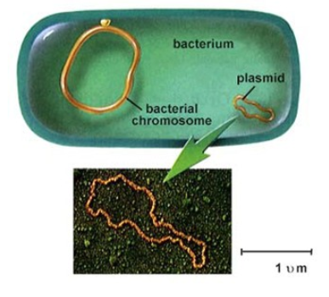
Extra genetic elements
Plasmids
Any bacteria have a plasmid which is a self-replicating circle of DNA that has a few genes.
Plasmids are passed from one generation of bacteria to
the next.
Plasmids are replicated independently of the "main“
chromosome.
Some plasmids carry genes for antibiotic resistance.
Plasmids which carry genes resistant (r-genes) are
called R-plasmids.
Much of the drug resistance in clinical practice is
plasmid mediated.

Slide 15
Horizontal gene transfer
Transfer of genes from one bacterium to another
Acquisition of foreign DNA material through HGT is one of the most important drivers of bacterial evolution and it is frequently responsible for the development of antimicrobial resistance.
Classically, bacteria acquire external genetic material through three main strategies:
  transformation (incorporation of naked DNA),
  transduction (phage mediated)
  conjugation (bacterial “sex”)

Slide 16
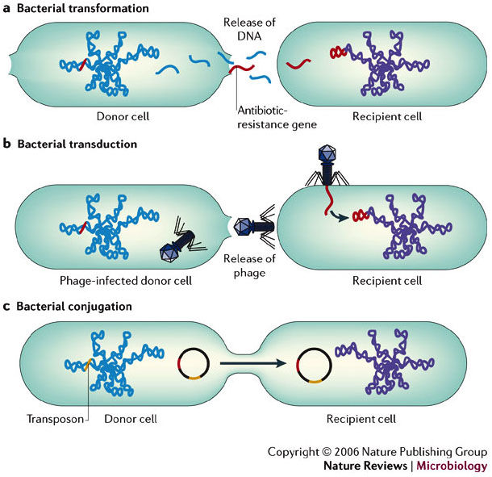

Slide 17
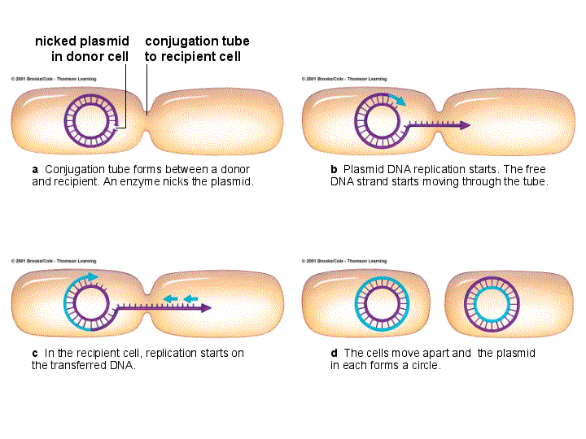
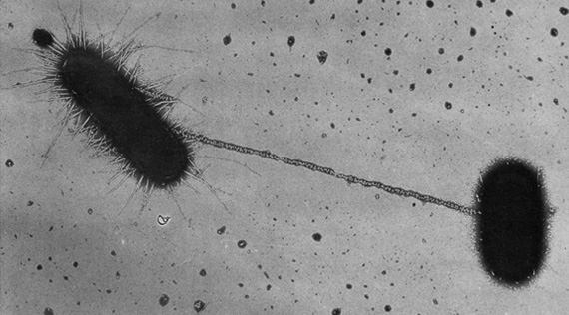
Horizontal gene transfer
Bacterial conjugation is the transfer of genetic material from one bacterium
to another via direct cell-to- cell contact.
Recipient cell gains a copy of plasmid together with any resistance genes
present on the plasmid.
Main mechanism for spread of resistance.

Slide 18
Horizontal gene transfer
Transfer of r-genes between plasmids within bacterium
By transposons
By integrons

Slide 19
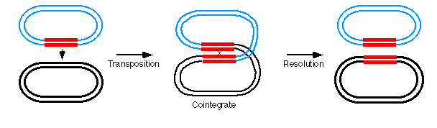
Transposons
Transposons are sequences of DNA that can move around different
positions within a genome of single cell.
The donor plasmid containing the transposons,
Co-integrate with acceptor plasmid.
They can replicate during cointegration.
Both plasmids then separate and each
Contains the r-gene carrying the transposon.

Slide 20
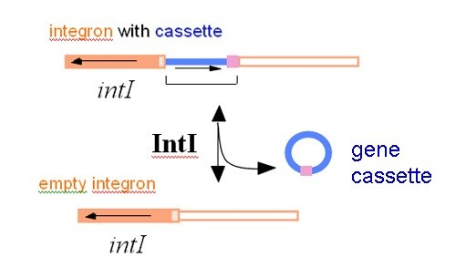
Integrons
One of the most efficient mechanisms for accumulating antimicrobial resistance genes is represented by integrons.
Integron is a large mobile DNA, encode resistance and virulence genes.
Each integron is packed with multiple gene casettes, each consisting
of a resistance gene attached to a small recognition site.
Integrons provide an efficient and rather simple mechanism for the addition of new genes into bacterial chromosomes, along with the necessary machinery to ensure their expression.

Slide 21
Horizontal gene transfer
The most important MGEs are plasmids and transposons, both of which play a crucial role in the development and dissemination of antimicrobial resistance among clinically relevant organisms.

Slide 22
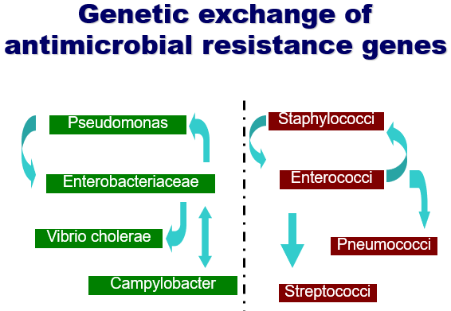

Slide 23
Mechanistic basis of antimicrobial resistance
Bacteria have evolved sophisticated mechanisms of drug resistance to avoid killing by antimicrobial molecules, a process that has likely occurred over millions of years of evolution.
Resistance to one antimicrobial class can usually be achieved through multiple biochemical pathways, and one bacterial cell may be capable of using a cadre of mechanisms of resistance to survive the effect of an antibiotic.

Slide 24
Biochemical routes involved in resistance
modifications of the antimicrobial molecule
prevention to reach the antibiotic target
  by decreasing penetration
  actively extruding the antimicrobial compound
changes and/or bypass of target sites
resistance due to global cell adaptive processes

Slide 25
Biochemical routes involved in resistance
Modifications of the antimicrobial molecule
One of the most successful bacterial strategies to cope with the presence of antibiotics is
to produce enzymes that inactivate the drug by adding specific chemical moieties to the compound
to destroy the molecule itself
Antibiotic unable to interact with its target.

Slide 26
Biochemical routes involved in resistance
Modifications of the antimicrobial molecule
Chemical alterations of the antibiotic
is a well-known mechanism of acquired antibiotic resistance in both gram-negative and gram-positive bacteria.
Bacterial cells produce enzymes that catalyze
acetylation (aminoglycosides, chloramphenicol, streptogramins)
phosphorylation (aminoglycosides, chloramphenicol)
adenylation (aminoglycosides, lincosamides)
the resulting effect is often related to steric hindrance that decreases the avidity of the antibiotic for its target

Slide 27
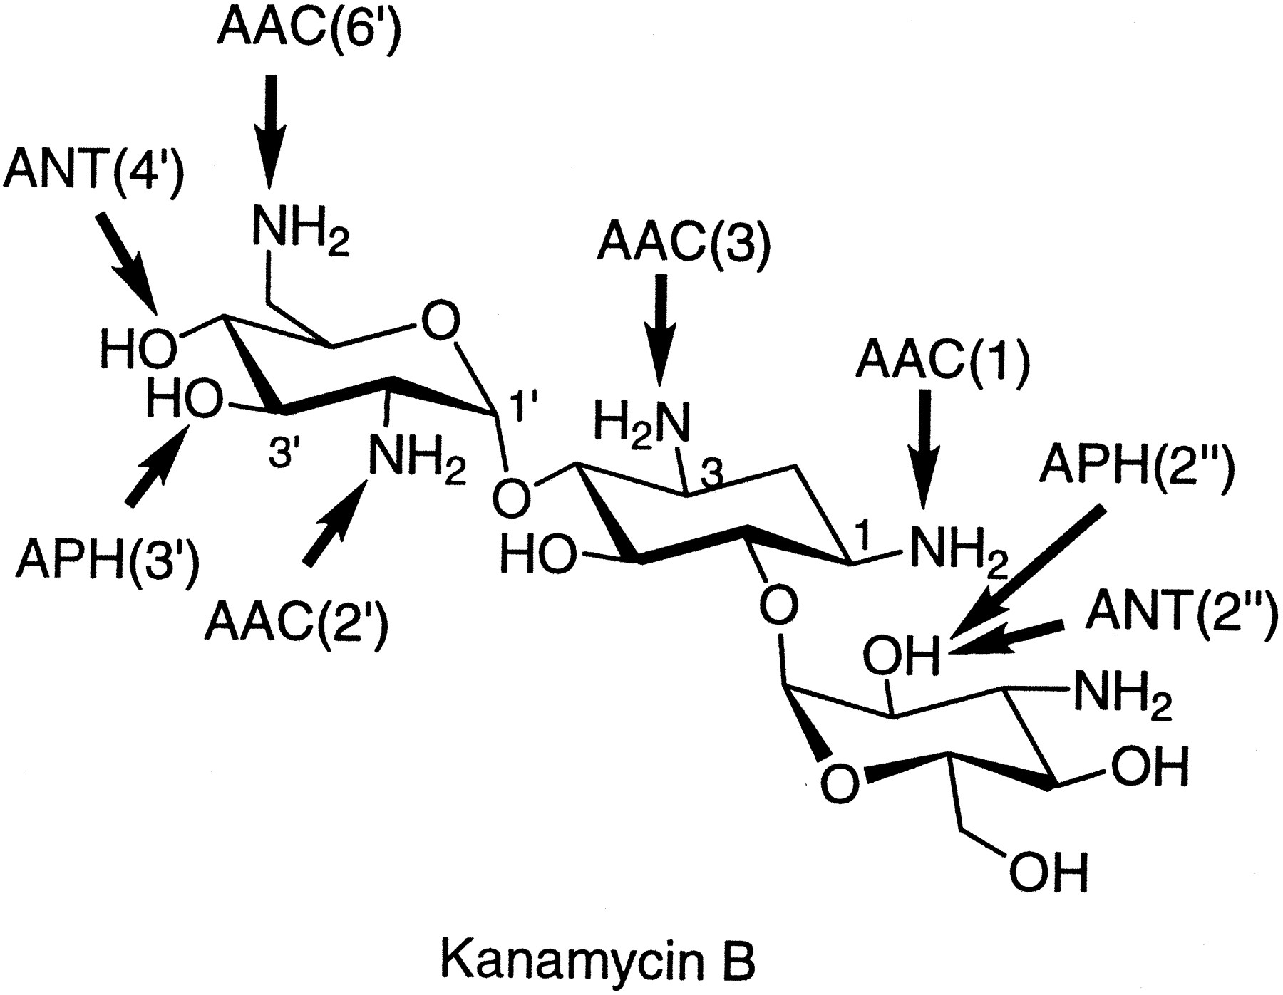
Modifications of the antimicrobial molecule
Chemical alterations of the antibiotic
Interestingly, most of the antibiotics affected by these enzymatic modifications exert their mechanism of action by inhibiting protein synthesis at the ribosome level.
One of the best examples of resistance via modification of the drug is the presence of aminoglycoside modifying enzymes (AMEs)-
acetyltransferase [ACC]
adenyltransferase [ANT]
phosphotransferase [APH]
These enzymes covalently modify the hydroxyl or
amino groups of the aminoglycoside molecule.
Sites of modification on kanamycin B by various aminoglycoside-modifying enzymes.

Slide 28
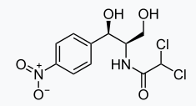
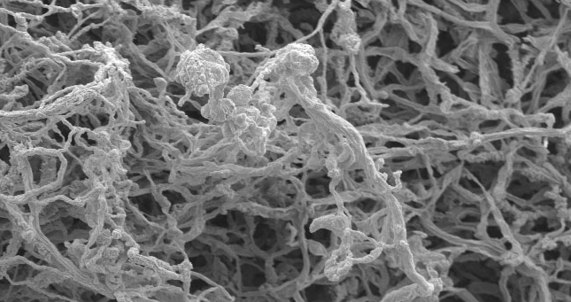
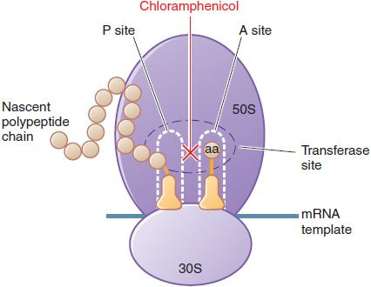
Modifications of the antimicrobial molecule
Chemical alterations of the antibiotic
Chloramphenicol is a broad spectrum antibiotic isolated
from Streptomyces venezuelae in 1947.
Chloramphenicol is an antibiotic that inhibits protein synthesis
by interacting with the peptidyl-transfer center of the
50S ribosomal subunit.
It binds irreversibly to the bacterial 50S ribosome subunit.

Slide 29
Modifications of the antimicrobial molecule
Chemical alterations of the antibiotic
The chemical modification of chloramphenicol is mainly driven by the expression of
CATs (Chloramphenicol AcetylTransferases).
Multiple cat genes have been described in both gram-positives and gram-negatives.
CATs inactivates chloramphenicol by covalently linking one or two acetyl groups, derived from acetyl-S-coenzyme A,
to the OH- groups on the chloramphenicol molecule.
The acetylation prevents chloramphenicol from binding to the ribosome.
Currently, some Enterococcus faecium and Pseudomonas aeruginosa strains are resistant to chloramphenicol. Some Veillonella spp. and Staphylococcus capitis strains have also developed resistance to chloramphenicol to varying degrees.

Slide 30
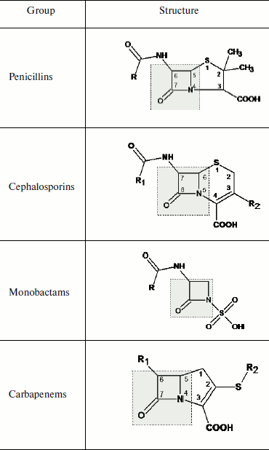
Modifications of the antimicrobial molecule
Destruction of antibiotic molecule
β-lactam antibiotics are broad spectrum antibiotics,
that contain a beta-lactam ring in their molecular structures.
This includes
penicillin derivatives (penams),
cephalosporins (cephems),
monobactams,
carbapenems
β-lactam antibiotics are the most widely produced
and used antibacterial drugs in the world.

Slide 31
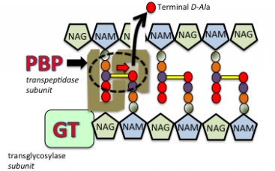
Modifications of the antimicrobial molecule
β-lactam antibiotics mechanism of action
β-lactam antibiotics inhibit bacterial growth by interfering with bacterial cell wall synthesis.
In the absence of drug, transpeptidase enzymes- Penicillin Binding Proteins (PBP) in the cell wall catalyze cross-links between adjacent glycan chains, which involves the removal of a terminal D-alanine residue from one of the peptidoglycan precursors (highlighted by the broken oval).
Glycosyltransferases (GT), which exist as either separate subunits, or tightly associated with transpeptidases (e.g. as is the case for PBP-2) create covalent bonds between adjacent sugar molecules NAM & NAG. The net result of covalent bonds between both the peptide and sugar chains creates a rigid cell wall that protects the bacterial cell from osmotic forces that would otherwise result in cell rupture.
NAG: N-acetylglucosamine; NAM: N-acetylmuramic acid

Slide 32
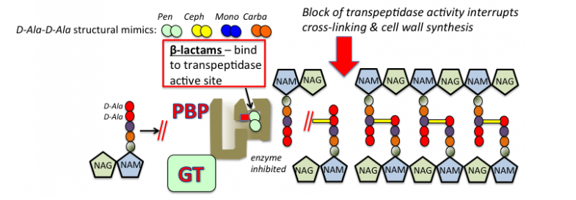
Modifications of the antimicrobial molecule
β-lactam antibiotics mechanism of action
The beta-lactam ring gives these antibiotics a three dimensional shape that mimics
the D-Ala-D-Ala peptide terminus that serves as the natural substrate for transpeptidase
activity during cell wall synthesis.
These antibiotics exert their inhibitory effects on cell wall synthesis by tightly binding to the active site of the transpeptidase (PBP).

Slide 33
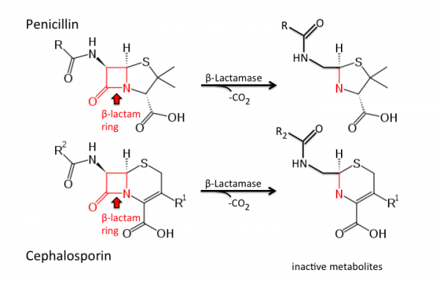
Modifications of the antimicrobial molecule
Destruction of antibiotic molecule
The main mechanism of β-lactam resistance relies on the destruction of
these compounds by the action of β- lactamases (penicillinase).
.
Genes encoding for β-lactamases are generally termed bla, and they have been found in the chromosome or localized in MGEs as part of the accessory genome.
To date more than 1,000 different β-lactamases have been described.
These enzymes destroy the amide bond of the β-lactam ring, rendering the antimicrobial ineffective.

Slide 34
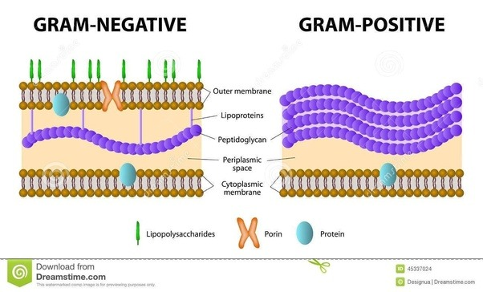
Decreased antibiotic penetration and efflux
Decreased permeability
Many of the antibiotics used in clinical practice have intracellular bacterial targets or, in case of gram-negative bacteria, located in the cytoplasmic membrane (the inner membrane).
The compound must penetrate the outer and/or cytoplasmic membrane in order to exert its antimicrobial effect.

Slide 35
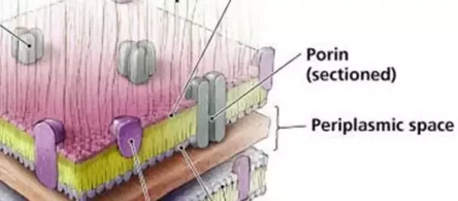
Decreased antibiotic penetration and efflux
Decreased permeability
Hydrophilic molecules such as β-lactams, tetracyclines and some fluoroquinolones are particularly affected by changes in permeability of the outer membrane since they often use water-filled diffusion channels known as porins to cross this barrier.
Alterations of porins could be achieved by 3 general processes:
a shift in the type of porins expressed,
a change in the level of porin expression,
impairment of the porin function.

Slide 36
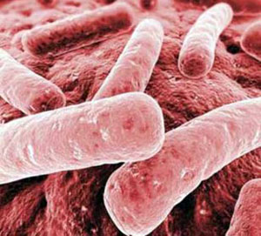
Decreased antibiotic penetration and efflux
Decreased permeability
One classic example of porin-mediated resistance is a shift in porin
expression from OmpK35 to OmpK36 type porin in Klebsiella pneumoniae
after antimicrobial therapy.
OmpK36 porin has a smaller channel size .
This results in a 4 – 8 fold decrease in susceptibility
for a wide range of β-lactam antimicrobials.
Klebsiella pneumoniae produces 10% of all hospital-acquired infections, including pneumonia and u
rinary tract infections, biliary tract and surgical wounds.
Similar examples are found in other bacterial species of clinical importance such as E.cloacae, Salmonella sp., Neisseria gonorrhoeae, and A. baumanii.

Slide 37
Decreased antibiotic penetration and efflux
Decreased antibiotic efflux
Bacterial cells produce a complex machineries capable to extrude a toxic compound out of the cell.
The description of an efflux system able to pump tetracycline out of the cytoplasm of E. coli dates from the early 1980s and was among the first to be described.
Many classes of efflux pumps have been characterized in both gram-negative and gram-positive pathogens.
The efflux pumps may be
  substrate-specific (for a particular antibiotic such as tet determinants for tetracycline and mef genes for macrolides in pneumococci) or
  with broad substrate specificity, which are usually found in MDR bacteria

Slide 38
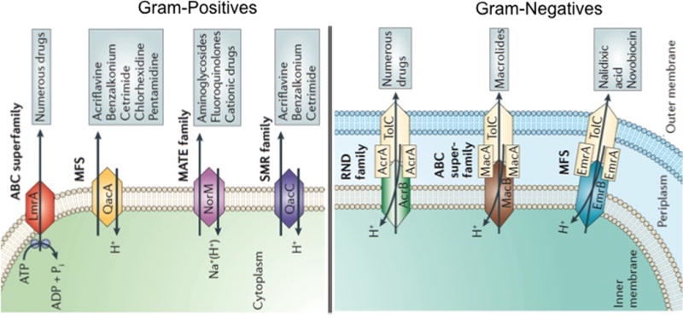
Decreased antibiotic penetration and efflux
Decreased antibiotic efflux
There are 5 major families of efflux pumps:
the major facilitator superfamily (MFS),
the small multidrug resistance family (SMR),
the resistance-nodulation-cell-division
family (RND),
the ATP-binding cassette family (ABC),
the multidrug and toxic compound
extrusion family (MATE).
These families differ in terms
  of structural conformation,
    energy source, range of substrates they are able to extrude
      in the type of bacterial organisms in which they are distributed.

Slide 39
Decreased antibiotic penetration and efflux
Decreased antibiotic efflux
Tetracycline resistance is one of the classic examples of efflux-mediated resistance.
Tet efflux pumps (belonging to the MFS family) extrude tetracyclines using proton exchange as the source of energy.
The majority of the tet genes are preferentially found in gram-negatives.
The efflux pumps that are encoded by the mef genes (mefA and mefE) extrudes the macrolide class of antibiotics (e.g., erythromycin).
The Mef pumps are mainly found in S. pyogenes and S. pneumoniae, along with other streptococci and gram-positive organisms.

Slide 40
Changes in target sites
One of the common strategies for bacteria to develop antibacterial resistance is to avoid the action of the antibiotic by interfering with their target site.
To achieve this, bacteria have evolved different tactics, including
protection of the target (avoiding the antibiotic to reach its binding site) and
modifications of the target site that result in decreased affinity for the antibiotic molecule.

Slide 41
Changes in target sites
Target protection
Drugs affected by this mechanism include tetracycline (Tet[M] and Tet[O]), fluoroquinolones (Qnr) and fusidic acid (FusB and FusC).
The tetracycline resistance determinants -Tet(M) and Tet(O).
Tet(M) was initially described in Streptococcus spp. and
Tet(O) in Campylobacter jejuni, but
they are now both widely distributed among different bacterial species.

Slide 42
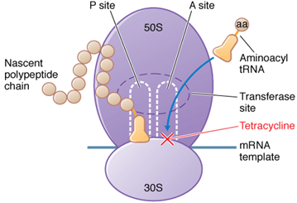
Changes in target sites
Target protection
Tet(M) and Tet(O) belong to the translation factor superfamily of GTPases and act as homologues of elongation factors (EF-G and EF-Tu) used in protein synthesis.
Tetracycline acts by binding reversibly to the 30S subunit of the bacterial ribosome. This inhibits addition of amino acids to the growing peptide resulting in inhibition of protein synthesis.
TetO and TetM interact with the ribosome and dislodge the tetracycline from its binding site in a GTP-dependent manner.
This interaction alters the ribosomal conformation, preventing rebinding of the antibiotic.

Slide 43
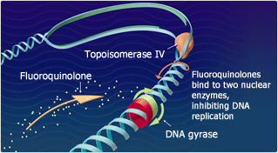
Changes in target sites
Target protection
Another example of target protection is the quinolone resistance protein Qnr, which is a plasmid-mediated fluoroquinolone resistance determinant frequently found in clinical isolates. Initially described in a clinical isolate of K. pneumoniae in the mid-1990s.
Quinolones act by binding to complexes that form between DNA and gyrase or topoisomerase IV.
Shortly after binding, the quinolones induce a conformational change in the enzyme.
The enzyme breaks the DNA and the quinolone prevents re-ligation of the broken DNA strands.
The enzyme is trapped on the DNA resulting in the formation of a quinolone– enzyme–DNA complex.
Quinolone–gyrase–DNA complex formation rapidly inhibits DNA replication.

Slide 44
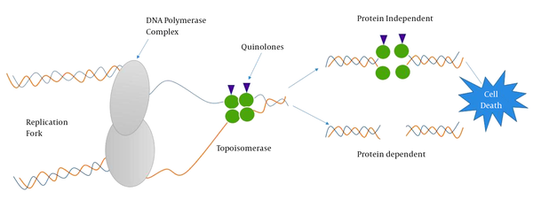
Changes in target sites
Target protection
Quinolone resistance protein Qnr belongs
to the pentapeptide repeat protein family and
it acts as a DNA homologue that competes for the DNA binding site of the DNA gyrase and topoisomerase IV.
This reduction in the DNA gyrase-DNA interaction decreases the opportunities of the quinolone molecule to form and stabilize the gyrase-cleaved DNA-quinolone complex that is lethal for the cell.

Slide 45
Changes in target sites
Modification of the target site
Introducing modifications to the target site is one of the most common mechanisms of antibiotic resistance in bacterial pathogens affecting almost all families of antimicrobial compounds.
These target site changes may consist of
point mutations in the genes encoding the target site,
enzymatic alterations of the binding site (e.g. addition of methyl groups),
replacement or bypass of the original target.
This will result in a decrease in the affinity of the antibiotic for the target site.

Slide 46
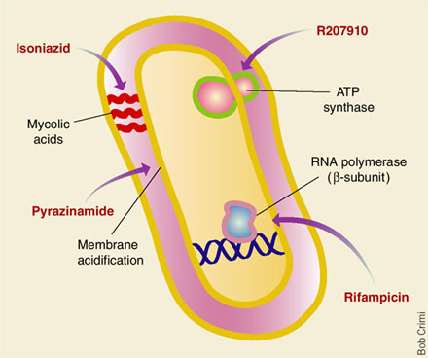
Modification of the target site
Mutations of the target site
One of the most classical examples of mutational resistance is the development of rifampin (RIF) resistance.
RIF interferes with RNA transcription in
Mycobacterium tuberculosis.
RIF binds to the β- subunits of the DNA-dependent RNA polymerase (encoded by rpoB).
After binding, the antibiotic molecule interrupts transcription by directly blocking the path of the nascent RNA.
High-level RIF resistance has been shown to occur by single-step point mutations resulting in amino acid substitutions in the rpoB gene.

Slide 47
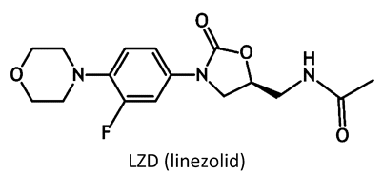
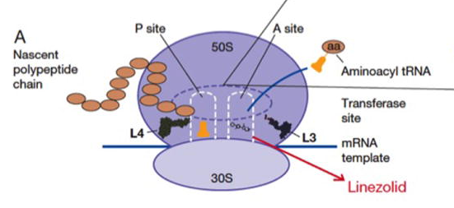
Modification of the target site
Mutations of the target site
Another example of antibiotic resistance arising due to mutational changes is resistance to oxazolidinones (linezolid and tedizolid).
These drugs are synthetic antibiotics with broad gram-positive activity that exert their mechanism through an interaction with the A site of bacterial ribosomes.
Such interaction inhibits protein synthesis by interfering with the positioning of the aminoacyl-tRNA.
Mutations in genes encoding the 23S rRNA and/or the ribosomal proteins L3 and L4 in the 50S ribosomal subunit are the most frequent determinants of linezolid resistance

Slide 48
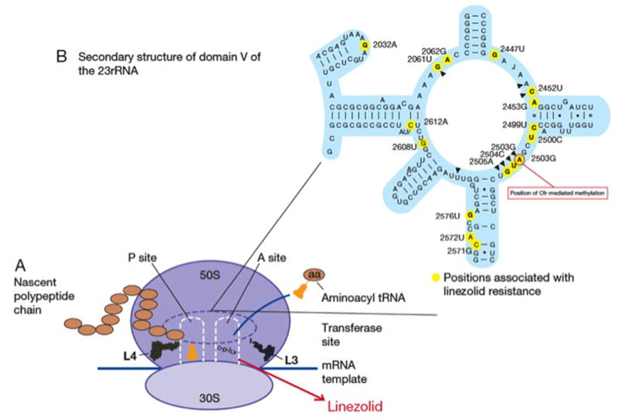
Modification of the target site
Enzymatic alteration of the target site
The methylation of the ribosome catalyzed by an enzyme encoded by the erm genes (erythromycin ribosomal methylation) results in macrolide resistance.
These enzymes are capable of mono- or dimethylating an adenine residue in position A2058 of the domain V of the 23rRNA of the 50S ribosomal subunit.
The binding of the antimicrobial molecule to its target is impaired.

Slide 49
Changes in target sites
Complete replacement or bypass of the target site
Complete replacement
Using this strategy, bacteria are capable of evolving new targets that accomplish similar biochemical functions of the original target but are not inhibited by the antimicrobial molecule.
Bypass of the target site
Overproducing the antibiotic target.

Slide 50
Changes in target sites
Complete replacement of the target site
Similar to β-lactams, glycopeptides (i.e., vancomycin and teicoplanin) kill bacteria by inhibiting cell wall synthesis.
Unlike β-lactams, glycopeptides do not directly interact with transpeptidase enzymes- Penicillin Binding Proteins (PBP).
They bind to the terminal D-alanine-D-alanine
(D-Ala-D-Ala) of the nascent peptidoglycan precursors
(lipid II), preventing PBP-mediated cross-linking
(presumably due to steric hindrance) and
resulting in inhibition of cell wall synthesis.

Slide 51
Changes in target sites
Complete replacement of the target site
Vancomycin resistance is especially relevant in enterococci (particularly E. faecium).
Vancomycin resistance in enterococci involves the acquisition of a group of genes (van gene clusters) that code for a biochemical machinery that remodels the synthesis of peptidoglycan by
changing the last D-Ala for either D-lactate (high-level resistance) or D-serine (low-level resistance),
destroying the “normal” D-Ala-D-Ala ending precursors to prevent vancomycin binding to the cell wall precursors.
The change of D-Ala for D-lactate removes a single hydrogen bond between the vancomycin molecule and its target (D-Ala-D-Ala moiety) decreasing the antibiotic affinity for the precursor ca. 1,000 fold.

Slide 52
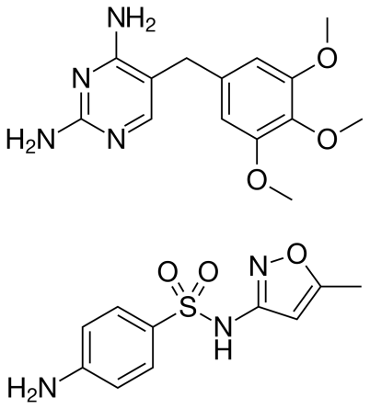
Changes in target sites
Bypass of the target site
Increasing the production of the antimicrobial target with the objective of overwhelming the antibiotic by increasing the amount of targets available.
One of the best examples of this mechanism is development of resistance to trimethoprim- sulfamethoxazole (TMP-SMX).
TMP-SMX impairs bacterial synthesis of purines and some important amino acids by altering the production of folate.
Most bacteria are unable to incorporate folate from external sources.

Slide 53
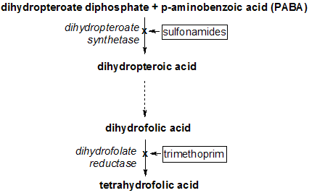
Changes in target sites
Bypass of the target site
The synthetic pathway of folate involves two major enzymes:
dihydropteroic acid synthase (DHPS), which forms dihydrofolate from para-aminobenzoic acid (inhibited by SMX), and
dihydrofolate reductase (DHFR), which catalyzes the formation of tetrahydrofolate from dihydrofolate (inhibited by TMP).

Slide 54
Changes in target sites
Bypass of the target site
The development of resistance to TMP-SMX can be achieved through several strategies including
amino acid changes in the above enzymes (decreasing their affinity for the antibiotic molecules, target modification),
acquisition of external genes encoding DHPS or DHFR that are less sensitive to inhibition by TMP/SMX (target bypass),
overproduction of DHFR or DHPS through mutations in the promoter region of the DNA encoding these enzymes.
These mutations result in the production of increased quantities of the above enzymes, “overwhelming” the ability of TMP-SMX to inhibit folate production and permitting bacterial survival.

Slide 55
Through years of evolution, bacteria have developed sophisticated mechanisms to cope with environmental stressors in order to survive the most hostile environments, including the human body.
Bacteria need to compete for nutrients and avoid the attack of molecules produced by other rival organisms in order to gain the “upper hand”.
Inside a particular host, bacterial organisms are constantly attacked by the host’s immune system and in order establish themselves in particular biological niches, it is crucial that they adapt and cope with these stressful situations.
Thus, bacterial pathogens have devised very complex mechanisms to avoid the disruption of pivotal cellular process.

Slide 56
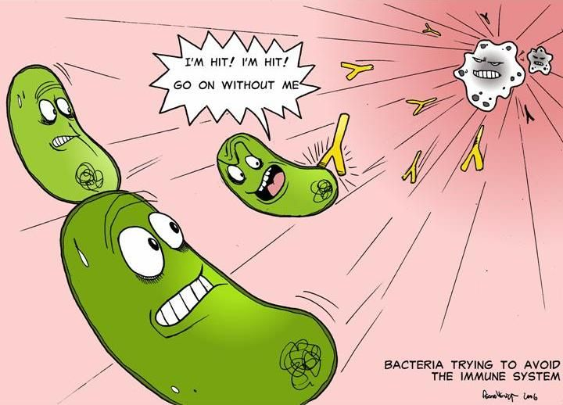
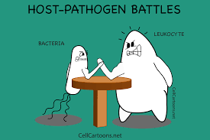
Pathogenic microorganisms strategies to evade normal host defenses
Human body have developed many different defenses against pathogens.
However pathogens
have evolved elaborate
strategies to evade these
immune system defenses.

Slide 57
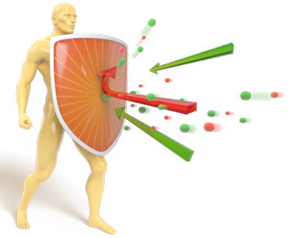
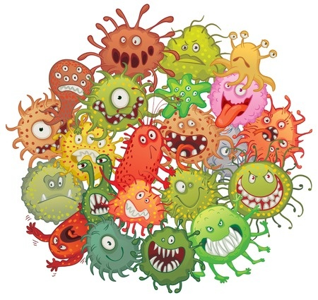

Slide 58
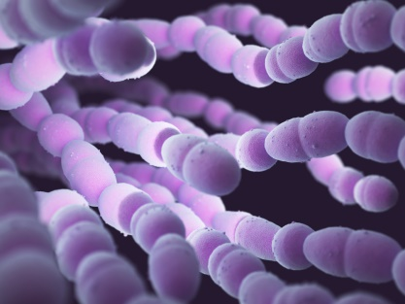
Pathogenic microorganisms strategies to escape normal host defenses
Antigenic variations
One way in which an infectious agent can evade host immune system is by altering its antigens.
There are three ways in which antigenic variation can occur.
Many infectious agents exist in a wide variety of antigenic types.
  There are 84 known types of Streptococcus pneumoniae, an important cause of bacterial pneumonia.
  Each type differs from the others in the structure of its polysaccharide capsule.

Slide 59
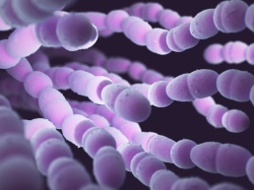
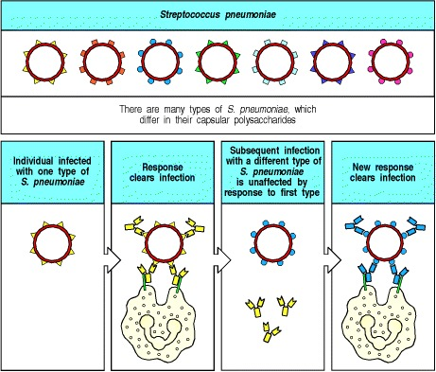
Pathogenic microorganisms strategies to escape normal host defenses
Antigenic variations
The different strains of S. pneumoniae have antigenically distinct capsular polysaccharides.
The capsule prevents effective phagocytosis until the bacterium is opsonized by antibody and complement, allowing phagocytes to destroy it.
Antibody to one type of S. pneumoniae does not cross-react with the other types, so an individual immune to one type has no protective immunity to a subsequent infection with a different type.
An individual must generate a new immune response each time he is infected with a different type of S. pneumoniae.
The same pathogen can cause
disease many times
in the same individual.

Slide 60
Pathogenic microorganisms strategies to escape normal host defenses
Antigenic variations
The different strains of S. pneumoniae have antigenically distinct capsular polysaccharides.
The capsule prevents effective phagocytosis until the bacterium is opsonized by antibody and complement, allowing phagocytes to destroy it.
Antibody to one type of S. pneumoniae does not cross-react with the other types, so an individual immune to one type has no protective immunity to a subsequent infection with a different type.
An individual must generate a new immune response each time he is infected with a different type of S. pneumoniae.
The same pathogen can cause
disease many times
in the same individual.

Slide 61
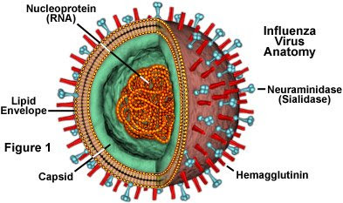
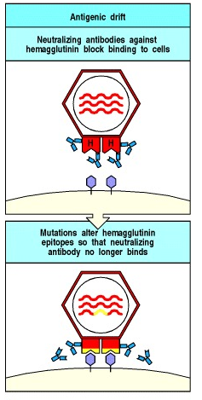
Pathogenic microorganisms strategies to escape normal host defenses
Antigenic variations
Influenza virus has more dynamic mechanism of antigenic variation.
The virus had evolved two distinct ways of changing its antigenic type:
Antigenic drift
  is caused by point mutations in the genes encoding hemagglutinin (responsible for viral binding to and entry into cell) and a second surface protein, neuraminidase.
Every 2–3 years, a variant arises with mutations that allow the virus
to evade neutralization by antibodies in the population.
Other mutations affect epitopes that are recognized by T cells,
so that cells infected with the mutant virus also escape destruction.

Slide 62
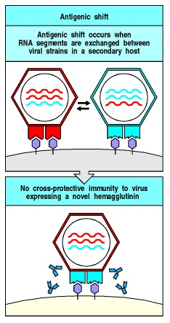
Pathogenic microorganisms strategies to escape normal host defenses
Antigenic drift
is a rare event involving reassortment of the segmented RNA viral genomes of two different influenza viruses, probably in a bird.
These antigen-shifted viruses have large changes in their hemagglutinin molecule and therefore T cells and antibodies produced in earlier infections are not protective.
These shifted strains cause severe infection that spreads widely, causing the influenza pandemics that occur every 10–50 years.

Slide 63
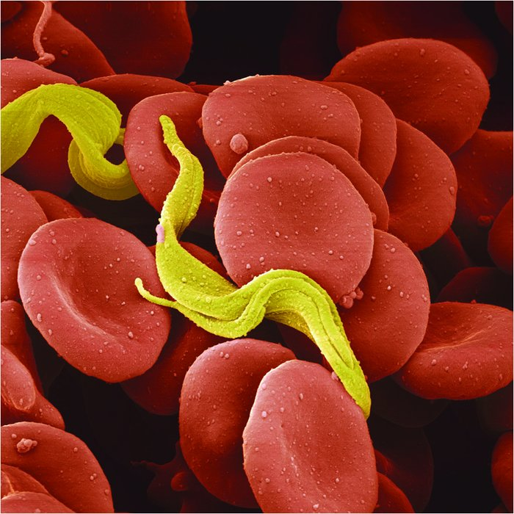
Pathogenic microorganisms strategies to escape normal host defenses
The third mechanism of antigenic variation involves
programmed rearrangements in the DNA of the pathogen.
Trypanosomes are insect-borne protozoa that replicate in the extracellular tissue spaces of the body and cause sleeping sickness in humans.
In African trypanosomes changes in the major surface antigen occur repeatedly within a single infected host.
The trypanosome is coated with a single type of glycoprotein, the variant-specific glycoprotein (VSG), which elicits a potent protective antibody response that rapidly clears most of the parasites.
The trypanosome genome, however, contains about 1000 VSG genes, each encoding a protein with distinct antigenic properties.

Slide 64
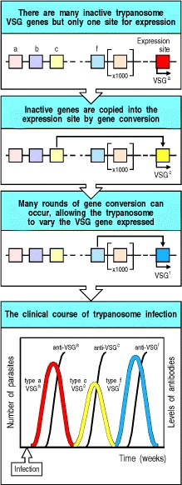
Pathogenic microorganisms strategies to escape normal host defenses
The third mechanism of antigenic variation involves
programmed rearrangements in the DNA of the pathogen.
However the trypanosome genome contains about 1000 VSG genes, each encoding a protein with distinct antigenic properties.
Only the gene in a specific expression site within the telomere at one end of the chromosome is active.
An inactive gene, which is not at the telomere, is copied and transposed into the telomeric expression site, where it becomes active.
When an individual is first infected, antibodies are raised against the VSG initially expressed by the trypanosome population.
A small number of trypanosomes spontaneously switch their VSG gene to a new type, and while the host antibody eliminates the initial variant, the new variant is unaffected. As the new variant grows, the whole sequence of events is repeated.

Slide 65

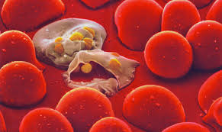
Pathogenic microorganisms strategies to escape normal host defenses
The third mechanism of antigenic variation involves
programmed rearrangements in the DNA of the pathogen.
This chronic cycle of antigen clearance leads to immune-complex damage and inflammation, and eventually to neurological damage, finally resulting in coma. This gives African trypanosomiasis its common name of sleeping sickness.
These cycles of evasive action make trypanosome infections very difficult for the immune system to defeat, and they are a major health problem in Africa.
Malaria is another major disease caused by a protozoan parasite that varies its antigens to evade elimination by the immune system.

Slide 66
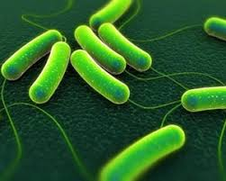
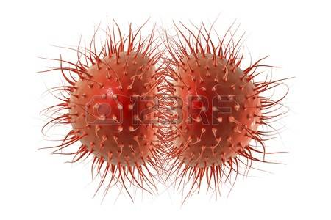
Pathogenic microorganisms strategies to escape normal host defenses
Programmed DNA rearrangements also occurs in bacterial pathogens
Salmonella typhimurium, a common cause of salmonella food poisoning, and
Neisseria gonorrhoeae, which causes gonorrhea, a major sexually transmitted disease.
S. typhimurium regularly alternates its surface flagellin protein by inverting a segment of its DNA containing the promoter for one flagellin gene. This turns off expression of the gene and allows the expression of a second flagellin gene, which encodes an antigenically distinct protein.
N. gonorrhoeae has several variable antigens, the most striking of which is the pilin protein, which is encoded by several variant genes, only one of which is active at any given time.

Slide 67
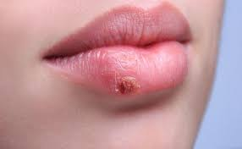
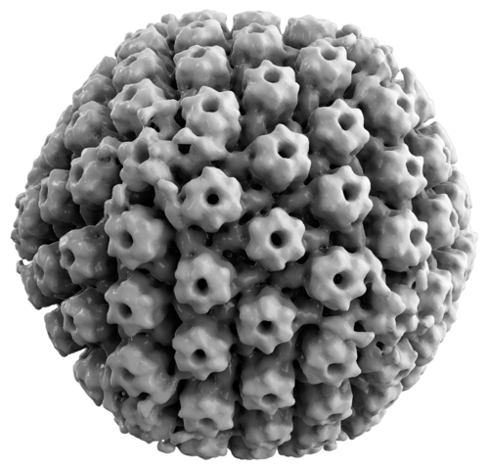
Virus latency
To replicate, a virus must make viral proteins, and rapidly replicating viruses that produce acute viral illnesses are therefore readily detected by T-cells.
Some viruses, can enter a state known as latency in which the virus is not being replicated and therefore is not eliminated.
Such latent infections can be reactivated and this results in recurrent illness.
Herpes simplex virus, the cause of cold sores, infects epithelia and spreads to sensory neurons serving the area of infection.

Slide 68

Herpes simplex
reactivation
is frequent.
Herpes zoster usually
reactivates only once
in a lifetime in an
immunocompetent
host.

Slide 69
Virus latency
This cycle can be repeated many times.
There are two reasons why the sensory neuron remains infected:
  the virus is quiescent in the nerve and therefore few viral proteins are produced, generating few virus-derived peptides to present on MHC class I;
  neurons carry very low levels of MHC class I molecules, which makes it harder for CD8 T-cells to recognize infected neurons and attack them.
    This low level of MHC class I expression might be beneficial, as it reduces the risk that neurons, which regenerate very slowly if at all, will be attacked in appropriately by CD8 T cells. It also makes neurons unusually vulnerable to persistent infections.

