Slide 1
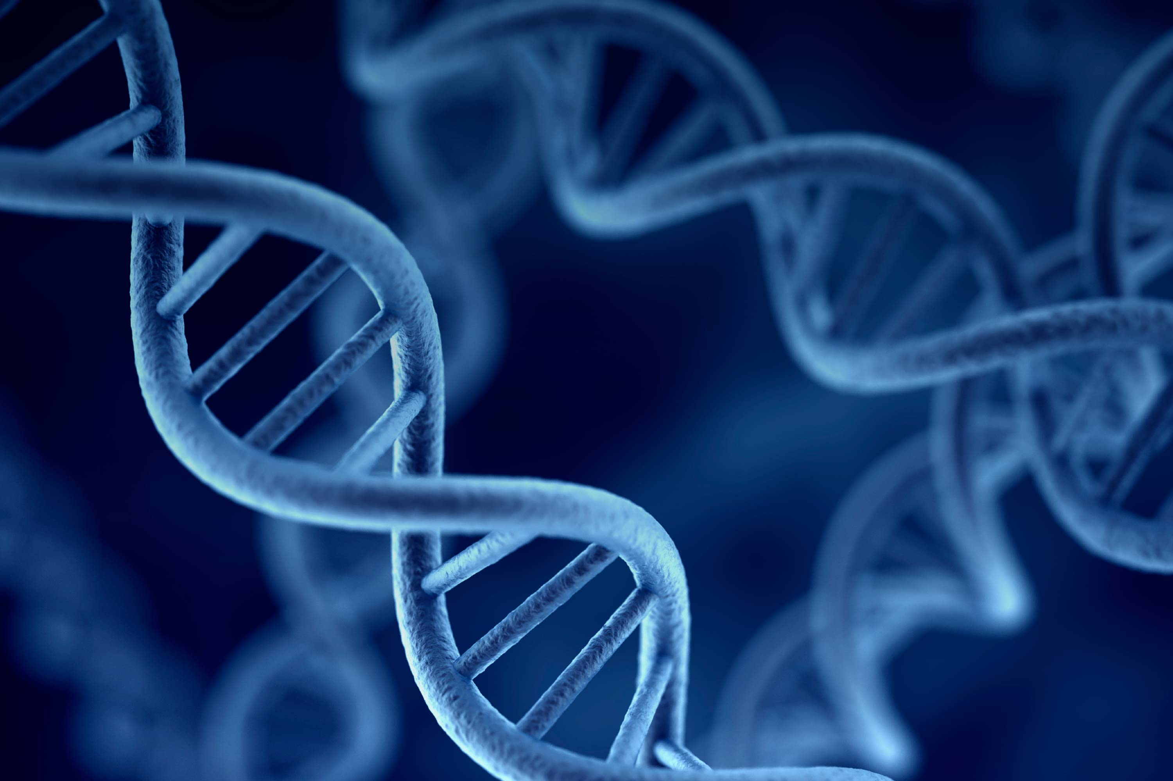
Introduction to
Molecular Genetics
Ilona Mandrika

Slide 2
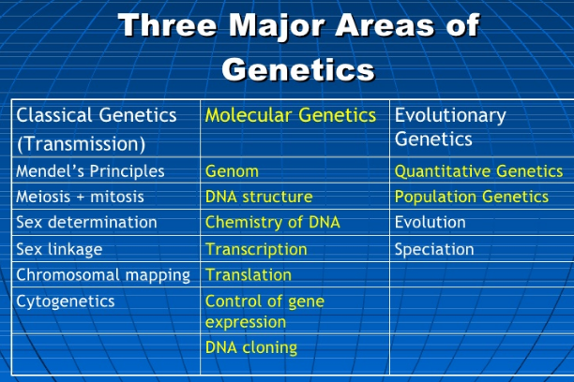
Classical genetics provide explanations of the
transmission of phenotypic differences from
parents to offsprings by following the
transmission of gene differences from generation to
generation.
Molecular genetics is the study of how the
molecules that bring about heritable traits interact to produce said traits.
Molecular genetics is the study of how
a proteins interact with the actual DNA molecule
itself to produce the target RNA and protein and
how all these macromolecules are regulated.
Molecular genetics also involves some cellular biology and biochemistry whereas
classical genetics is more statistical/mathematic.

Slide 3
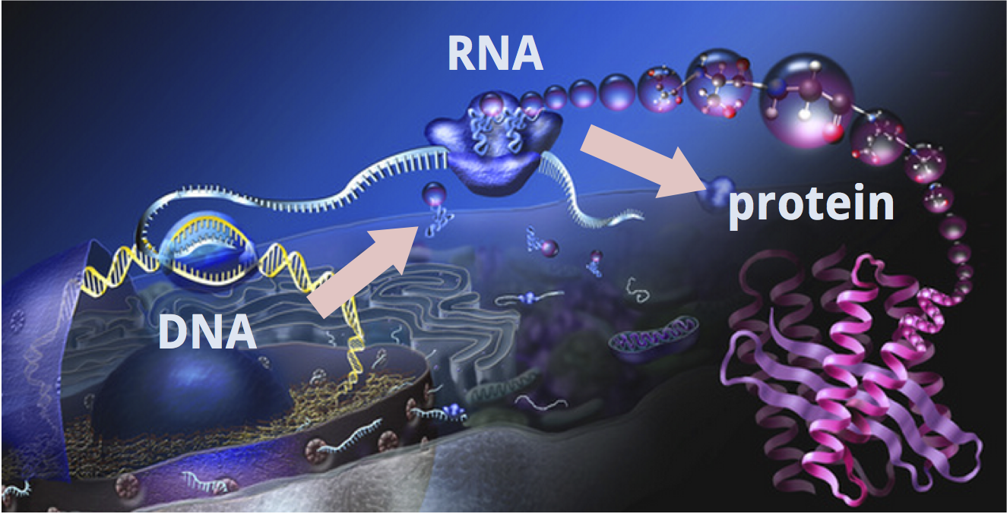
Central dogma of life
Genes and DNA direct all life processes by providing the information that specifies the development and
functioning of organisms.
The central dogma describes the flow of genetic information from DNA to RNA to protein.

Slide 4
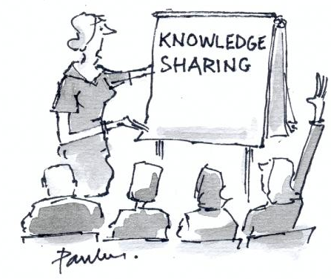
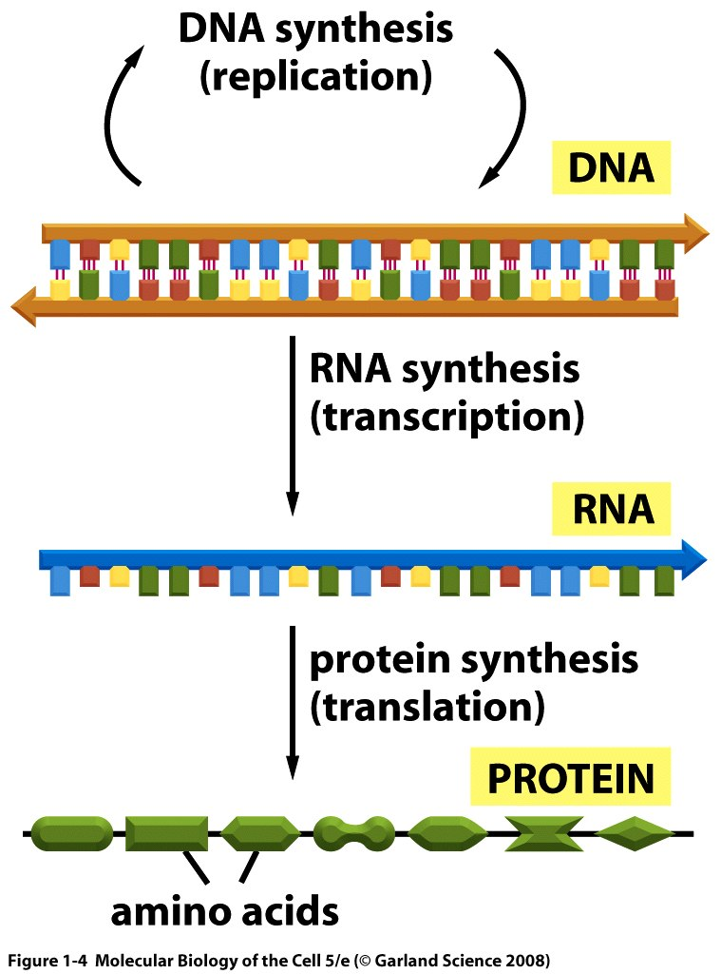
Introduction to
Molecular Genetics
DNA synthesis
(replication)
DNA
Lectures:
Structure of nucleic acids
DNA replication
Transcription, mRNS maturation
Translation
Human genome organisation
Gene expression regulation
Hot fields in science research
RNS synthesis
(transcription)
RNA
Protein synthesis
(translation)
Protein
amino acids

Slide 5
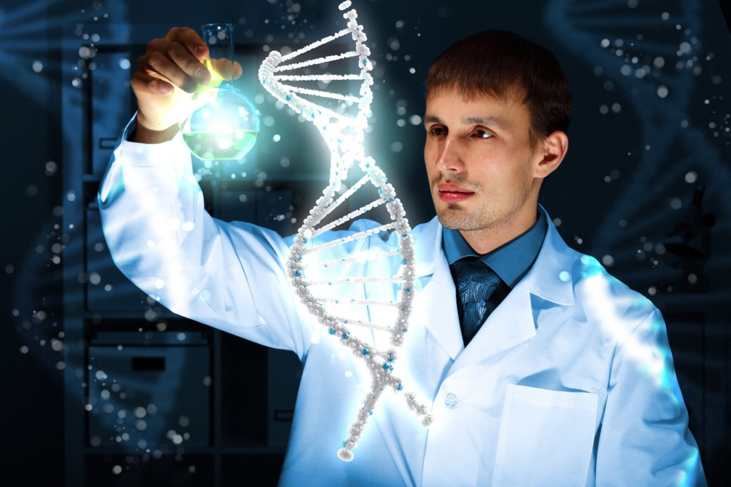
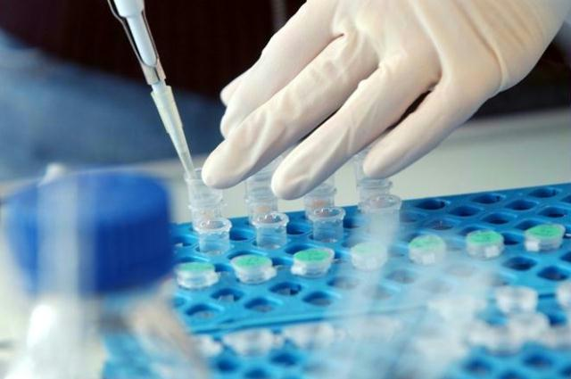
Introduction to
Molecular Genetics
Laboratory works:
Genomic DNA extraction from biological samples.
Amplification of gene fragments from extracted genomic DNA by
polymerase chain reaction (PCR).

Slide 6
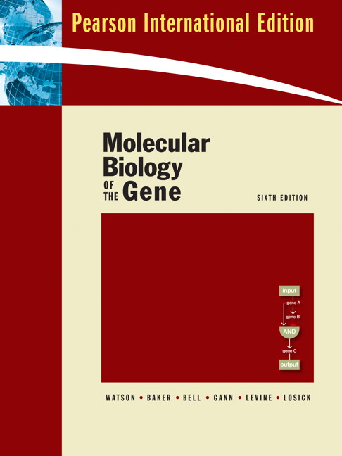
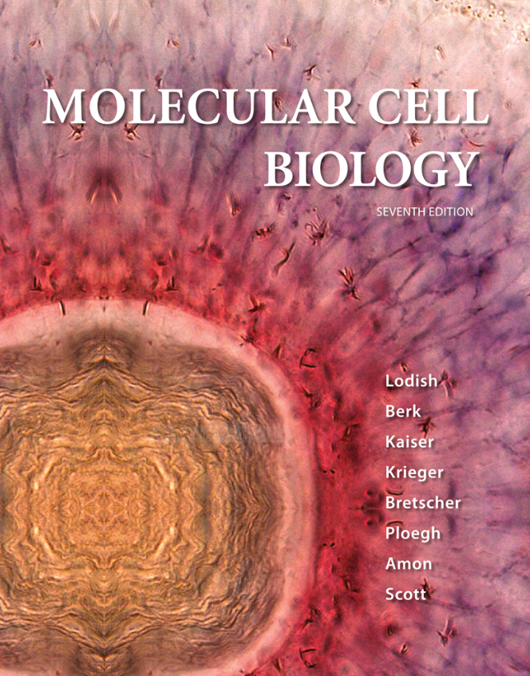
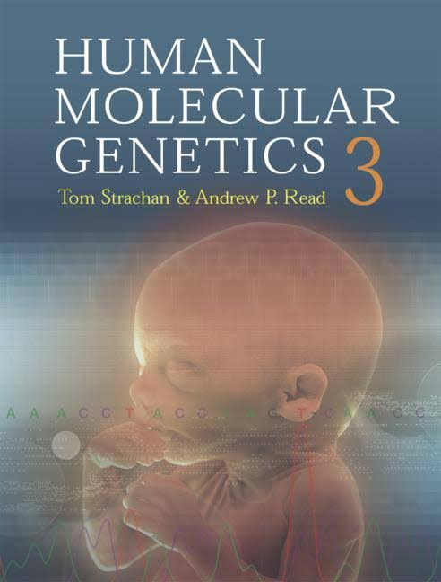
Literature

Slide 7
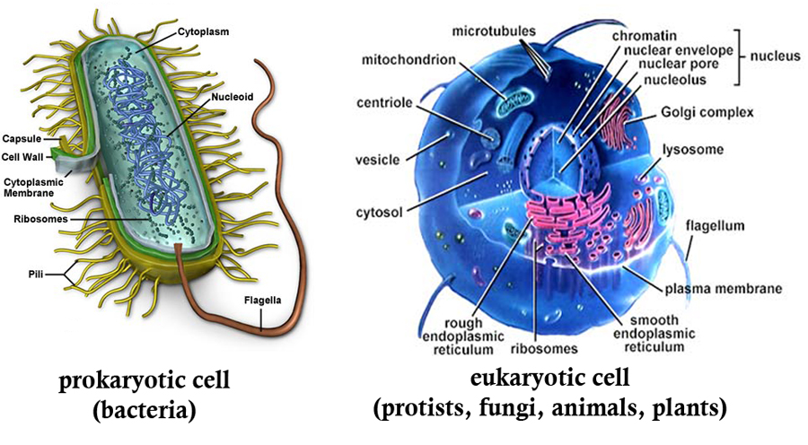
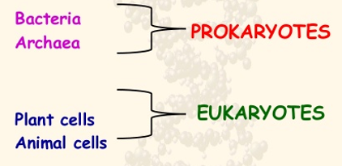
Living organisms can be classified into
prokaryotes and eukaryotes
Prokaryotes and eukaryotes are two distinct cell types with structural differences.
Notes:
4.7 Eukaryotic Cells In electron micrographs, many plant cell organelles are nearly identical in form to those observed in animal cells. Cellular structures unique to plant cells include the cell wall and the chloroplasts. Animal cells contain centrioles, which are not found in plant cells.

Slide 8
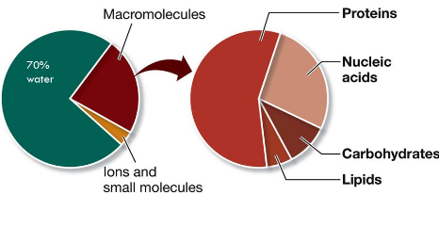
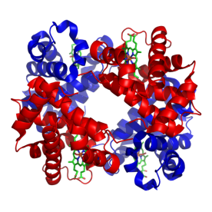
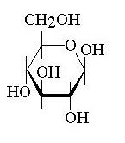
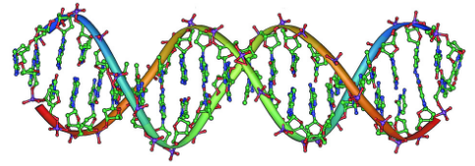

Chemical composition of living cells
There are four general classes of
macromolecules within living cells:
26%
Proteins
Carbohydrates
4 %
Lipids
Nucleic acids

Slide 9
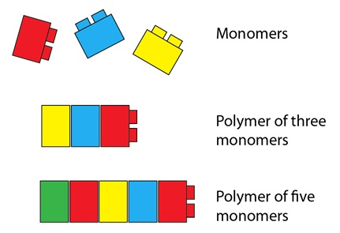
Monomers and polymers
Macromolecules are actually made up of even
smaller subunits. Each subunit is called a monomer.
The macromolecules are called polymers,
because they are made up of many of these monomers,
chemically joined together.
from the Greek word poly, meaning "several", and mer, meaning "unit"

Slide 10
Nucleic acids
There are two common forms of nucleic acids in biological systems
Ribonucleic acid
RNA
Deoxyribonucleic acid
DNA
DNA and RNA form the fundamental building blocks of the universal genetic code.
They can form complex structures which interact with proteins, other nucleic acids, and small regulatory molecules.

Slide 11
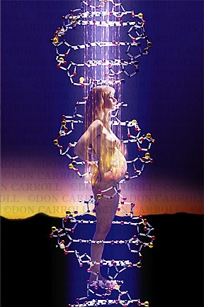
Revealing DNA as the molecule of life
How was DNA discovered to be the carrier
of genetic information?

Slide 12

Let’s take a journey back in time

Slide 13
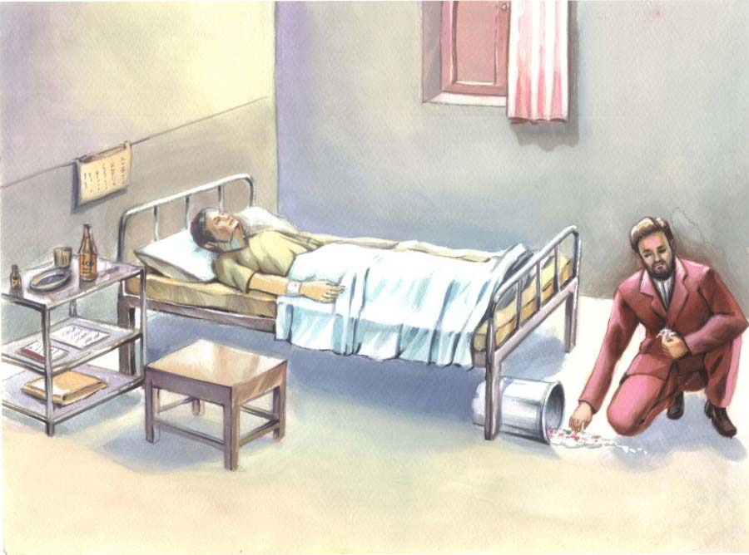
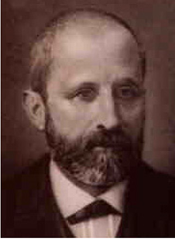
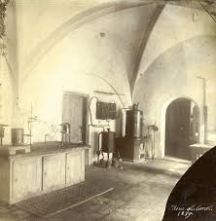
Swiss chemist Friedrich Miescher
The man who discovered DNA.
Worked in Hoppe-Seyler lab at University of
in Tubingen, south- west Germany.
1844- 1895
Hoppe-Seyler lab researchers were isolating the
molecules that made up cells.
Miescher was given the task of researching the
composition of lymphoid white blood cells.
He collected the white blood cells from pus on surgical
bandages he obtained from a nearby hospital.
kitchen of a Tubingens medieval castle

Slide 14
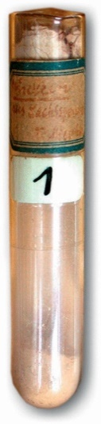
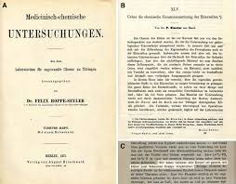
Swiss chemist Friedrich Miescher
In 1869 he extracted from the cell nuclei a new
molecule that was slightly acidic and contained a high percentage of phosphorus.
He named this molecule as nuclein. Later known
as nucleic acid or deoxyribonucleic acid or DNA.
He was able to isolate nuclein also from other cells
and later used a salmon sperm as a source.
His paper on nuclein was published only in 1871.
His chief was skeptical about such a unique molecule
and repeated himself Miescher’s experiments before
publication.

Slide 15
Swiss chemist Friedrich Miescher
He did not believe that nuclein was the carrier of hereditary information
    it was a simple molecule that lacked the variability necessary to account for the incredible diversity among organisms.
He believed that proteins were the molecules of heredity
    they were more complicated molecules and existed in such a wide variety of forms.

Slide 16
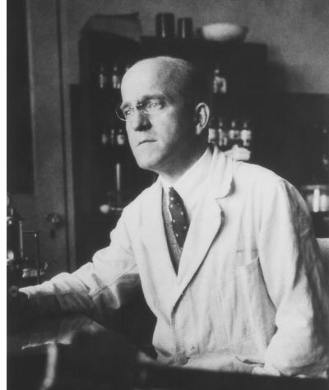
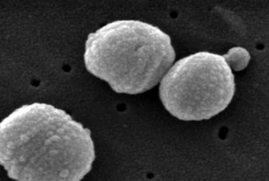
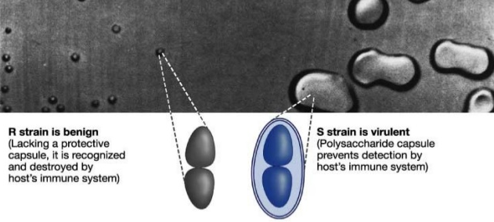
British bacteriologist Frederick Griffith
The man who identified the ‘transforming prnciple’.
In the 1920s he was trying to develop a vaccine for pneumonia
caused by bacteria
Streptococcus pneumoniae
He noticed that bacteria has two visually distinct strains:
Smooth (S) strain
  produce smooth colonies
    secrete a polysaccharide capsule
      pathogenic
1879 - 1941
Rough (R) strain
  produce colonies with a rough appearance
    unable to secrete a capsule
      non-pathogenic

Slide 17


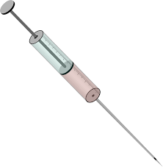
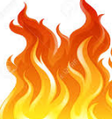
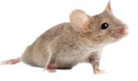
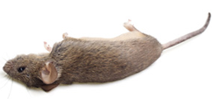
British bacteriologist Frederick Griffith
In 1928 he performed ground – breaking experiment, where he established that there was a transforming principle in bacterial genetics.
He infected mice with both strains
heat-killed
smooth strain
heat-killed
smooth +
rough strain
smooth strain
rough strains
no cells
no cells

Slide 18

From experiments, Griffith concluded that non- pathogenic R strain could be converted
to lethal S strain by «S factor».
«S factor» had to be one of proteins, lipids, sugars or nucleic acids.
Previous research had ruled out lipids and sugars as the heritable material.
Protein
DNA

Slide 19
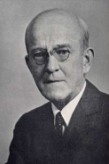
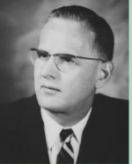
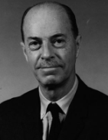
For the next multiple decades, most scientists continued to believe
that protein, not DNA, was the carrier of hereditary information.
This changed in 1944
Avery, McCarty and MacLeod
repeated Griffith’s experiment
looking for
what is being transferred.
Oswald T Avery
Maclyn McCarty
Colin MacLeod

Slide 20
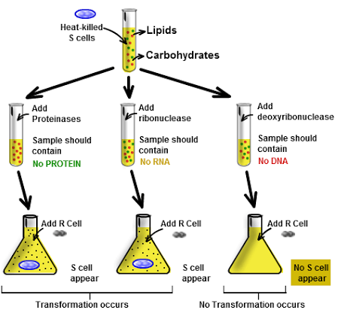
Avery, MacLeod and McCarty experiment
Out of concern for the animals, scientists in the 1940s had
stopped using live mice for the pneumonia test.
They separated the classes of macromolecules
found in the S cell debris and tested them
for transforming ability, one at a time.
They removed from the solution lipids and
carbohydrates.
Used enzymes- RNase to destroy RNA,
proteases (trypsin&chemotrypsin) to destroy
proteins and DNase to destroy DNA.
Transformation of R cells into S cells
did not happen without DNA.

Slide 21
In 1944, their experiment proved that
DNA is the heritable material and not protein.
However, many biologists still were not willing to concede that Avery’s team
had demonstrated that DNA molecules are the source of genetic information.
Avery’s work was regarded as significant, but not definitive.

Slide 22
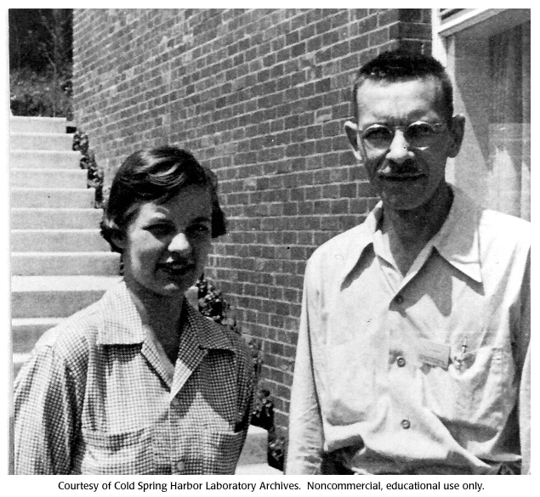
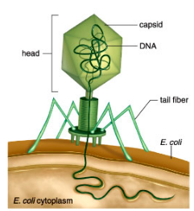
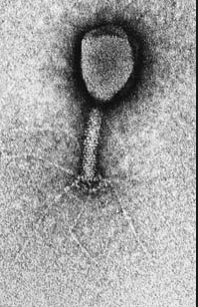
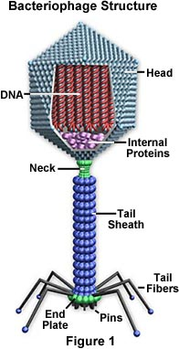
Finally, the clincher was provided by
Alfred Hershey and Martha Chase experiment in 1952.
They studied the bacteriophage T2- a virus
that infects and replicates within bacteria.
Phage infection reprograms a host bacterial
cell to produce more virus.
What they knew:
capsid
The bacteriophage T2 is relatively simple.
It is composed of only
  protein
    DNA
Which viral component is responsible for the reprogramming,
DNA or protein?

Slide 23
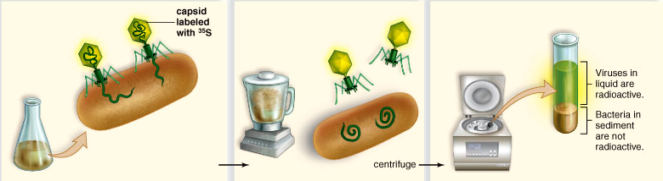
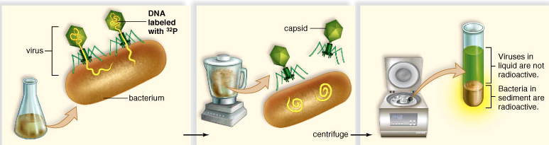
Alfred Hershey and Martha Chase experiment, 1952
Two sets of T2 bacteriophages were used in experiment:
Only the ³²P was injected into
the E.coli, indicating that DNA
was the agent necessary
for the production of
new phages.
1. The protein coat was labeled with radioactive sulfur ³⁵S,
not found in DNA.
Demonstrated that the genetic
material of phage is DNA, not
protein.
Provided further evidence that
DNA is the genetic material.
2. The DNA was labeled with radioactive phosphorus ³²P,
not found in protein.

Slide 24
DNA and RNA structure

Slide 25
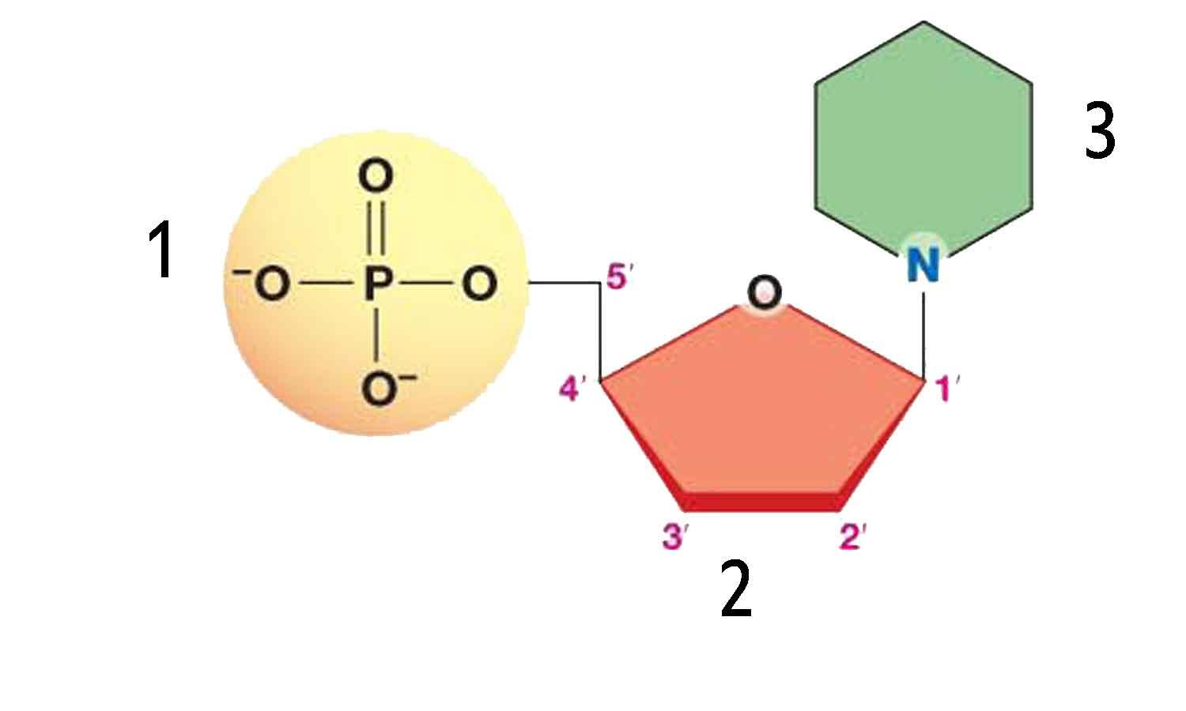
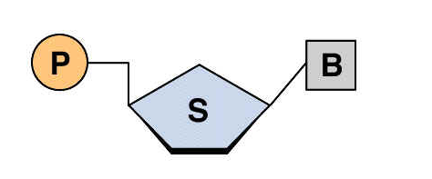
DNA and RNA structure
Nucleic acids are polymers composed of monomers. The monomer of all nucleic acids (DNA and RNA) is called a nucleotide.
Each single nucleotide consist of
three smaller components:
1. Phosphate group(s)
2. Pentose sugar
3. Nitrogenous base
All components held together by strong covalent bonds.

Slide 26


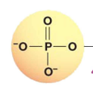

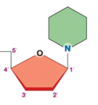
Phosphate(s) groups
If there is one phosphate, the nucleotide is
a monophosphate.
If there are two phosphates, the nucleotide is
a diphosphate.
If there are three phosphates, the nucleotide is
a triphosphate.
If there are no phosphates, the molecule is called a nucleoside, not a nucleotide.

Slide 27
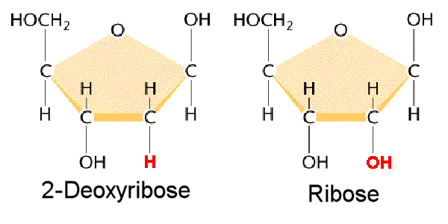
Pentose sugar
Ribose is the sugar component of nucleotides.
One of the main chemical differences between
DNA and RNA is that in RNA, the sugar is ribose,
but in DNA , the sugar is deoxyribose,
in which an oxygen has been removed.
Ribose
DNA
RNA
(compare the bottom right corners of the two structures - you'll see that the "OH" side group of ribose has been replaced with an "H" ).

Slide 28

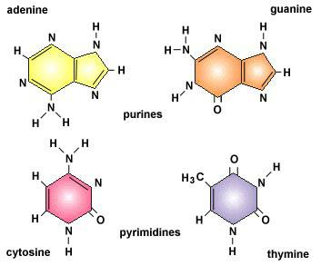
Nitrogenous bases
In DNA 4 different bases are found:
Adenine (A)
Guanine (G)
A and G are double ringed purines.
Cytosine (C)
Thymine (T)
C and T are single ringed pyrimidines.

Slide 29
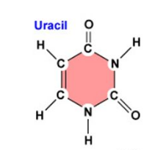
Nitrogenous bases
In RNA also 4 different bases are found:
The same purines, A and G.
Adenine (A)
Guanine (G)
The same pyrimidine C,
Cytosine (C)
But instead of T, it uses the pyrimidine uracil (U).
Uracil (U)

Slide 30
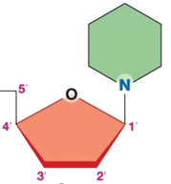

Naming nucleotides
Nitrogenous base
Nucleoside
Adenine Adenosine
Guanine Guanosine
Thymine Thymidine
Cytosine Cytidine
Uracil Uridine

Slide 31
RNA
Naming nucleotides
Nucleotide names are a three letter abbreviation.
NTP – nucleoside triphosphate
ATP Adenosine Tri– Phosphate
ADP Adenosine Di–Phosphate
AMP Adenosine Mono–Phosphate
GTP Guanosine Tri– Phosphate
CTP Cytidine Tri– Phosphate
UTP Uridine Tri– Phosphate
The first letter refers to the nucleoside.
The second letter refers to the number of
phosphates.
The third letter refers to the phosphate.

Slide 32
DNA
Naming nucleotides
Nucleotide names are a three letter abbreviation.
dNTP – deoxynucleoside triphosphate
Usually phosphate groups are
connected to 5’ C atom of sugar.
dATP deoxyAdenosine Tri– Phosphate
dADP deoxyAdenosine Di–Phosphate
dAMP deoxyAdenosine Mono–Phosphate
dGTP deoxyGuanosine Tri– Phosphate
dCTP deoxyCytidine Tri– Phosphate
dTTP deoxyThymidine Tri– Phosphate
dATP- deoxyadenosine- 5’- triphosphate
In rare cases phosphate group could be
connected to 3’ C atom of sugar.
dATP- deoxyadenosine- 3’- triphosphate
In this case, the position of phosphate
groups should be mentioned.
only deoxy and only in DNA

Slide 33
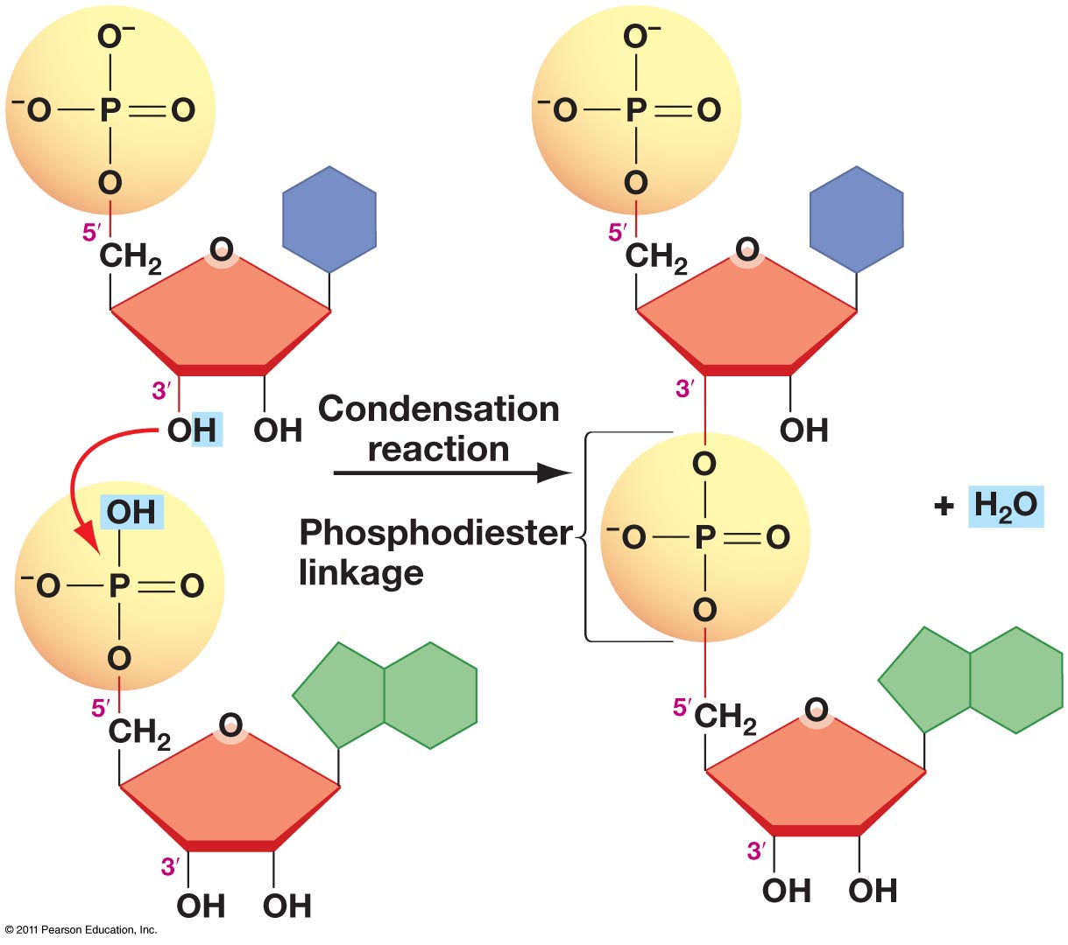
How are nucleotides joined together to form nucleic acids?
Nucleotides are the subunit that is polymerized to make nucleic acid.
When a DNA or RNA polymer is created,
the bond is formed between the 5' phosphate group one nucleotide and the 3' -OH group in
sugar of the preceding nucleotide.
This is called a phosphodiester bond.
It is a covalent bond.
Because of this intrinsic directionality,
nucleic acid sequences are typically written
from 5´to 3´ unless otherwise specified.

Slide 34
Structure of nucleic acids
The linear sequence of nucleotides linked by phosphodiester bonds constitutes
the primary structure of nucleic acids.
Polynucleotides can twist and fold into 3D conformations stabilized
by noncovalent bonds.
Although the primary structures of DNA and RNA are generally similar,
their 3D conformations are quite different.
These structural differences are critical to the different functions of the nucleic acids.

Slide 35
Let’s take a journey back in time
How the structure of DNA has been discovered?

Slide 36
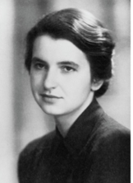


Discovering the structure of DNA
Franklin’s X-ray
diffraction photograph
of DNA
Maurice Wilkins
Rosalind Franklin
1916 - 2004
1920 - 1958
In 1952, Maurice Wilkins and Rosalind Franklin used a technique called X-ray crystallography to get information about the structure of DNA.
King’s college n London

Slide 37

Spots from
diffracted X-rays
Photo 51
In X-ray crystallography, X-rays were diffracted as they passed through aligned fibers of purified DNA creating the image now known as Photo 51. The beams going through the crystal are bent at specific angles that are unique to the molecular structure of the crystal.
X-ray diffraction revealed an X-shaped pattern showing that the strands in DNA are twisted around each other. The twisted shape is known as a helix.
The angle of the X-shaped pattern suggested that there are two strands
in the DNA structure.
Other clues suggest that the nitrogenous bases are near the center of the DNA molecule.

Slide 38

Discovering of DNA structure
James Watson and Francis Crick used Rosalin Franklin’s X-ray
crystallography diffraction image (without her permission)
to determine the width of DNA helix and the spacing of bases
(to develop a model of the DNA structure).
They read one of Franklin’s unpublished studies
where she figured out that the sugar
phosphate is part of the DNA backbone,
with the hydrophobic nitrogenous bases in the center.
James Watson
Francis Crick
1928 -
1916 - 2004
University of Cambridge’s Cavendish
laboratory in England
They read Edwin Chargaff’s studies where he showed
that in all organisms tested, the nucleic acid A content was comparable to T, and the G content was comparable to C.

Slide 39

Discovering the structure of DNA
1953
James Watson and Francis Crick made a model of
DNA that incorporated the findings of
Chargaff, Franklin and Wilkins.
In 1953 they published a 1 page paper on the DNA structure.
Watson JD and FH Crick, ”Molecular Structure of Nucleic Acids; A Structure for
Deoxynucleic Acids”. Nature 171 (1953), p.738.
Their DNA model fit the experimental data so perfectly that
it was almost immediately accepted.

Slide 40



1962: Nobel Prize in Physiology or Medicine
Wilkins shared the 1962 Nobel Prize in Physiology or Medicine
with Francis Crick and James Watson.
Rosalind Franklin
1920 - 1958

Slide 41

DNA structure
5’
3’
DNA consists of 2 associated polynucleotide strands
that wind together through space in a helical fashion which is named as double helix (looks like a twisted staircase).
Strands are held together by the cooperative energy of many hydrogen bonds (H- bonds) and hydrophobic interactions.
The orientation of the 2 strands is antiparallel. Their 5’ 3 directions are opposites.
5’
3’

Slide 42


DNA structure
The two sugar-phosphate backbones are on the outside of the double helix.
The sugar and phosphate make up the backbone.
Sugar – phosphate backbone of each strand is negatively charged.
The bases project the interior of the double helix and are stacked in parallel “rungs”, 0.34 nm apart.

Slide 43

Watson- Crick base pairs rules
The nitrogen bases can only pair in a certain way:
A specifically binds to T
G specifically binds to C
The base composition of DNA is not random:
The amount of Adenine equals that of Thymine
A = T
The amount of Cytosine equals that of Guanine
C = G
Associations between a larger purine (A or G) and a smaller pyrimidine (C or T),
are often called Watson- Crick base pairs.

Slide 44

A – T base pairs have 2 connecting hydrogen bonds.
C – G base pairs have 3 connecting hydrogen bonds.
Hydrogen bonds
Two polynucleotide strands, in which all the nucleotides form such
base pairs are said to be complementary.
A – T or T - A
G – C or C - G

Slide 45
What is the sequence of bases on the complementary strand?
One DNA strand has the sequence
5’- ATTCCGTAGC - 3’
Complementary strand sequence:
      5’- -3’
Remember
A pairs with T
G pairs with C
The complementary strand
will read from
left to right in the 3′ to 5′ direction.
Therefore, the complementary strand
starts with 3’ and ends with 5’.

Slide 46


Variations in DNA structure
DNA can adopt different types of helical structure.
A- DNA
B- DNA
Z- DNA
A- DNA and B- DNA are both right handed helices.
Ones in which the helix spirals in a clockwise direction
as it moves away from the observer.
right handed
left handed
Z- DNA is a left handed helix.

Slide 47

Variations in DNA structure
B- DNA
The most common form of DNA under physiological conditions.
Stacked bases are regularly spaced 0.34 nm apart along the helix axis.
Here each helical strand has a pitch (the distance occupied by a
single turn of the helix) of 3.4 nm which accommodates
10 nucleotides (bp).

Slide 48


B- DNA
Major and minor grooves
On the outside of DNA, the spaces between the
intertwined strands form two helical grooves of
different widths- major groove and
the minor groove.
A major and minor groove result from
the unequal spacing of the phosphate- sugar backbone.
The atoms in the bases within these grooves are accessible
for DNA- binding proteins. Proteins are able to bind to specific
DNA sequences without separating the strands of the double
helix.

Slide 49

Variations in DNA structure
A- DNA
Is wider and shorter than B- form DNA,
with the wider and deeper major groove
and a more narrow and shallow minor groove.
Has 11 base pairs per turn.
Forms under conditions of low salt and low humidity.

Slide 50

Variations in DNA structure
Z- DNA
Is long and thin.
Phosphate backbone has a zig-zag appearance.
Has 12 base pairs per turn.
Consists of alternating purines and pyrimidines.
Found infrequently.
Is present in nucleosomes and sites of active transcription.

Slide 51

Reversible DNA strand separation
DNA Denaturation or “melting” is the separation of a double strand into two single strands.
Increase in molecular motion breaks the
hydrogen bonds and strands moves apart from
each other by the electrostatic repulsion of the
negatively charged deoxyribose – phosphate
backbone of each strand.
The strands of the double helix must separate during replication and transcription of DNA.
In vitro experiments denaturation can be induced by increasing the temperature of DNA solution.

Slide 52

Reversible DNA strand separation
The temperature at which half the bases in a double- stranded DNA sample
have denatured is denoted- Tm (“temperature of melting”).
Tm depends on several factors:
The amount of G-C base pairs.
Three hydrogen bonds in G-C pairs makes these base pairs more stable than A- T
pairs, which have only 2 hydrogen bonds.
The ion concentration.
The negatively charged phosphate groups in the two strands are shielded by
positively charged ions.
pH of the solution.
At low/ acid pH, the bases became protonated and thus positively charged,
repelling each other.
At high/ alkaline pH, the bases lose protons and become negatively charged,
repelling each other because of the similar charge.
In cells, temperature and pH are maintained.

Slide 53

Reversible DNA strand separation
The process of formation of single stranded DNA from double stranded helical DNA - denaturation.
The process of formation of double stranded helical DNA from single stranded DNA - renaturation.
It involves reannealing of formation of hydrogen bonds between complementary bae pairs.
It is affected by lowering temperature, increasing the ion concentration, or neutralizing pH.
Denaturation and renaturation of DNA are the basis of nucleic acid hybridization, a method used for
detection and isolation of specific DNA molecules in a mixture with different DNA sequences.

Slide 54



Circular DNA
Many bacterial genomic and viral DNAs are circular molecules.
Circular DNA occurs in eukaryotic cell mitochondria.
Circular DNA
Circular DNA also occurs in chloroplasts, which are present in plants
and some unicellular eukaryotes.
Circular DNA still exists as a double helix, but it is a closed molecule
because it is connected in a circular form.
Supercoiled DNA
When the double helix is further coiled around an axis and crosses itself it
forms superhelix.
Supercoiled DNA molecule is more compact than relaxed DNA molecule.
Extent of coiling also affects the DNA’s interactions with other molecules in cells
by determining the ability of the double helix to unwind.
E.coli DNA

Slide 55

Ribonucleic acid (RNA)

Slide 56


RNA
The major function of RNA is to transfer genetic information from DNA to proteins.
This process requires three classes of RNA:
Messenger RNA (mRNA)
Transfer RNA (tRNA)
Ribosomal RNA (rRNA)

Slide 57

RNA structure
RNA mostly is a single- stranded molecule with relatively short chain of nucleotides.
RNA can also be double- stranded and circular.
RNA can also participate in a hybrid helix, composed of one RNA and one DNA strand (RNA- DNA double helices) which are important requirements for gene expression.
DNA mostly is a double stranded molecule with
long chain of nucleotides.

Slide 58


RNA primary structure
RNA primary structure is generally similar to that of DNA with two exceptions:
1. The sugar component of RNA is ribose with a hydroxyl group at the 2’ position.
The OH group on the 2’ position of ribose makes RNA more chemically labile than DNA.
As a result of this lability, RNA is cleaved into mononucleotides by alkaline solution.
This OH group in RNA also provides a chemically reactive group that takes part in RNA-
mediated catalysis.

Slide 59


RNA primary structure
2. Pyrimidine thymine (T) in DNA is replaced by uracil (U) in RNA.
DNA
RNA
The presence of thymine rather than uracil in DNA is important to the long- term stability of DNA because
of its function in DNA repair.

Slide 60

RNA secondary structure
Primary structure of RNA contains a sequence of the bases A, G, C and U.
Due to hydrogen bonds, the bases in RNA may also form base pairs
Whatson – Crick base pairs:
A - U formed by a double hydrogen bond
G - C formed by a triple hydrogen bond
Wooble base pairs:
G ● U formed by a single hydrogen bond
This form of base pairing is not particularly stable.
Exists in secondary structure of RNA: when base pairs occurs in RNA fold

Slide 61



Secondary structure of RNA
Various types of RNA exibit different sizes and conformations, which permit them to carry out
specific functions in a cell.
In secondary structure a single RNA molecule folds
over and forms hairpin loops, stabilized by
intramolecular hydrogen bonds between
complementary bases.

Slide 62

Transfer RNA (tRNA)
Transfer RNA (t RNA) show particularly high degrees of secondary structure (cloverleaf).
Transfer RNA are the smalest of three major
species of RNA molecules, containing
74-95 nucleotide residues.
They transfer the amino acids from cytoplasm
to the protein synthesizing machinery,
hence the name tRNA.
Involved in process of translation.
There are at least 20 species of tRNA one
corresponding to each of the 20 amino acids
required for protein synthesis.

Slide 63

Messenger RNA
Messenger RNA (mRNA) carries information
(protein making instructions)
from DNA to the ribosome.

Slide 64

Ribosomal RNA (rRNA)
Ribosomal RNA (rRNA) provides
a mechanism for decoding mRNA into
amino acids of the protein.
23S subunit of bacterial rRNA

Slide 65

Types of RNA in cells

Slide 66
RNA vs. DNA
RNA | DNA
The number of RNA may differ from cell to cell | For a particular species, the DNA numbers remains constant for every cell
Stability of RNA is low (due to the presence hydroxyl group) | Stability of DNA is high
Types of RNA: mRNA, tRNA, rRNA, hnRNA, snRNA, snoRNA, miRNA, siRNA | Types of DNA: Nuclear DNA, mitohondrial DNA
Molecular weight of RNA from 25000 to 2 million | Molecular weight of DNA from 2 to 6 million
RNA is located in the ribosome. Inside, as well as outside the nucleus | DNA is located in the chromosome Only inside the nucleus

Slide 67
RNA and DNA are two very similar molecules, performing vastly different tasks.
While structurally they differ only by one hydroxyl group,
their functions, importance, and presence in any organism are miles apart.

Slide 68
The RNA World Hypothesis
The first genetic material was probably RNA, not DNA.
This hypothesis was proposed independently by Carl Woese,
Francis Crick and Alexander Rich in the 1960s,
soon after the double-helical structure of DNA was determined.
The term RNA World was first used by Walter Gilbert in 1986 after discovery of ribozymes.

Slide 69

Ribozymes
Ribonucleic acid enzymes or catalytic RNA
Ribozymes have been found to catalyze many different reactions:
  ribozymes can make complementary copies of short stretches of
  their own sequence;
  they catalyze either the breaking or synthesis of phosphoester bonds
  in DNA or RNA.
This property would enable the capacity to self replicate and propagate life.

Slide 70


The RNA World Hypothesis
Earlier forms of life may have relied solely on RNA to store genetic
information and to catalyze chemical reactions.
Protobionts are abiotically (from non-living matter) created molecules surrounded by a membrane.
  They can engage in simple
  reproduction and metabolism.
  They can maintain an internal environment
  different than the external.
Liposomes can spontaneously organize in water
from lipids and organic molecules.

Slide 71

DNS is sometimes considered as modified RNA better
suited for the conservation of genetic information.

Slide 72





DNA sculptures from around the world
New Zealand, Pongaroa
the birthplace of Maurice Wilkins
UK, Newcastle
Sweden, Uppsala
Russia, Novosibirsk
Latvia, Riga

