Slide 1
Genetics of populations
Natural populations
  unit of evolution
  own area
  genetic system
Artificial
  mixture of genotypes
  (opposite of "pure lines")

Slide 2
Genetic characterisation of populations
Genetic heterogeneity of populations
  genetic differences among individuals
  heterozygosity by many of genes of each individual
Main characteristics of genetic particularities of populations
  a set of alleles and their frequencies
  trends of allele changes

Slide 3
Idealised population
  infinite
  sexually reproducing
  randomly mating (panmixy, panmixia)
  diploid
  no selection
  no mutation
  no migration (gene flow)
  no genetic drift

Slide 4
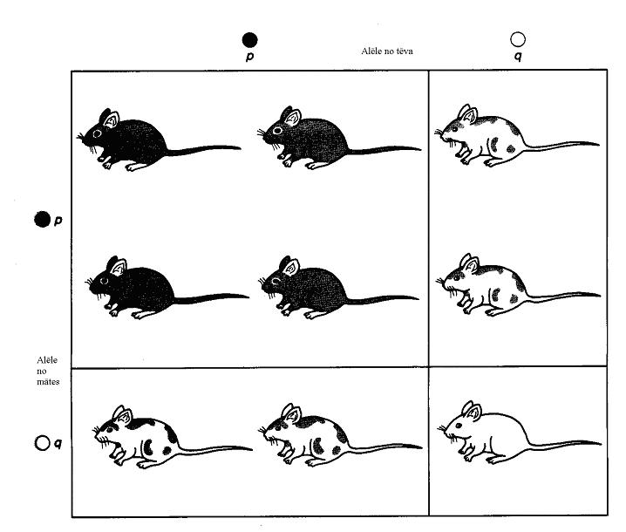
Genotypes in idealised population

Slide 5
Genotypes in ideal population
Model

Slide 6
Hardy-Weinberg law
Main equation
p²(AA) + 2pq(Aa) + q²(aa) =1
allelic frequencies do not change among subsequent generations
after single changes population come back to equilibrium during one generation (gene in autosomal chromosome)

Slide 7
Hardy-Weinberg law consequences
rare alleles are mostly in heterozygous conditions

Slide 8
Gene in the sex chromosome
Equilibrium
p_{m} q_{m}
p_{f}, q_{f}
p_{m(n+1)} = p_{f(n)}
p_{f} = 1.0
p_{f(n+1)} = (p_{f(n})+p_{m(n)} )/2
0.66
0.5
p = 2/3p_{f} + 1/3p_{m}
q = 2/3q_{f} + 1/3q_{m}
p_{m}=0

Slide 9
Hardy-Weinberg law
Relations between allelic frequencies and phenotypic/genotypic frequencies
from allelic frequencies to phenotypic/genotypic
  f_{AA} = p² f_{Aa} = 2pq f_{aa} = q²
from phenotypic frequencies to allelic
  q = √ f_{aa} p = 1 - q

Slide 10
Factors of evolution
selection
mutations
migrations
genetic drift
inbreeding

Slide 11
Natural selection
Selection acts via reproductive success – probability to have progenies
Different traits influence reproductive success in different way
Selection acts according phenotype, not genotype

Slide 12
Types of selection
Objects
  individual
  group, family (complex social structure, altruism)
  Individual selection is more effective than group
    individual life cycle is shorter than group
    genetic diversity between individuals is higher than between groups
    higher correlation between reproductive success and individual traits than with group properties

Slide 13
Types of selection
  directional selection
  stabilizing selection
  disruptive selection
  balancing selection

Slide 14
Selection
Selection – different reproductive success of different genotypes.
W – fitness (1 – for the best genotype)
S – selection coefficient = 1-W (W = 1-S)
Genotypes
AA Aa aa Total
Start frequencies p² 2pq q² 1
Fitness (W) 1 1 1-s
After selection p² 2pq q² (1-s) 1-sq² = W'
W' – average fitness of population
New frequencies p² 2pq q² (1-s) 1
W' W' W'

Slide 15
Types of selection from genetic point of view
1 – against allele (partial dominance)
2 – against recessive allele in homozygotic condition
3 – favourable to heterozygote (against homozygotes)
4 – against heterozygote
1 2 3 4
AA 1.0 1.0 0.9 1
Aa 0.9 1.0 1.0 0.9
aa 0.8 0.8 0.8 1

Slide 16
Types of genetic equilibrium
      a) if W_{het} > W_{hom} stable
      b) if W_{het} < W_{hom} unstable
      c) if W_{het} = W_{hom} neutral

Slide 17
Selection
effective against dominant alleles
not effective against recessive alleles with low frequency
NEUTRAL EVOLUTION
“Neutral evolution” – if absent relations between changes of frequencies of particular genes and adaptiveness (fitness)

Slide 18
Factors of evolution
Mutations
  dominant
    direct selection
  recessive
    under pressure of natural selection only in homozygotic condition
    accumulate in heterozygotic condition
    genetic load
Inbreeding
  increasing number of homozygotes (risk of inbred depression)
Genetic drift
  fluctuations rise by small number individuals in a population
  founder effect

Slide 19
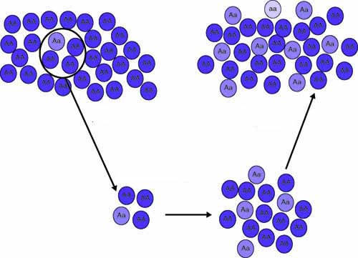
Founder effect
New population is founded by a group with small number of individuals.
Allelic frequencies of several genes in the group can accidentally differed from those in initial population.

Slide 20
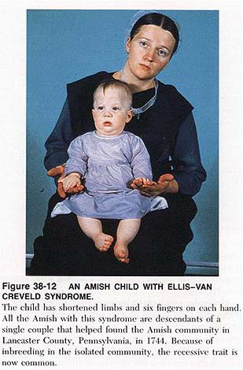
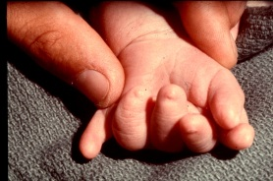
Founder effect
Tay-Sachs disease
  Ashkenazi Jews in USA
    1/27 (Aa)
  French Canada
  General population, USA
    1/250 (Aa)
Huntington’s disease
  Afrikaners in South Africa
    1/29 000 (aa)
      Dutch settlement since 1652. g.
  blacks in South Africa
    1/10 000 000 (aa)
High frequency of syndrome (1/200). Among 30 migrants from Switzerland (1744) one individual had corresponding recessive allele in heterozygotic condition.

Slide 21
Breeding
business, art, science
evolution driven by men
Breeding – creating and selection of genotypes useful for food, agriculture, medicine and other purposes
Genetics – theoretical basis of breeding

Slide 22
Main stages of breeding
Creating of necessary genetic diversity
45 %
Identification and selection of the best genotypes
45 %
Multiplication and testing of selected genotypes
10 %

Slide 23
Breeding methods
selection from local populations
________________________________________
hybridisation ☑ □ □
induced mutagenesis ☑ □ □
heterosis ☑ □ □
polyploidy ☑ □ □
distant hybridisation ☑ □ □
quantitative genetics ☑ ☑ ☑
tissue cultures ☑ ☑ ☑
genetic engineering (GMO) ☑ □ □
molecular markers ☑ ☑ ☑

Slide 24
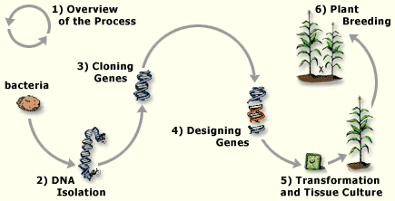
Creating transgenic plants

Slide 25
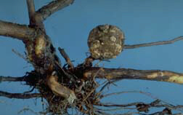
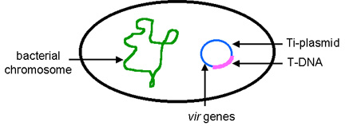
Agrobacterium tumefaciens

Slide 26
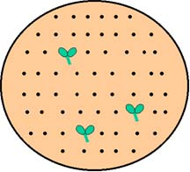
Selection of transformed plants
specific media

Slide 27
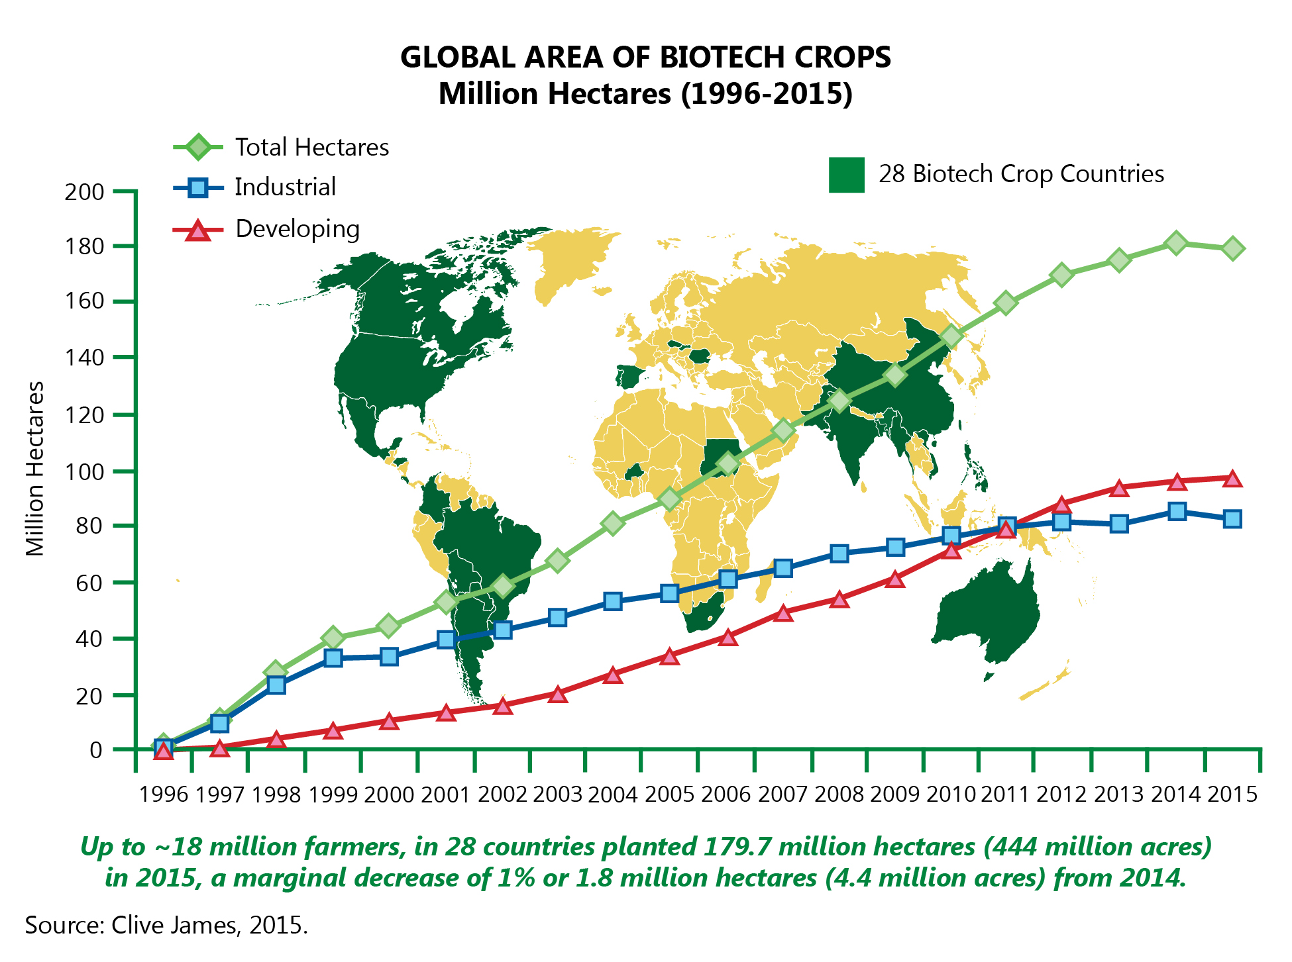

Slide 28
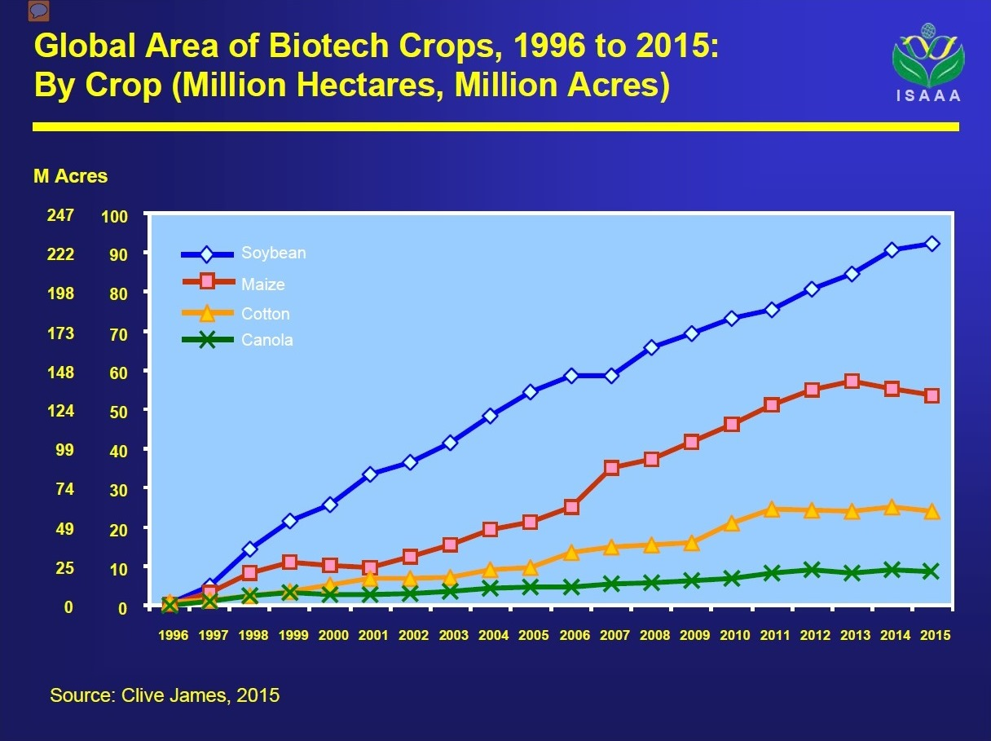

Slide 29
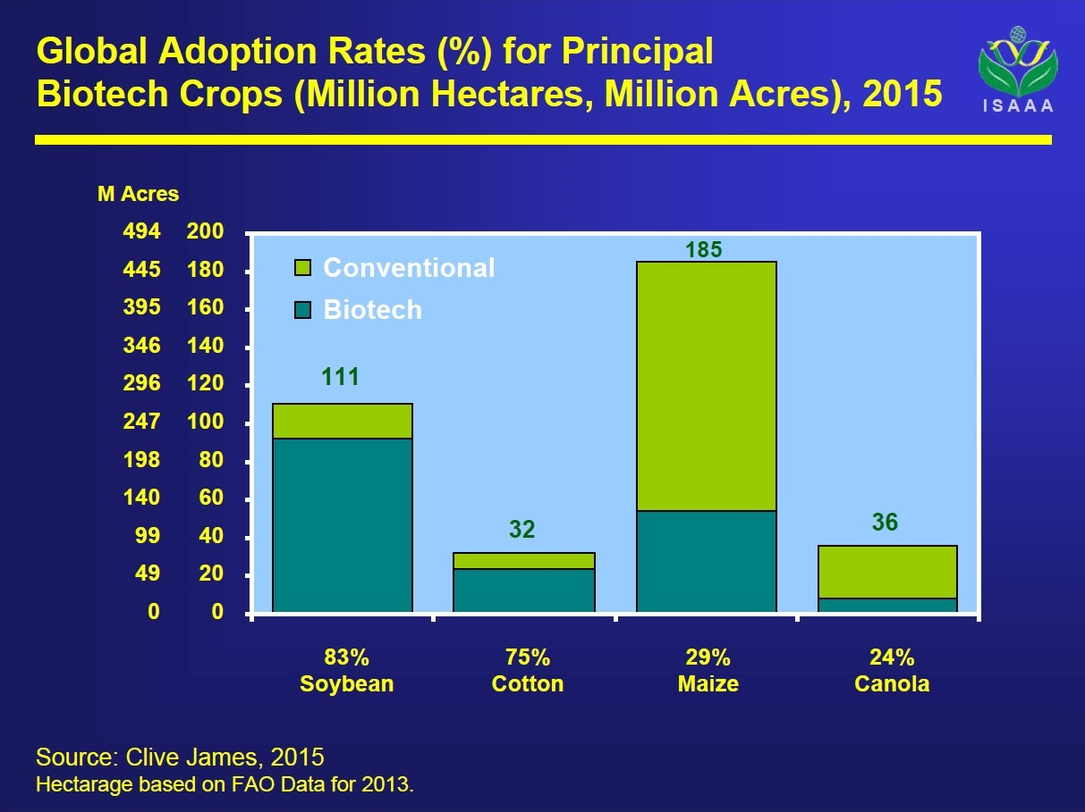

Slide 30
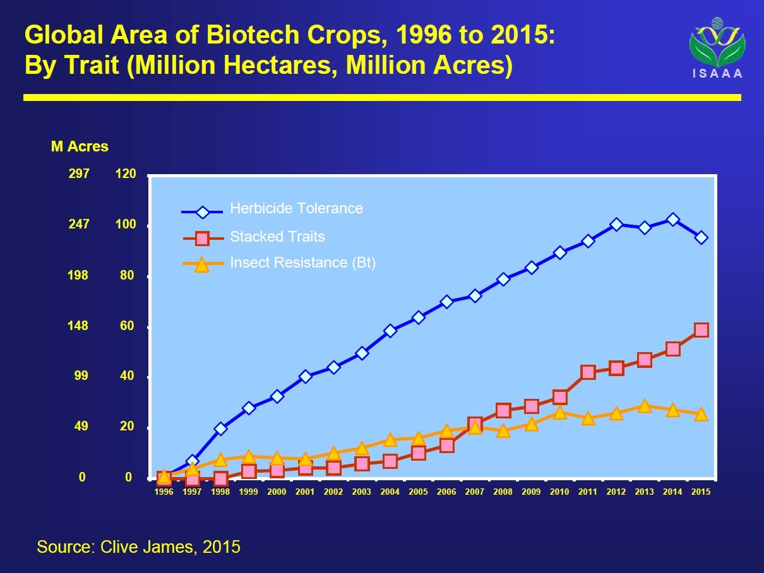

Slide 31
Dangerous of GMO?
direct influence on human heredity
toxic (allergic) effects
influence on heredity of human micro flora
forming of super pathogen race
gene flow from GMO to wild populations

Slide 32
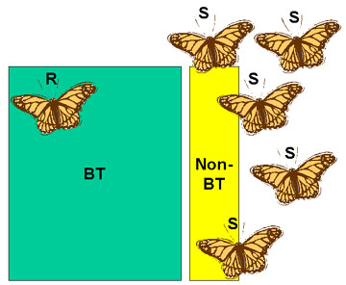
Growing of Bt varieties

Slide 33
Avidin an alternative for Bt protein
blocs a vitamin biotin intake which is necessary to insects development
natural substance – in egg’s albumin
more wide effects
created several GMO with avidin transformation (maize, tobacco)

Slide 34
Blocking of gene flow
Block pollen formation on GMO plants
  make modification in mitochondrial or chloroplast genomes
  using GMO with cytoplasmic male sterility

Slide 35
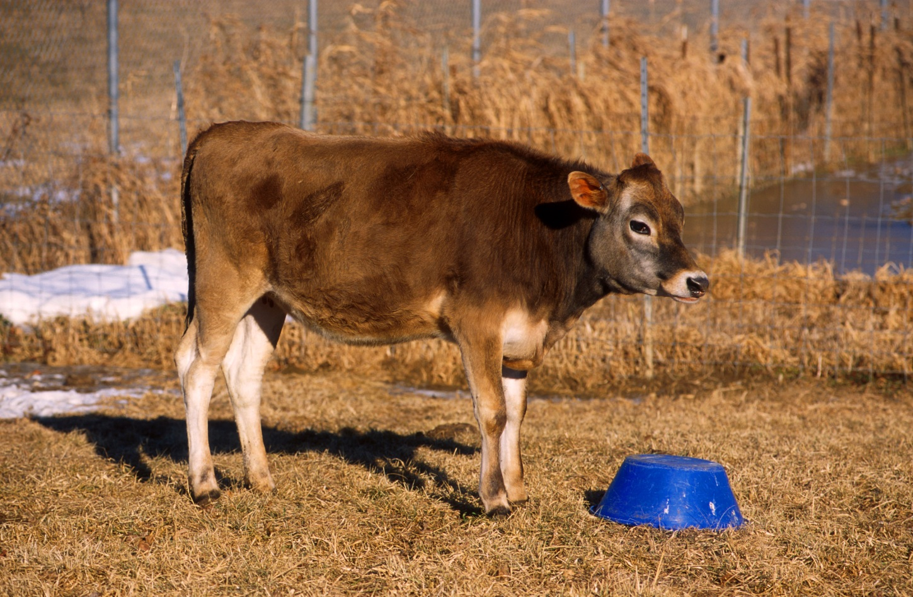
Annie (March of 2000) the first cloned cow with agriculturally important gene
Goal: synhesis of the protein lysostaphin, which suppress bacterium Staphylococcus aureus, causal agent of mastitis.

Slide 36
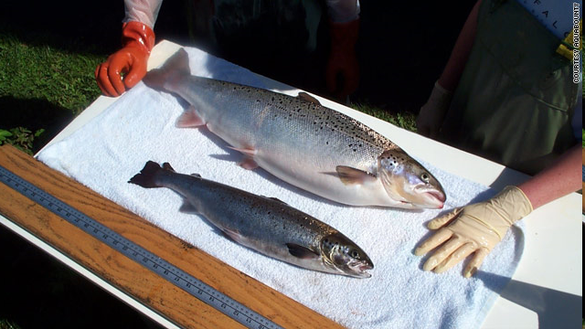
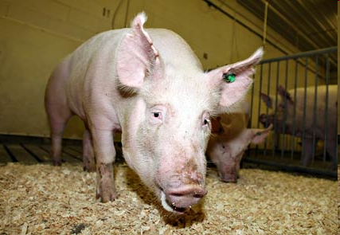
GMO animals
Salmon "AquAdvantage® Salmon“ –more fast growth.
Allowed for food by USA authorities in November 2015!
Pig “Enviropig™” – producing phytase, which allowed to effective utilization of plant phosphorus

