Slide 1
Mutations
Process
Result
  organisms carrying mutation - mutants
  New genetic variability
  Material for evolution

Slide 2
Depending of origin
spontaneous (10⁻⁵ – 10⁻⁶)
induced
  Even "spontaneous" mutations have an inducting factor
  Mutations:
  random
  specific (rate, "hot points" etc)

Slide 3
Classification
Direction
  direct
  reverse
Location
  nucleus
  cytoplasm
Type of cells
  germ-line
  somatic

Slide 4
Classification
Interaction in the locus
  recessive
  dominant (co-dominant, partially dominant)
Influence on fitness
  adaptive
  negative
  lethal
  neutral

Slide 5
Classification
Manifestation
  morphological
  biochemical
  chlorophyll
  ……………………..
  pleiotropic

Slide 6
Classification
Point
  substitution of the one nucleotide
Chromosomal rearrangements
  whole caryotype
  particular chromosomes
  sub microscopic, can be separated from the point mutations only by sequencing

Slide 7
Inducting factors
Mutagens
Physical factors
  temperature
  radiation
    X rays
    ultraviolet light
    neutrons
Chemicals
  different types
  super mutagens
  mutagens in environment, mutagens in the food

Slide 8
Chromosomal rearrangements
Number of whole chromosomal set (euploidy)
  haploidy, polyploidy (colchicine)
    haploid, triploid, tetraploid
Number of particular chromosomes
  aneuploidy (heteroploidy)
    nullisomy, trisomy (nullisomics, trisomics)
Changes of the chromosome structure
  duplications
  deletions
  inversions
  translocations

Slide 9
Chromosomal rearrangements
euploidy – changes in number of whole set of chromosomes
    euploids
  haploidy, polyploidy
    haploids
      genetic analyse, breeding
    triploids, tetraploids
      evolution, breeding

Slide 10
Chromosomal rearrangements
Aneuploidy (heteroploidy) – alteration in the number of particular chromosomes
    aneuploidy
  nullisomy, monosomy, trisomy
    nullisomic (2n - 2)
      can occur only in polyploid species
    monosomic (2n - 1)
    trisomic (2n + 1)

Slide 11
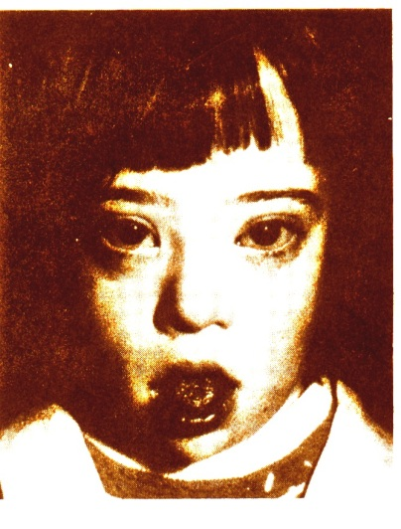
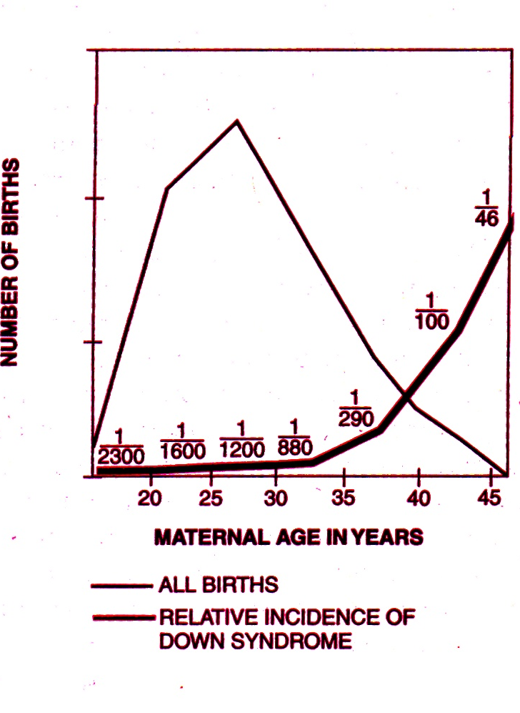
Chromosomal rearrangements
trisomy in humans (2n = 46 + 1)
  trisomy 21 – Down syndrome
Age of mother
20 1 of 1500 births
30 1 of 900 - '' -
35 1 of 400 - '' -
40 1 of 100 - '' -
45 1 of 30 - '' -

Slide 12
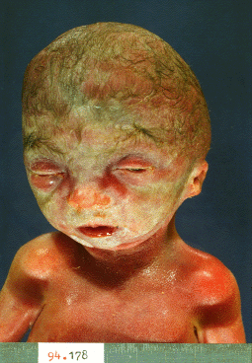
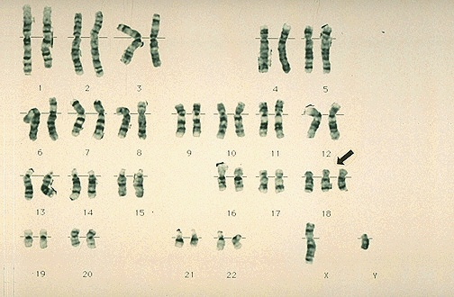
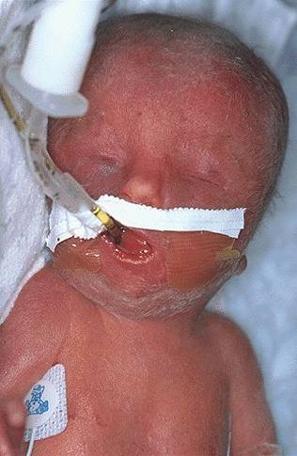
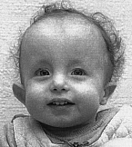
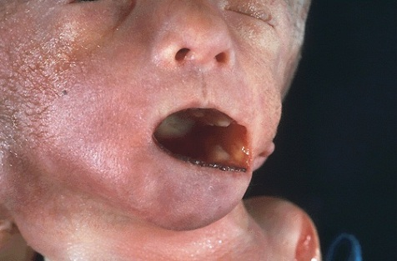
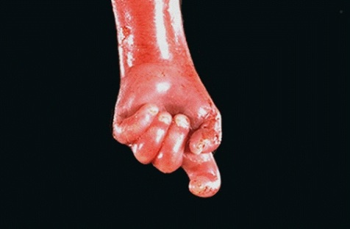
Chromosomal rearrangements
Trisomy in humans (2n = 46 + 1)
  trisomy 18 – Edwards syndrome
    ~ 1 of 3000 births
47, XY, +18 (trisomy 18)

Slide 13
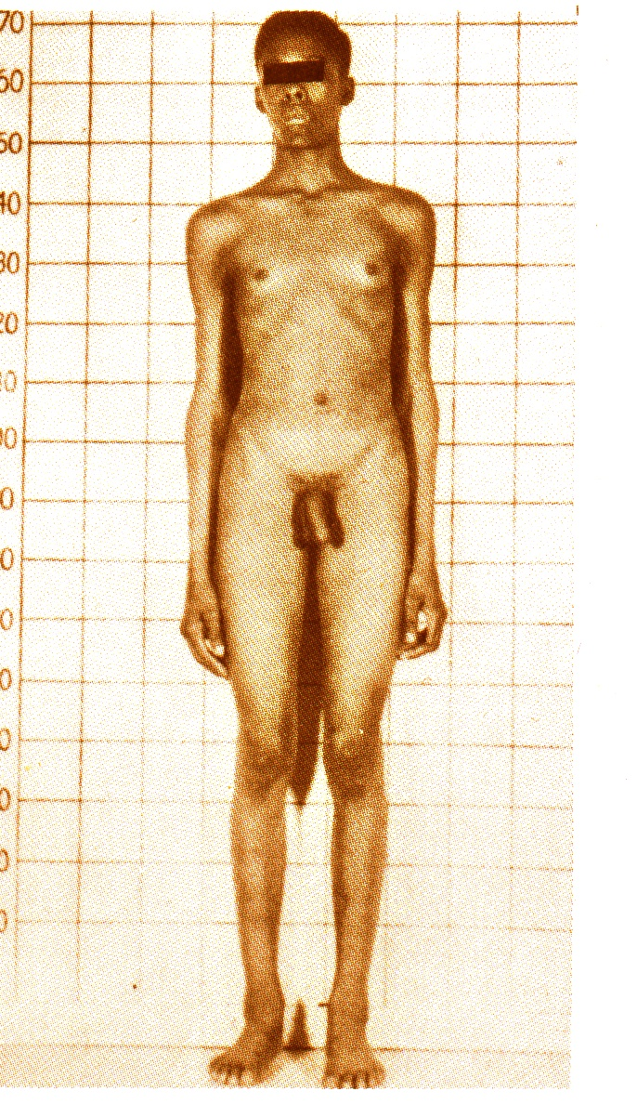
Chromosomal rearrangements
Klinefelter syndrome, XXY
Synonyms:
Klinefelter-Reifenstein-Albright syndrome
Klinefelter-Reifenstein syndrome
Reifenstein-Albright XXY syndrome
chromosome XXY syndrome
XXY syndrome
aspermatogenesis-gynaecomastia syndrome
gynaecomastia-aspermatogenesis syndrome
medullary gonadal dysgenesis
primary microorchidism
puberal seminiferous tubule failure
sclerosing tubular degeneration
seminiferous tubule dysgenesis
Variant forms:
  48,XXXY
  49,XXXXY
  48,XXYY
  49,XXXYY

Slide 14
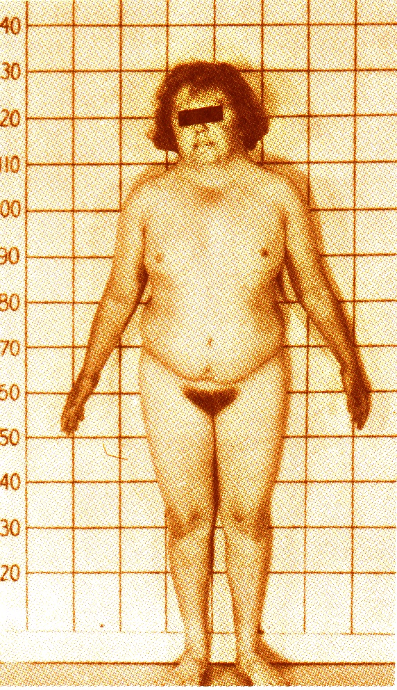
Chromosomal rearrangements
Turner syndrome, X0
Synonyms
Schereshevkii-Turner Syndrome
Turner-Varny Syndrome
Bonnevie-Ulrich Syndrome
45, X Syndrome
XO Syndrome
Monosomy X
Gonadal Dysgenesis (45,X)
Gonadal Dysgenesis (XO)
Morgagni-Turner-Albright Syndrome
Ovarian Dwarfism, Turner Type
Ovary Aplasia, Turner Type
Pterygolymphangiectasia

Slide 15
Chromosomal rearrangements
Changes in the structure of chromosomes
  inside a chromosome:
  inversions
  duplications
  deletions
  insertions

Slide 16
Chromosomal rearrangements
Changes in the structure of chromosomes
  affect two chromosomes
  translocations
    reciprocal translocations
    Robertson translocations

Slide 17
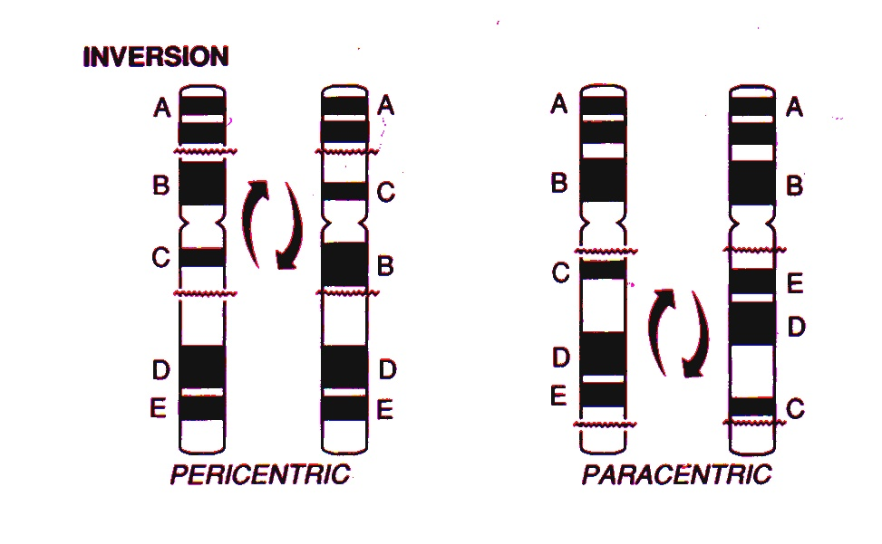
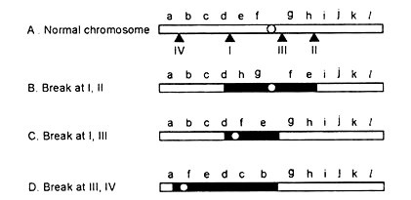
Inversion
Amount of the genetic material is not changed (gene linkage is changed)

Slide 18
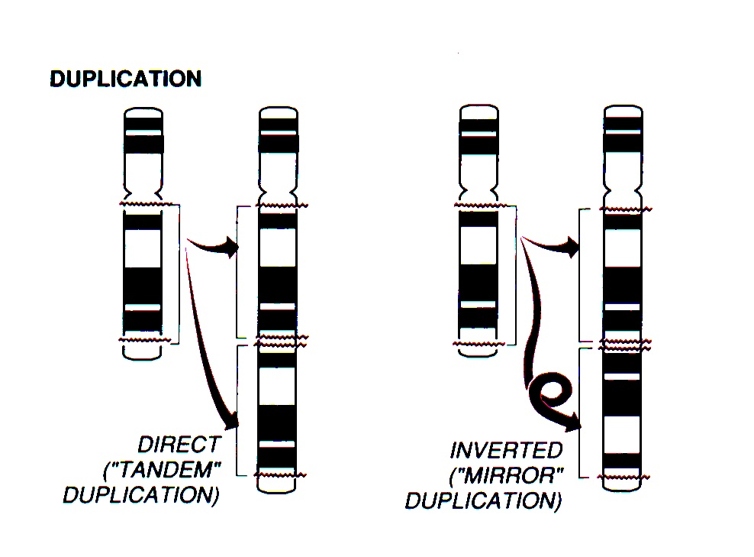
Duplication
Genes controlling importing functions
  quantitative effect
  stability of the system
Background for the function divergence

Slide 19
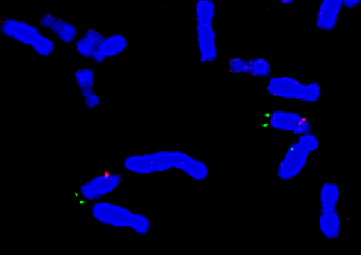
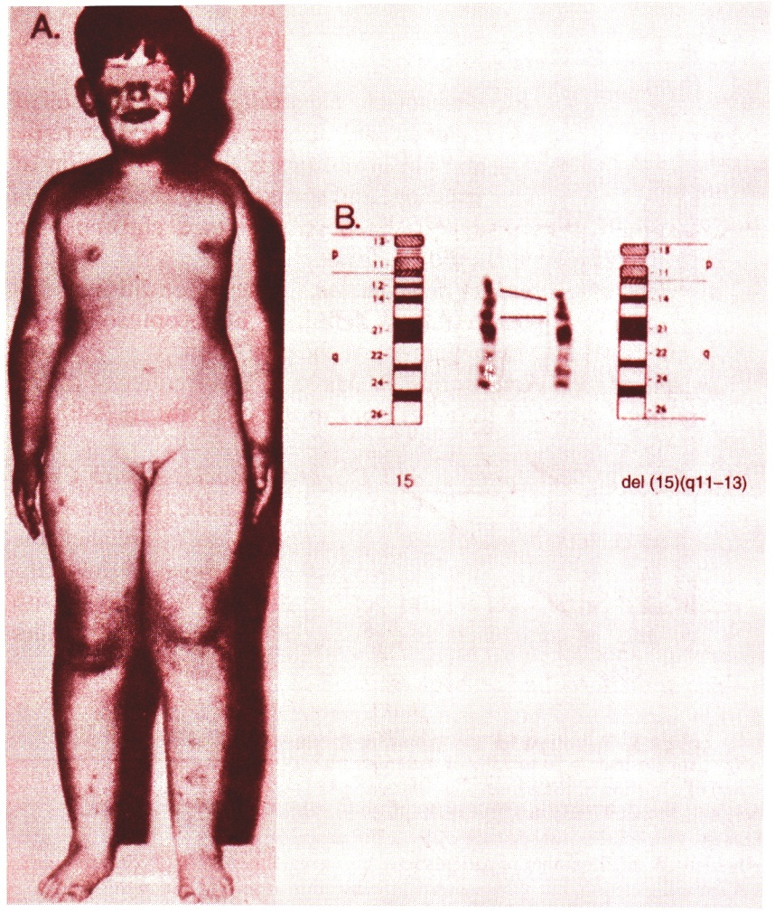
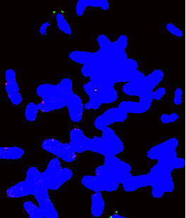
Deletion 15q11-13 (Prader-Willi syndrome)
norm
deletion
Probe of the 15 chromosome (green)
Probe of the critical region (red)

Slide 20
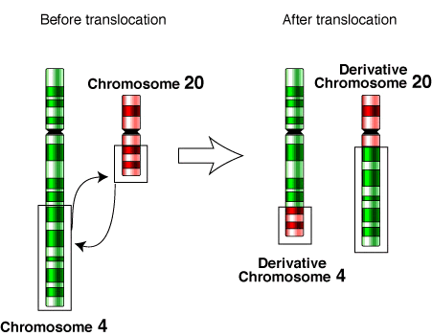
Translocation
Rearrangement of linkage groups
balanced translocations
unbalanced translocations
Reciprocal translocation

Slide 21
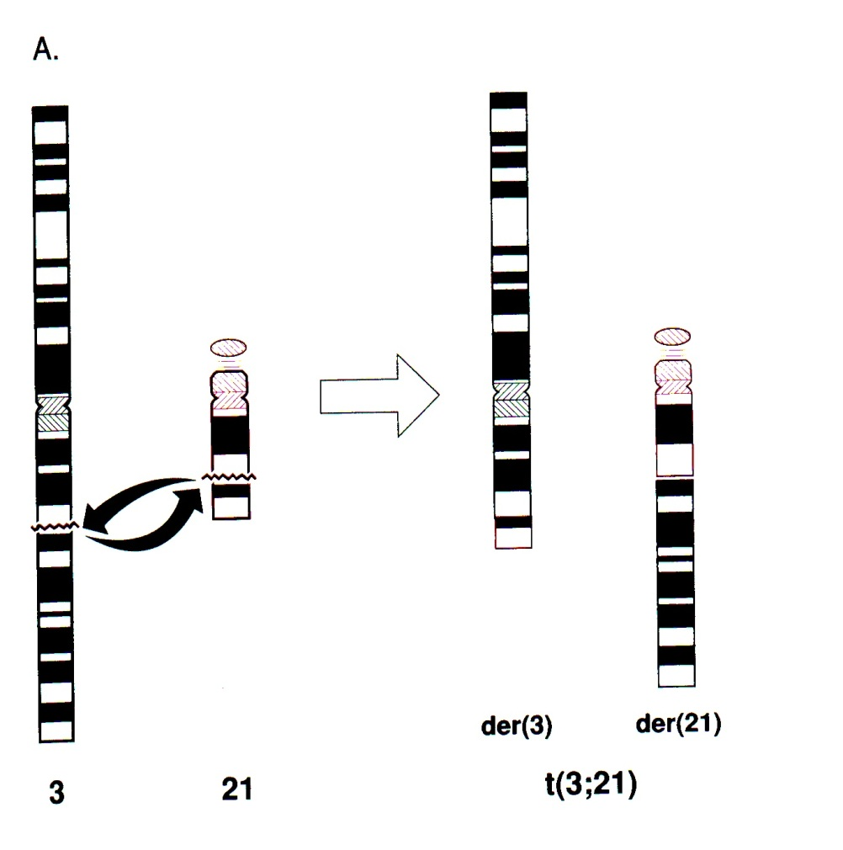
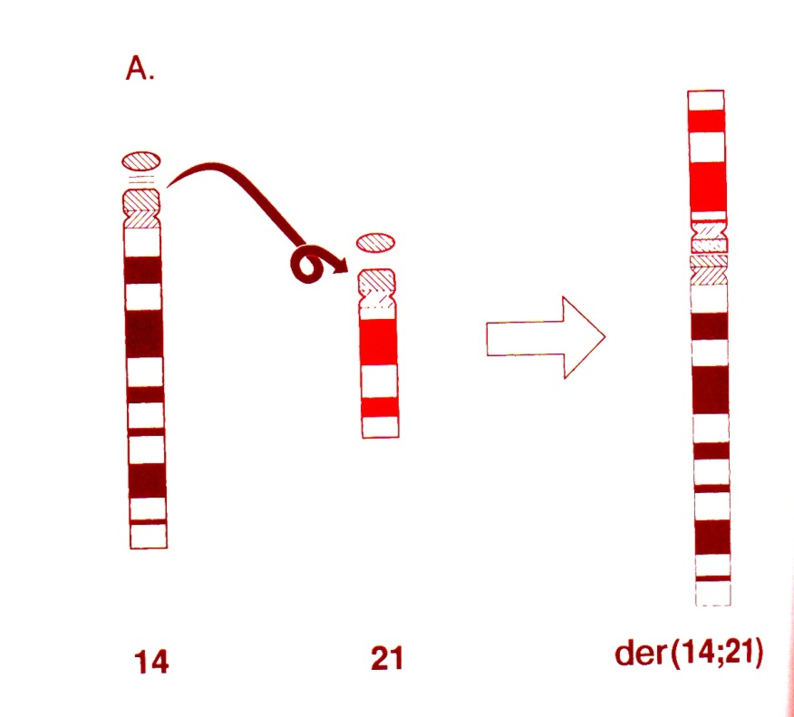
Translocation
Robertsonian
In human can involved chromosomes 13, 14, 15, 21 and 22
Reciprocal

Slide 22
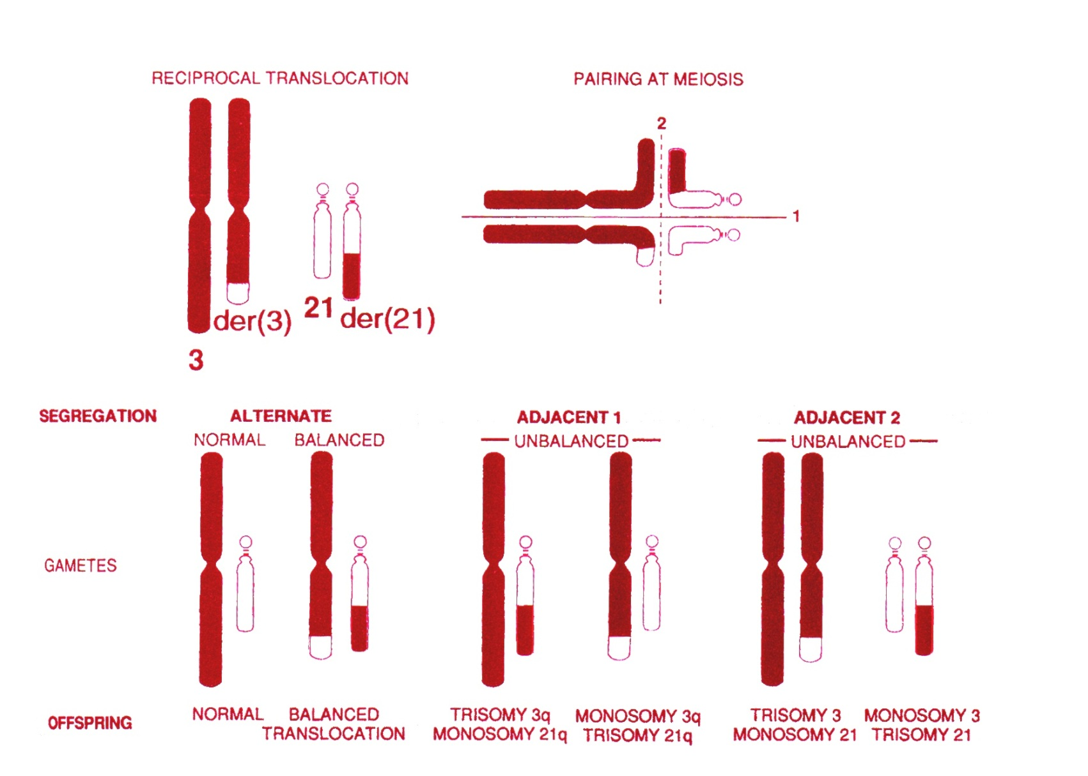
Reciprocal translocations during meiosis

Slide 23
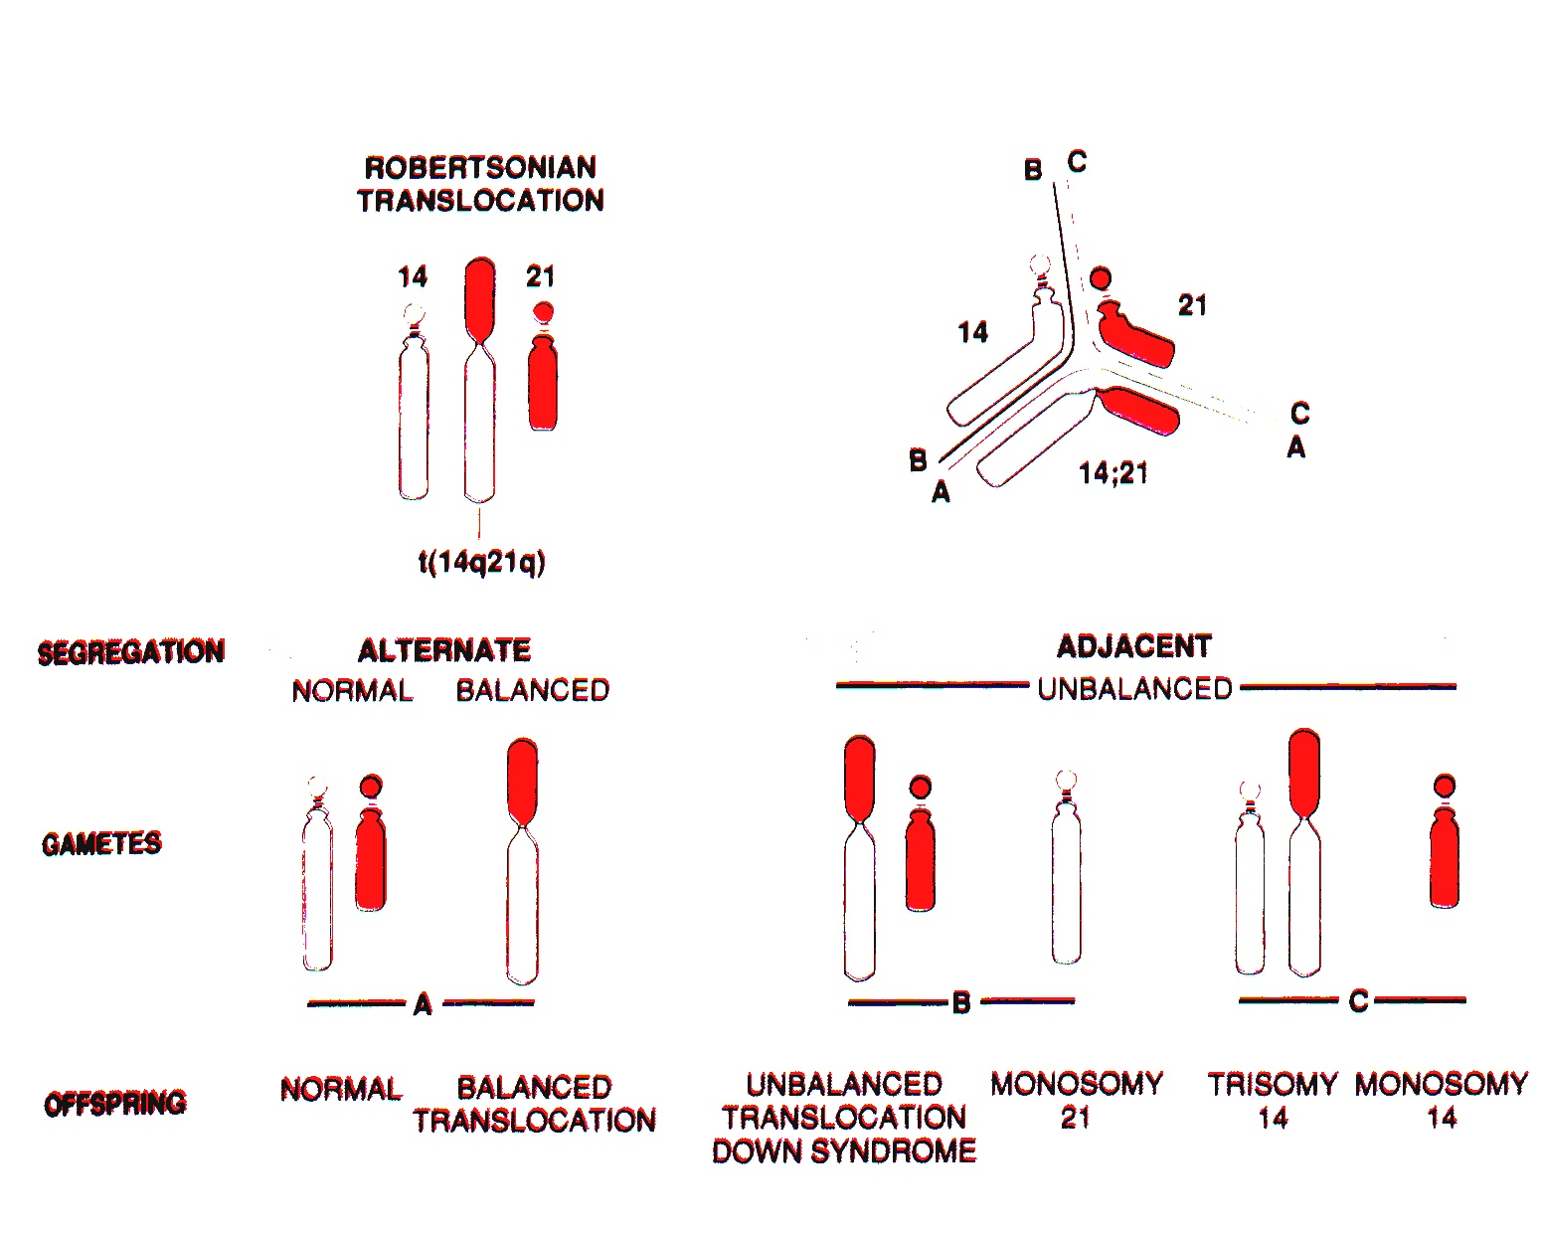
Robertsonian translocations during meiosis

Slide 24
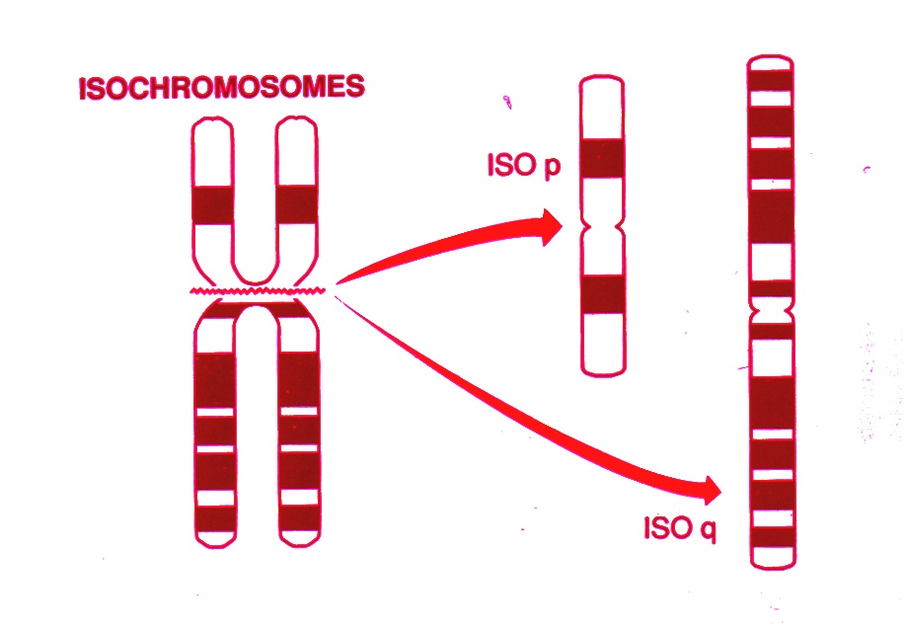
Isochromosomes

Slide 25
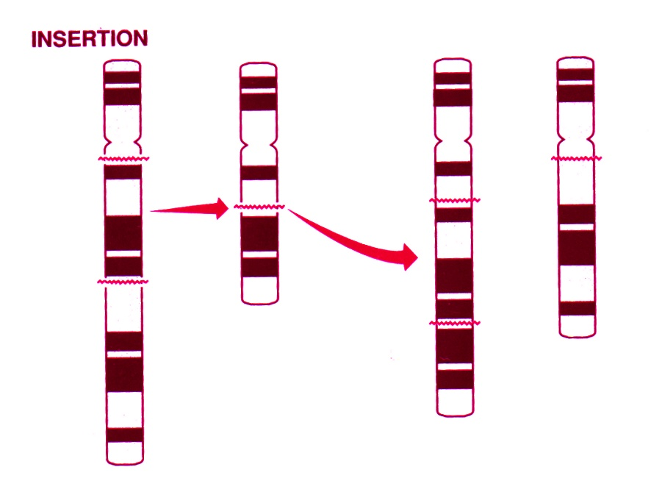
Insertion

Slide 26
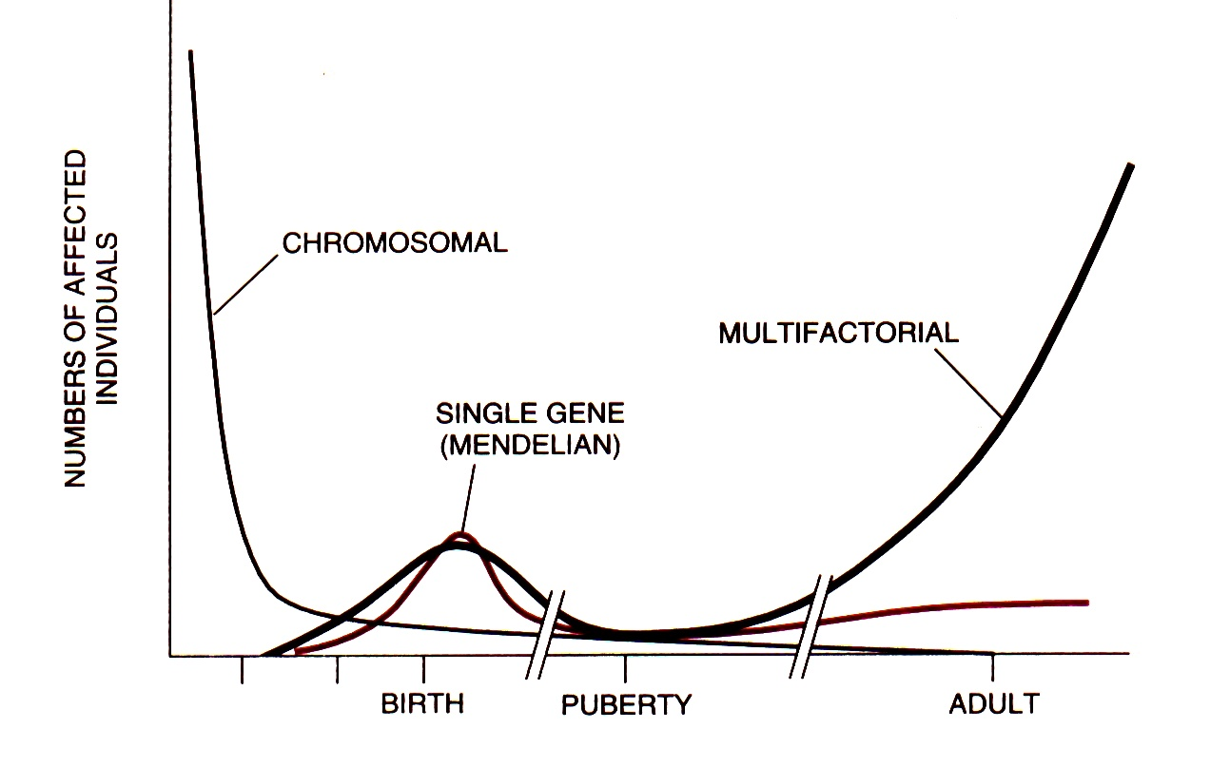
Frequency of different mutation types during aging

Slide 27
Control of mutations
phenotypical
genetic methods
sequencing

Slide 28
Control of mutagens
test-objects
test systems

Slide 29
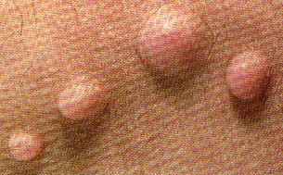
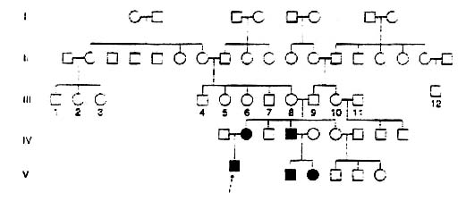
Dominant autosomal mutation
Neurofibromatosis
neurofibroma
Mutation in the germ-line cells of the individual III-8,
or individual III-9

Slide 30
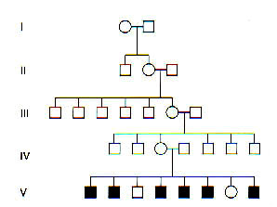
Sex-related recessive mutation
Hemophilia

Slide 31
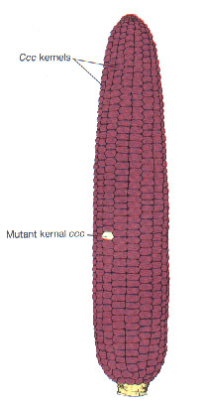
Mutation determination in the endosperm of maize
The first system for mutation detection
Triploid endosperm (3n)
C allele controls pigment formation
Cross: cc x CC
Seeds without a pigment indicate mutation C ➔ c in the germ-line (pollen forming line)

Slide 32
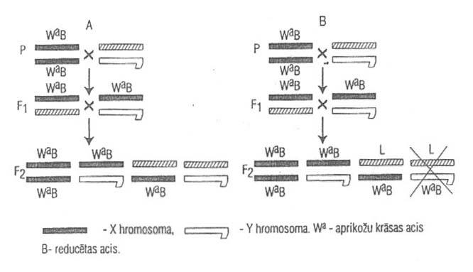
Registration of lethal recessive mutations
Method Meller 5
In the case of lethal recessive mutation (B) males with wild type eyes are absent in F₂

Slide 33
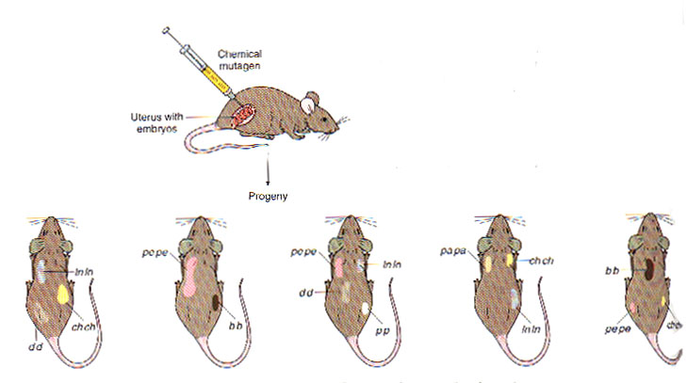
Detection of somatic recessive mutations
lnln papa pepe b⁺b⁺ ch⁺ch⁺ p⁺p⁺ d⁺d⁺ x ln⁺ln⁺ pa⁺pa⁺ pe⁺pe⁺ bb chch pp dd

Slide 34
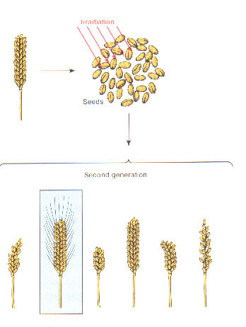
Detection of useful mutations in plants
Analysis of F₂ families

Slide 35
Complementation test of allelism
If two different mutant lines with alteration in the same trait
Mutation in he same or different loci?
Crossing: both mutations in the heterozygotic condition
br1a
Mutant phenotype
br1b
red1
Wild phenotype
red2

Slide 36
Cis-trans functional test for allelism
a1/a2
cis-
condition
x
x
Wild phenotype
a1
trans-
condition
x
x
Mutant phenotype
a2

Slide 37
Cystic fibrosis
Mutation dF508 in the gene CFTR
normal allele
  DNA ATC ATC TTT GGT
  Aminoacid Ile Ile Phe Gly
  No. 506 507 508 509
dF508 allele
  DNA ATC AT T GGT
  Aminoacid Ile Ile Gly

Slide 38
Identification of mutation dF508
Mutation -
DNA
Primers
?
98
95
98
95
dF508/dF508 dF508/N N/N dF508/N dF508/dF508

Slide 39
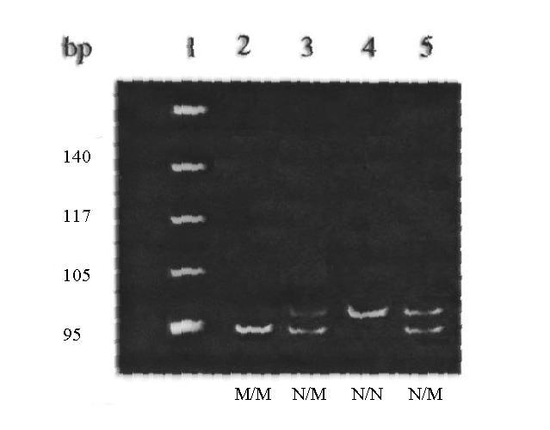
Identification of mutation dF508

Slide 40
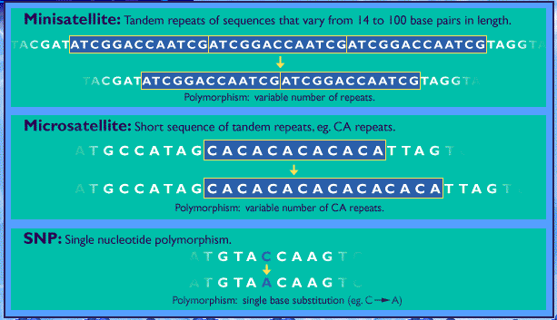
Some molecular markers

Slide 41
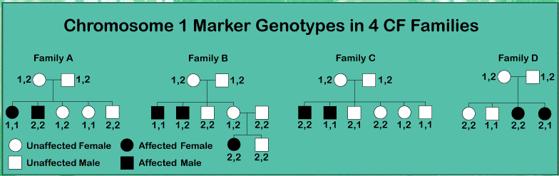
Independent inheritance

Slide 42
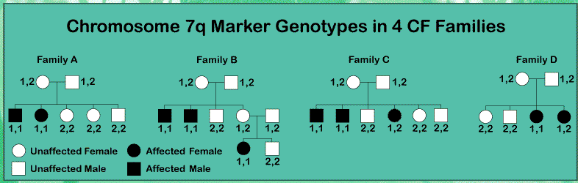
Linked inheritance

Slide 43
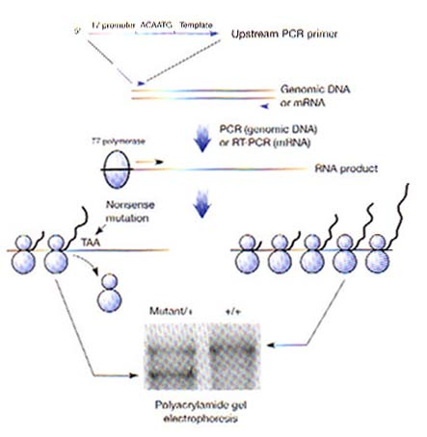
Analysis of BRCA2 mutation
Protein test

Slide 44
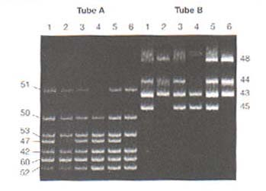
PCR test for deletions
Muscular dystrophy
Specific sequences of exons of dystrophin gene

Slide 45
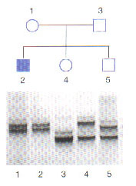
Prader-Willi syndrome
Analysis of deletion in human chromosome 15
In the result of genome imprinting the locus PWS on the chromosome of maternal origin is usually inactivated.
If deletion located on the chromosome of paternal origin functionally active protein is not synthesized and Prader-Willi syndrome is manifested.
Uniparental heterodisomy

Slide 46
Some test systems

Slide 47
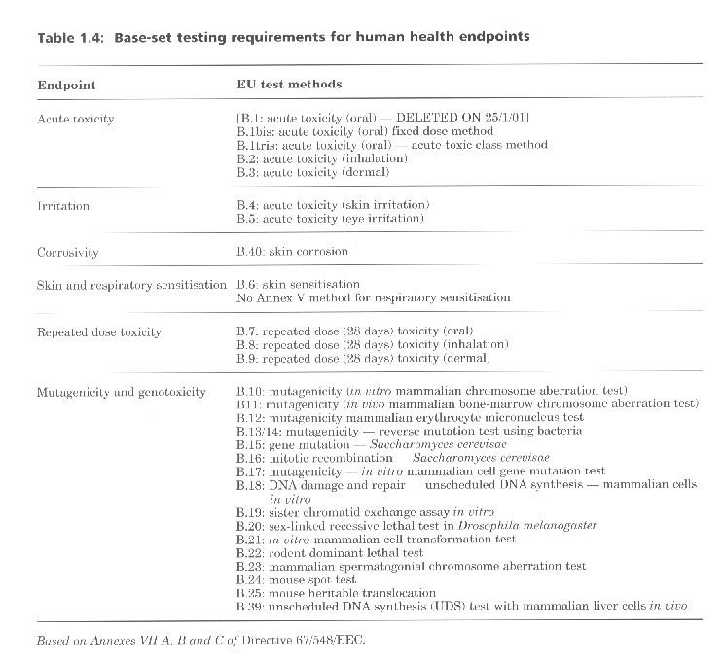
EU Directive 67/548/EEC
"Dangerous Substances Directive"

Slide 48
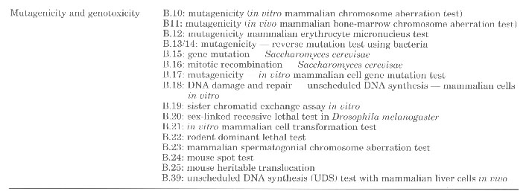
Directive 67/548/EEC
"Dangerous Substances Directive"
Annually about 30 000 chemicals are entered to the marked in quantity more than 1 t

Slide 49
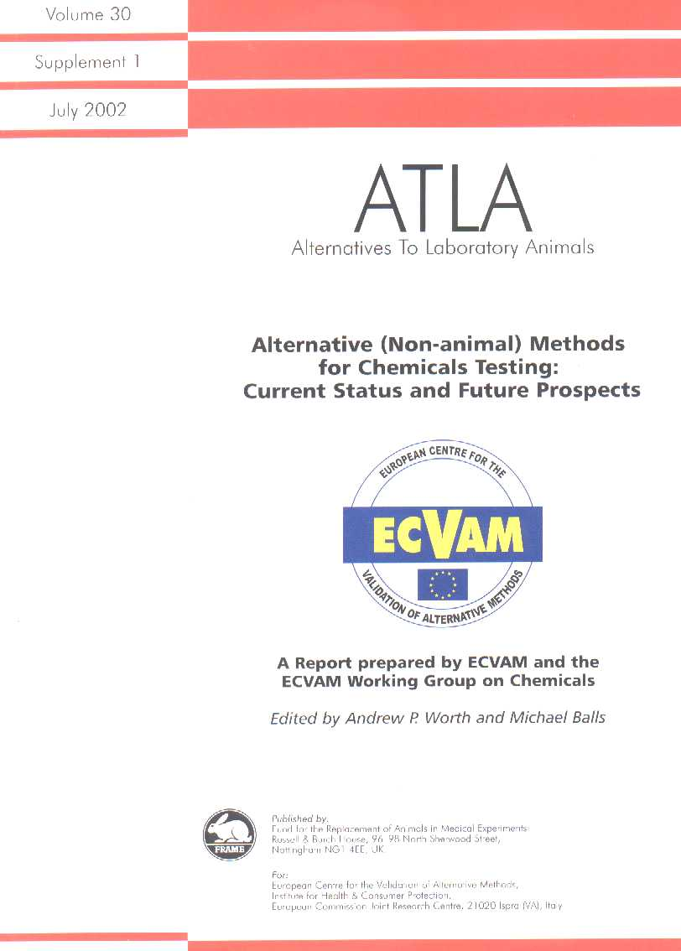
Directive 86/609/EEC
"Protection of Laboratory Animals for experimental and Other Scientific Purposes"
The Commission and Member States should encourage research into the development and validation of alternative techniques, which could provide the same level of information as that obtained in experiments using animals, but which involve fewer animals or which entail less painful procedures, and shall take such other steps as they consider appropriate to encourage research in this field.

