Slide 1
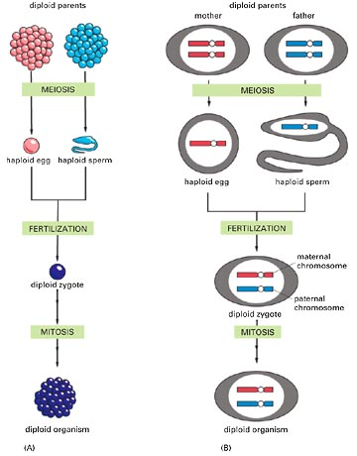
Alteration of diploid and haploid phases

Slide 2
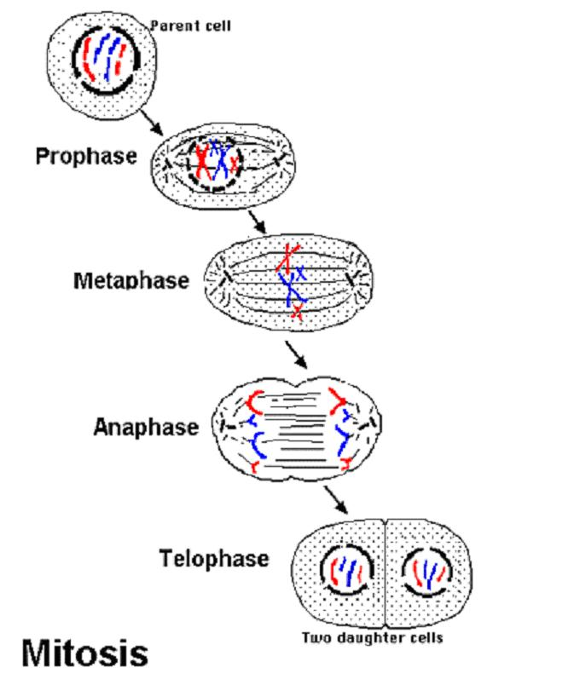
Mitosis

Slide 3
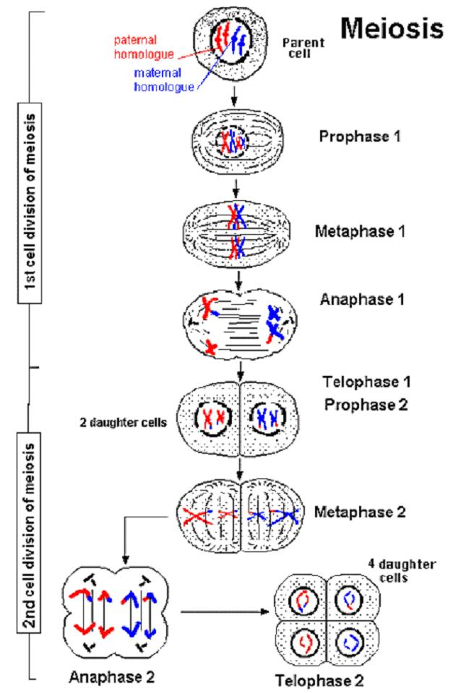
Meiosis

Slide 4
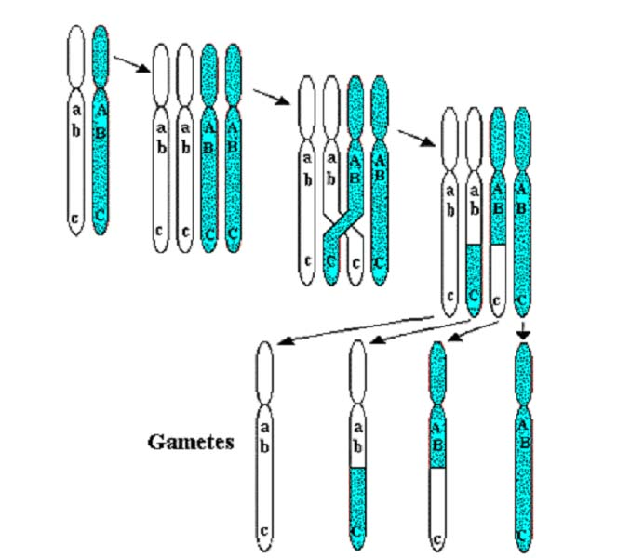
Crossing over and recombination

Slide 5
Crossing over and recombination
Crossing over – exchange of parts of homologous chromosomes by a breakage and reunion process
Recombination – no parental arrangement of alleles in progeny
  in result of crossing over
  in result of assortment of independent alleles

Slide 6
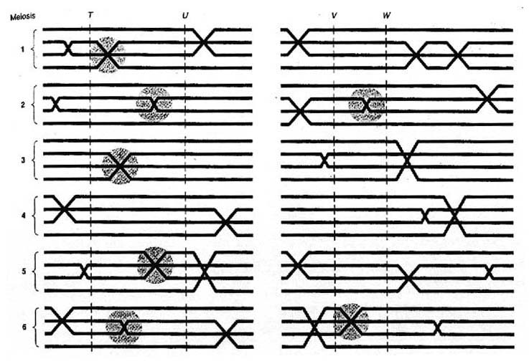
Frequency of crossing over

Slide 7
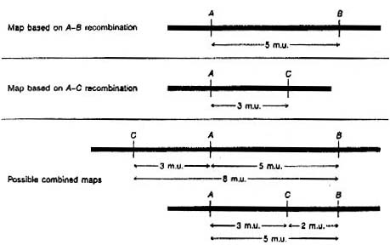

Slide 10
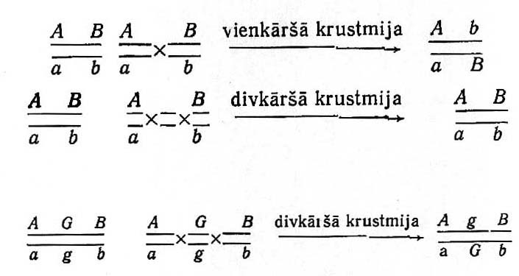
Double crossing over
ordinary crossing over
double crossing over
double
crossing over

Slide 11
Genetic distance
Measure of genetic distance is the recombination frequency among two loci.
In result of multiple crossing over distances between loci are not additive:
if loci sequence ABC, then r_{AC} < r_{AB} + r_{BC}
Frequency of the double crossing over among loci A and C – r_{AB} x r_{BC}
Max of possible recombination frequency among two loci – 50 %

Slide 12
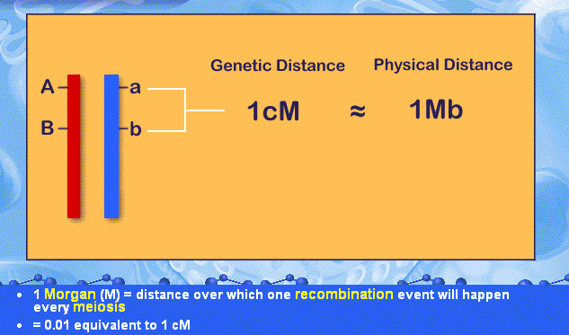
Unit of recombination
Frequency of recombination – percent of recombinant gametes (percent of meiosis where recombination happened)
1cM (centimorgan) = 1 % recombinant gametes

Slide 13
Test crossing
Crossing with homozygote by recessive alleles of genes of question
P₁ AABB, P₂ aabb
F₁ AaBb
AB
ab
Ab
aB
Gametes in F₁
Crossing with aabb (all gametes ab)
Phenotypes after test
crossing
AaBb
aabb
Aabb
aaBb

Slide 14
Recombination in F₂
P₁ AABB P₂ aabb
AB
ab
AB
ab
Genotypes F₁
AB
ab
Ab
aB
Gametes F₁
AB AB ab AB AB ab ab Ab Ab aB
AB ab ab Ab aB Ab aB Ab aB aB
A-B- A-B- aabb A-B- A-B- A-bb aaB- A-bb A-B- aaB-
GenotypesF₂
Phenotypes F₂

Slide 15
Genetic map
Genetic map – a schema which shows linear gene location on a chromosome and genetic distance among them.
  Distance among distant genes is found by summing distances among corresponding close located genes or is calculated theoretically.
Not a formal limit of genetic distance between genes at the same chromosome on genetic map!
Genes located on the same chromosome form a linkage group.

Slide 16
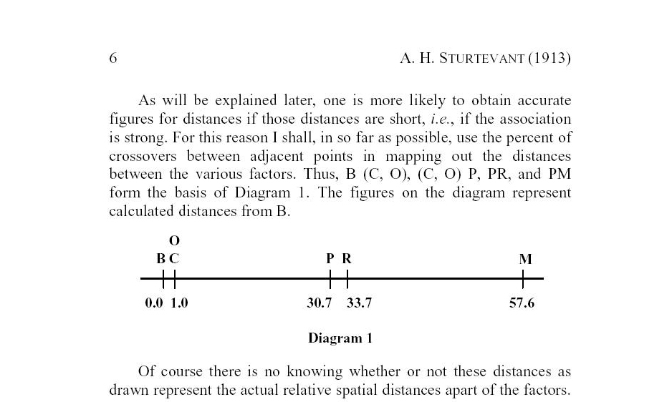
First genetic map

Slide 17
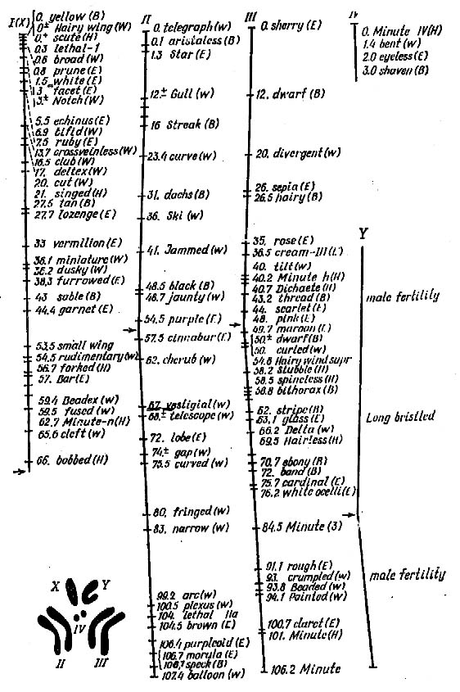
Genetic map of Drosophila

Slide 18
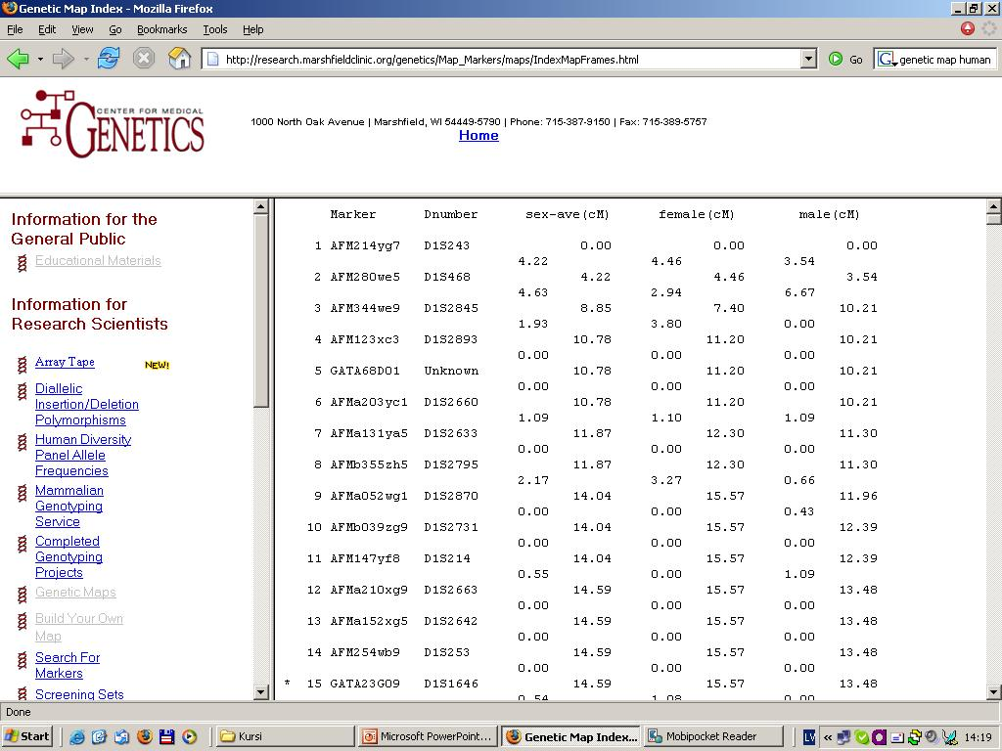
Genetic map of human

Slide 19
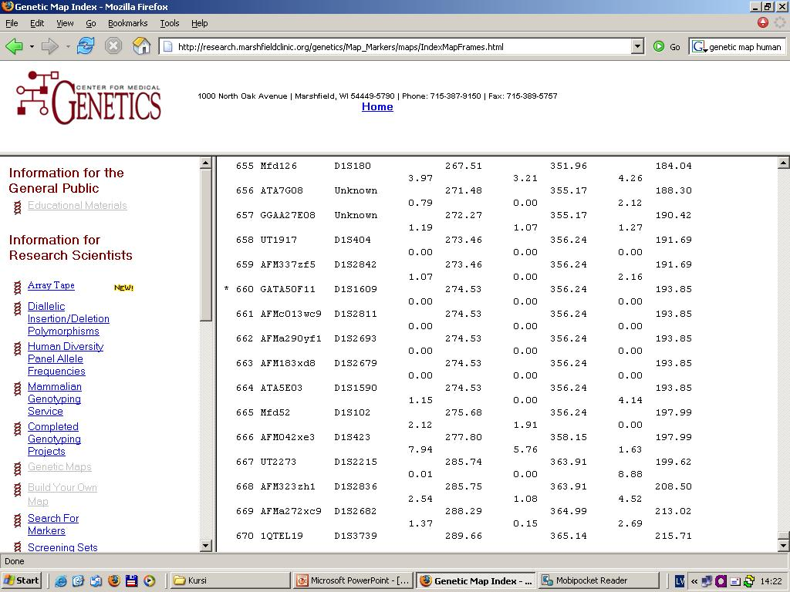
Genetic map of human

Slide 20
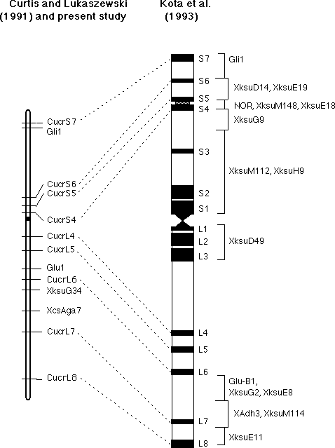
Physical mapping
Physical localisation on a chromosome
http://wheat.pw.usda.gov/cgi-bin/graingenes/report.cgi?class=image;name=1B+physical+vs.+genetic+maps

