Slide 1
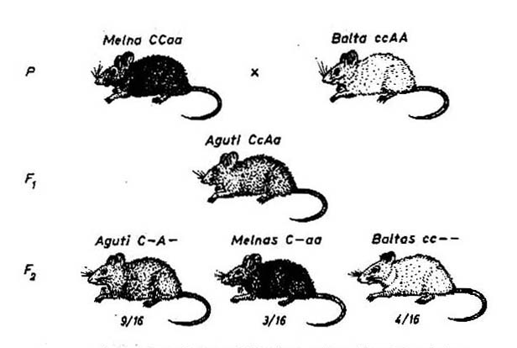
Recessive epistasis
A– agouti
aa black
cc – – white
C– A – agouti
C– aa black

Slide 2
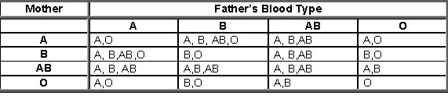
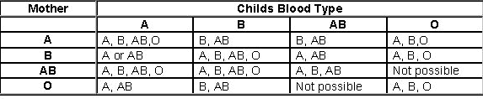
Inheritance of blood groups
Possible child’s blood type
(A-)
(B-)
(A-)
(B-)
Possible father’s blood type
(A-)
(B-)
(A-)
(B-)

Slide 3
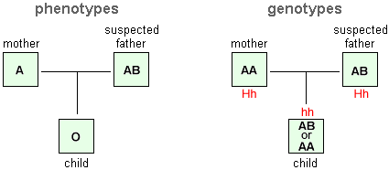
Inheritance of blood groups:
Bombay phenotype
?

Slide 4
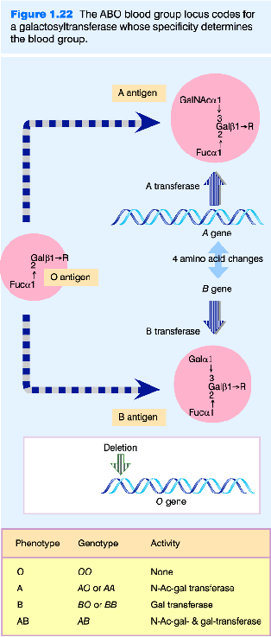
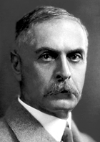
ABO blood groups
I^{A}-
H-
ii
I^{B}-
Karl Landsteiner
(1868-1943)

Slide 5
Inheritance of blood groups:
Bombay phenotype

Slide 6
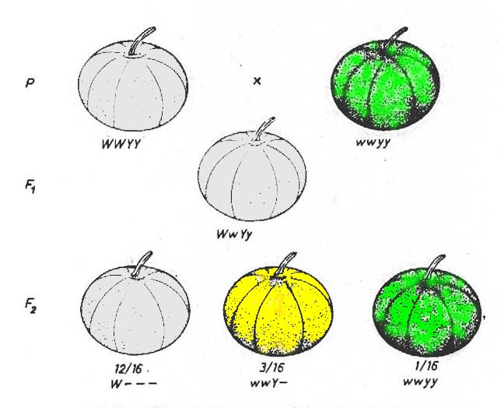
Dominant epistasis
Y– yellow
yy green
W – – – white
ww Y– yellow
ww yy green
Inheritance of pumpkin colour

Slide 7
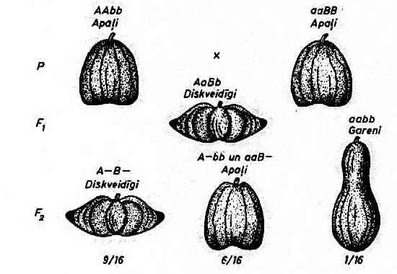
Complementarity (1)
Inheritance of pumpkin shape

Slide 8
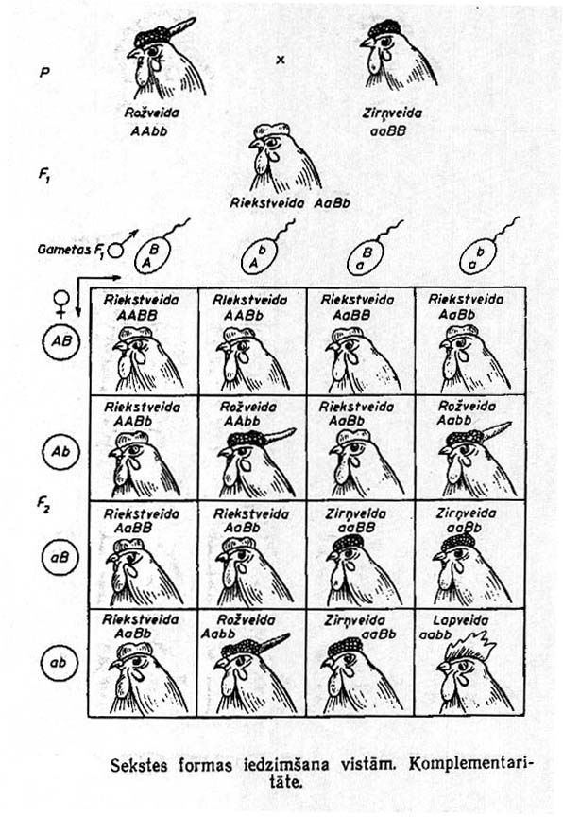
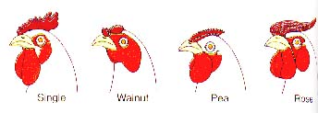
Complementarity (2)
Single Walnut Pea Rose
aabb A–B– aaB– A–bb
Inheritance combs types in fowl

Slide 9
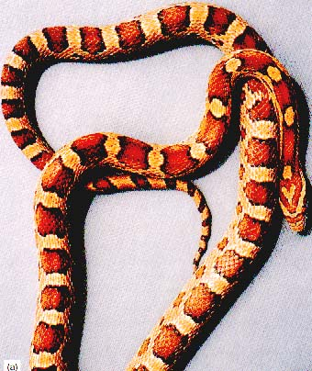
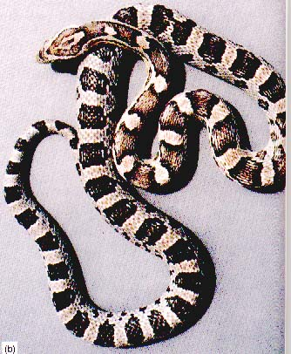
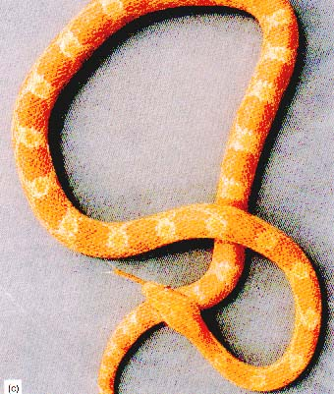
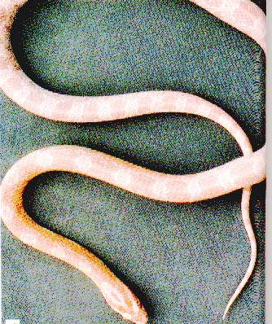
Complementarity (2)
Elaphe guttata [corn snake]
O– - orange pigment
B– - black pigment
OOBB
ooBB
OObb
oobb

Slide 10
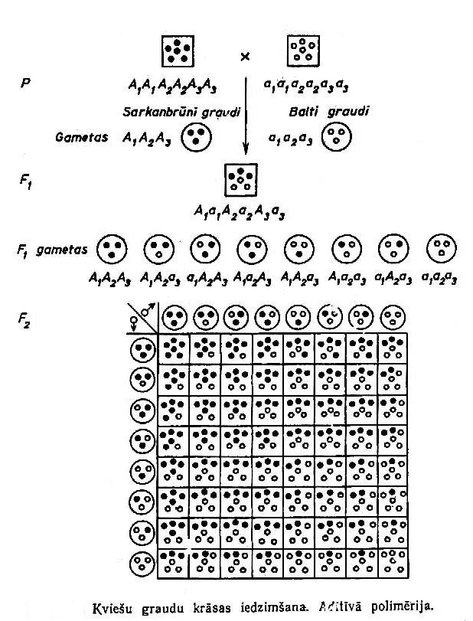
Additive polymery
a₁a₂A₃
Inheritance of grain colour of wheat

Slide 11
Additive polymery
+++
+++
- - -
- - -
+++
- - -
+++
+++
+++
++-
+++
+- -
+++
- - -
++-
- - -
+ - -
- - -
- - -
- - -
1 6 15 20 15 6 1

Slide 12


Additive polymery
Inheritance of human height
H₁ H₁ H₂ H₂ very short
H₁ H₁ H₂ h₂ short
H₁ H₁ h₂ h₂ mid
H₁ h₁ h₂ h₂ tall
h₁ h₁h₂ h₂ very tall
Sultan Kösen (Turkey)
251 cm (2011)

Slide 13

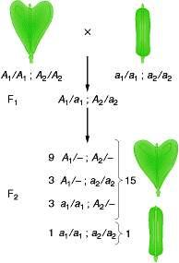

Nonadditive polymery
Capsella bursa-pastoris

Slide 14
Some properties of gene action
Pleiotropy
  a single gene can affect several traits
Penetrance
  frequency of the gene expression

Slide 15
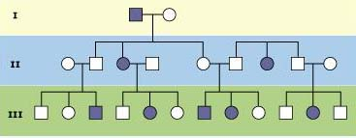
Properties of gene action
Penetrance – frequency of the gene expression
Incomplete penetrance in a case of polydactyly

Slide 16
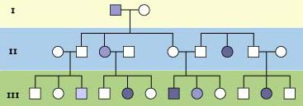
Properties of gene action
Expressivity – degree of the expression of the trait
Different expressivity in a case of polydactyly

Slide 17
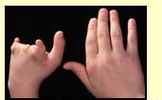
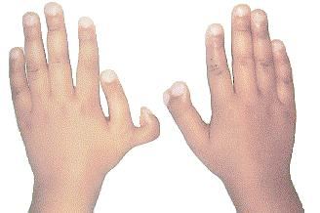

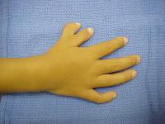
Properties of gene action
Expressivity – degree of the expression of the trait
Different expressivity in a case of polydactyly

Slide 18

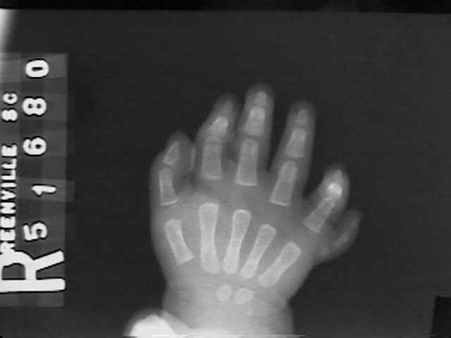

Properties of gene action
Expressivity – degree of the expression of the trait
Different expressivity in a case of polydactyly

Slide 19
Phenocopies
Alterations in a trait expression caused by environment, which are phenotypically identical to mutation expression

Slide 20
Sex related inheritance
chromosomal
cytoplasmic heredity
  different inheritance of genes (traits) depending of the sex

Slide 21
Sex related inheritance
Different expression of autosomal genes in individuals with different
  sex limited traits
    milk production
    egg production
    breast cancer
  sex depending traits
    baldness
    horn development

Slide 22
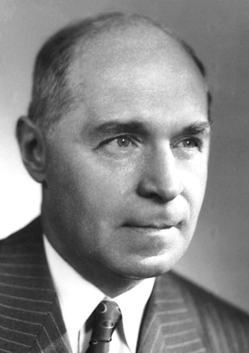
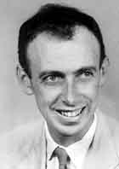
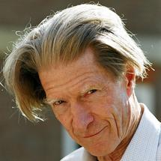
Sex related inheritance
Baldness in human
  Dominant allele B – bald
  Women Man
    bb norm. norm.
    Bb norm. bald
    BB bald bald
Hermann J. Muller, 1946
James Watson, 1962
John Gurdon, 2012

Slide 23
Human chromosomes

Slide 24
Sex determination
homogametic sex (XX)
heterogametic sex
  XY
  X0

Slide 25
Heterogametic sex
male (X, Y)
  mammals
  fishes (part)
  amphibians (part)
  reptiles (part)
  insects (biggest part)
female (Z, W)
  birds
  fishes (part)
  amphibians (part)
  reptiles (part)
  butterflies
(XX) (ZZ)

Slide 26
Sex chromosomes and sex
XX XY
Human female male
Drosophila female male
XXY XO
Human male female
Drosophila female male

Slide 27
Influence of sex choromosomes/autsomes ratio on the sex of Drosophila melanogaster
X Chromosomes | Autosomes | Ratio of X:A | Sex
XXXX | AAAA | 1 | Normal Female
XXX | AAA | 1 | Normal Female
XX | AA | 1 | Normal Female
X | AA | 0.50 | Normal Male
XXX | AA | 1.50 | Metafemale
XXXX | AAA | 1.33 | Metafemale
XX | AAA | 0.66 | Intersex
X | AAA | 0.33 | Metamale

Slide 28
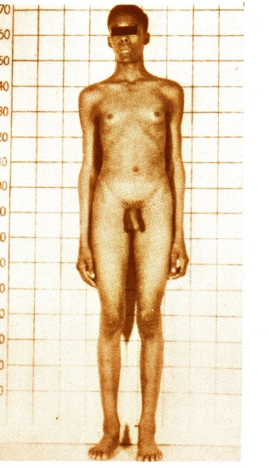
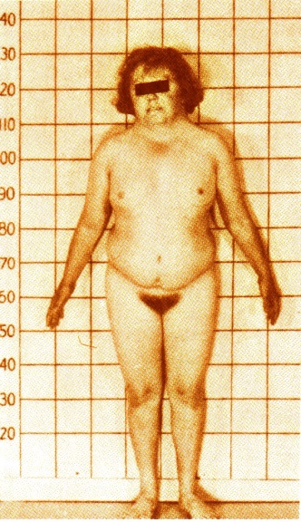
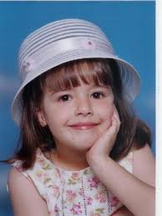

Sex chromosomes in human
Klinefelter syndrome
XXY, XXYY, XXXY, XXXYY, XXXXY
Turner syndrome
X0
XYY syndrome
(Jacobs sindrome)
"super-male"
XYY, XYYY, XYYYY
Triple X syndrome
"super-females", "metafemales"
XXX, XXXX, XXXXX

Slide 29
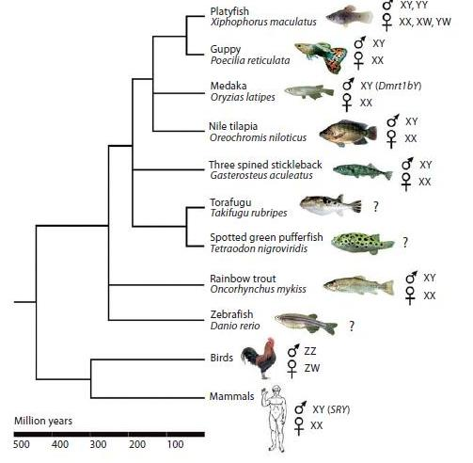
Sex determination in fishes
Volff et al., Sex Dev., 2007, 1, 85-99

Slide 30
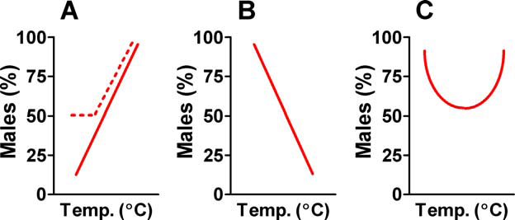
Percentage of males depending of water temperature
(different fish species)
Ospina-Alvarez & Piferrer_PLoSONE, 2008, 3(7)

Slide 31
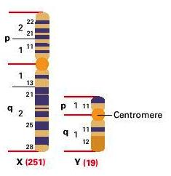
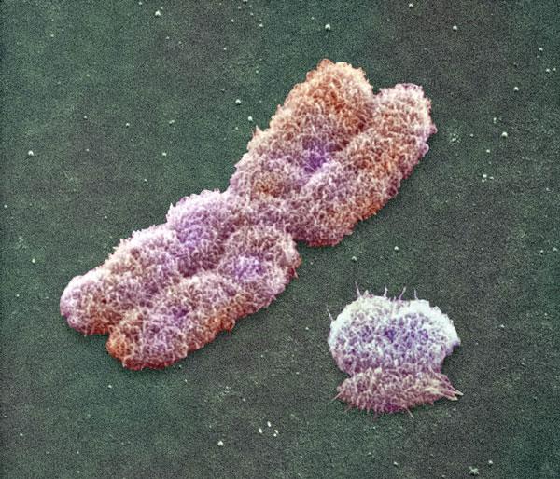
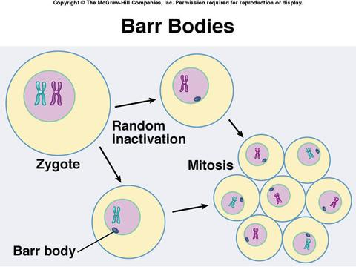
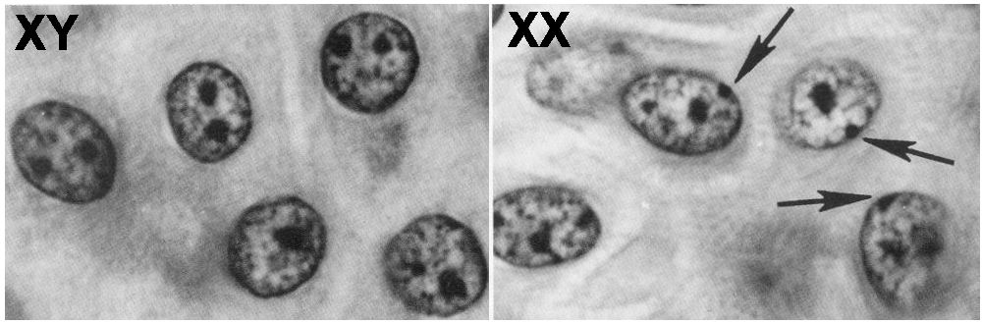
Human X and Y chromosomes
Lyonization
(Mary Lyon)
Barr bodies
(Murray L. Barr)

Slide 32
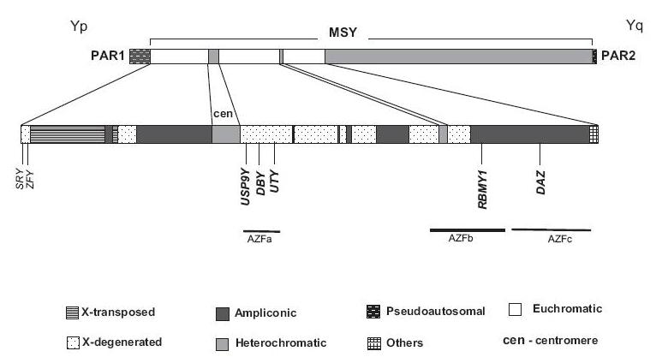
Human Y chromosome
PAR – pseudoautsomal regions
MSY – male specific region of the Y chromosome
SRY – sex determination region on the Y chromosome

Slide 33
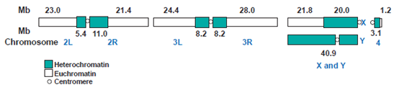
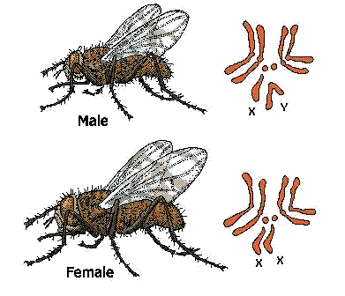
Sex chromosomes ofDrosophila melanogaster
Adams et al., 2000, Science, 287, 2185–2195
Hallacli & Akhtar, Chromosome Research, 2009, 17, 603–619

Slide 34
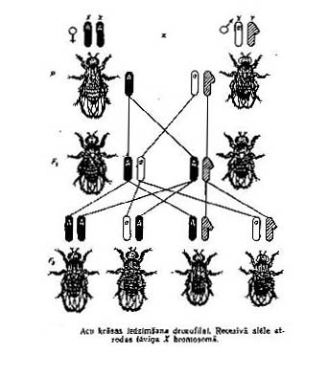
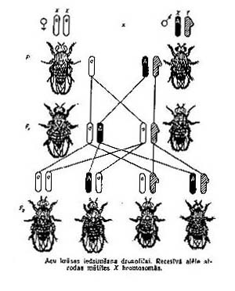
Recessive allele in X chromosome

Slide 35
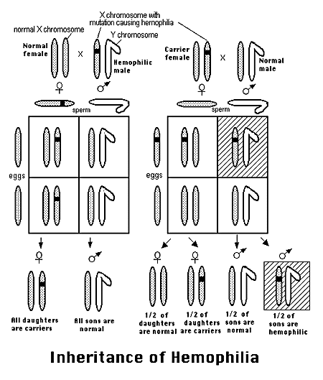
Inheritance of hemophilia

Slide 36
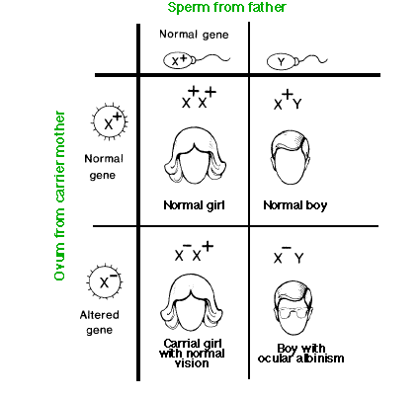
Inheritance of albinism

Slide 37
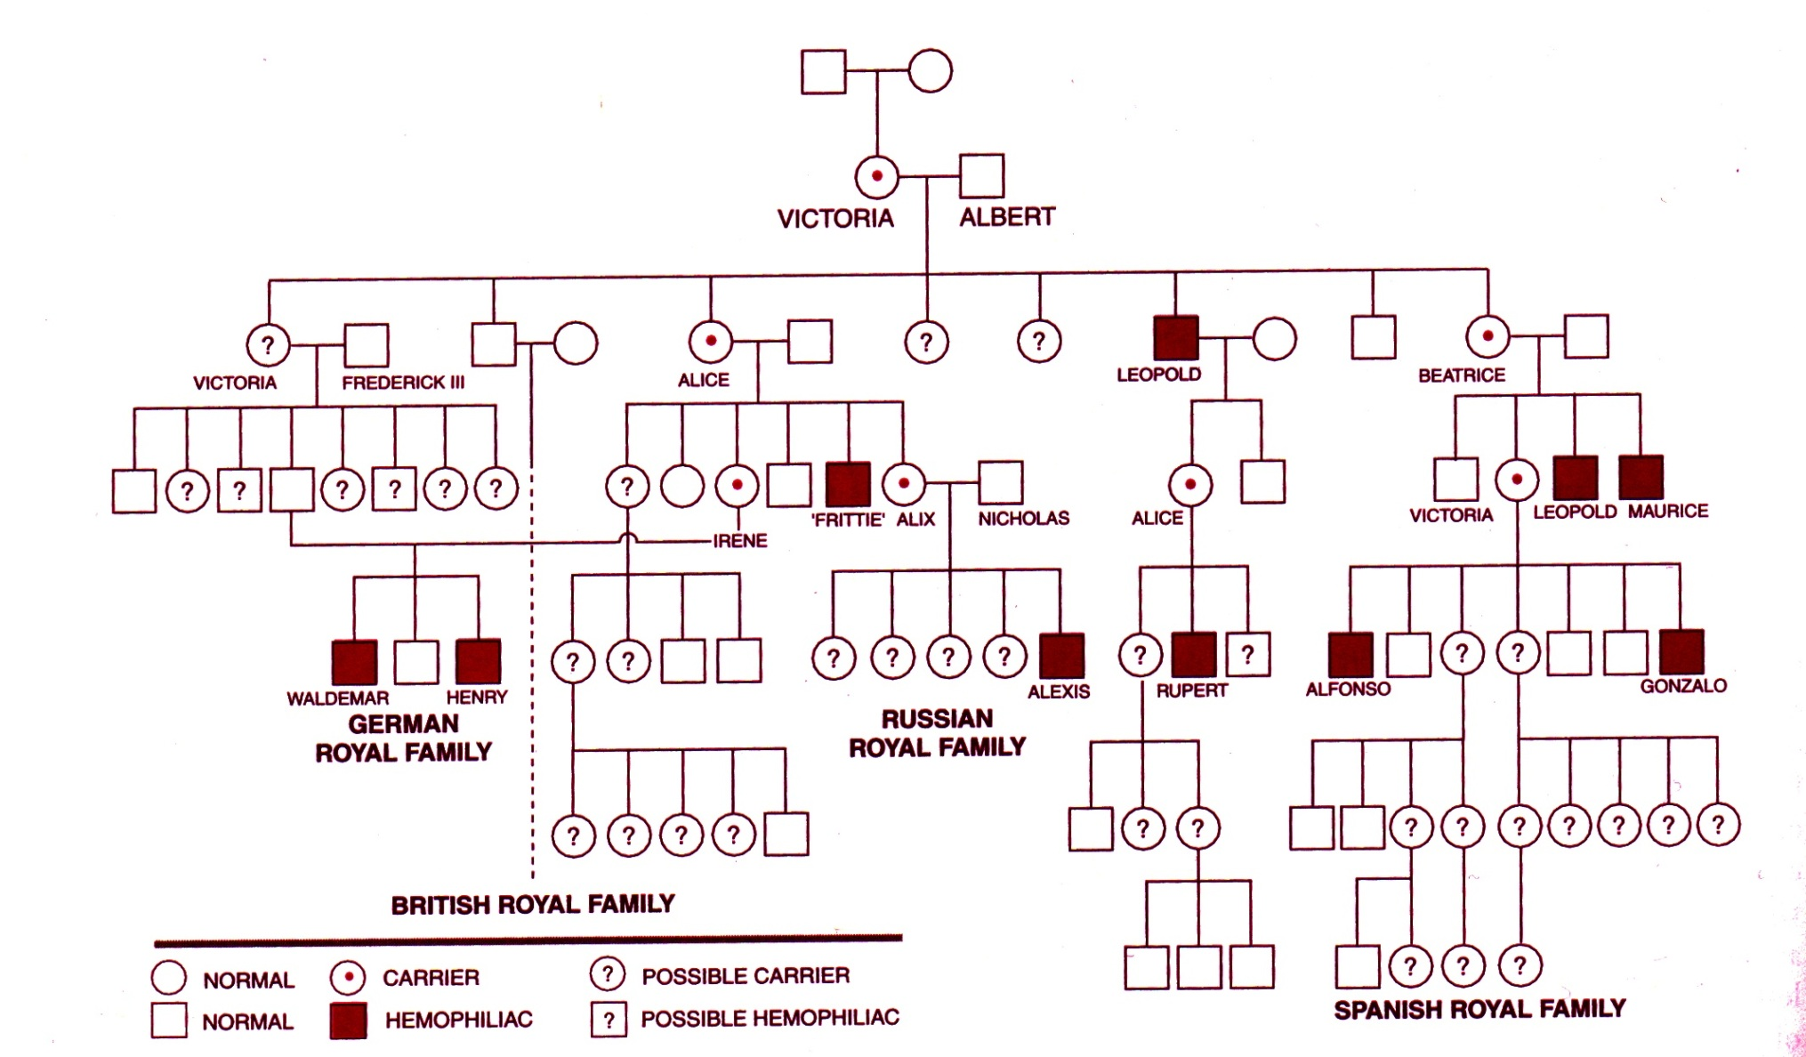
Hemophilia in European royal families

Slide 38
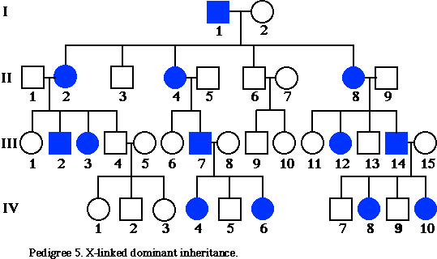
Dominant allele in X chromosome
Trait can appear in both sexes but its frequency in female is double in comparison with male.
In case of disease severity for men is usually higher than in women.

Slide 39
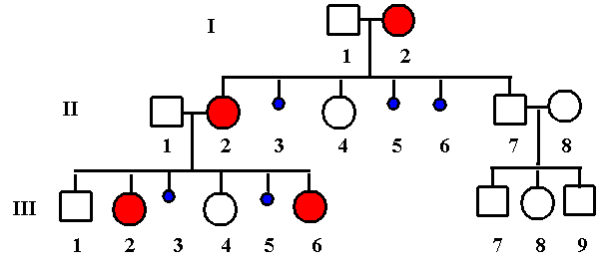
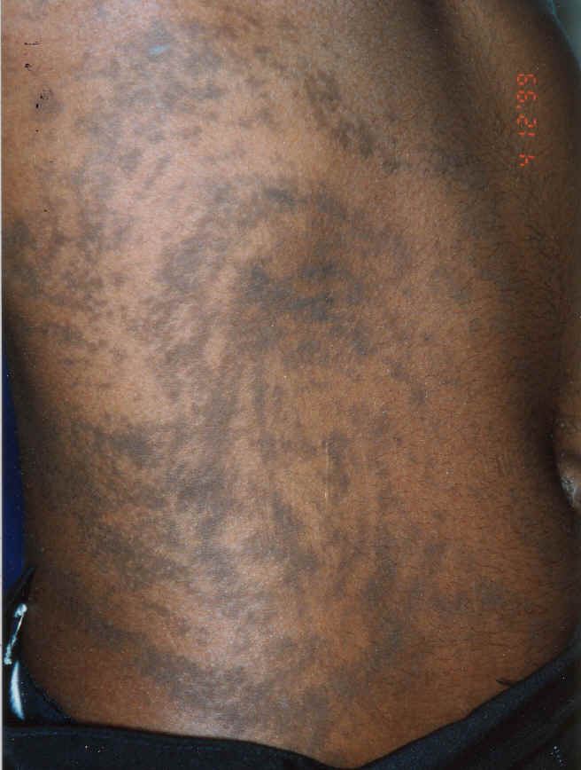
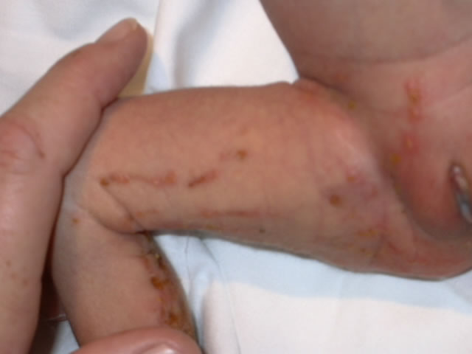
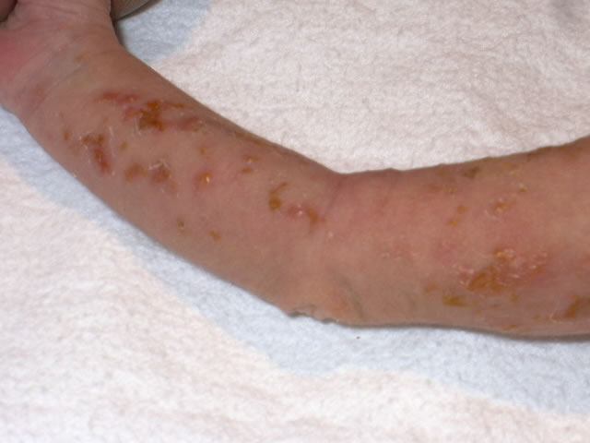
Dominant allele in X chromosome
(lethal in the hemizygotic condition)
Incontinentia pigmenti

Slide 40
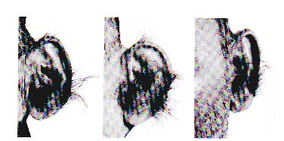
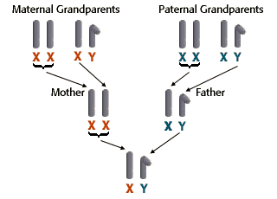
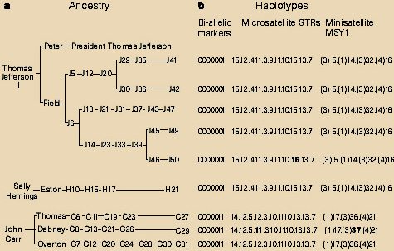
Gene in Y chromosome

Slide 41
Maternal inheritance
(maternal effects)
Maternal effects – inheritance only from mother:
  direct cross A x B
  reciprocal cross B x A
  Maternal effect:
    F_{A x B} ≠ F_{B x A}
    F_{A}, F_{B} F_{A x B} = F_{A}; F_{B x A} = F_{B}

Slide 42
Maternal inheritance
Pseudo cytoplasmatic inheritance
  Cytoplasmatic predetermination
    phenotypes are controlled by nuclear factors found in the cytoplasm of the female
Cytoplasmatic inheritance
  phenotypes are controlled by genes localised it cytoplasmatic organelles (mitochondria or chloroplasts)

Slide 43


Cytoplasmatic predetermination
(coiling direction of snail shells
Lymnea sp.)

Slide 44
Mitochondrial genome
In the each cell 2-100 mitochondria
In the each mitochondria 5-10 circular DNA molecules (“chromosomes")

Slide 45

Human mitochondrial DNA
22 tRNA genes
2 rRNA genes
13 protein coding genes

Slide 46
Mitochondrial genome
mutation frequency in mtDNS is about 20 times as much than in nuclear DNA
mitochondria are segregating among daughter cells independently from nuclear chromosomes
  replicative segregation

Slide 47
Mitochondrial genome
percent of mitochondria with particular mutation can be different in different somatic cells and in different tissues
  heteroplazmy
phenotypically variable manifestation
age depending manifestation
interaction with nuclear genes

Slide 48
Mitochondrial disorders
tissues (organs) depending from the function of mitochondria
  heart
  skeleton muscles
  central nervous system
typical disorders:
  myopathy
  encephalopathy

Slide 49

Mitochondrial disorders

Slide 50

Pedigree in case of mitochondrial inheritance

Slide 51

Mitochondrial encephalopathy

