Slide 1
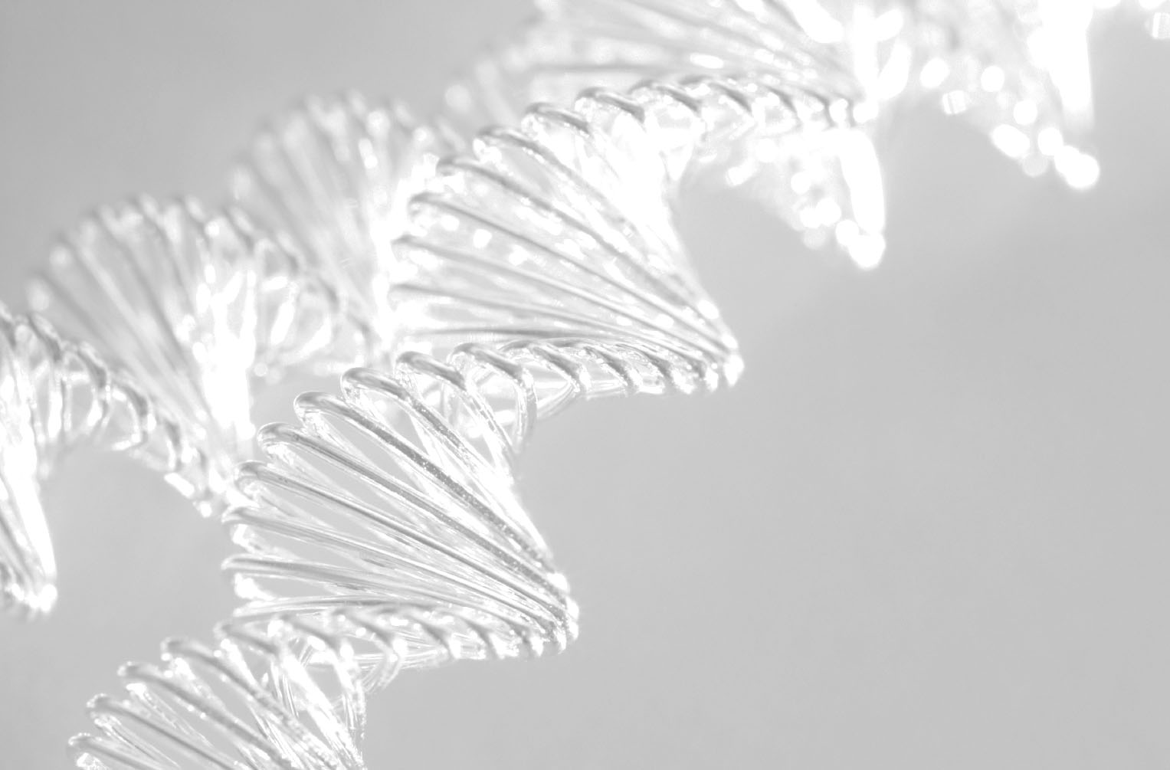
Gēnu ekspresijas regulācija genoma līmenī

Slide 2
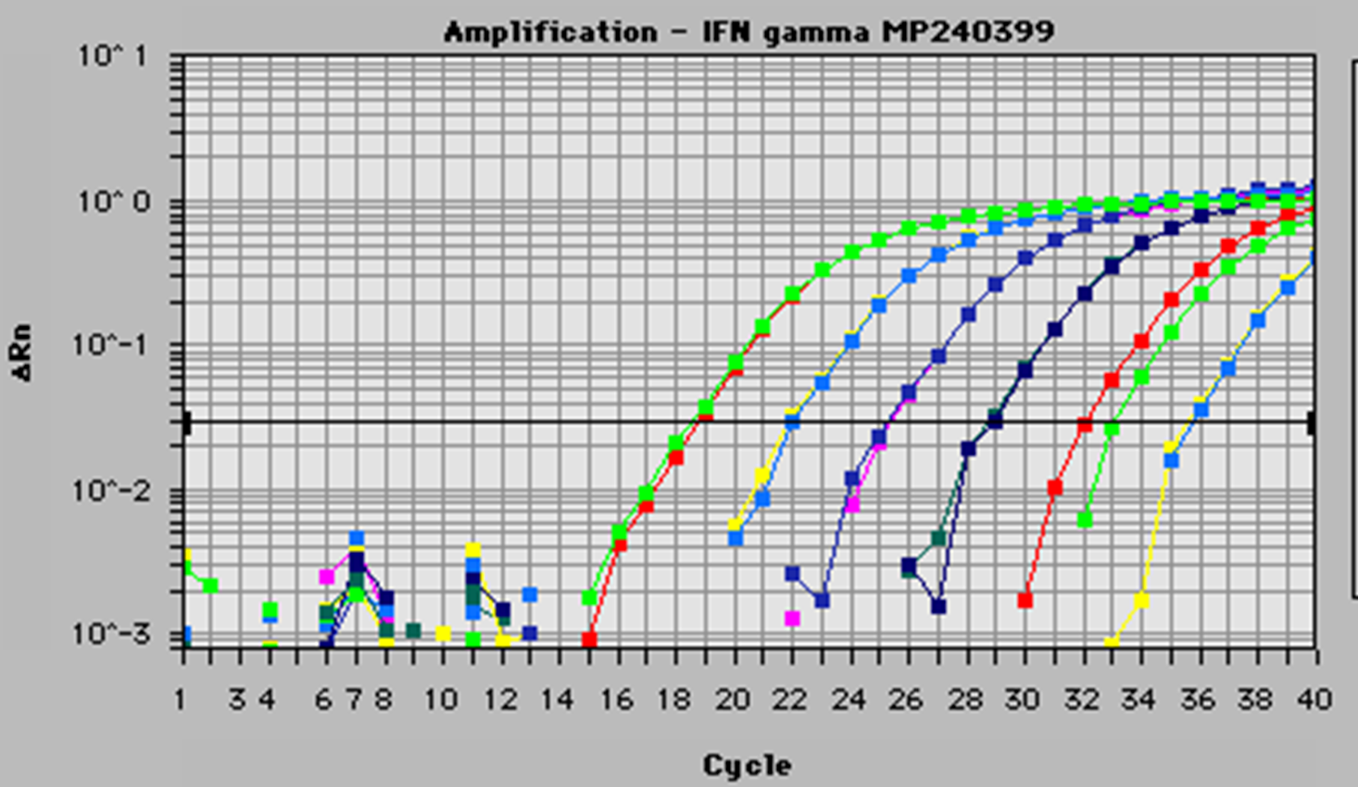
Digitālais PCR
RT- PCR ir teorētiskais limits – koncentrācijas atškirību var noteikt 2x līmenī- kas ir līdzvērtīgs kļūdas līmenim
Digitālais PCR var atrisināt šo problēmu

Slide 3
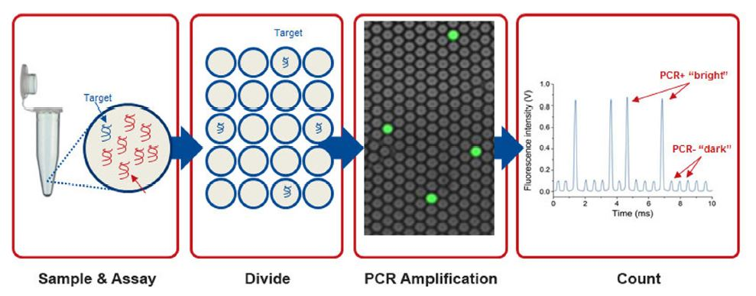
Digitālais PCR
Teorētiski molekulu skaits atbilst pozitīvajām reakcijām
Kopējais reakciju tilpums ir līdzvērtīgs kopējam paraugu tilpumam – iespējams precīzi aprēķināt koncentrāciju

Slide 4
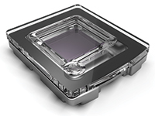
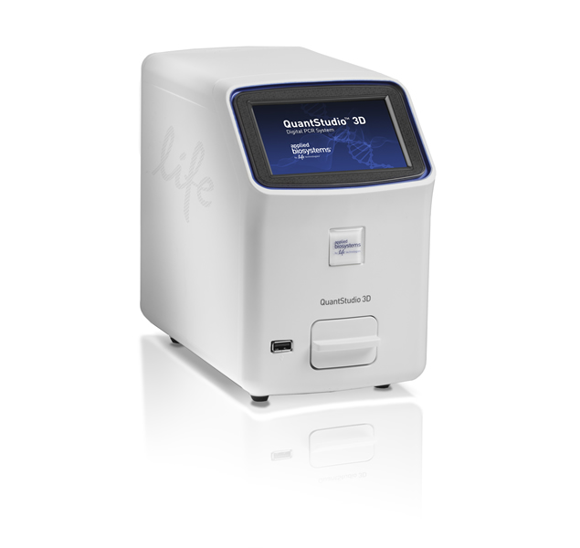
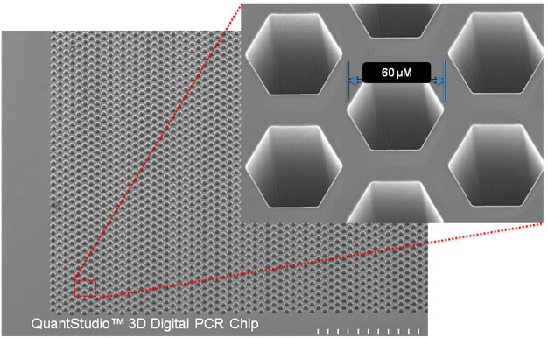
QuantStudio® 3D Digital PCR System
20,000 consistently-sized nanoscale reaction wells

Slide 5
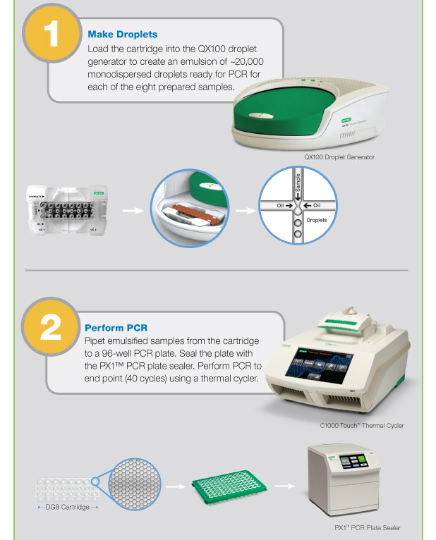
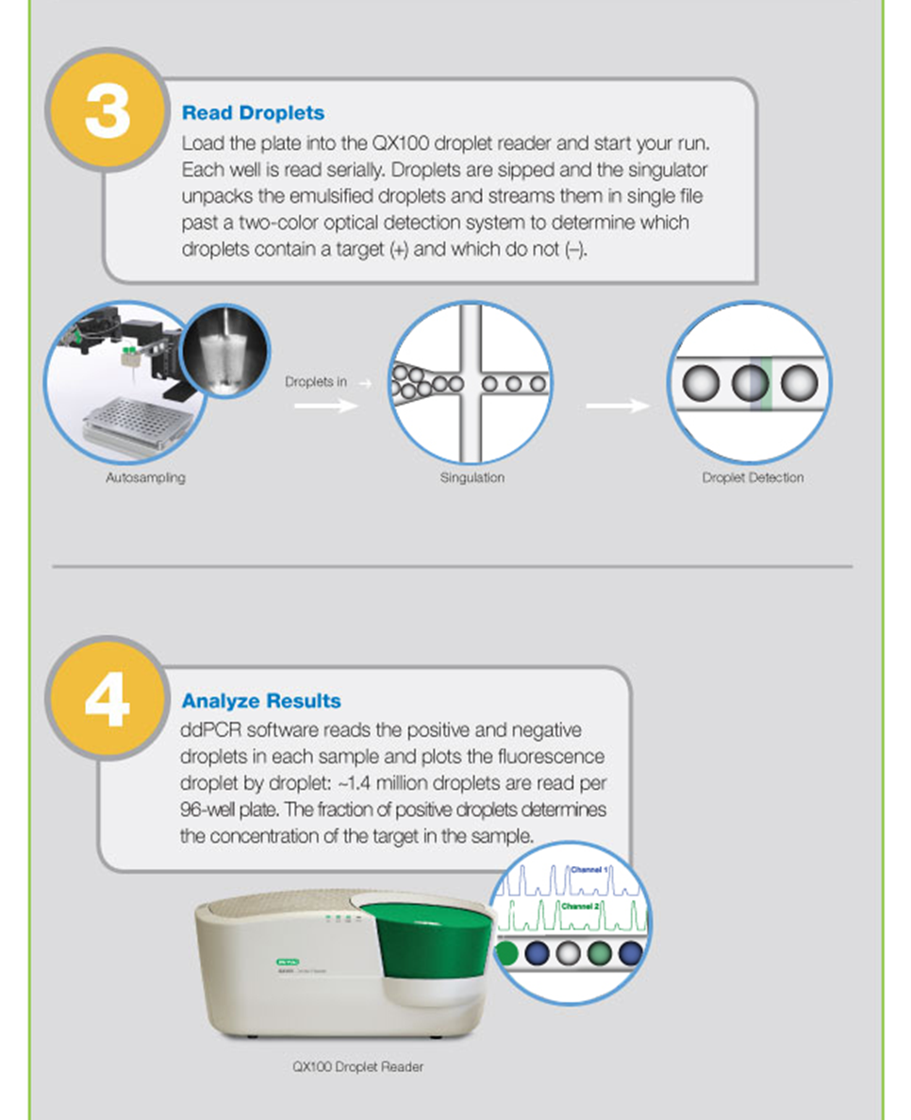
QX100™ Droplet Digital™ PCR System

Slide 6
Trešās paaudzes sekvenēšanas platformas

Slide 7

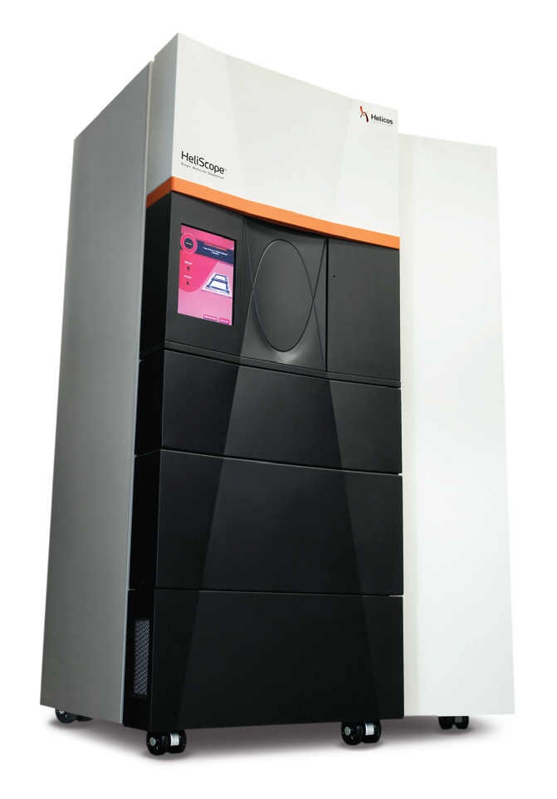
Helicos sekvenēšana
Metodes pamatā ir tieša vienas DNS molekulas sintēze (true Single molecule sequencing).
DNS amplifikācija
DNS klonēšana
Sekvenēšanas apjomi – 1Gb 1h
Sekvences garums – 25-50b
Kvalitāte – 99,4%
HeliScope™
Single Molecule Sequencer

Slide 8
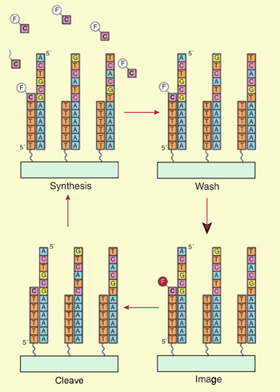
Helicos sekvenēšana
Galvenie sekvenēšanas soļi:
1.DNS fragmenti tiek imobilizēti uz slaida virsmas;
2.Polimerāze katalizē fluoriscenti iezīmēta nukleotīda pievienošanu;
3.Tiek aizvākti liekie nukleotīdi un polimerāze;
4.Tiek nolasīts signāls;
5.Fluoriscentā grupa tiek nošķelta;
6.Tiek pievienots nākamais nukleotīds...
2.
3.
5.
4.

Slide 9
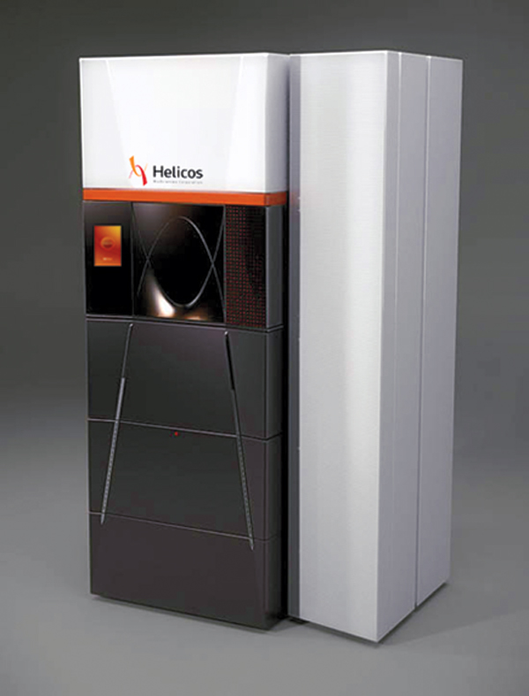
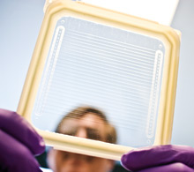
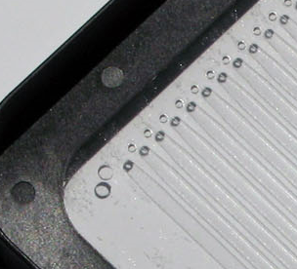
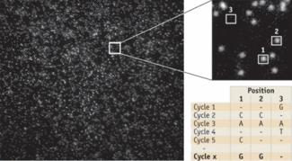
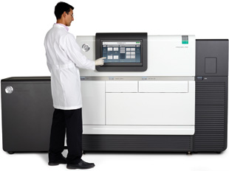
Helicos sekvenēšana
Helicos sekvenātorā signāla nolasīšana tiek nodrošināta ar fluoriscento mikroskopu.
HeliScope™ Single Molecule Sequencer.
Stikla slaids, uz kā tiek uznesta DNS.
PACIFIC BIOSCIENCES SMRT TECHNOLOGY
Sekvenātora HeliScope™ uzņemts attēls.

Slide 10
3rd paaudzes sekvenēšanas platformas
Oxford Nanopore – vienas DNS molekulas sekvenēšana bez amplifikācijas vai iezīmēšanas tieši detektējot tiešu elektrisku signālu .

Slide 11
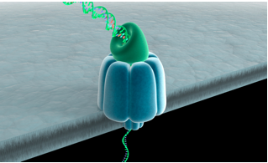
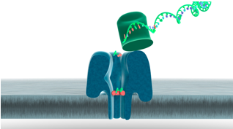
3rd paaudzes sekvenēšanas platformas
Oxford Nanopore – vienas DNS molekulas sekvenēšana bez amplifikācijas vai iezīmēšanas tieši detektējot tiešu elektrisku signālu .
Exonuclease sequencing
Using a processive enzyme to cleave individual nucleotides from a DNA strand and pass them through a protein nanopore. .
Strand sequencing
Identifying individual nucleotides on a DNA strand as it passes intact through a protein nanopore.
Solid state sequencing
Using synthetic materials, rather than protein pores, to create nanopores.

Slide 12
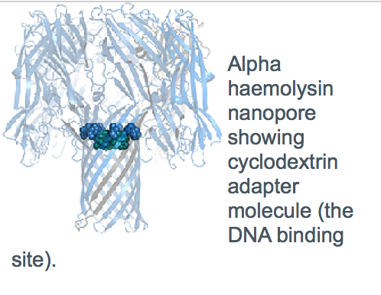
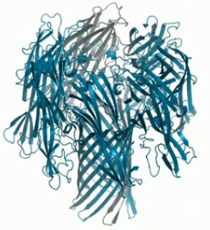
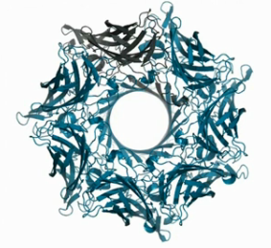
Structure of the Protein Nanopore
Exonuclease sequencing: Combining a protein nanopore and processive enzyme for the sequential identification of DNA bases as they pass through the pore.

Slide 13
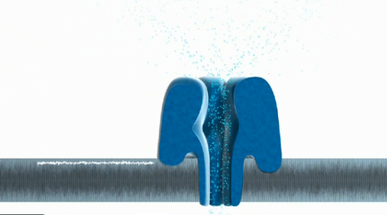
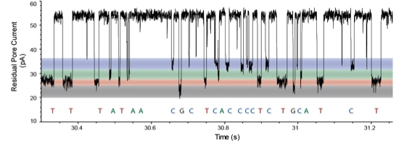
Electronic trace showing DNA bases in solution entering the nanopore.
The bases individually, transiently bind to the cyclodextrin adapter.
Each time a base passes through the pore there is a disruption in the current.
Diagram shows four different magnitudes of disruption which can be classified as C, G, A or T.

Slide 14

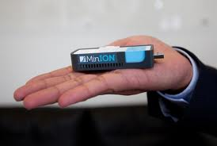

Slide 15
https://www.nanoporetech.com/news/movies#movie-24-nanopore-dna-sequencing

Slide 16
NGS sekvenēšanas pielietojums:
RNA-seq: ekspresijas, izoformu un slaisinga variantu analīze
Small RNA-seq: microRNS, nekodējošās RNS sevenēšana
Visa genoma-seq: SNP varianti, CNV
Exome-seq: SNP varianti kodējošā secībā
Chip-seq: transkripcijas u.c faktoru regulatorie saiti.

Slide 17
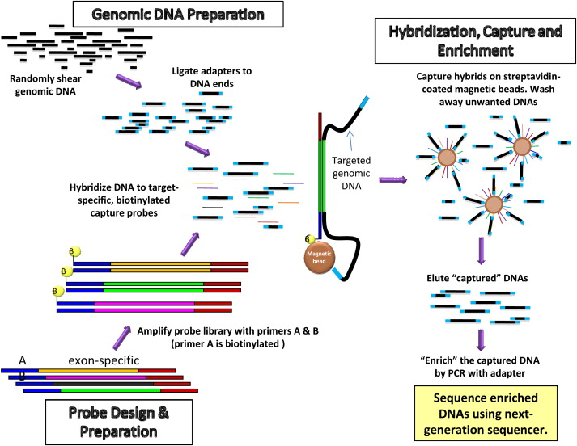
Proteīnus kodējošās genoma frakcijas (Eksoma) sekvenēšana

Slide 18
Pilna garuma mRNS sekvenēšana
mRNS ekspresijas līmeņa kvantificēšana pēc nolasījumu skaita
Genoma anotācija:
  Jaunu transkriptu atklāšana
  Alternatīvā splaisinga raksturošana
Slimību procesa (piem. audzēju raksturošana):
  Kodējošo SNP identificēšana
  Slimības bāzētu biomarķieru identificēšana
  Abnormālas ar slimību saistītas ekspresijas identificēšana

Slide 19
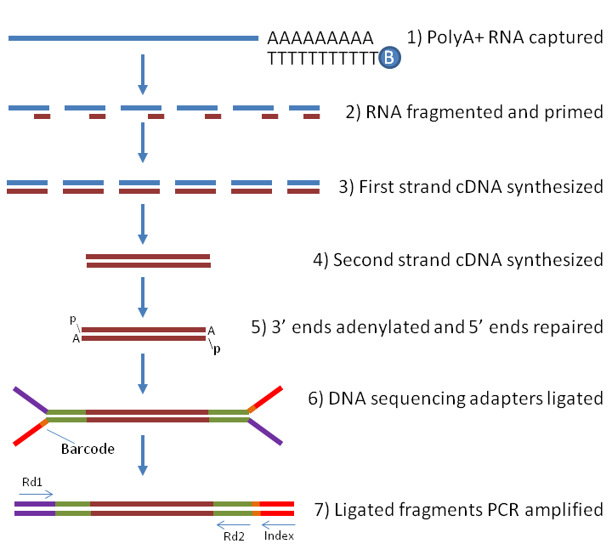

Slide 20
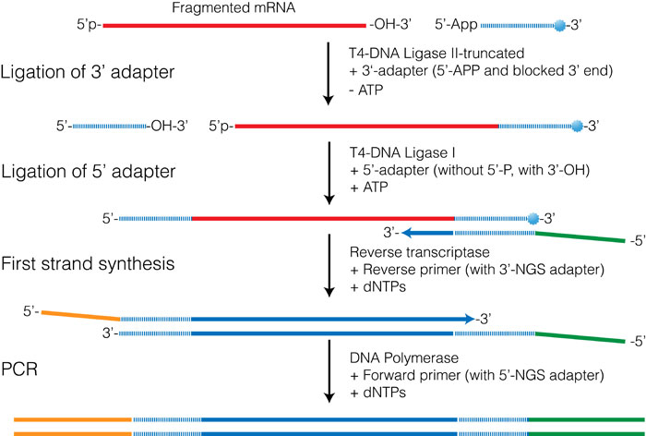

Slide 21
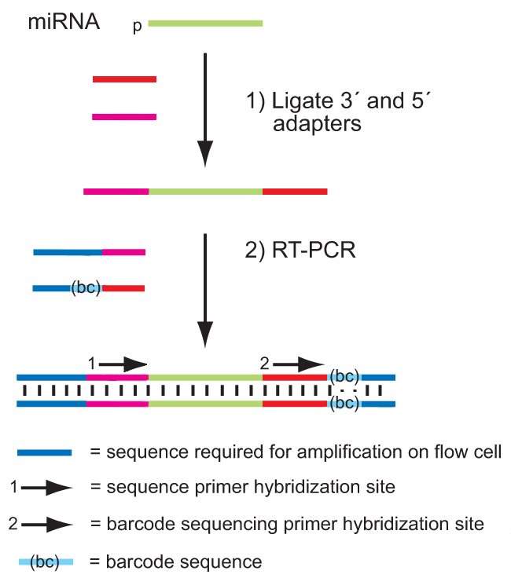

Slide 22
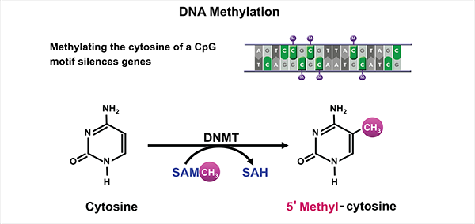
Metodes epiģenētikas pētniecībai

Slide 23
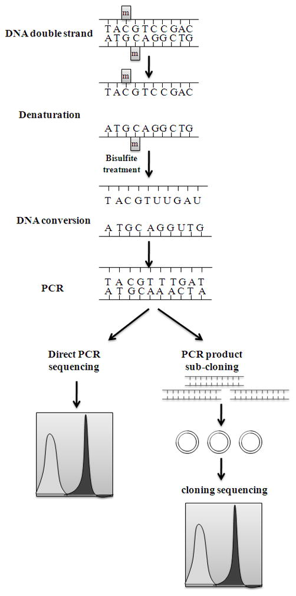
Bisulfīta apstrādāta DNS izmantošana CpG metilēšanas noskaidrošanai

Slide 24
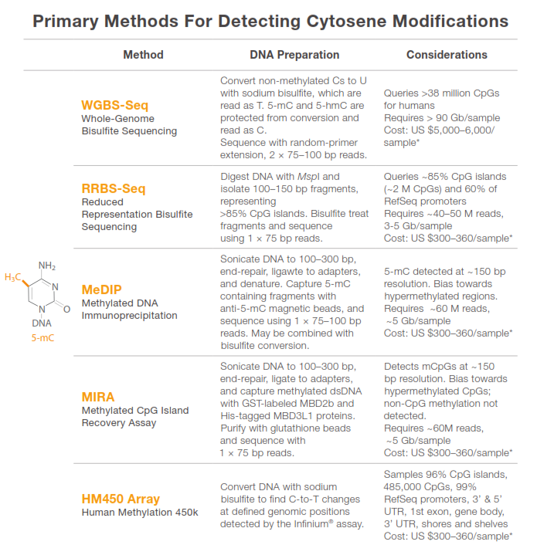
Metilēšanas mērīšanas pieejas

Slide 25
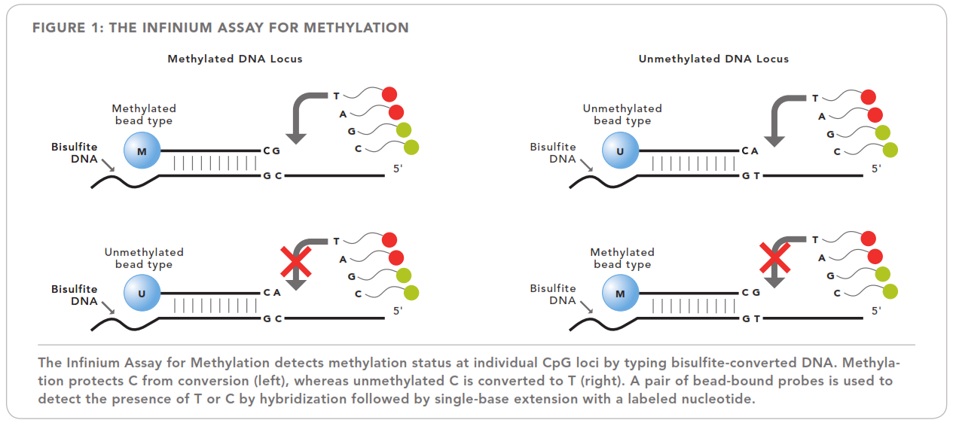

HM450 array

Slide 26
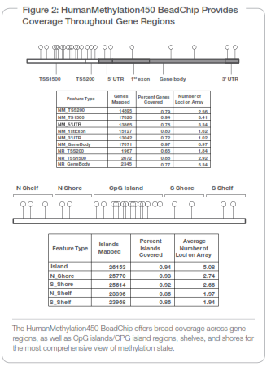

Slide 27
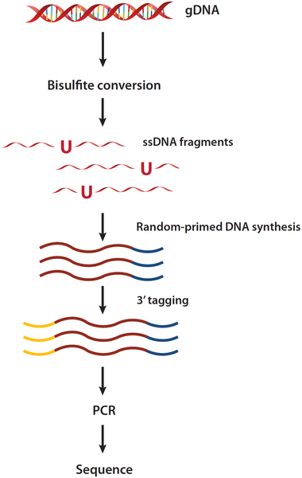
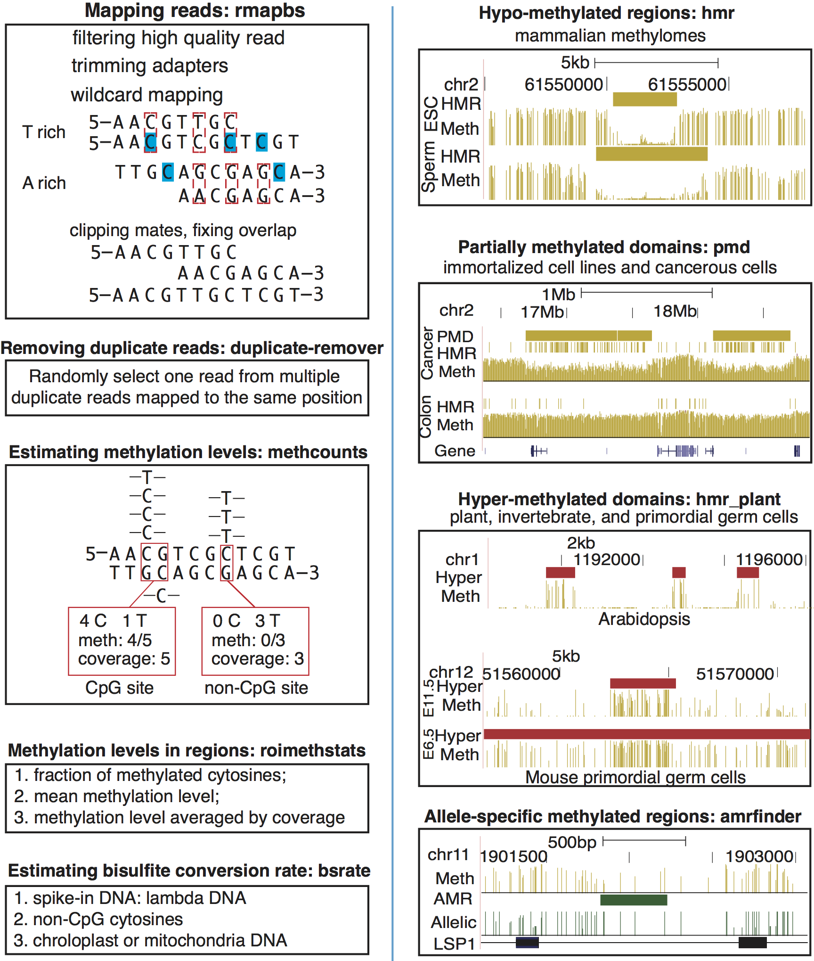
WGBS

Slide 28
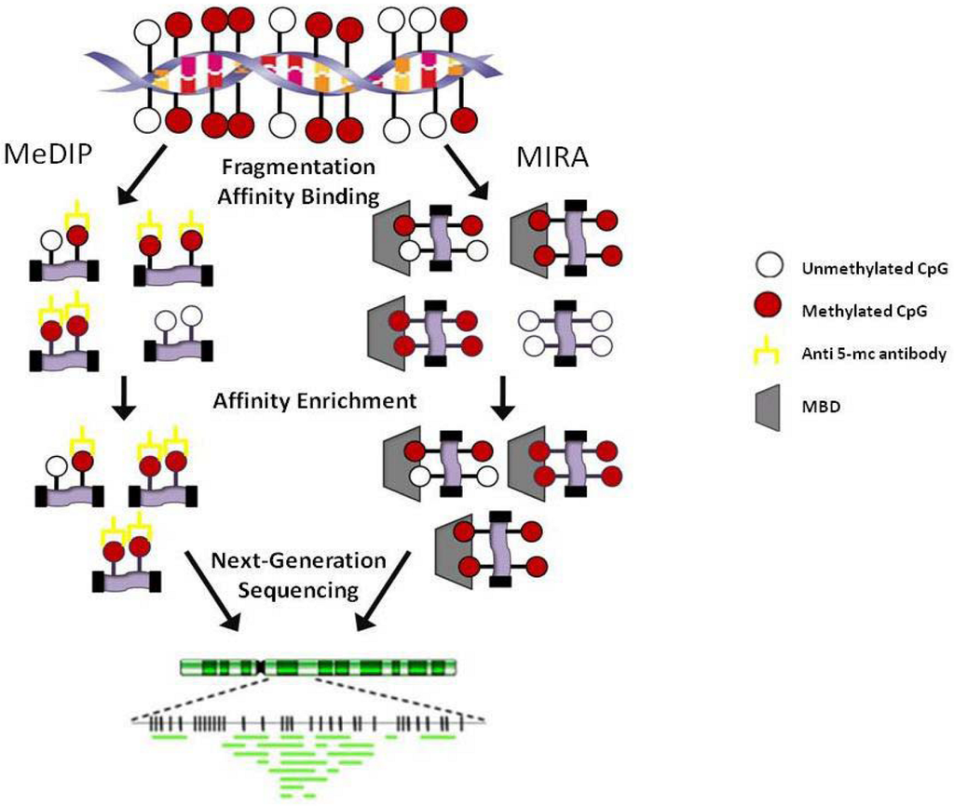
MeDIP un MIRA

Slide 29
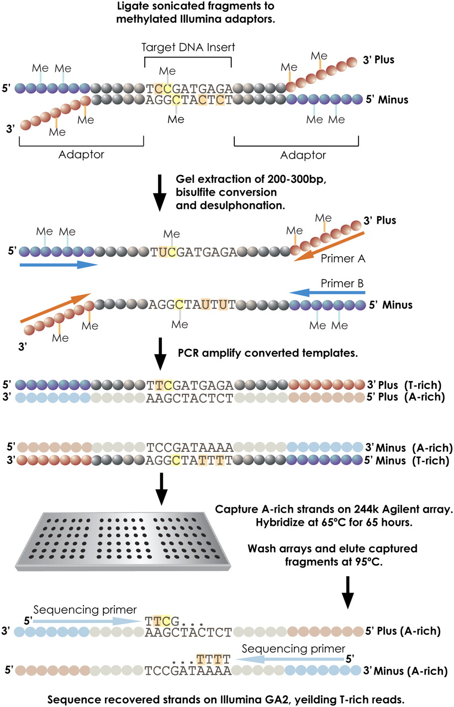

Bisulfite capture procedure.
Copyright © 2009 by Cold Spring Harbor Laboratory Press
Hodges E et al. Genome Res. 2009;19:1593-1605
Notes:
Bisulfite capture procedure. Genomic DNA was randomly fragmented according to the standard Illumina protocol and ligated to custom-synthesized adaptors in which each C was replaced by 5-meC. The ligation was size-fractionated to select material from 150–300 bases in length. The gel-eluted material was treated with sodium bisulfite (see Methods) and then PCR-enriched using Illumina paired-end PCR primers. The resulting products were hybridized to custom-synthesized Agilent 244K arrays containing probes complementary to the A-rich strands. Hybridizations were carried out with Agilent array CGH buffers under standard conditions. After washing, captured fragments were eluted in water at 95°C and amplified again prior to quantification and sequencing on the Illumina GA2 platform.

Slide 30
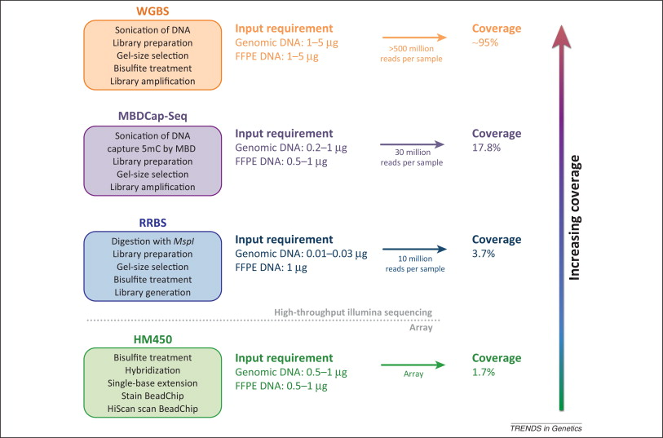

Slide 31
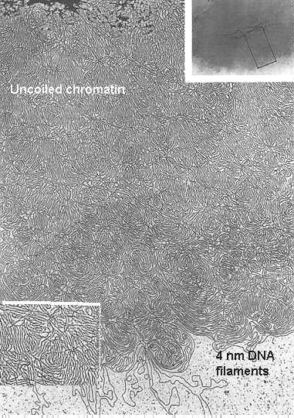
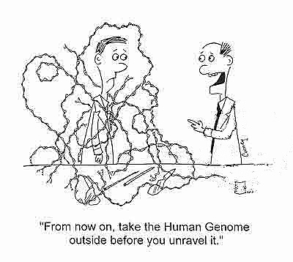
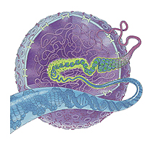
Eikariotiem ir DNS iepakošanas problēmas
2 m DNS ir jāiedābū iekšā kodolā
Tas viss ir jāreplicē, jāstranskribē un jāregulē!!!
Notes:
Like packaging 24 miles of fine thread into a tennis ball

Slide 32
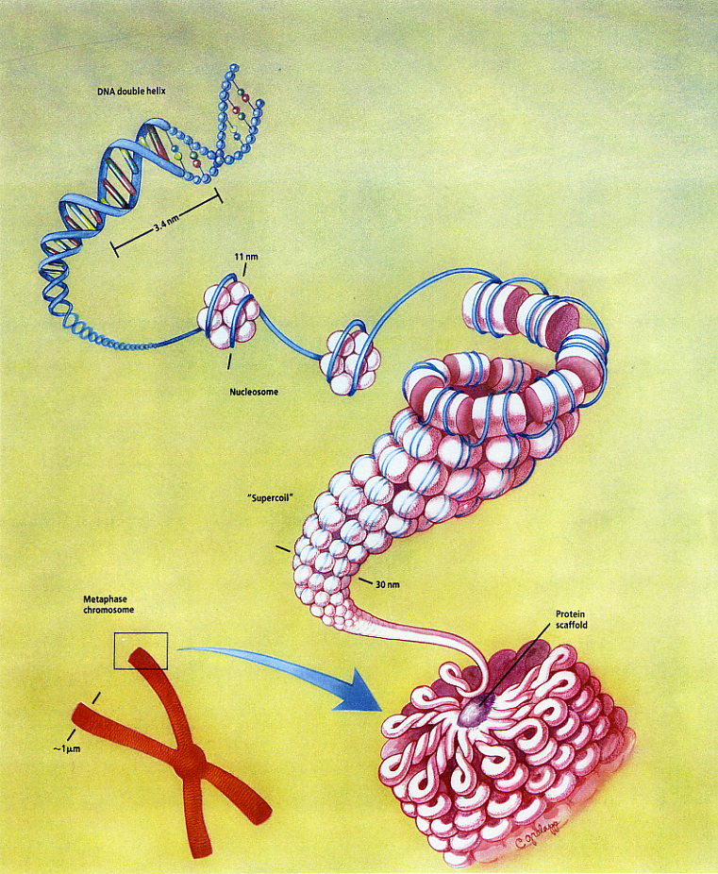
Hromatīns
Hromatīns ir DNS, kas ir sapakots ar specializētiem proteīniem
Notes:
Make sure they know the difference between structural proteins and enzymes

Slide 33
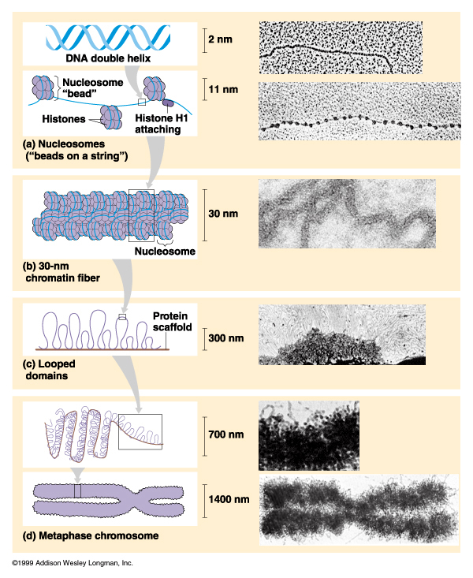
Hromatīna pakošanas līmeņi
1.
Nukleosomas
2.
30 nm fibrilla
3.
Cilpu struktūras kodolā
4.
Metafāzes hromosomas

Slide 34
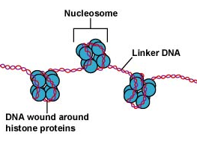
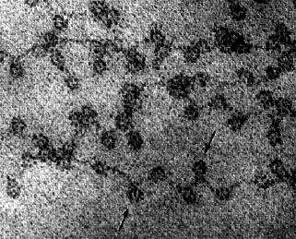
1. Līmenis - Nukleosomas
“string on a bead”
Linkera izmēri variē (8-114bp)
Kompaktizācijas līmenis ir 7 kārtīgs
Notes:
Histones: A group of positively charged small proteins; high content of lysine and arginine
Generally small polypeptides; 10,000 to < 25,000 daltons
Facilitates interactions with negatively charged phosphate backbone of DNA
Linker DNA may vary anywhere from 8-114bp

Slide 35
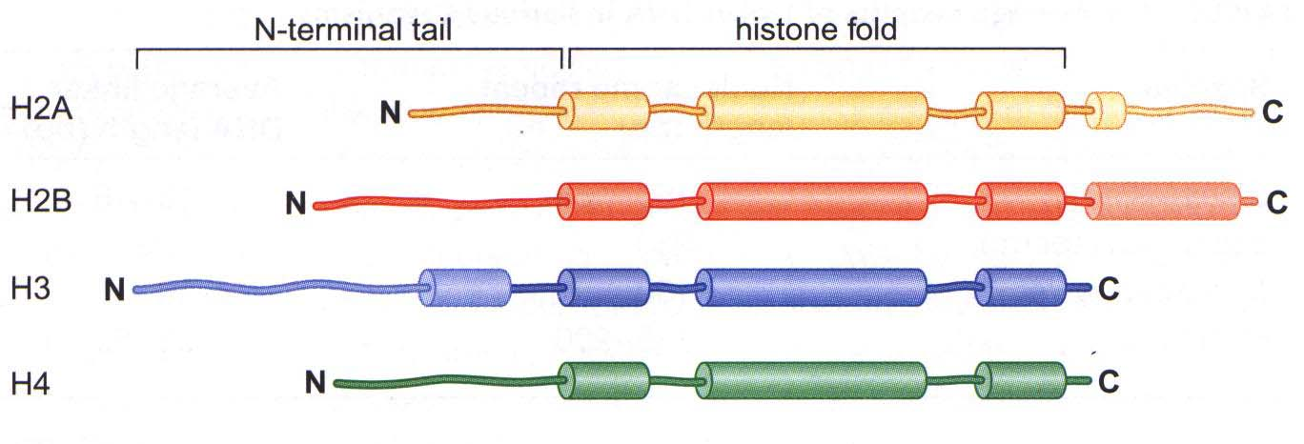
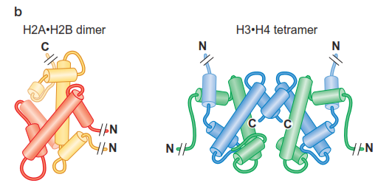
Histonu proteīni- nukleosomu pamatā
H1
N
C
Notes:
Histones: A group of positively charged small proteins; high content of lysine and arginine
Generally small polypeptides; 10,000 to < 25,000 daltons
Facilitates interactions with negatively charged phosphate backbone of DNA
Most abundant chromatin protein
Linker DNA may vary anywhere from 8-114bp

Slide 36
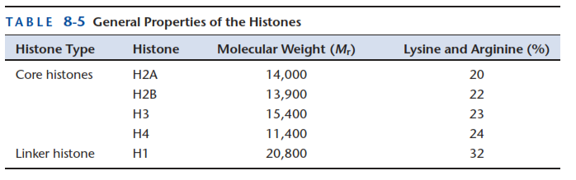
Histoni
2/3 no hromatīna masas ir proteīni
95% no hromatīna proteīniem ir histoni

Slide 37
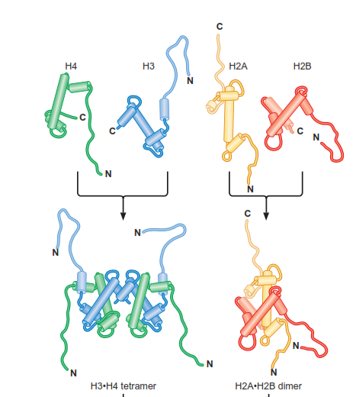
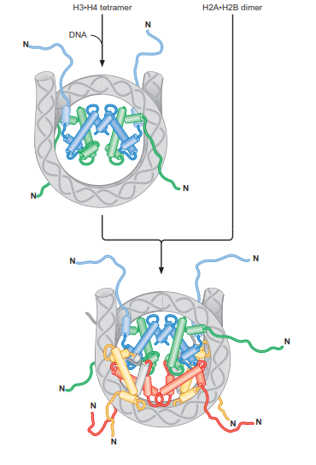
Nukleosomas savākšanās

Slide 38
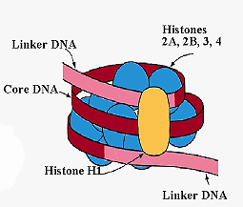

Nukleosomas struktūra
Hromatosoma: histonu oktamērs + ~146 bp DNS un linkera histons H1
Nukleosoma - pamatvienība oktamērs + ~146 bp DNS

Slide 39

Nucleosome core particle

Slide 40

Nukleosomas struktūra

Slide 41

Histoni saistās ar DNS minoro iedobi
DNS saistās ar nukleosomu ar aptuveni 40 ūdeņraža saitēm pārsvarā ar skābekļa
atomiem fosfodiestersaitē minorās iedobes tuvumā. Tikai 7 ūdeņraža saites ir ar
bāzēm.

Slide 42

Histonu N-terminālie gali atrodas noteiktās nuklosomas pozīcijās

Slide 43

Otrais līmenis : 30nm fibrilla
Nepieciešams H1 histons
Nodrošina 100 kārtīgu kompaktizācijas līmeni
Lehninger

Slide 44



30 nm pavediena struktūra

Slide 45



Trešais līmenis: cilpu struktūra

Slide 46
Heterohromatīns / Eihromatīns
Tumšs krāsojums (augsti kondensēts)
DNS sekvences atkārtojumi
Replikācija notiek šūnas cikla beigās
Zems rekombinācijas līmenis
Represē transkripciju
Gaišs krāsojums (vāji kondensēts DNS)
Bagātāks ar gēniem
Replikācija notiek šūnas cikla sākumā
Auksts rekombinācijas līmenis
Transripcionāli aktīvs

Slide 47

Hromatīna struktūras regulēšana
Proteīnu saistīšanās ar DNS ir atkarīga no DNS lokalizācijas nukleosomā

Slide 48

Nukleosomu remodelēšanas komplekss

Slide 49


Nukleosomu remodelēšanas komplekss
ATF atkarīgs DNS translokācijas mehānisms, kas izraisa DNS pārvietošanos uz nukleosomas (slīdēšanu)

Slide 50

Nukleosomu remodelēšanas kompleksi

Slide 51

Proteīnu atkarīga nukleosomu pozicionēšana
Proteīni saistās specifiskās vietās un
novērš nukleosomu veidošanos
Proteīnu saistīšanās veicina nukleosomu veidošanos noteiktās vietās

Slide 52

DNS secības atkarīga nukleosomu pozicionēšana
Secības, kur A-T bagāti rajoni mainās ar C-G raroniem ar 5bp intervālu veicina DNS poesaisti pie histonu kompleksa

Slide 53

N-terminālo histonu galu modifikācijas
Notes:
Modifications of the histone amino-terminal tails alters the function of chromatin. The sites of known histone modifications are illustrated on each histone. Although the types of histone modifications continue to grow, for simplicity, only sites of acetylation, methylation, phosphorylation, and ubiquitinylation are shown. The majority of these modifications occur on the tail regions, but there are occasional modifications within the histone fold (e.g., methylation of lysine 79 of histone H3). (Adapted, with permission, from Alberts B. et al. 2002. Molecular biology of the cell, 4th ed., Fig. 4-35. # Garland Science/Taylor & Francis LLC; and, with permission, from Jenuwein T. and Allis C.D. 2001. Science 293: 1074–
1080, Figs. 2 and 3. #AAAS.)

Slide 54
Histonu modifikāciju ietekme :
Acetilēšana un fosforilēšana samazina pozitīvo lādiņu un līdz ar to afinitāti pret DNS
Samazina augstākā līmeņa struktūru veidošanos- piemēram 30nm fibrillu.
Ietekme ir diferenciāla:
  H4 molekulu K8 un K16 acetilēšana ir saistīta ar gēnu starta saitiem
  K5 un K12 acetilēšana iezīmē jaunās H4 molekulas, kas ir gatavas DNS saistīšanai
  H3 molekulu K4, K36, K79 metilē šana aktivē gēnu ekspresiju, kamēr K9 un K27 metilēšana to kavē

Slide 55

Histonu modifikāciju ietekme :

Slide 56
Proteīnu domēni remodelēšanas un modificējošo kompleksu sastāvā
Bromodomēni – saistās ar acetilētiem histonu galiem
Hromodomēni \
TUDOR domēni ] saistās ar metilētiem histonu galiem
PHD pirksti /
SANT domēni – saistās ar nemodificētiem histoniem
Atseviški domēni atpazīst tikai specifiski modificētus histonu galu atlikumus (piemēram HP1 pazīst tikai H3 lizīnu 9)

Slide 57

Histonus modificējošie enzīmi:

Slide 58


Nukleosomu pozicionēšanas noskaidrošana ar restriktāžu palīdzību

Slide 59


Nukleosomu pozicionēšanas noskaidrošana ar Nextgen sekvenēšanas palīdzību

Slide 60


Histonu modificēšana un hromatīna remodelēšana var notikt vienlaicīgi

Slide 61



Histonu modifikācijas tiek pārnestas jaunajā DNS pēc replikācijas

Slide 62


Nukleosomu veidošanos nosaka histonu čaperoni

Slide 63



Transkripcijas komplekss eikariotos:

Slide 64

Eikariotos pieaug transkripcijas kompleksicitāte

Slide 65




Saistīšanos ar DNS nodrošina dažādi domēni
Homeodomēnu proteīni
Cinku saturošie
saistīšanās domēni
Leicīna rāvējslēdžu
proteīns
Spirāles-cilpas-
spirāles proteīns
HMG saistīšanās proteīni

Slide 66
Ekspresijas aktivatori
Aktivatori eikariotos tiešā veidā nesaista RNS polimerāzi, bet var saistīties ar faktoriem, kas tieši ietekmē polimerāzi
Aiktivātori var saistīt vispārējos transkripcijas faktoru kompleksus (piemēram «mediatoru komplesu»)
Aktivātori var saistīties ar nukleosomu modificējošiem kompleksiem, kas izmaina hromatīna struktūru

Slide 67

Transkripcijas mašinērijas piesaiste

Slide 68

Enhānseri un insulatori
Enhānseri var regulēt gēnu ekspresiju no liela attāluma.
Insulātori novērš enhānseru iedarbību uz blakusesošajiem gēniem.
Insulatoru secības bieži saista cinka saistīšanas proteīnu CTCF
Insulātori var arī bloķēt histonu modifikāciju izplatīšanos blakus rajonos
Notes:
FIGURE 19-14 Insulators block activation
by enhancers. (a) A promoter activated
by activators bound to an enhancer.
(b) An insulator is placed between the
enhancer and the promoter. When bound
by insulator-binding protein CTCF, activation
of the promoter by the enhancer is
blocked, despite activators binding to the
enhancer. (c,d) Neither the activators at
the enhancer nor the promoter is inactivated
by the action of the insulator. Thus, the
activator can activate another promoter
nearby (c), and the original promoter can
be activated by another enhancer placed
downstream (d).

Slide 69

Aktivatori var mijiedaroties dažādos veidos
Notes:
FIGURE 19-16 Cooperative binding
of activators. Four ways that the binding of
one protein to a site on DNA can help the
binding of another to a nearby site. (a)
Cooperative binding through direct interaction
between the two proteins is shown, as
we saw for the l repressor in Chapter 18
and shall see between many regulators in eukaryotes
as well. (b) Asimilar effect is achieved
by both proteins interacting with a common
third protein. (c,d) Indirect effects in which
binding of one protein to its site on DNA
within nucleosomes helps binding of a
second protein. (c) The ﬁrst protein recruits
a nucleosome remodeler whose action
reveals a binding site for a second protein.
(d) The binding of the ﬁrst protein to its site
on the DNA just where it exits the nucleosome.
By binding there, it unwinds the
DNA from the nucleosome a little, revealing
the binding site for the second protein.
Each of these mechanisms can explain how
one regulator can help others bind or,
indeed, how an activator can help the transcriptional
machinery bind to a promoter.

Slide 70

Transkripcijas represori

Slide 71

Histonu modifikāciju iekakme uz blakusesošo saitu modificēšanu
Notes:
Histone modification cross-talk. Histone modifications can positively or negatively affect other modifications. A positive effect is indicated by an arrowhead and a negative effect is indicated by a flat head (updated from reference ⁵³).

Slide 72

Histonu modifikācijas saistošie proteīni
Notes:
omains binding modified histones. Examples of proteins with domains that specifically bind to modified histones as shown (updated from reference ⁵³).

Slide 73


DNS metilēšana

Slide 74


Imprintings ar DNS metilēšanas palīdzību

Slide 75

Metilēšana var tikt saglabāta arī replicētajās DNS ķēdēs ar uzturēšanas metilāžu palīdzību un pārmatota

Slide 76

Demetilēšana var būt aktīva un pasīva
Notes:
During early development, methylation patterns are initially established by the de novo DNA methyltransferases DNMT3A and DNMT3B. When DNA replication and cell division occur, these methyl marks are maintained in daughter cells by the maintenance methyltransferase, DNMT1, which has a preference for hemi-methylated DNA. If DNMT1 is inhibited or absent when the cell divides, the newly synthesized strand of DNA will not be methylated and successive rounds of cell division will result in passive demethylation. By contrast, active demethylation can occur through the enzymatic replacement of 5-methylcytosine (5meC) with C

Slide 77

Aktīvā demetilēšana
Notes:
Active demethylation at the brain-derived neurotrophic factor (BDNF) promoter. In neurons, BDNF is maintained in a repressed state through DNA methylation and binding of the repressive methylcytosine (meC)-binding protein MeCP2. On depolarization with KCl, DNA methylation and MeCP2 binding are lost, concomitant with increased BDNF expression. This demethylation event is considered to be active because it occurs in post-mitotic neurons. b | Active demethylation at nuclear receptor target promoters. The promoter of the oestrogen receptor (ER) target gene pS2 (also known as TFF1) undergoes cyclical rounds of methylation and demethylation that correspond to the repression and expression of the gene, respectively. Transcriptional activation of pS2 occurs in the presence of oestrogens (E2) and coincides with demethylation of the promoter. This is achieved by deamination of 5meC by DNA methyltransferase 3 (DNMT3) followed by base excision repair (BER) of the T•G mismatch by T DNA glycosylase (TDG). To revert to repression, DNMT3 re-methylates the promoter. Although DNMT3 is involved in both methylation and demethylation, it is important to note that DNMT3 can only carry out the deamination step in the absence or at low concentrations of the methyl donor S-adenosylmethionine (SAM)

Slide 78


Metodes DNS-proteīnu mijiedarbības pētīšanai

Slide 79

Hromatīna imunoprecipetācija (ChIP)

Slide 80

Hromosomu konformācijas noteikšana (3C)

Slide 81

ChIP-on-chip

Slide 82

Chip-seq

Slide 83


Slide 84

ENCODE projekts
Notes:
Chromosome Conformation Capture Carbon Copy

Slide 85

DNAse seq

Slide 86

FAIRE - Formaldehyde-Assisted Isolation of Regulatory Elements
FAIRE in human cells is illustrated on the left, while preparation of the reference is illustrated on the right.
Giresi P G et al. Genome Res. 2007;17:877-885
Copyright © 2007, Cold Spring Harbor Laboratory Press
Notes:
FAIRE in human cells is illustrated on the left, while preparation of the reference is illustrated on the right. For FAIRE, formaldehyde is added directly to cultured cells. The crosslinked chromatin is then sheared by sonication and phenol-chloroform extracted. Crosslinking between histones and DNA (or between one histone and another) is likely to dominate the chromatin crosslinking profile (Brutlag et al. 1969; Solomon and Varshavsky 1985; Polach and Widom 1995). Covalently linked protein–DNA complexes are sequestered to the organic phase, leaving only protein-free DNA fragments in the aqueous phase. For the hybridization reference, the same procedure is performed on a portion of the cells that had not been fixed with formaldehyde, a procedure identical to a traditional phenol-chloroform extraction. DNA resulting from each procedure is then labeled with a fluorescent dye, mixed, and comparatively hybridized to DNA microarrays. In this case, we used high-density oligonucleotide arrays that tile across the ENCODE regions of the human genome (30 Mb).

Slide 87
ENCODE projekts
Notes:
Chromosome Conformation Capture Carbon Copy

Slide 88

Hromosomu konformācijas noteikšanas (3C) metodes modificācijas
Chromosome Conformation Capture
Circularized Chromosome Conformation Capture
Carbon-Copy Chromosome Conformation Capture

Slide 89

TCC - tethered chromosome conformation capture Hi-C
Notes:
Cells are treated with formaldehyde, which covalently crosslinks proteins (purple ellipses) to each other and to DNA (orange and blue strings). (1) The chromatin is solubilized and its proteins are biotinylated (purple ball and stick). DNA is digested with a restriction enzyme that generates 5′ overhangs. (2) Crosslinked complexes are immobilized at a very low density on the surface of streptavidin-coated magnetic beads (gray arc) through the biotinylated proteins; noncrosslinked DNA fragments are removed. (3) The 5′ overhangs are filled in with an α-thio-triphosphate–containing nucleotide analog (the yellow nucleotide in the inset), which is resistant to exonuclease digestion, and a biotinylated nucleotide analog (the red nucleotide with the purple ball and stick in the inset) to generate blunt ends. (4) Blunt DNA ends are ligated. (5) Crosslinking is reversed and DNA is purified. The biotinylated nucleotide is removed from nonligated DNA ends using Escherichia coli exonuclease III whereas the phosphorothioate bond protects DNA fragments from complete degradation. (6) The DNA is sheared and fragments that include a ligation junction are isolated on streptavidin-coated magnetic beads, but this time through the biotinylated nucleotides. (7) Sequencing adaptors are added to all DNA molecules to generate a library. (8) Ligation events are identified using paired-end sequencing.

Slide 90

ChiA-PET (Chromatin interaction analysis with paired-end tag sequencing)

Slide 91
ENCODE projekts
Notes:
Chromosome Conformation Capture Carbon Copy

Slide 92

ChIP-seq protokoli
(Furey 2012, Nature reviews)

Slide 93




ChipSeq
Immunoprecipitate
High-throughput sequencing
Map sequence tags
to genome
Release DNA

Slide 94
ENCODE projekts
Notes:
Chromosome Conformation Capture Carbon Copy

Slide 95
Bisulfite capture procedure.
Copyright © 2009 by Cold Spring Harbor Laboratory Press
Hodges E et al. Genome Res. 2009;19:1593-1605
Notes:
Bisulfite capture procedure. Genomic DNA was randomly fragmented according to the standard Illumina protocol and ligated to custom-synthesized adaptors in which each C was replaced by 5-meC. The ligation was size-fractionated to select material from 150–300 bases in length. The gel-eluted material was treated with sodium bisulfite (see Methods) and then PCR-enriched using Illumina paired-end PCR primers. The resulting products were hybridized to custom-synthesized Agilent 244K arrays containing probes complementary to the A-rich strands. Hybridizations were carried out with Agilent array CGH buffers under standard conditions. After washing, captured fragments were eluted in water at 95°C and amplified again prior to quantification and sequencing on the Illumina GA2 platform.

Slide 96
ENCODE projekts
Notes:
Chromosome Conformation Capture Carbon Copy

Slide 97

CLIP-seq

Slide 99
ENCODE galvenie atklājumi
Vismaz 80.4% no cilvēka genoma piedalās vismaz vienā bioķīmiskā reakcijā (RNS vai hromatīna asociētā)
Regulatorie elementi uzrāda negatīvās selekcijas pazīmes norādot uz to funkcionalitāti
Definētas vairākas hromatīna stadijas ar 399,124 enhānseru līdzīgām un 70,292 promoteru līdzīgām īpašībām
RNS ekspresijas līmeņi korelē ar hromatīna un transkripcijas faktoru saistīšanās marķieriem
Ar slimībām asociētie SNP pārsvarā ir lokalizētu funkcionālajos elementos

Slide 100
Izmantotās šūnu līnijas
Tier1. 3 šūnu līnijas (2sievietes 1 vīrietis):
  B-limfocīti,
  embrionālā cilmes šūna
  Leikēmijas šūnas
15 šūnu līnijas no dažādiem audu tipiem (dažādi dzimumi un normālas/vēža izcelsmes
336 papildus šūnu līnijas
http://encodeproject.org/ENCODE/cellTypes.html

