Slide 1

Gēnu ekspresijas regulācija genoma līmenī

Slide 2
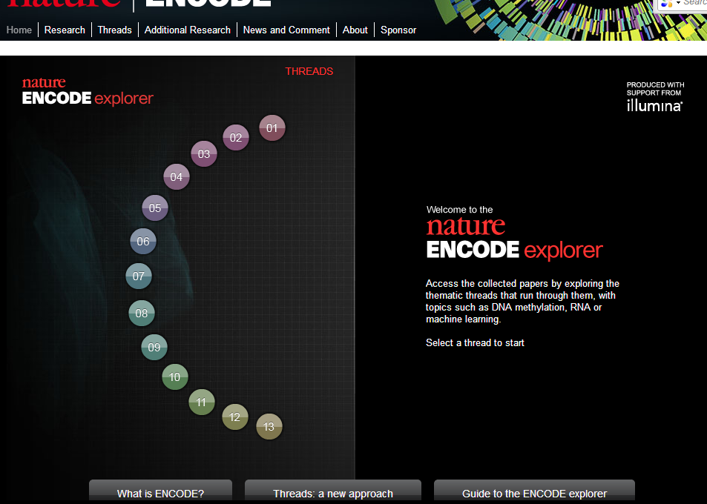

Slide 3
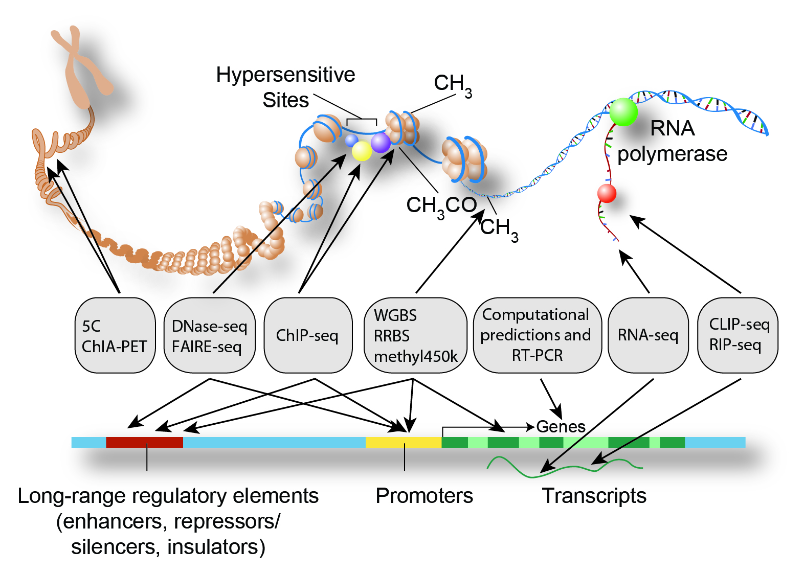
ENCODE projekts
Notes:
Chromosome Conformation Capture Carbon Copy

Slide 5
ENCODE galvenie atklājumi
Vismaz 80.4% no cilvēka genoma piedalās vismaz vienā bioķīmiskā reakcijā (RNS vai hromatīna asociētā)
Regulatorie elementi uzrāda negatīvās selekcijas pazīmes norādot uz to funkcionalitāti
Definētas vairākas hromatīna stadijas ar 399,124 enhānseru līdzīgām un 70,292 promoteru līdzīgām īpašībām
RNS ekspresijas līmeņi korelē ar hromatīna un transkripcijas faktoru saistīšanās marķieriem
Ar slimībām asociētie SNP pārsvarā ir lokalizētu funkcionālajos elementos

Slide 6
Izmantotās šūnu līnijas
Tier1. 3 šūnu līnijas (2sievietes 1 vīrietis):
  B-limfocīti,
  embrioniskā cilmes šūna
  Leikēmijas šūnas
15 šūnu līnijas no dažādiem audu tipiem (dažādi dzimumi un normālas/vēža izcelsmes
336 papildus šūnu līnijas
http://encodeproject.org/ENCODE/cellTypes.html

Slide 7
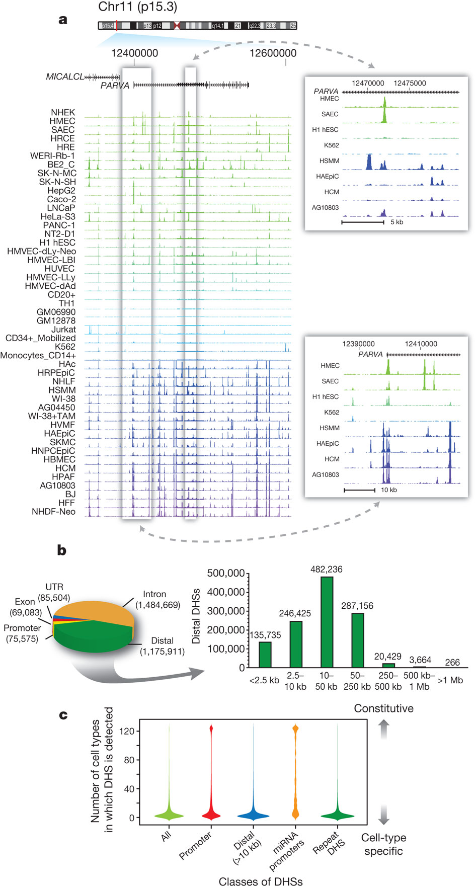
DHS- Dnāzes hiperjūtīgie rajoni – 350 kb piemērs
RE Thurman et al. Nature 000, 1-8 (2012) doi:10.1038/nature11232

Slide 8
DHS izvietojums genomā
RE Thurman et al. Nature 000, 1-8 (2012) doi:10.1038/nature11232

Slide 9
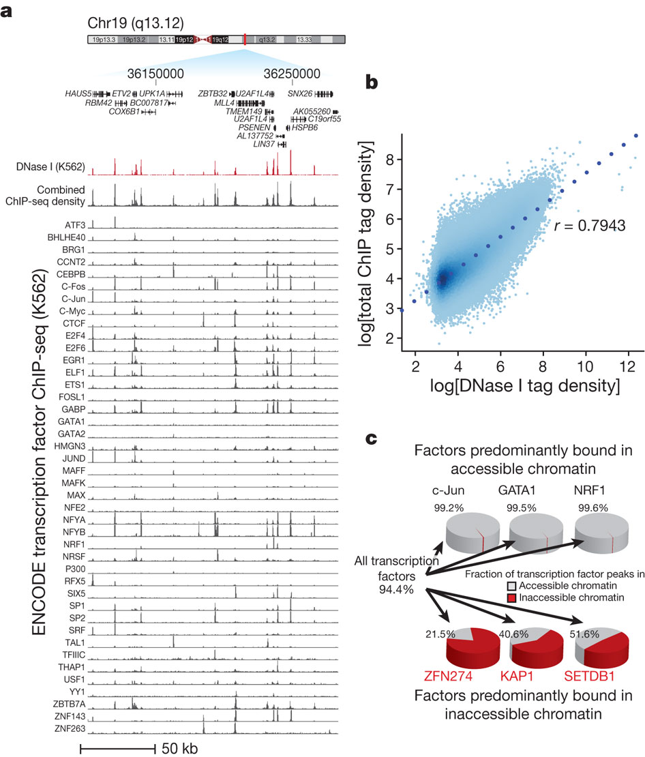
Korelācija starp TF un DHS
Zināmi hromatīna represori
RE Thurman et al. Nature 000, 1-8 (2012) doi:10.1038/nature11232
Notes:
a, DNase I tag density is shown in red for a 175-kb region of chromosome 19. Below: normalized ChIP-seq tag density for 45 ENCODE ChIP-seq experiments from K562 cells, with a cumulative sum of the individual tag density tracks shown immediately below the K562 DNase I data. b, Genome-wide correlation (r = 0.7943) between ChIP-seq and DNase I tag densities (log₁₀) in K562 cells. c, Left: 94.4% of a combined 1,108,081 ChIP-seq peaks from all transcription factors assayed in K562 cells fall within accessible chromatin (grey areas of pie chart). Top: three examples of transcription factors localizing almost exclusively within accessible chromatin. Bottom: three transcription factors from the KRAB-associated complex localizing partially or predominantly within inaccessible chromatin.

Slide 10
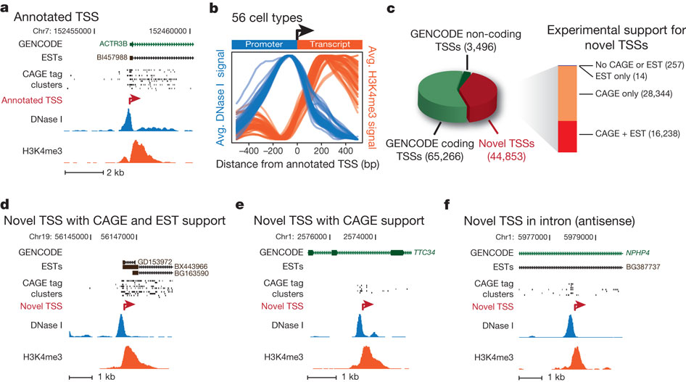
Jaunu promoteru identificēšana un klasifikācija
RE Thurman et al. Nature 000, 1-8 (2012) doi:10.1038/nature11232
Notes:
DNase I (blue) and H3K4me3 (red) tag densities for K562 cells around annotated TSS of ACTR3B. b, Averaged H3K4me3 tag density (red, right y axis) and log DNase I tag density (blue, left y axis) across 10,000 randomly selected GENCODE TSSs, oriented 5′3′. Each blue and red curve is for a different cell type, showing invariance of the pattern. c, Relation of 113,615 promoter predictions to GENCODE annotations, with supporting EST and CAGE evidence (bar at right). d–f, Examples of novel promoters identified in K562; red arrow marks predicted TSS and direction of transcription, with CAGE tag clusters, spliced ESTs and GENCODE annotations above. d, Novel TSS confirmed by CAGE and ESTs. e, Novel TSS confirmed by CAGE, no ESTs. Note intronic location. f, Antisense prediction within annotated gene.

Slide 11
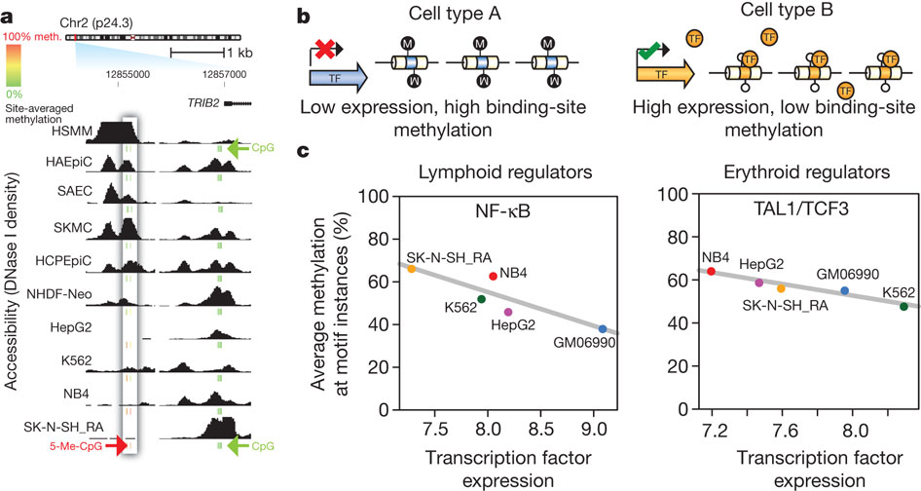
DHS un DNS metilēšanas saistība
RE Thurman et al. Nature 000, 1-8 (2012)
doi:10.1038/nature11232
Notes:
a, DNase I sensitivity in 10 cell types with ENCODE reduced representation bisulphite sequencing data. Inset box: accessibility (y axis) decreases quantitatively as methylation increases. Other DHSs (right) show low correlation between accessibility and methylation. CpG methylation scale: green, 0%; yellow, 50%; red, 100%. b, Model of transcription factor (TF)-driven methylation patterns in which methylation passively mirrors transcription factor occupancy. c, Relationship between transcription factor transcript levels and overall methylation at cognate recognition sequences of the same transcription factors. Lymphoid regulators in B-lymphoblastoid line GM06990 (left) and erythroid regulators in the erythroleukaemia line K562 (right). Negative correlation indicates that site-specific DNA methylation follows transcription factor vacation of differentially expressed transcription factors.

Slide 12
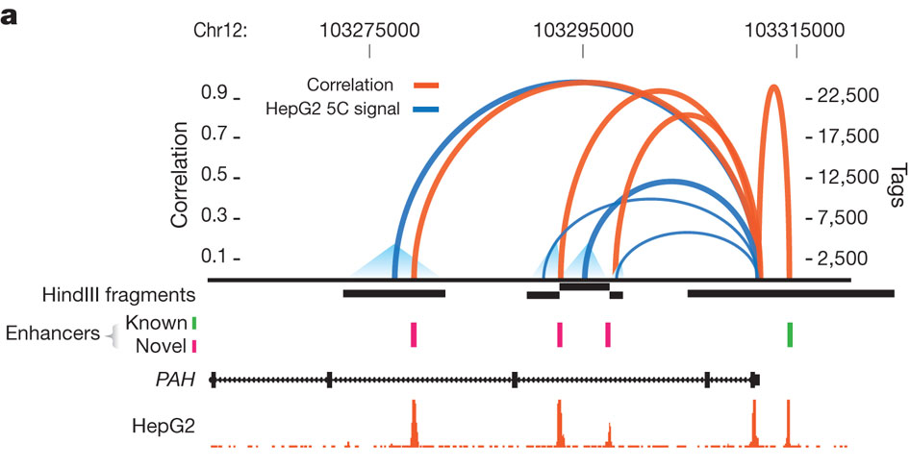
DHS parādās saistībā ar aktīviem promoteriem
RE Thurman et al. Nature 000, 1-8 (2012) doi:10.1038/nature11232
Notes:
a, Cross-cell-type correlation (red arcs, left y axis) of distal DHSs and PAH promoter closely parallels chromatin interactions measured by 5C-seq (blue arcs, right y axis); black bars indicate HindIII fragments used in 5C assays. Known (green) and novel (magenta) enhancers confirmed in transfection assays are shown below. Enhancer at far right is not separable by 5C as it lies within the HindIII fragment containing the promoter. b, Left: proportions of 69,965 promoters correlated (r > 0.7) with 0 to >20 DHSs within 500 kb. Right: proportions of 578,905 non-promoter DHSs (out of 1,454,901) correlated with 1 to >3 promoters within 500 kb. c, Pairing of canonical promoter motif families with specific motifs in distal DHSs.

Slide 13
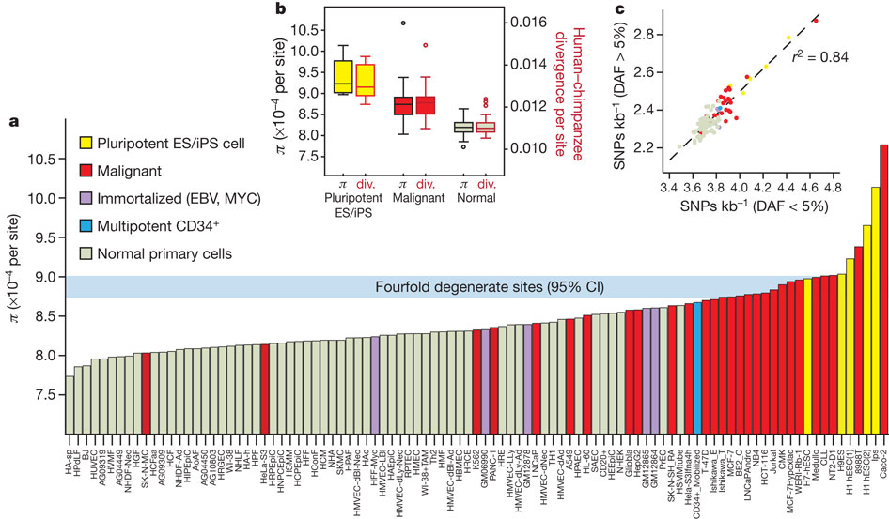
Ģenētiskā varibilitāte ir saistīta ar mutēšanas ātrumu regulatorajos DNS elementos
RE Thurman et al. Nature 000, 1-8 (2012) doi:10.1038/nature11232
Notes:
a, Mean nucleotide diversity (π, y axis) in DHSs of 97 diverse cell types (x axis) estimated using whole-genome sequencing data from 53 unrelated individuals. Cell types are ordered left-to-right by increasing mean π. Horizontal blue bar shows 95% confidence intervals on mean π in a background model of fourfold degenerate coding sites. Note the enrichment of immortal cells at right. ES, embryonic stem; iPS, induced pluripotent stem. b, Mean π (left y axis) for pluripotent (yellow) versus malignancy-derived (red) versus normal cells (light green), plotted side-by-side with human–chimpanzee divergence (right y axis) computed on the same groups. Boxes indicate 25–75 percentiles, with medians highlighted. c, Both low- and high-frequency derived alleles show the same effect. Density of SNPs in DHSs with derived allele frequency (DAF) <5% (x axis) is tightly correlated (r² = 0.84) with the same measure computed for higher-frequency derived alleles (y axis). Colour-coding is the same as in panel a.

Slide 14
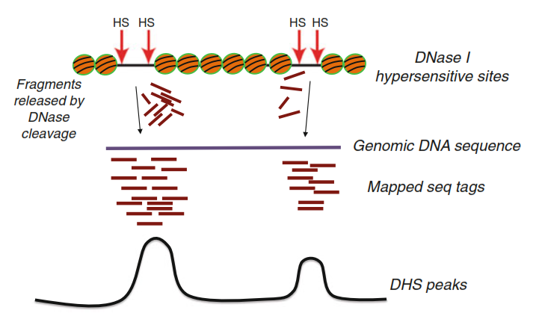
DNAse seq

Slide 15
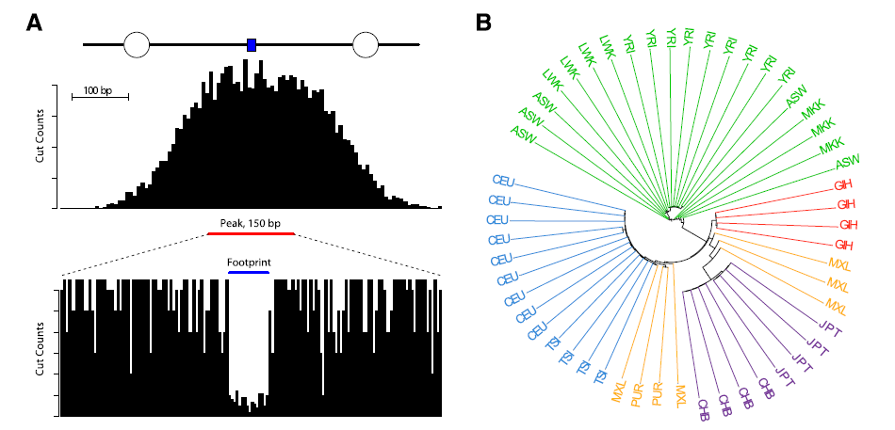
Dnāzes I footprintings

Slide 16
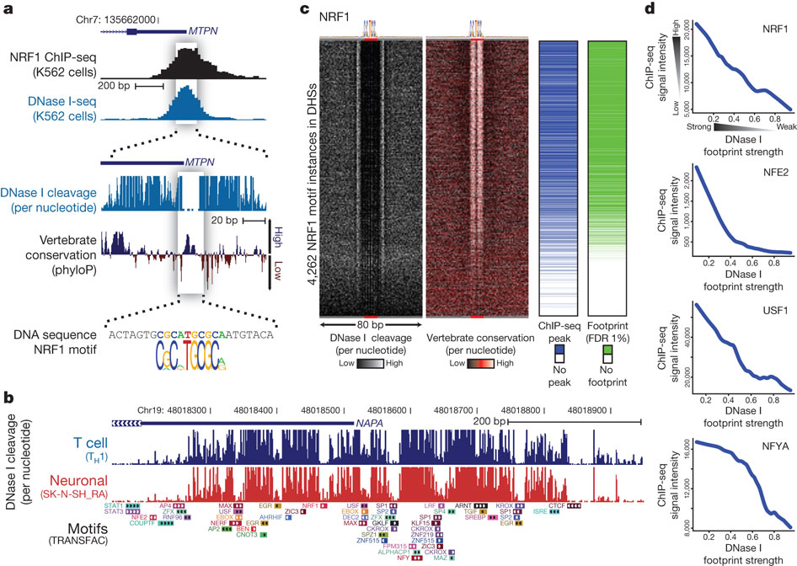
Regulatoro faktoru profilēšana dažādās šūnu līnijās
S Neph et al. Nature 000, 1-8 (2012) doi:10.1038/nature11212
Notes:
a, DNase I footprinting of K562 cells identifies the individual nucleotides within the MTPN promoter that are bound by NRF1. b, Example locus harbouring eight clearly defined DNase I footprints in T-helper type 1 (T_{H}1) and SK-N-SH_RA cells, with TRANSFAC database motif instances indicated below. c, Heat maps showing per-nucleotide DNase I cleavage (left) and vertebrate conservation by phyloP (right) for 4,262 NRF1 motifs within K562 DHSs ranked by the local density of DNase I cleavages. Green ticks indicate the presence of DNase I footprints over motif instances. Blue ticks indicate the presence of ChIP-seq peaks over the motif instances. d, Lowess regression of NRF1, USF1, NFE2 and NFYA K562 ChIP-seq signal intensities versus DNase I footprinting occupancy (footprint occupancy score) at K562 DNase I footprints containing NRF1, USF, NFE2 and NFYA motifs.

Slide 17
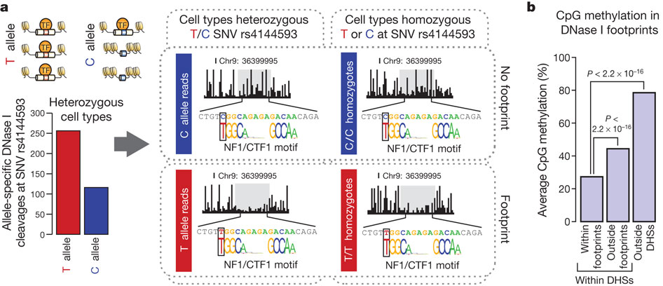
SNP ietekme uz TF saistīšanos
S Neph et al. Nature 000, 1-8 (2012) doi:10.1038/nature11212
Notes:
a, Schematic and plots showing the effect of T/C SNV rs4144593 on protein occupancy and chromatin accessibility. The y axis of the bar graph shows the number of DNase I cleavage events containing either the T or C allele. Middle plots show T or C allele-specific DNase I cleavage profiles from ten cell lines heterozygous for the T/C alleles at rs4144593. Right plots show DNase I cleavage profiles from 18 cell lines homozygous for the C allele at rs4144593 and one cell line homozygous for the T allele at rs4144593. Cleavage plots are cut off at 60% cleavage height. b, The average CpG methylation within IMR90 DNase I footprints, IMR90 DHSs (but not in footprints) and non-hypersensitive genomic regions in IMR90 cells. CpG methylation is significantly depleted in DNase I footprints (P < 2.2 × 10⁻¹⁶, MannWhitney U-test).

Slide 18
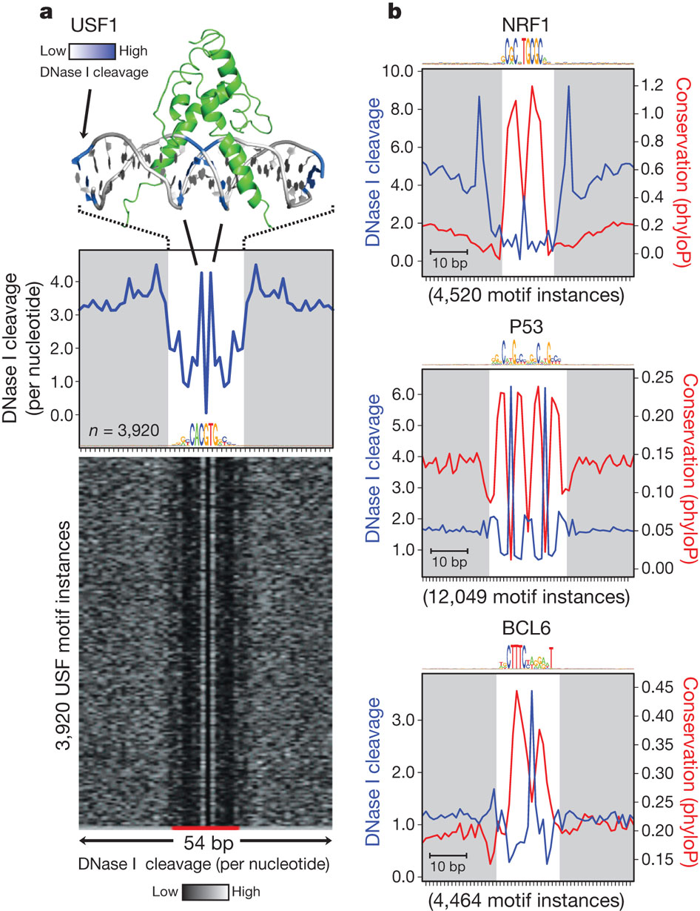
Dnāzes protekcija ir saistītas ar TF struktūras īpatnībām
S Neph et al. Nature 000, 1-8 (2012)
doi:10.1038/nature11212
Notes:
a, The co-crystal structure of upstream stimulatory factor (USF1) bound to its DNA ligand is juxtaposed above the average nucleotide-level DNase I cleavage pattern (blue) at motif instances of USF in DNase I footprints. Nucleotides that are sensitive to cleavage by DNase I are coloured blue on the co-crystal structure. The motif logo generated from USF DNase I footprints is displayed below the DNase I cleavage pattern. Below is a randomly ordered heat map showing the per-nucleotide DNase I cleavage for each motif instance of USF in DNase I footprints. b, The per-base DNase I hypersensitivity (blue) and vertebrate phylogenetic conservation (red) for all DNase I footprints in dermal fibroblasts matching three well-annotated transcription factor motifs. The white box indicates width of consensus motif. The number of motif occurrences within DNase I footprints is indicated below each graph.

Slide 19
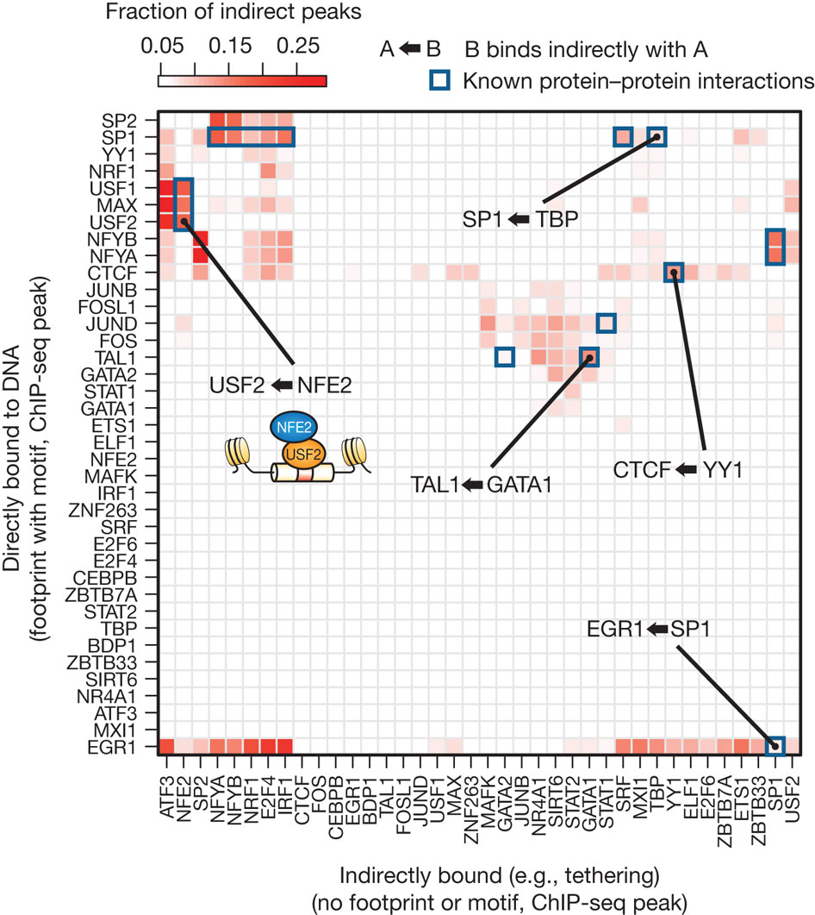
Tiešas un netiešas saistības analīze var identificēt proteīna-proteīna mijiedarbības
S Neph et al. Nature 000, 1-8 (2012) doi:10.1038/nature11212
Notes:
Heat map of the enrichment of pairs of transcription factors in a direct–indirect association. Direct peaks are defined by ChIP occupancy accompanied by a footprint overlapping a compatible motif. Indirect peaks do not have a compatible motif. The colour of each cell is determined by the fraction of indirect peaks that co-localize with the direct peaks of another factor.

Slide 20
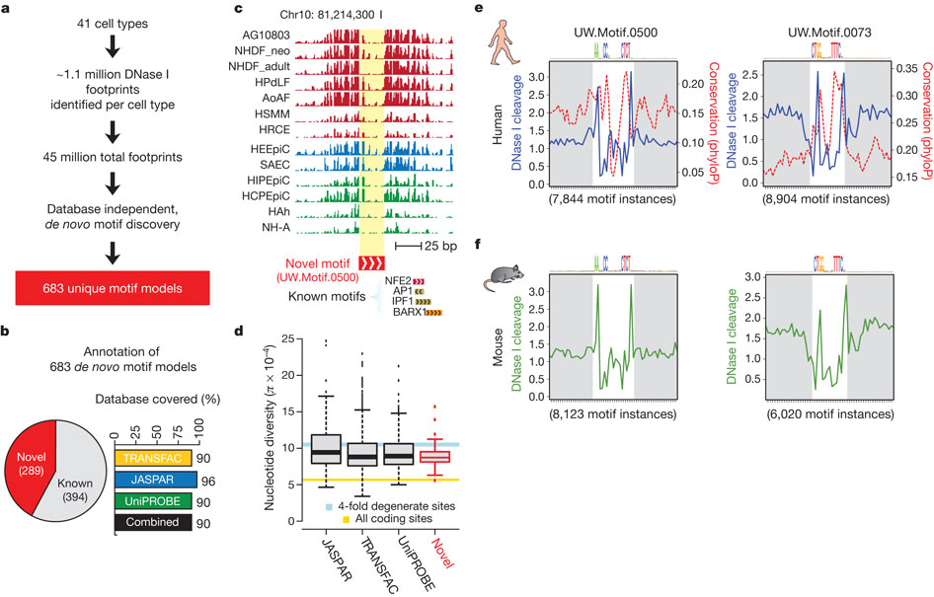
De novo motīvu atklāšana
S Neph et al. Nature 000, 1-8 (2012) doi:10.1038/nature11212
Notes:
a, Overview of de novo motif discovery using DNase I footprints. b, Annotation of the 683 de novo-derived motif models using previously identified transcription factor motifs. A total of 394 of these de novo-derived motifs match a motif annotated within the TRANSFAC, JASPAR or UniPROBE databases, whereas 289 are novel motifs (pie chart). The de novo consensus matching TRANSFAC, JASPAR or UniPROBE sequences cover the majority of each database (bar chart). c, Example of a DNase I footprint found in multiple cell types that is annotated solely by one of the novel de novo-derived motifs. d, Box-and-whisker plot comparing the average nucleotide diversity at instances of the 289 novel de novo-derived motif models to instances of motifs present in databases of known specificities (x axis). The box defines the 25% and 75% percentiles and the whiskers display 1.5 times the inner quartile range of the distribution of π values in each respective database. The blue bar indicates the average nucleotide diversity (π) at fourfold degenerate coding sites (width is equal to 95% confidence interval); gold bar indicates π at all coding sites (width is equal to 95% confidence interval). e, Phylogenetic conservation (red dashed) and per-base DNase I hypersensitivity (blue) for all DNase I footprints in dermal fibroblast cells matching two novel de novo-derived motifs. The white box indicates width of consensus motif. f, Per-nucleotide mouse liver DN

Slide 21
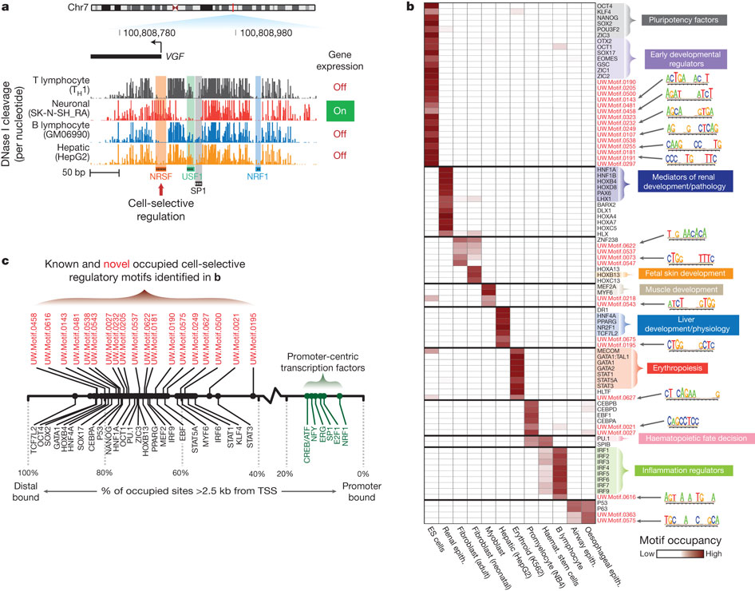
Dnāzes protekcija atklāj šūnu selektīvus gēnu regulatorus
NRSF – VGF promotera represors
S Neph et al. Nature 000, 1-8 (2012) doi:10.1038/nature11212

Slide 22
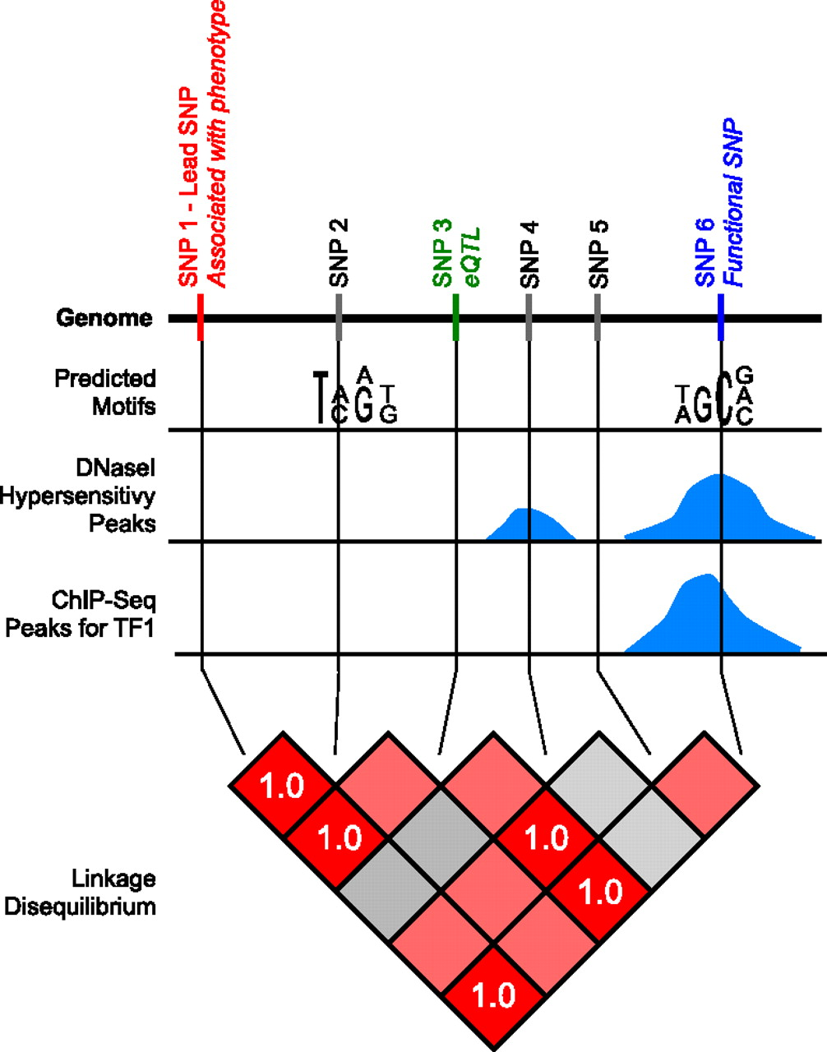

GWAS variantu izskaidrošana
Schaub M A et al. Genome Res. 2012;22:1748-1759
© 2012, Published by Cold Spring Harbor Laboratory Press
Notes:
Schematic overview of the functional SNP approach. This figure illustrates the approach we use to identify functional SNPs. Three different types of regulatory data are represented for an area of the genome: motif-based predictions, DNase I hypersensitivity peaks, and ChIP-seq peaks. This region contains six SNPs. SNP1 is associated with a phenotype in a genome-wide association study. SNP3 is an eQTL associated with changes in gene expression in a different study. SNP6 overlaps a predicted motif, a DNase I hypersensitivity peak, and a ChIP-seq peak. There are, therefore, multiple sources of evidence that SNP6 is in a regulatory region. Furthermore, SNP6 is in perfect linkage disequilibrium (r² = 1.0) with SNP1 and SNP3, meaning that there is transitive evidence due to the LD that SNP6 is also associated with the phenotype and is also an eQTL. SNP6 is therefore the most likely functional SNP in this associated region.

Slide 23
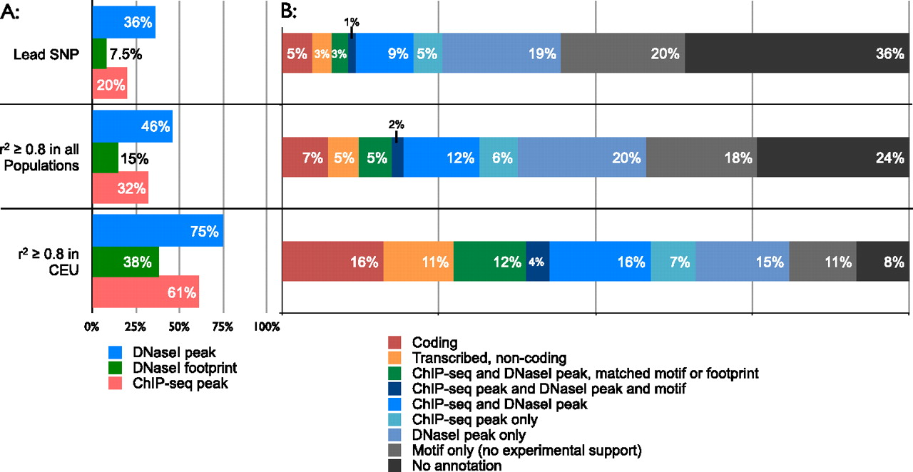
GWAS variantu proporcija funkcionālajos datos
Schaub M A et al. Genome Res. 2012;22:1748-1759
© 2012, Published by Cold Spring Harbor Laboratory Press
Notes:
Proportions of associations for different types of functional data. Proportions are shown for individual assays (A) and for all sources of evidence combined (B). Proportions are presented separately for lead SNPs and SNPs in strong linkage disequilibrium (r² ≥ 0.8) with a lead SNP. For each association, we determine which SNP in the LD region is most strongly supported by functional data in order to generate the proportions in panel B. We separately consider SNPs in strong linkage disequilibrium with a lead SNP in all HapMap 2 populations, and SNPs in strong linkage disequilibrium with a lead SNP in the CEU population. For the latter case, we use only associations identified in populations of European descent, and show that we can map 80% of these associations to a functional SNP supported by experimental ENCODE data.

Slide 24
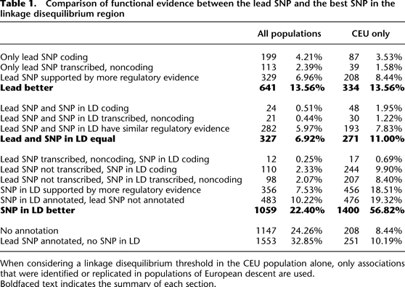
GWAS SNP salīdzinājums ar LD variantiem

Slide 25
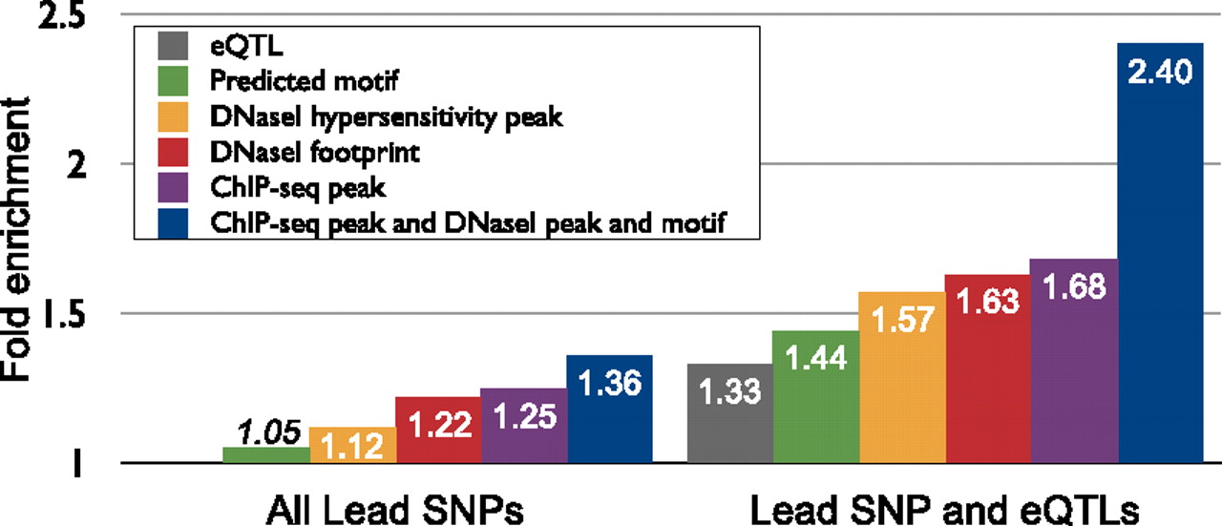
Dažādu eksperimentālo datu kombinēšana
Schaub M A et al. Genome Res. 2012;22:1748-1759
© 2012, Published by Cold Spring Harbor Laboratory Press
Notes:
Overview of enrichment for different combinations of assays. Enrichments are reported for all lead SNPs associated with a phenotype and separately for lead SNPs that are also eQTLs or in strong linkage disequilibrium with an eQTL. The enrichment for predicted motifs alone (italics) is not significant. These results show that combining multiple types of experimental evidence increases the observed enrichment.

Slide 26
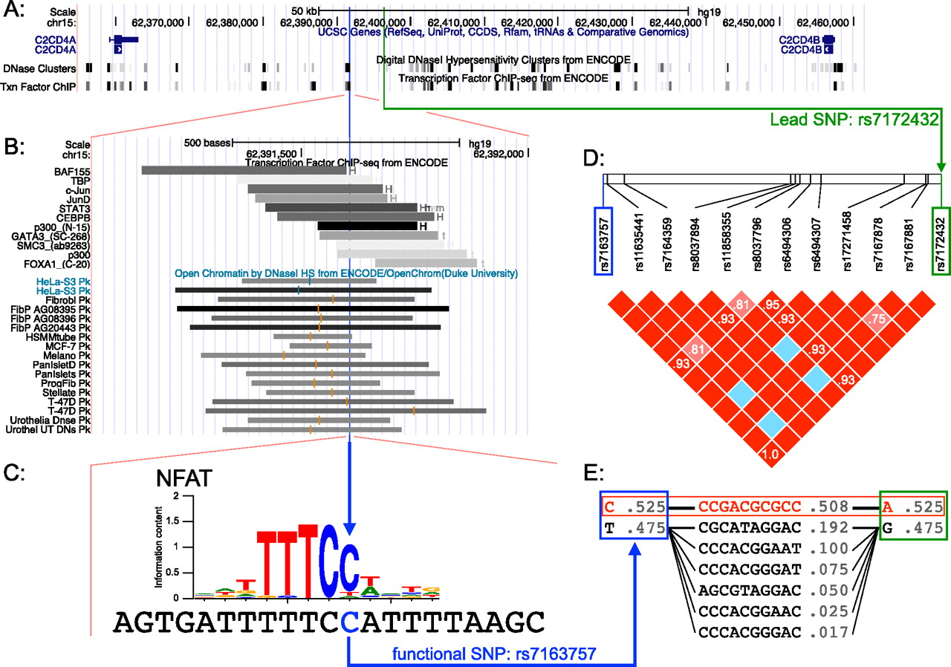
Funkcionālais SNP rs7163757.
Schaub M A et al. Genome Res. 2012;22:1748-1759
© 2012, Published by Cold Spring Harbor Laboratory Press
Notes:
Functional SNP rs7163757. Multiple sources of evidence indicate that SNP rs7163757 is functional. (A) Overview of the region between genes C2CD4A and C2CD4B. (Blue vertical line) Functional SNP rs7163757; (green vertical line) lead SNP rs7172432. Multiple ChIP-seq and DNase-seq peaks can be seen, including one that overlaps rs71763757. (B) Vicinity of functional SNP rs7163757. ChIP-seq binding is observed for multiple transcription factors in multiple cell lines. Due to space, DNase peaks are represented only for a subset of the peaks overlapping the region. (C) Sequence around rs7163757 and motif for the NFAT binding site that overlaps the functional SNP. The minor allele is T. (D) Linkage disequilibrium region between the functional SNP and the lead SNP in the HapMap 2 CEU population. The two SNPs are in perfect LD (r² = 1.0). (E) Haplotypes between the functional SNP and the lead SNP. There is a single haplotype with frequency above 1% that carries the identified risk allele (A at rs7172432), whereas there are multiple haplotypes that include the protective allele. Haplotypes with frequency of <1% are not shown.

Slide 27
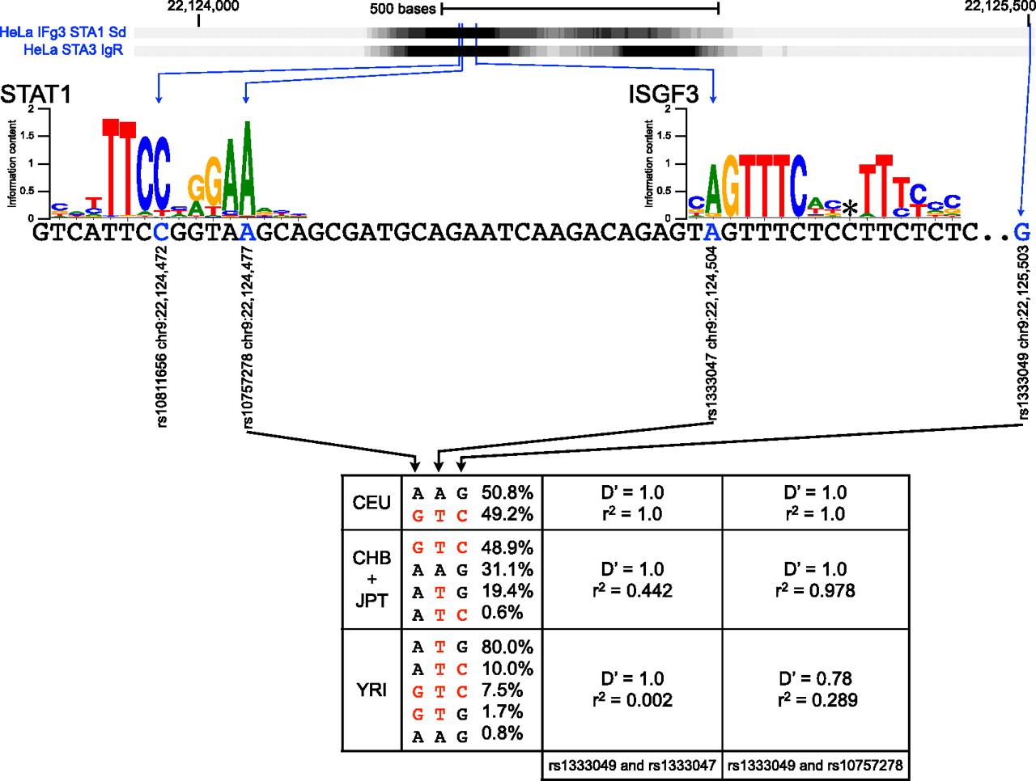
Funcionālā informācija un LD struktūra palīdz noskaidrot rs1333047 lomu koronārās artērijas izraisīšanā
Schaub M A et al. Genome Res. 2012;22:1748-1759
© 2012, Published by Cold Spring Harbor Laboratory Press
Notes:
Functional information and linkage disequilibrium patterns support the implication of rs1333047 in coronary artery disease. Functional data (ChIP-seq) generated by the ENCODE Consortium show evidence of STAT1 binding in the 9p21 region associated with coronary artery disease. rs10757278 and rs1333047 are both located in the peak, whereas rs1333049 is a tag SNP that does not overlap any functional region in RegulomeDB. rs10757278 is part of a regulatory motif for STAT1 binding, and rs1333049 is part of a regulatory motif for ISGF3 binding. (*) The location at which a gap is inserted into the motif to handle variable linker length. Haplotype frequency and linkage disequilibrium data from the different HapMap2 populations show that all three SNPs are in perfect linkage disequilibrium in the CEU population, but not the CHB and JPT populations. In the YRI population, the frequency of the A allele at rs1333047 is only 0.8%. Risk alleles for all SNPs are determined using the haplotype associated with coronary artery disease in the CEU population (red). There is an absence of linkage disequilibrium between rs1333047 and rs1333049 in YRI, and the association between rs1333049 and rs10757278 and coronary artery disease has not been replicated in populations of African descent.

Slide 28
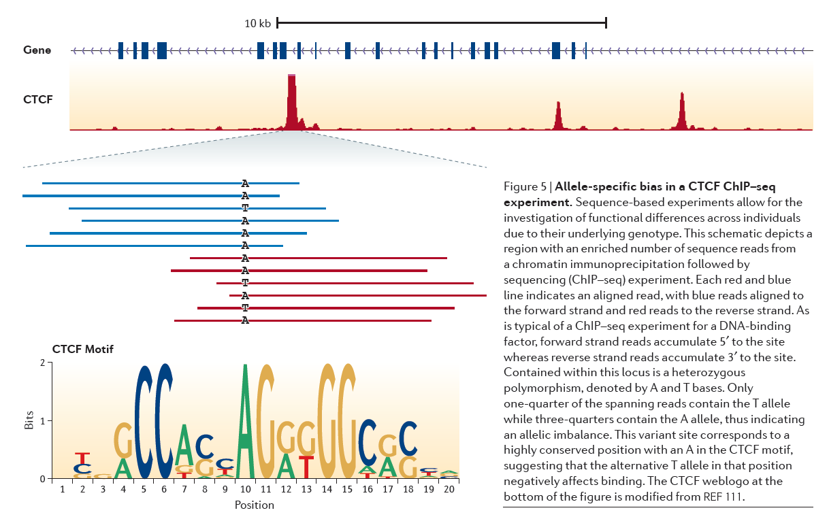
Alēles specifiska saistīšana

Slide 29
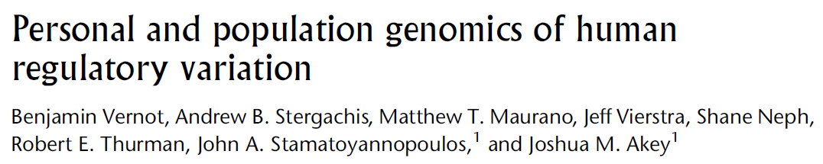
Notes:
Overview of data used in the analyses. (A) Schematic of the DNase I data. Binding of regulatory proteins to DNA (blue rectangle) results in nucleosome (open circles) displacement and local chromatin remodeling, and these regions are susceptible to cleavage with the endonuclease DNase I. High-throughput sequencing of libraries made from digested nuclei reveals DNase I hypersensitive sites, detectable by increased depth of coverage. Peaks are defined as 150-bp windows centered on the area of maximum cleavage (The ENCODE Project Consortium 2012). Within hypersensitive sites, footprints of regulatory factor binding are observed as decreased cleavage. (B) Unrooted neighbor-joining tree of the 53 unrelated individuals colored by population.

Slide 30
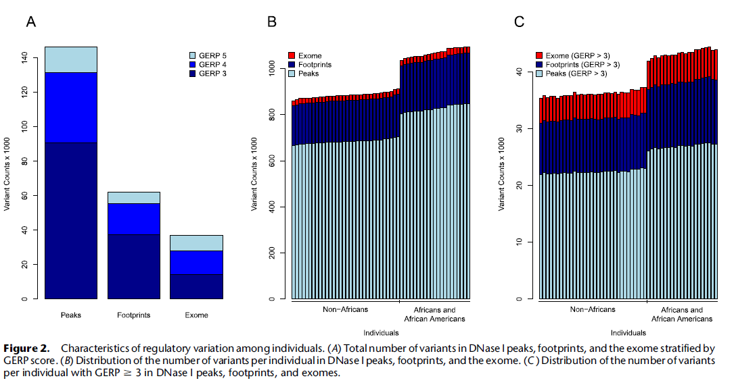
Evolucionāri konservatīvi varianti ir biežāki eksonos

Slide 31
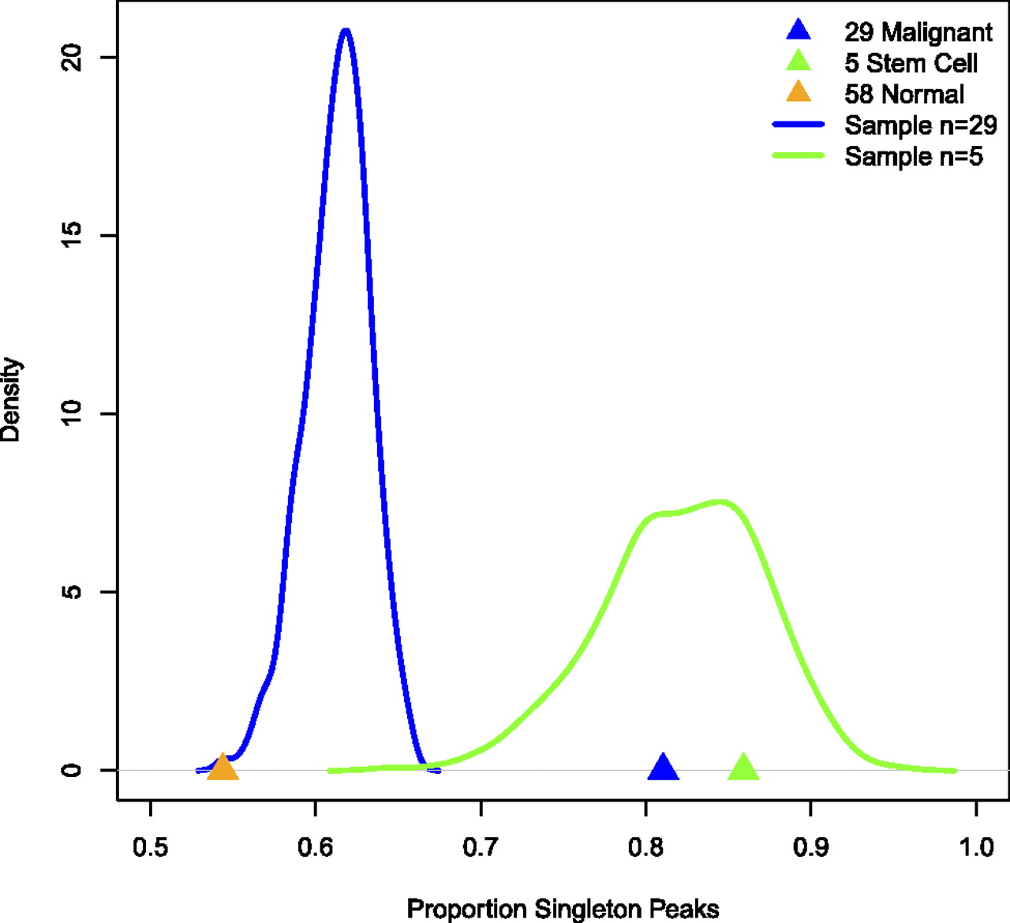
Vēža sūnu līnijas uzrāda daudz vairāk unikālus DNāzes I pīķus salīdzinot ar normālām šūnām.
Vernot B et al. Genome Res. 2012;22:1689-1697
© 2012, Published by Cold Spring Harbor Laboratory Press
Notes:
Malignant cell lines exhibit significantly more singleton DNase I peaks than normal cell lines. (Triangles) Observed proportion of singleton peaks. (Blue and green lines) Distribution (density histograms) of singleton peaks when randomly sampling 29 (blue) or five (green) cell types; this is the distribution of the number of singleton peaks we would expect if malignant or stem cells were similar to normal cells, respectively. Note the malignant category (blue) shows significantly more singleton peaks than expected given its sample size, but the stem cell category (green) falls within the expected range.

Slide 32

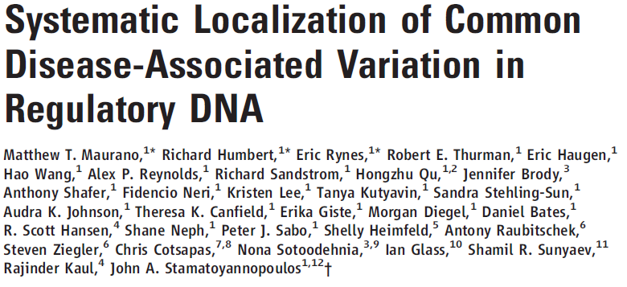

Slide 33
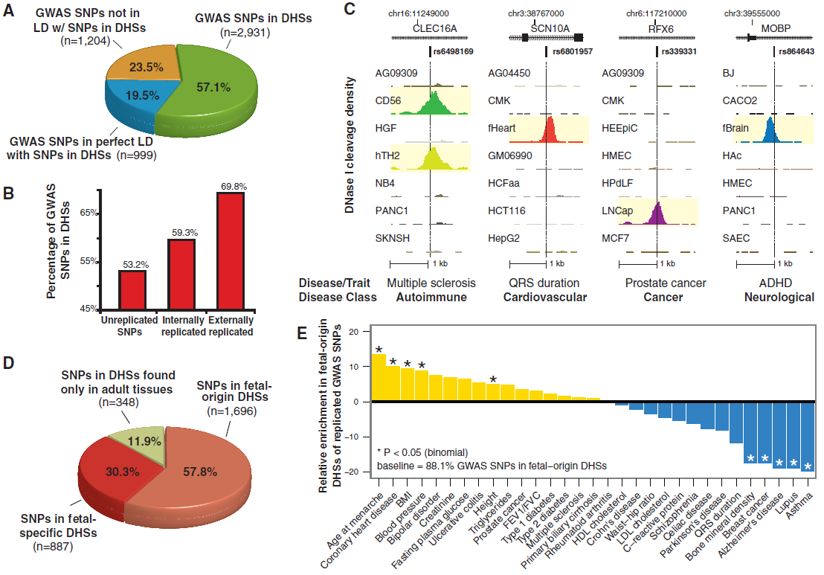
Notes:
(A) Proportions of noncoding GWAS SNPs localizing within DHSs (green); in complete linkage disequilibrium (r² = 1) with a SNP in a DHS (blue); or neither (yellow). Note that 76.5% of GWAS SNPs are either within or in perfect LD with DHSs. (B) Proportions of GWAS SNPs overlapping DHSs after partitioning by degree of replication. (C) Representative DNase I hypersensitivity (tag density) patterns at diverse disease-associated variants. (D) Proportion of GWAS SNPs localizing in DHSs active in fetal tissues that persist in adult cells (salmon); fetal stage-specific DHSs (red); and adult stage DHSs (green). (E) GWAS SNPs in DHSs show phenotype-specific enrichment for fetal regulatory elements.

Slide 34
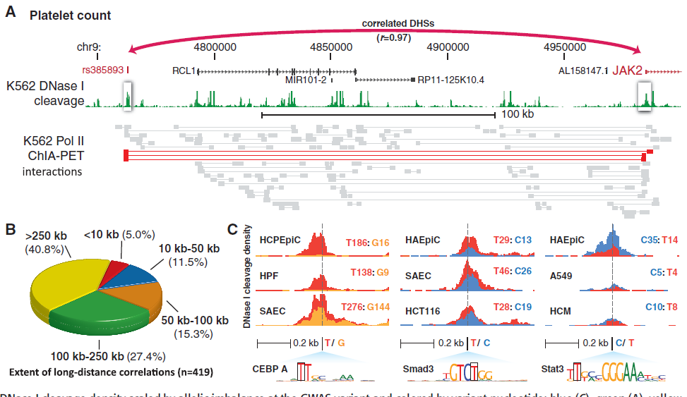
GWAS SNP regulatorie kandidāti
Notes:
(A) GWAS variant associated with platelet count is connected with the JAK2 gene (myeloproliferative disorders) 222 kb away. Below, ChlA-PET tags (36) validate direct chromatin interactions between this DHS and the JAK2 promoter; red tags demonstrate an interaction between these DHSs. (B) Proportion of DHSs harboring GWAS variants that can be linked to target promoters at the indicated distance. (C) Examples of allele-specific DNase I sensitivity in cell types derived from heterozygous individuals for GWAS variants that alter TF recognition motifs within DHSs (also see table S9). Each cell type track shows DNase I cleavage density scaled by allelic imbalance at the GWAS variant and colored by variant nucleotide (blue = C, green = A, yellow = G, red = T). Total reads from each allele are also shown.

Slide 35
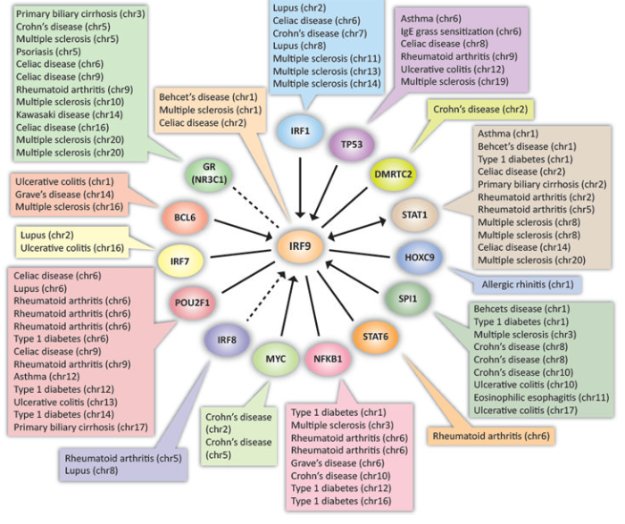
Autoimūno slimību SNP (24%) ir TF DHS, kas mijiedarbojas ar IRF9
Notes:
(B) 24.4% of SNPs associated with autoimmune disorders that fall within DHSs localize in recognition sequences of TFs that interact with IRF9. Arrows indicate directionality of relationship, dotted lines represent indirect interactions (12). The complete network is shown in fig. S10.

Slide 36
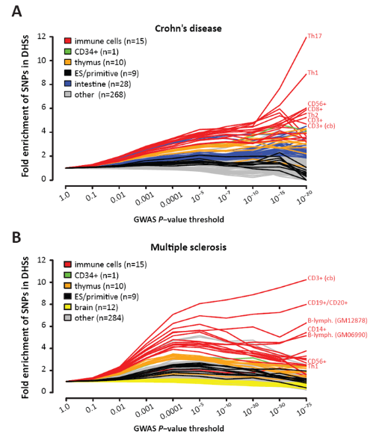
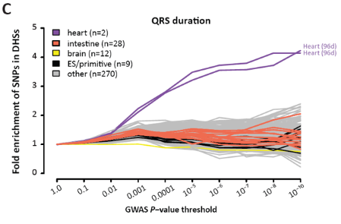
Slimību SNP izpaužas atbilstošajās šūnu līnijās
Notes:
GWAS SNPs are systematically enriched in the regulatory DNA of disease-specific cell types throughout the full range of significance. Shown are SNPs tested for association with the autoimmune disorders Crohn’s disease (A), multiple sclerosis (B) and QRS duration (C).

