Slide 1
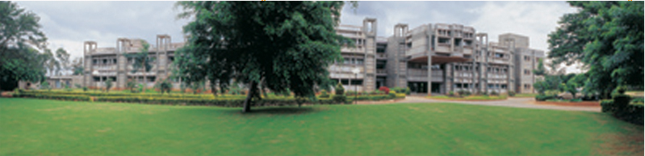
Perturbing the Nervous System
MK Mathew
NCBS, TIFR
UAS – GKVK Campus
Bangalore
IBRO Course in Neuroscience
Center for Cognitive Neuroscience & Semantics, University of Latvia
Riga, Latvia
August 21-August 29, 2013

Slide 2
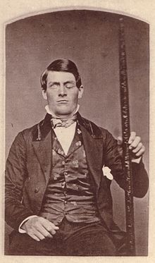
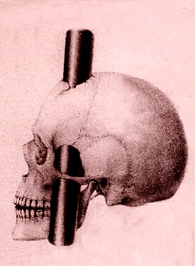
Phineas Gage
Accident 1848

Slide 3
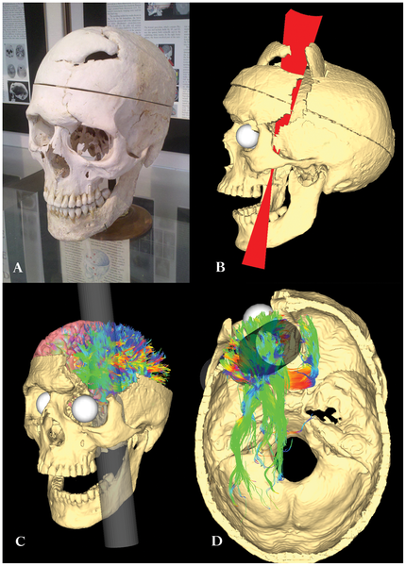

Figure 1. Modeling the path of the tamping iron through the Gage skull and its effects on white matter structure.
Van Horn JD, Irimia A, Torgerson CM, Chambers MC, et al. (2012) Mapping Connectivity Damage in the Case of Phineas Gage. PLoS ONE 7(5): e37454. doi:10.1371/journal.pone.0037454
http://www.plosone.org/article/info:doi/10.1371/journal.pone.0037454
Notes:
Figure 1. Modeling the path of the tamping iron through the Gage skull and its effects on white matter structure.
a) The skull of Phineas Gage on display at the Warren Anatomical Museum at Harvard Medical School. b) CT image volumes were reconstructed, spatially aligned, and manual segmentation of the individual pieces of bone dislodged by the tamping iron (rod), top of the cranium, and mandible was performed. Surface meshes for each individual element of the skull were created. Based upon observations from previous examinations of the skull as well as upon the dimensions of the iron itself, fiducial constraint landmarks were digitally imposed and a set of possible rod trajectories were cast through the skull. This figure shows the set of possible rod trajectory centroids which satisfied each of the anatomical constraints. The trajectory nearest the mean trajectory was considered the true path of the rod and was used in all subsequent calculations. Additionally, voxels comprising the interior boundary and volume of the cranial vault were manually extracted and saved as a digital endocast of Mr. Gage's brain cavity. c) A rendering of the Gage skull with the best fit rod trajectory and example fiber pathways in the left hemisphere intersected by the rod. Graph theoretical metrics for assessing brain global network integration, segregation, and efficiency [92] were computed across each subject and averaged to measure the changes to topological, geometrical, and wiring cost properties. d) A view of the interior of the Gage skull showing the extent of fiber pathways intersected by the tamping iron in a sample subject (i.e. one having minimal spatial deformation to the Gage skull). The intersection and density of WM fibers between all possible pairs of GM parcellations was recorded, as was average fiber length and average fractional anisotropy (FA) integrated over each fiber.
doi:10.1371/journal.pone.0037454.g001

Slide 4
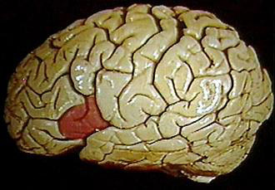
Broca’s Area
Broca's patients
Leborgne: Almost completely unable to produce any words or phrases, he was able to repetitively produce only the word tan. After his death, a lesion was discovered on the surface of the left frontal lobe.
Lelong: He also exhibited reduced productive speech. He could only say five words, 'yes,' 'no,' 'three,' 'always,' and 'lelo' (a mispronunciation of his own name). At autopsy, a lesion was also found in the same region of lateral frontal lobe as in Leborgne.
These two cases led Broca to believe that speech was localized to this particular area.

Slide 5
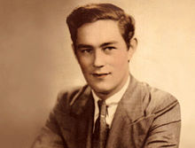
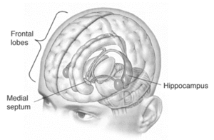

Henry Gustav Molaison
Brenda Miller

Slide 6


Slide 7
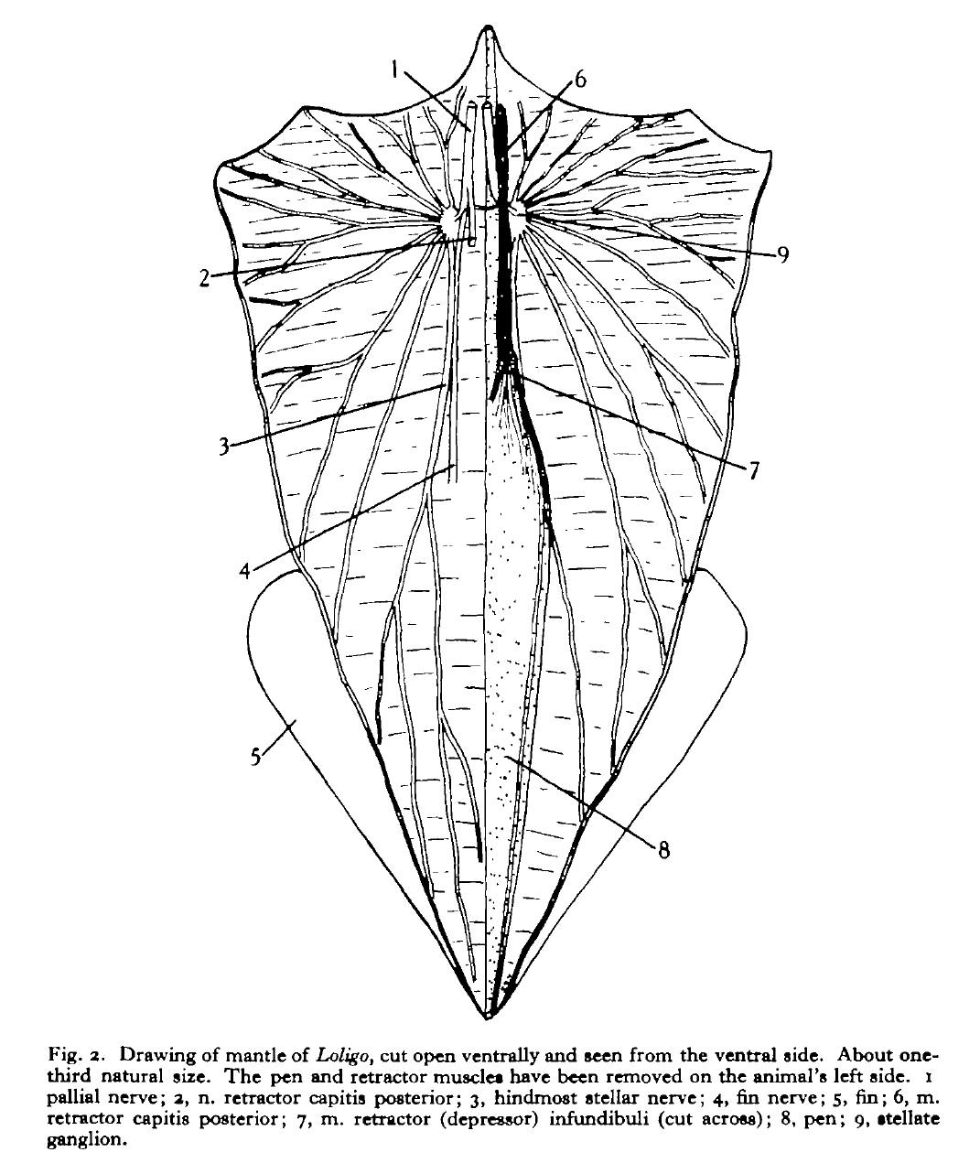
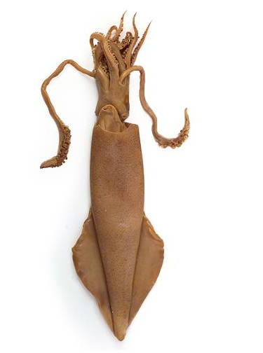
JZ Young (1937) J Exp Biol

Slide 8
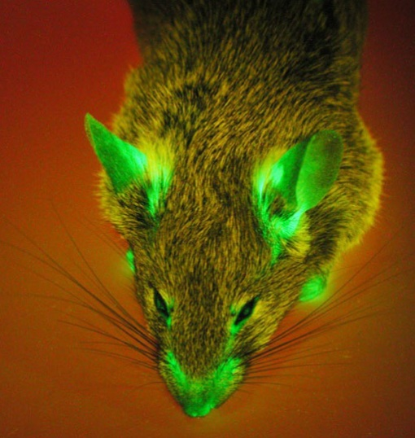

Slide 9
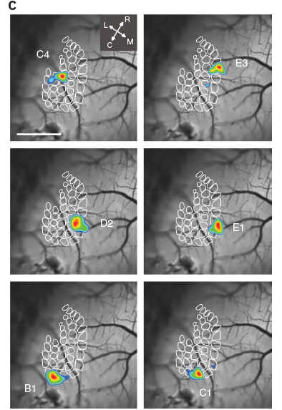
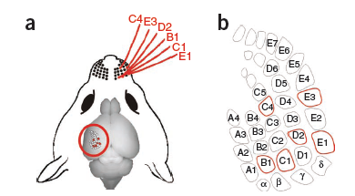
Figure 6 | Construction of receptive field maps using in vivo VSFP2 imaging. (a) Selection of six whiskers (C4, E3, D2, E1, B1 and C1) for sequential stimulation and receptive field imaging. (b) Identification of selected whisker in schematic representation of cortical barrel field. (c) Composite images showing responsive areas for each of the six whiskers from a single VSFP2.3 mouse. Responsive areas (shown in color) were determined by superimposing ΔR/R0 values greater than a threshold value of 90% peak amplitude on the baseline cyan/yellow fluorescence image (shown in grayscale). Arrows below indicate rostral (R), caudal (C), lateral (L) and medial (M) directions. Scale bar, 1 mm.
Akemann et al (2010 Aug) Nature Methods

Slide 10
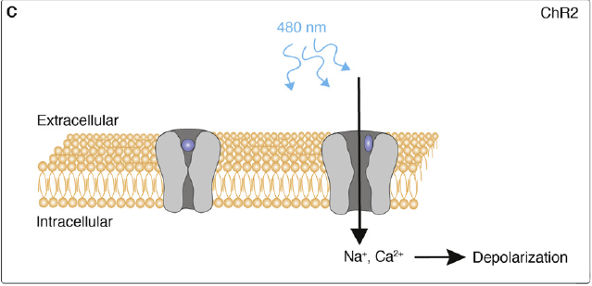
(C) The channel protein channelrhodopsin-2 (ChR2) is a monomolecular protein that is in itself
light sensitive due to a binding site for alltrans retinal. Illumination of the channel with blue light causes the opening of the channel, ultimately leading to a depolarization of the neuronal membrane
Fiala et al (2010) Current Biology 20, R897–R903

Slide 11
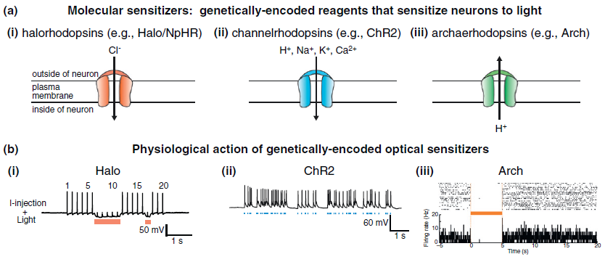
Bernstein (2012) Current Opinion in Neurobiology 22:61–71

Slide 12
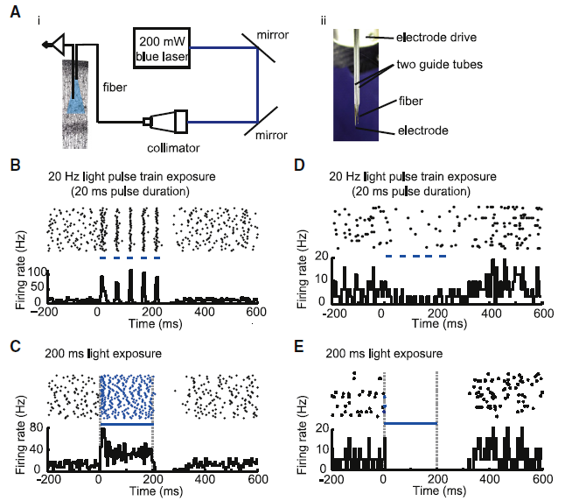
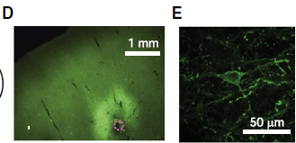
(D) Fluorescence image showing ChR2-GFP expression in deep layers of cortex (coronal slice; dotted magenta circle indicates diameter of virus injection cannula). (E) Representative cortical neuron expressing ChR2-GFP.
(A) Apparatus for optical activation and electrical recording. (Ai) Schematic. (Aii) Photograph, showing optical fiber (200 mm diameter) and electrode (200 mm shank diameter) in guide tubes. (B and C) Increases in spiking activity in one neuron during blue light illumination (five pulses, 20 ms duration each [B], and 1 pulse, 200 ms duration [C]). In each panel, shown at top is a spike raster plot displaying each spike as a black dot; 40 trials are shown in horizontal rows (in this and subsequent raster plots); shown at bottom is a histogram of instantaneous firing rate, averaged across all trials; bin size, 5 ms (in this and subsequent histogram plots). Periods of blue light illumination are indicated by horizontal blue dashes, in this and subsequent panels. (D and E) Decreases in spiking activity in one neuron during blue light illumination (five pulses, 20 ms duration (D), and one pulse, 200 ms duration [E])
Han et al (09) Neuron 62, 191–198

Slide 13
worm

Slide 14
Mouse

Slide 15
Classical studies of mammalian movement control define a prominent role for the primary motor cortex. Investigating the mouse whisker system, we found an additional and equally direct pathway for cortical motor control driven by the primary somatosensory cortex. Whereas activity in primary motor cortex directly evokes exploratory whisker protraction, primary somatosensory cortex directly drives whisker retraction, providing a rapid negative feedback signal for sensorimotor integration. Motor control by sensory cortex suggests the need to reevaluate the functional organization of cortical maps.
Matyas … Petersen (2010) Science 330, 1240-1243

Slide 16
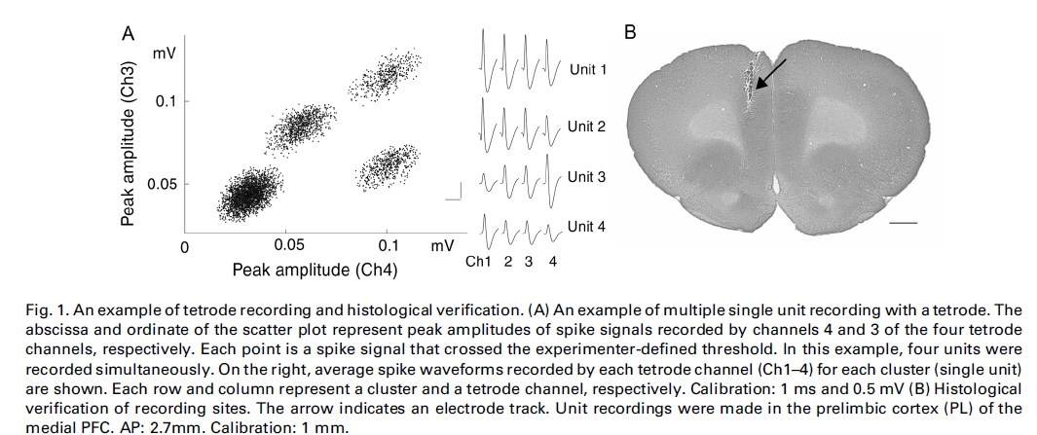
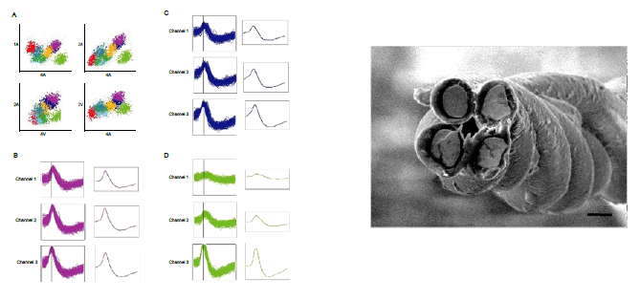
Kim et al (2001) Neuroscience Letters 298: 217 - 221

Slide 17
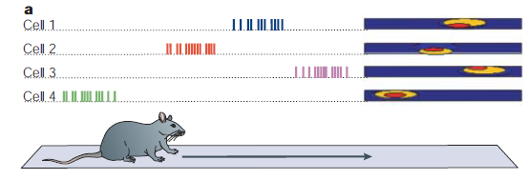
In 1971,O’Keefe and Dostrovsky found that single hippocampal neurons increased their firing rate whenever a rat traversed a particular region of a chamber8.When they recorded extracellular action potentials from the hippocampus of freely moving rats, some hippocampal pyramidal cells demonstrated firing patterns that seemed to depend on the animal’s location in the environment. When the rat left the ‘place’ that was encoded by a given cell, the cell fell almost silent. In an open field, the firing rate was also independent of the direction in which the animal entered the area and the direction that it was facing. The firing of each cell seemed to
indicate a specific location in the environment of the rat; so these cells are called ‘place cells’.
Panel a represents the place-specific firing properties of hippocampal pyramidal cells as a rodent runs down a linear track.
.. Matt Wilson .. Susumu Tonegawa (2004) Nature Neuroscience

Slide 18
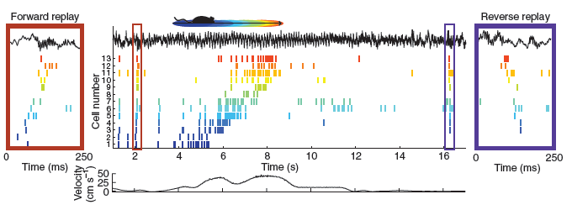
Figure 1 Place cell sequences experienced during behavior are replayed in both the forward and reverse direction during awake SWRs. Spike trains for 13 neurons with place fields on the track are shown before, during and after a single traversal. Sequences that occur during running (center) are reactivated during awake SWRs. Forward replay (left inset, red box) occurs before traversal of the environment and reverse replay (right inset, blue box) after. The CA1 local field potential is shown on top and the animal’s velocity is shown below. Adapted with permission from ref. 47.
Carr Jadhav Frank (2011) Nature Neuroscience 14, 147 - 153

Slide 19
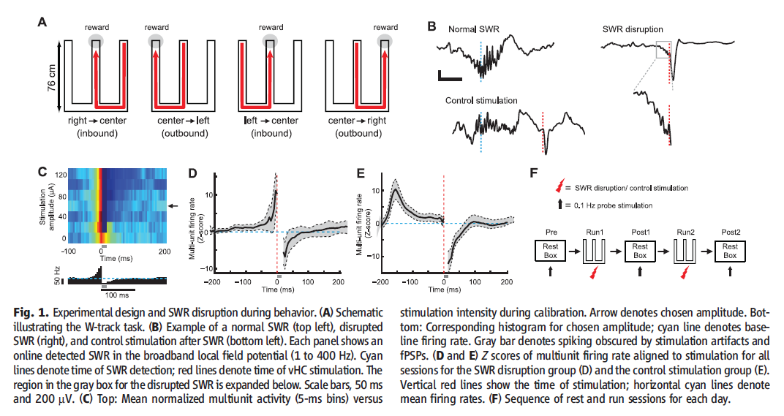
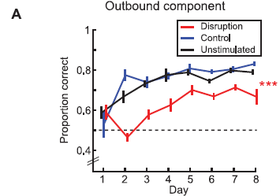
Jadhav et al (2012) Science 336, 1454

Slide 20
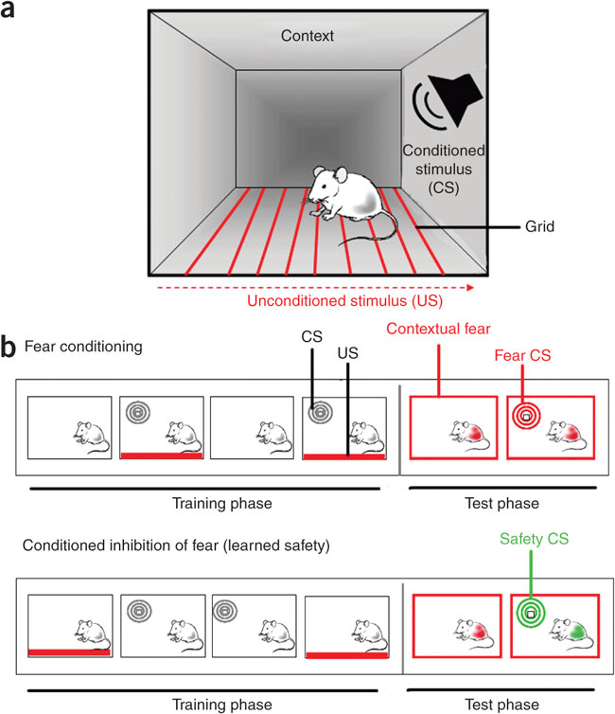

Slide 21
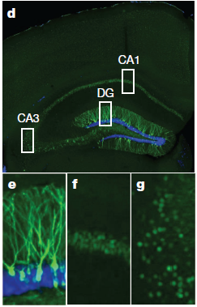
Conditions for ChR to express:
Location: Hippocampus
Drug
Activity: Neuron must be firing repeatedly
Liu … Tonegawa (2012) Nature

Slide 22
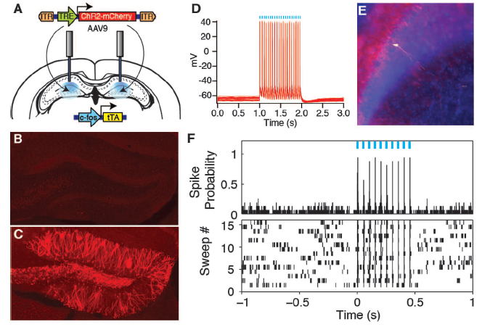
Ramirez … Tonegawa (2013) Science 341, 387
Notes:
Fig. 1. Activity-dependent labeling and lightactivation
of hippocampal neurons, and the basic
experimental scheme. (A) The c-fos-tTA mice were
bilaterally injected with AAV9-TRE-ChR2-mCherry and
implanted with optical fibers targeting DG. (B) While on
Dox, exploration of a novel context did not induce expression
of ChR2-mCherry. (C) While off Dox, exploration
of a novel context induced expression of ChR2-mCherry
in DG. (D) Light pulses induced spikes in a CA1 neuron
expressing ChR2-mCherry. The recorded neuron is shown
labeled with biocytin in (E). (F) Light pulses induced spikes
in DG neurons recorded from a head-fixed anesthetized
c-fos-tTA animal expressing ChR2-mCherry. (G) Basic experimental
scheme. Post-surgery mice were taken off
Dox and allowed to explore context A in order to let DG
or CA1 cells become labeled with ChR2-mCherry. Mice
were put back on Dox and fear conditioned in context B
with simultaneous delivery of light pulses. Freezing levels
were then measured in both the original context A and a
novel context C. The light green shading indicates the
presence of Dox in the diet during corresponding stages
of the scheme. Prime indicates the second exposure to a
given context. The yellow lightning symbol and blue
shower symbol indicate foot shocks and blue light delivery,
respectively. Red circles represent neurons encoding
context A that are thus labeled with ChR2-mCherry. Gray
and white circles represent neurons encoding context B
and C, respectively. Asterisks indicate neurons activated
either by exposure to context or light stimulation.

Slide 23
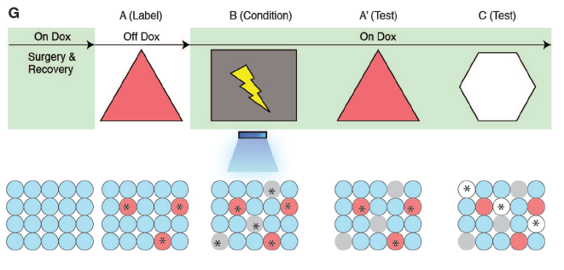
Ramirez … Tonegawa (2013) Science 341, 387
Notes:
Fig. 1. Activity-dependent labeling and lightactivation
of hippocampal neurons, and the basic
experimental scheme. (A) The c-fos-tTA mice were
bilaterally injected with AAV9-TRE-ChR2-mCherry and
implanted with optical fibers targeting DG. (B) While on
Dox, exploration of a novel context did not induce expression
of ChR2-mCherry. (C) While off Dox, exploration
of a novel context induced expression of ChR2-mCherry
in DG. (D) Light pulses induced spikes in a CA1 neuron
expressing ChR2-mCherry. The recorded neuron is shown
labeled with biocytin in (E). (F) Light pulses induced spikes
in DG neurons recorded from a head-fixed anesthetized
c-fos-tTA animal expressing ChR2-mCherry. (G) Basic experimental
scheme. Post-surgery mice were taken off
Dox and allowed to explore context A in order to let DG
or CA1 cells become labeled with ChR2-mCherry. Mice
were put back on Dox and fear conditioned in context B
with simultaneous delivery of light pulses. Freezing levels
were then measured in both the original context A and a
novel context C. The light green shading indicates the
presence of Dox in the diet during corresponding stages
of the scheme. Prime indicates the second exposure to a
given context. The yellow lightning symbol and blue
shower symbol indicate foot shocks and blue light delivery,
respectively. Red circles represent neurons encoding
context A that are thus labeled with ChR2-mCherry. Gray
and white circles represent neurons encoding context B
and C, respectively. Asterisks indicate neurons activated
either by exposure to context or light stimulation.

Slide 25
SHOCK
NICE
NICE

Slide 26
SHOCK
NICE
NICE
Turn ON expression of ChR2 while the mouse is exploring one side of the the NICE arena
Turn expression OFF
Shine blue light while the mouse is getting a shock in the SHOCK arena
Check later for exploration of the two sides of the NICE arenas

Slide 27
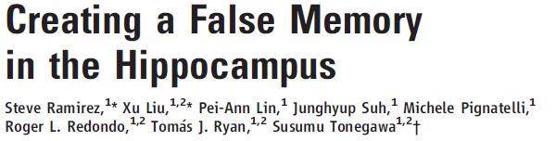
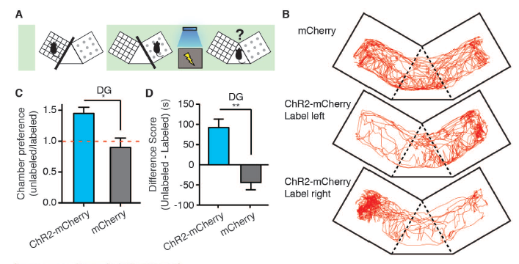
Science 341, 387 (2013)
Ramirez … Tonegawa (2013) Science 341, 387

