Slide 1

Hodgkin & Huxley I. The Na⁺ Hypothesis
MK Mathew
NCBS, TIFR
UAS – GKVK Campus
Bangalore
IBRO Course in Neuroscience
Center for Cognitive Neuroscience & Semantics, University of Latvia
Riga, Latvia
August 21-August 29, 2013

Slide 2
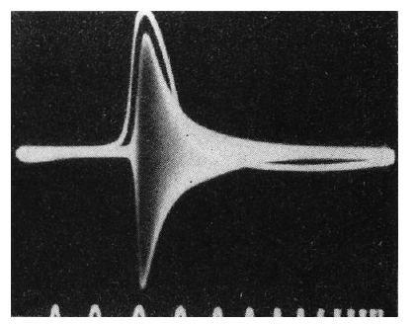
FIG. 13. The classical demonstration of the increase of conductance in the
squid axon during the discharge of the action potential. Upper line: action
potential; white-dark band: measure of the membrane impedance obtained
with the Wheatstone bridge method by applying a high frequency (20 KHz)
sinusoidal signal to two electrodes placed on the opposite site of a giant
axon. From a measure of the impedance changes obtained at various frequencies (and proportional to the width of the band) the change of conductance was estimated to be approximately 40 times at the peak of the action potential relative to rest. Time marks: 1 ms apart. (From [24]).
24. Cole, K. S.; Curtis, H. J. Electric impedance of the squid giant axon during activity. J. Gen. Physiol. 22:649–670; 1939.
Piccolino (98) Brain Research Bulletin, Vol. 46, No. 5, pp. 381–407,

Slide 3
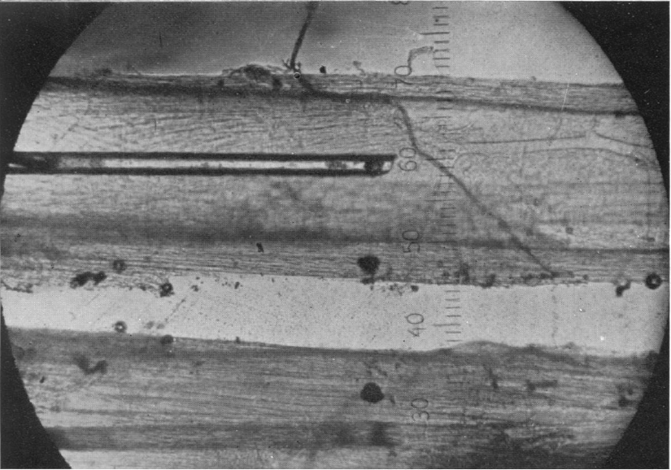
Hodgkin & Huxley (45) J. Physiol. I04, I76-I95

Slide 4
FIG. 14. The first published intracellular recording of the action potential in the squid axon. Time course of the difference between the internal and
external potential, in the resting state and during the discharge of an action potential. Time mark, 500 Hz. Notice the large positive overshoot of the
membrane potential during the action potential, which contrasted with the expectation of the Bernstein’s theory (From [60]).
Fig. 3, which illustrates one of these experiments, shows an
action potential of 86 mV and a resting potential of 45 mV. In their 1939 experiments Curtis and Cole recorded the action potential with a condenser coupled amplifier; later measurements with a d. c. amplifier gave an average action potential of 108 mV and an average resting potential of 51 mV.
Hodgkin Lecture
60. Hodgkin, A. L.; Huxley, A. F. Action potentials recorded from inside
a nerve fibre. Nature 144:710 –711; 1939.
Hodgkin & Huxley (45) J. Physiol. I04, I76-I95

Slide 5
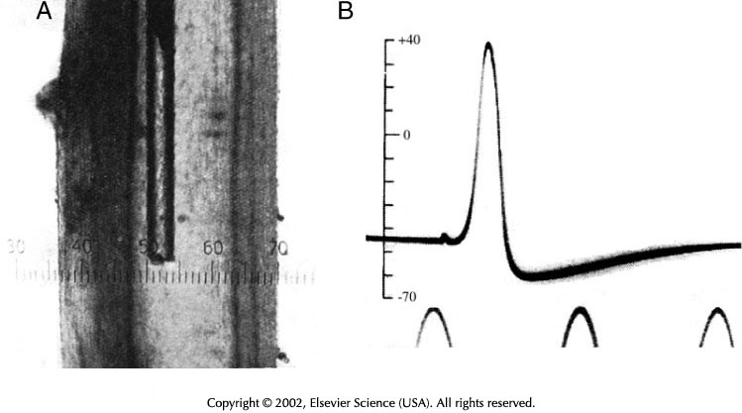

Slide 6
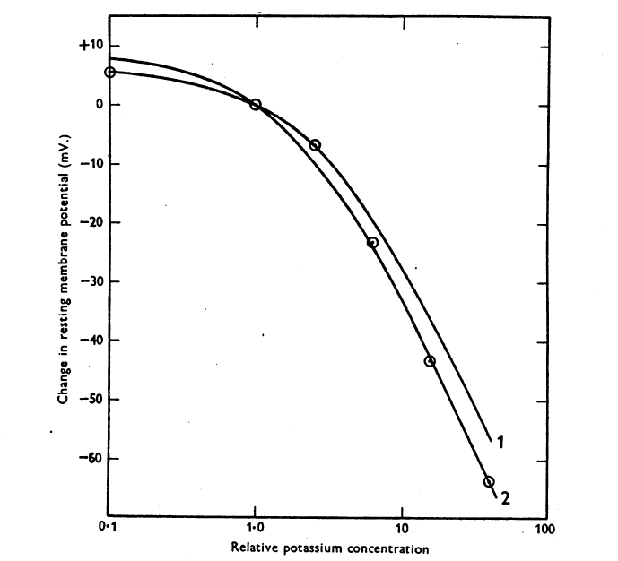

Slide 8
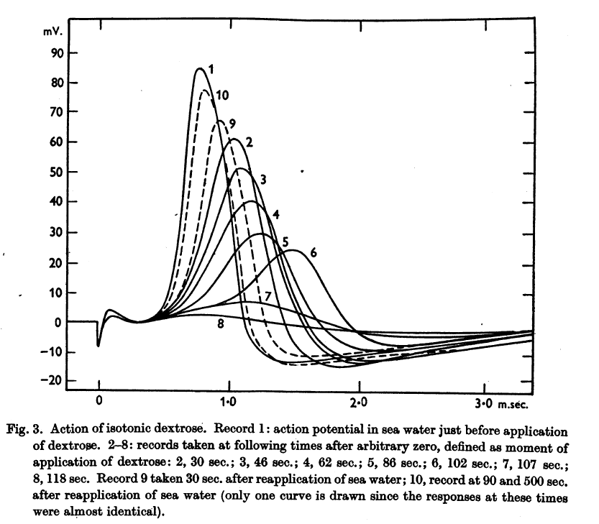
Dextrose perfusion

Slide 9
Fig. 4. Effect of sodium-deficient external solutions on the action potential of a giant axon. Records labelled 1 and 3 were with the axon in sea water; A2 with 0.3 3 sea water 0.67 isotonic dextrose; B2 with 0.5 sea water 0.5 isotonic dextrose; C2 with 0.7 sea
water 0.3 isotonic dextrose. From Hodgkin and Katz.
A simple consequence of the sodium hypothesis is that the magnitude of the
action potential should be greatly influenced by the concentration of sodium
ions in the external fluid.
0.33 sea water
0.5 sea water
25. A. L. Hodgkin and B. Katz, J. Physiol. (London), 108(1949)37.
0.7 sea water

Slide 10
1.56 sea water
25. A. L. Hodgkin and B. Katz, J. Physiol. (London), 108(1949)37.
Fig. 5. Effect of sodium-rich external solution on the action potential of a giant axon. Record a in sea water; record b, 50 sec after applying sea water containing additional NaCl (Na concentration 1.56 times that in sea water).

Slide 11
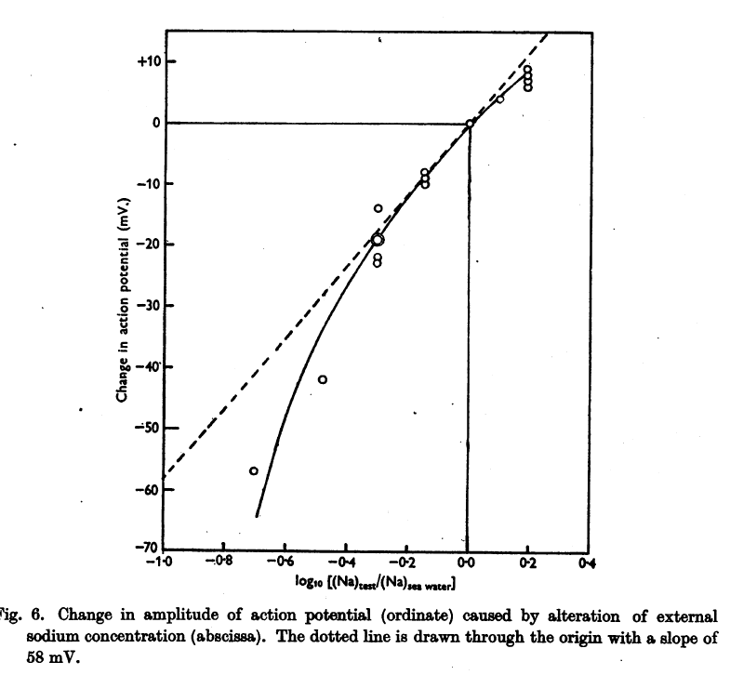

Slide 13
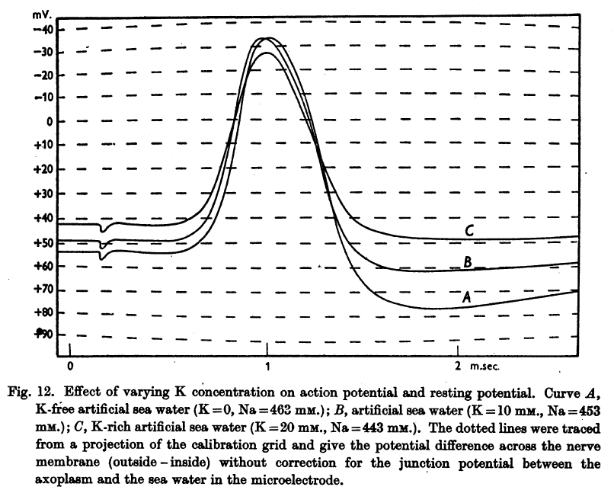
High K sea water
ASW
Low K sea water

Slide 14
Overton CE (1902) Betrage zur allgemaine Muskel-und Nervenphysiologie.
II Uber die Unentbehrlichkeit von Natrium- (oder Litium-) Ionen fur den Contractionsact des Muskels. Pflugers Arch 92:346–380
On the indispensability of Na (or Li) ions for the contraction of muscles
“It would not be difficult to imagine that during the latent period or perhaps even the contraction a change takes plpace in the surface layer of the plasmolemma whereby the fibre becomes permeable to sodium and potassium ions for a short, probably very brief, time interval … If the exchange were to occur between sodium or lithium on the outside and potassium ions of the muscle fibre, this would give rise to an electrical potential difference, which might well be a source of the action currents”
-translated by Bernard Katz

Slide 16
High Na⁺ permeability
High K⁺ permeability
Low K⁺ permeability
Low K⁺ permeability

Slide 17
Problem:
Membrane Potential, Ionic Selectivity and Membrane Conductance are all changing at the same time
24. Cole, K. S.; Curtis, H. J. Electric impedance of the squid giant axon during activity. J. Gen. Physiol. 22:649–670; 1939.
Piccolino (98) Brain Research Bulletin, Vol. 46, No. 5, pp. 381–407,

Slide 18
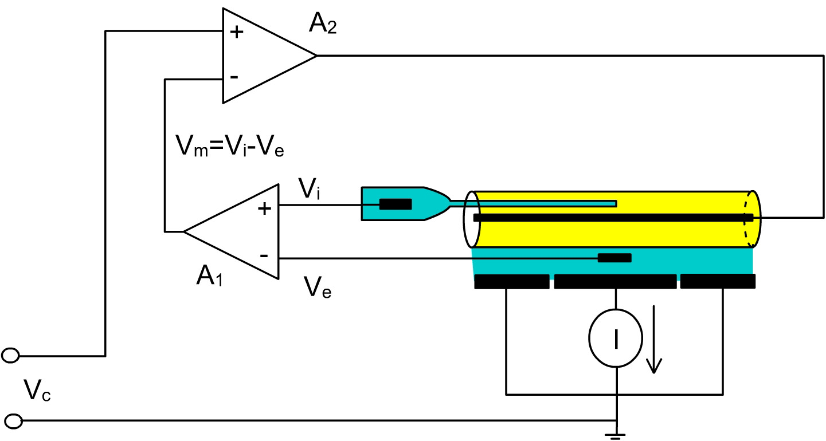
Voltage clamp of the squid axon. Vi is the internal potential measured with a pipette inserted in the axon. Ve is the external potential measured by an external electrode. Vm=Vi-Ve as computed by amplifier A1. A2 compares Vm with Vc (which is the command desired voltage) to inject current I, which maintains Vm at Vc. The current injected by the axial wire crosses the axonal membrane as it is drained by the chamber plates and measured by a current measuring device.
Bezanilla web page

Slide 19
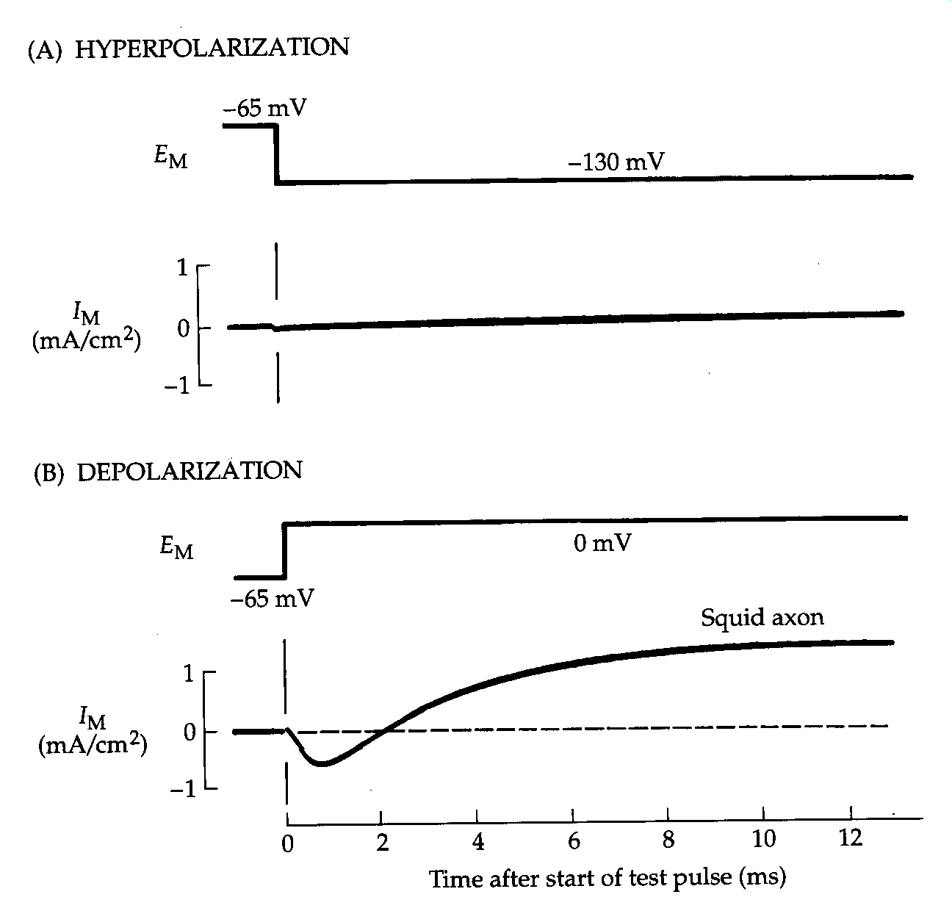
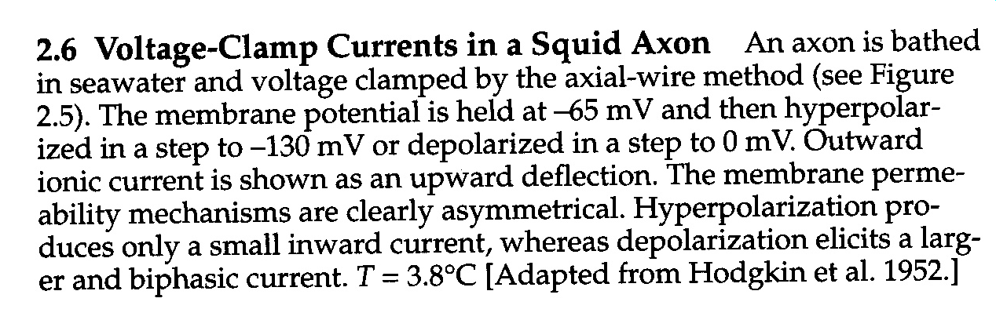
Nicholls “From Neuron to Brain”

Slide 20
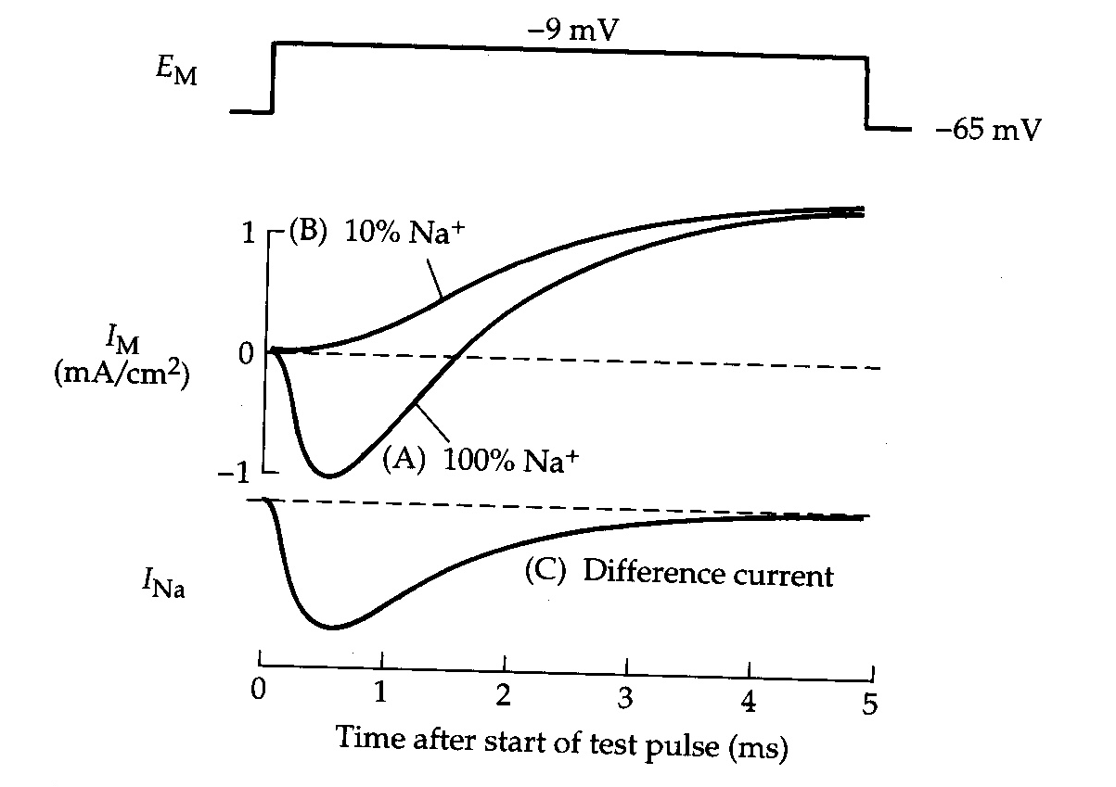
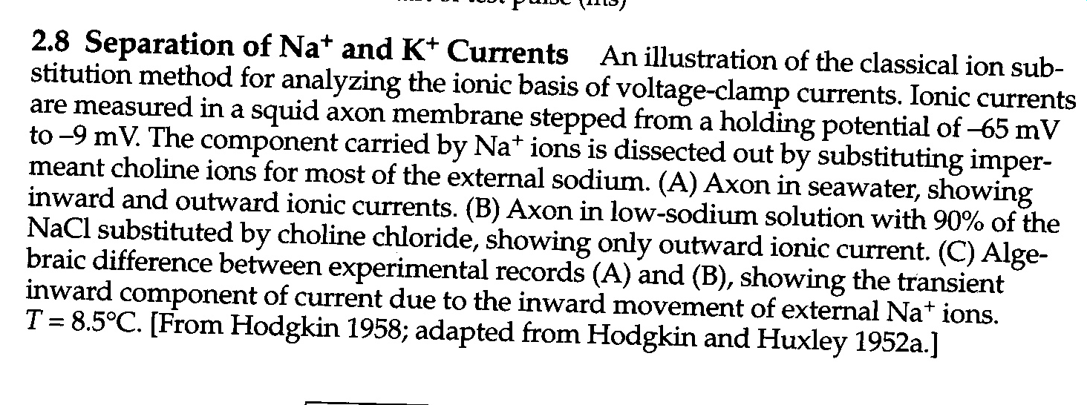
Nicholls “From Neuron to Brain”

Slide 21
I_{K} = g_{K} (E_{m} – E_{K})
Nicholls “From Neuron to Brain”

Slide 22
I_{K}(t)= g_{K}(t).(E_{m}(t)– E_{K})
Nicholls “From Neuron to Brain”

Slide 23
