Slide 1
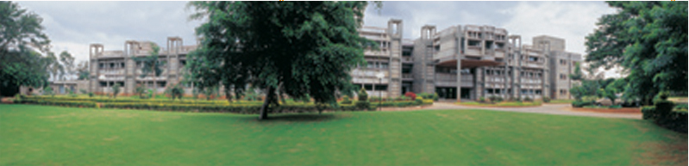
Electrical Activity in the Nervous System
MK Mathew
NCBS, TIFR
UAS – GKVK Campus
Bangalore
IBRO Course in Neuroscience
Center for Cognitive Neuroscience & Semantics, University of Latvia
Riga, Latvia
August 21-August 29, 2013

Slide 2
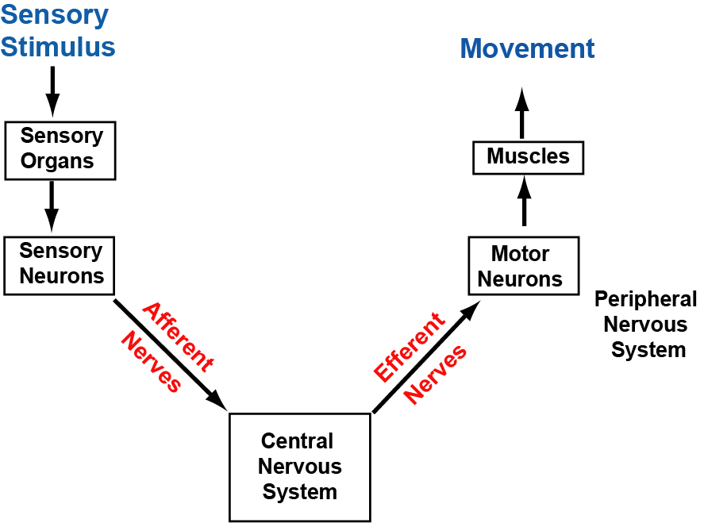
What is the main role of nervous systems?

Slide 3
ca. 500 B.C. - Empedocles suggests that "visual rays" cause sight
460-379 B.C. - Hippocrates discusses epilepsy as a disturbance of the brain
460-379 B.C. - Hippocrates states that the brain is involved with sensation and is the seat of intelligence
387 B.C. - Plato teaches at Athens. Believes brain is seat of mental process
335 B.C. - Aristotle writes about sleep; believes heart is seat of mental process

Slide 4
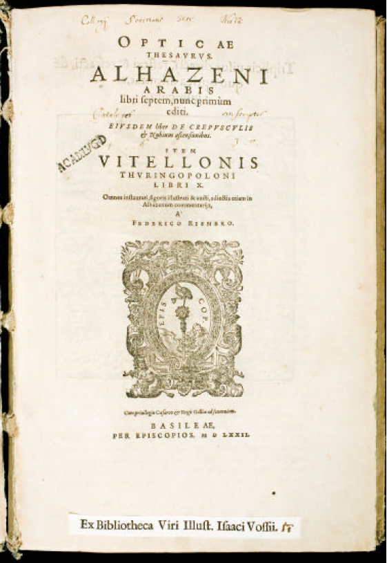
Kitab al-Manazir
Abu ‘Ali al-Hasan ibn al-Hasan ibn al-Haytham

Slide 5
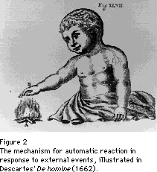
Descartes proposed a mechanism for automatic reaction in response to external events. According to his proposal, external motions affect the peripheral ends of the nerve fibrils, which in turn displace the central ends. As the central ends are displaced, the pattern of interfibrillar space is rearranged and the flow of animal spirits is thereby directed into the appropriate nerves. It was Descartes' articulation of this mechanism for automatic, differentiated reaction that led to his generally being credited with the founding of reflex theory.

Slide 6
Antoni van Leeuwenhoek (1632–1723): ‘Often and not without pleasure, I have observedthe structure of the nerves to be composed of very slender vessels of an indescribable fineness, running length-wise to form the nerve’
Felice Fontana (1730 –1805): Carried out nerve dissections at 700X magnification with fine needles. Found that nerves were composed of fine cylinders. These were
transparent, homogeneous, not empty, as I had found them in previous occasions.
Swammerdam (1738): Showed that muscle contraction did not involve any change in volume – ie no animal spirits or corpuscles were flooding into it and causing the contraction.

Slide 7
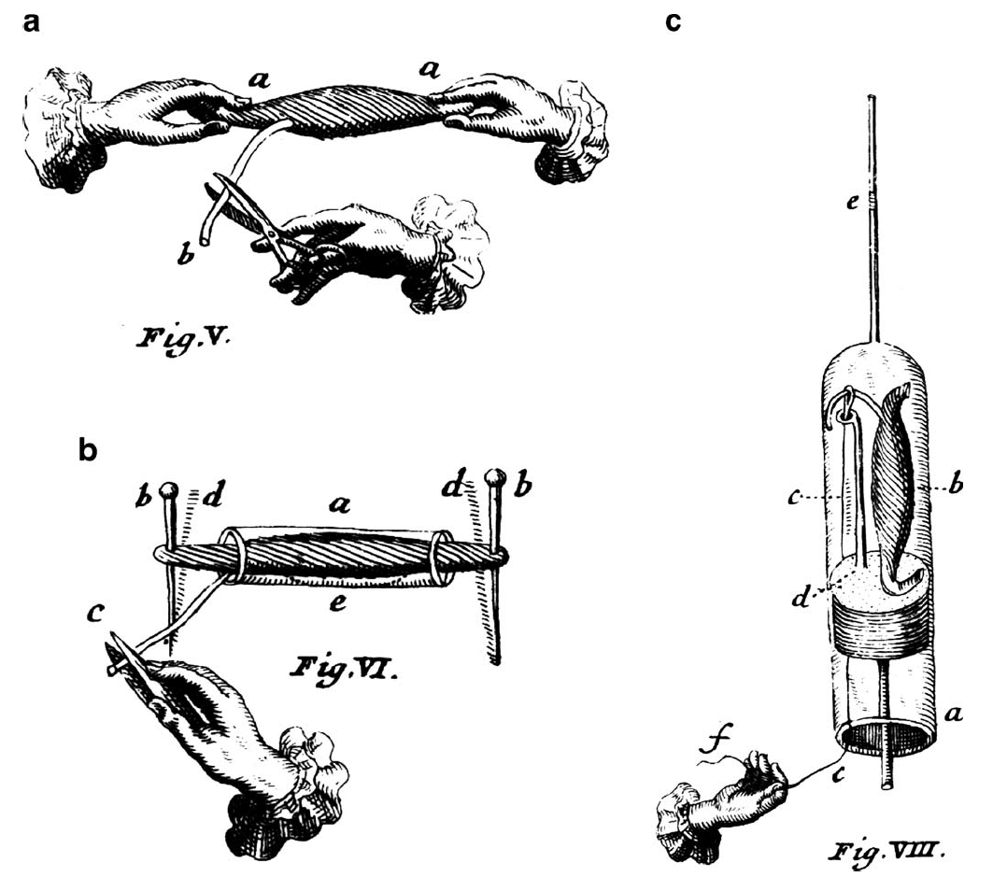
1 Neuromuscular preparations of Jan Swammerdam
Verkhratsky et al (2006) Pflugers Archiv
Notes:
Fig. 1 Neuromuscular preparations of Jan Swammerdam, with his
original descriptions (Images [74] and quotations were kindly
provided by Dr. Mathew Cobb, University of Manchester; see also
[11, 12]). a “if [...] you take hold, aa, of each tendon with your hand,
and then, irritate b, the propending nerve, with scissors or any other
instrument, the muscle will recover its former motion, which it had
lost. You will see that it is immediately contracted and draws
together, as it were, both the hands, which hold the tendons.” b “If
we have a mind to observe, very exactly, in what degree the muscle
thickens in its contraction and how far its tendons approach towards
each other, we must put the muscle into a glass tube, a, and run two
fine needles, bb, through its tendons, where they had been before held
by the fingers; and then fix the points of those needles, neither too
loose nor too firmly, in a piece of cork. If afterwards you irritate, c, the
nerves, you will see the muscle drawing, dd, the heads of the needles
together out of the paces; and that the belly of the muscle itself
becomes considerably thicker, e, in the cavity of the glass tube, and
stops up the whole tube, after expelling the air. This continues till the
contraction ceases, and the needles then move back into their former
places.“ c The stimulation of neuromuscular preparation by silver
wire.” a) The glass tube, or siphon. b) The muscle. c) A silver wire
with a ring in it, through which the nerve passes. d) A bras wire...
through which the silver wire passes. e) A drop of water in glass tube.
f ) The hand that irritates the nerve, in consequence of which irritation
the drop on the muscle, contracting itself, descends a little”

Slide 8
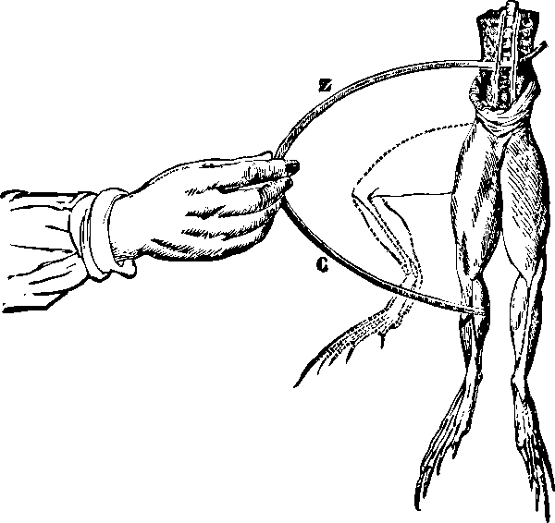
1780’s
The electrochemical behavior of two dissimilar metals [(zinc (Z) and copper (C)] in a bimetallic arch, in contact with the electrolytes of tissue, produces an electric stimulating current that elicits muscular contraction.[

Slide 9
Piccolino (98) Brain Research Bulletin, Vol. 46, No. 5, pp. 381–407,

Slide 10
1780’s Galavni’s experiments with “Animal Electricity” establish that nerves are conductors of electricity and not of fluid, establishing the basis for neurophysiology
1848 Emile Du-Bois Reymond (1818 - 1896) discovered the nerve injury current and the \negative" variation (the nerve action potential).

Slide 11
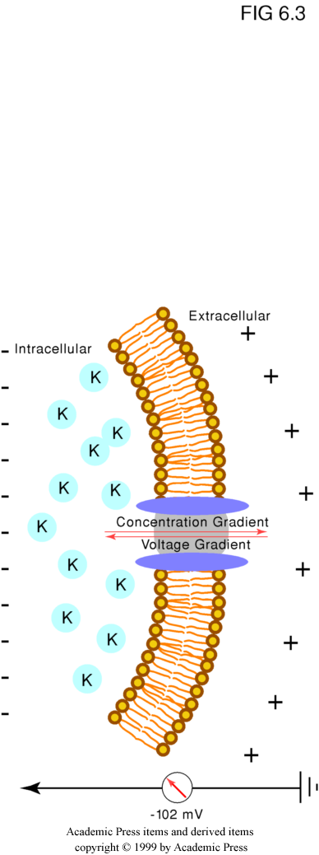
1888 | Walther Nernst develops a theory of electrical potentials based on diffusion of ions in solution.
Opposing forces:
Conc gradient
Potential difference
[c]
RT [c]_{o}
__ _{o}
ΔΨ = ln
= 58 log
nF [c]_{i}
[c]_{i}

Slide 12
FIG. 8. Scheme of Bernstein’s theory of membrane polarization. (a) A muscle fiber in the resting state, with an excess of negative charges inside the membrane and of positive charge outside; (b) a lesion has removed the local barrier to ion passage provided by the membrane, and, therefore, A becomes negative with respect to B, allowing for a current flow from B to A. According to Bernstein [15], a similar phenomenon would occur
during excitation A representing then the active region of the membrane (From [15]).
Piccolino (98) Brain Research Bulletin, Vol. 46, No. 5, pp. 381–407,

Slide 13
“somewhere in the substance of the muscle fiber (fibril, sarkoplasm) a lack of permeability for one ion, e.g., for the anion of the electrolyte”
- Bernstein, J. Pflügers Arch. 1902, 92, 521
Note: In this paper Bernstein measured the electromotive force of the resting current and showed that its changes with temperature were consistent with the Nernst equation. Did not mention K⁺ selectivity here.
- Höber, R. Pflügers Arch. 1905, 106, 599
Showed that resting membrane potential decreased on increasing external K⁺. He concludes that in addition to what he calls “physical-diosmotic permeability” (as described by Overton) there must a different, second kind that depends more on the cell’s physiological state: “physiological permeability”. Höber remarks, with what duBois-Reymond would have called “manly resignation”, that “'physiological' here means hardly more than 'unexplained'”.

Slide 14
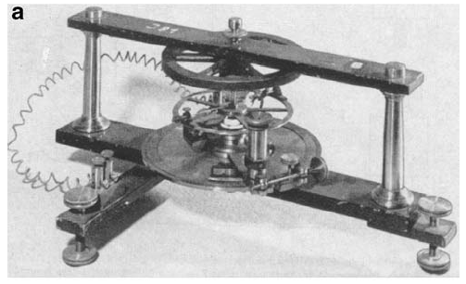
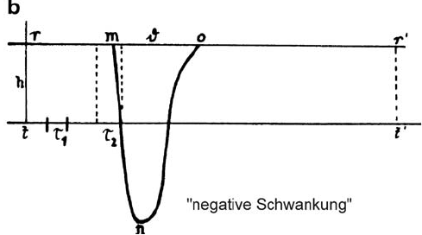
Verkhratsky et al (2006) Pflugers Archiv
Notes:
Fig. 4 First recording of action potential from the nerve made by
Julius Bernstein [6, 52]; original images were kindly provided by Prof.
Bernd Nilius, University of Leuven. a The Bernstein rheotome; b the
recording of an action potential. The τ1 and τ2 indicate “sampling”
intervals of the rheotome; the duration m–o is the duration of action
potential [“negative Schwankung”, and n is the “sign reversal”
(overshoot)]

Slide 15
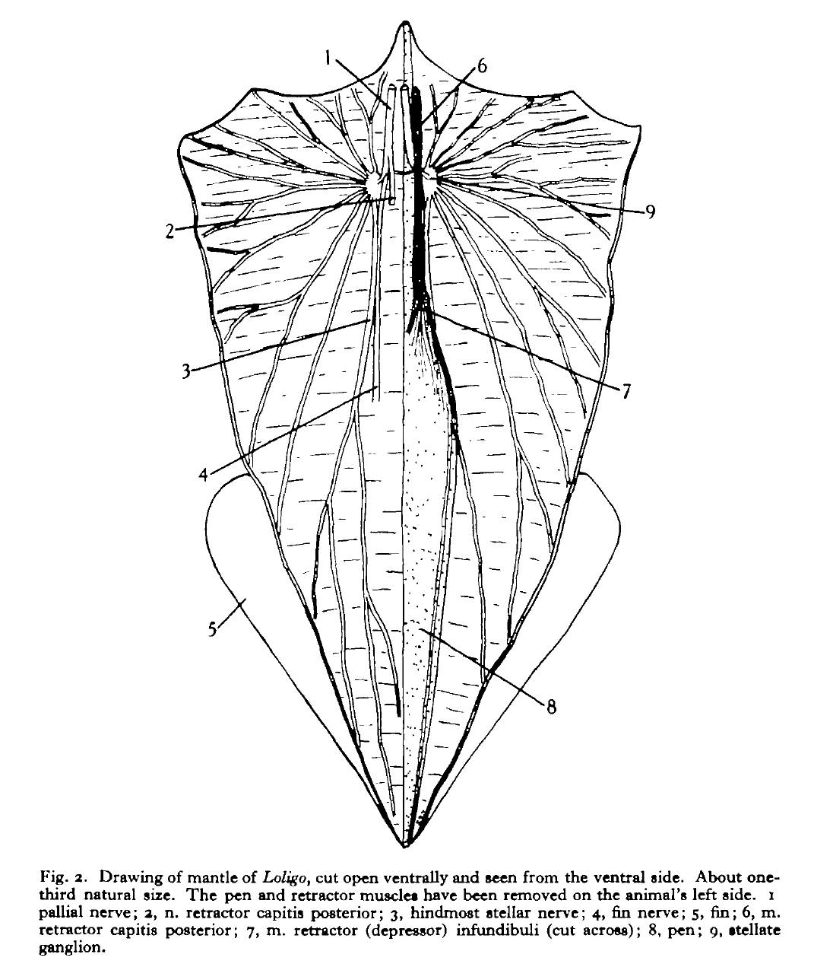
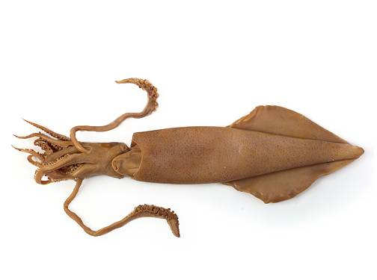
JZ Young (1937) J Exp Biol

Slide 16
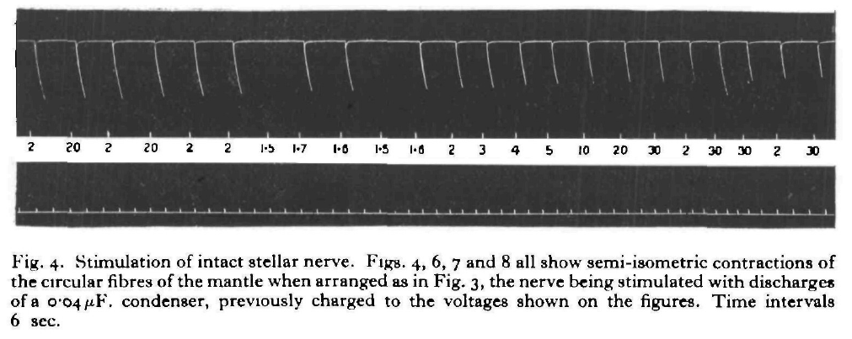
2
20
2
20
2
2
1.5
1.7
1.6
1.5
1.6
2
3
4
5
10
20
JZ Young (1937) J Exp Biol
30
2
30
30
2
30
“The ease with which the single nerve fibres can be isolated in
the squid, and the large number of muscle fibres which each innervates, make this system ideal for showing the working of such single neuromotor units.”
JZ Young (1937) J Exp Biol

Slide 17
1780’s Galavni’s experiments with “Animal Electricity” establish that nerves are conductors of electricity and not of fluid, establishing the basis for neurophysiology
1848 Emile Du-Bois Reymond (1818 - 1896) discovered the nerve injury current and the \negative" variation (the nerve action potential).
1888 Walther Nernst develops a theory of electrical potentials based on diffusion of ions in solution.
1896 Bernstein proposes K⁺ selective membrane to explain Resting Potential
1902 Bernstein predicted massive increase in non-selective membrane permeability during an action potential. This was subsequently referred to as the Bernstein Hypothesis.
1937 JZ Young introduces the squid axon as a preparation for electrphysiology

Slide 18
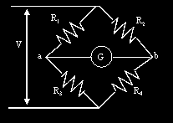
1780’s Galavni’s experiments with “Animal Electricity” establish that nerves are conductors of electricity and not of fluid, establishing the basis for neurophysiology
1848 Emile Du-Bois Reymond (1818 - 1896) discovered the nerve injury current and the \negative" variation (the nerve action potential).
1888 Walther Nernst develops a theory of electrical potentials based on diffusion of ions in solution.
1896 Bernstein proposes K⁺ selective membrane to explain Resting Potential
1902 Bernstein predicted massive increase in non-selective membrane permeability during an action potential. This was subsequently referred to as the Bernstein Hypothesis.
1937 JZ Young introduces the squid axon as a preparation for electrphysiology

Slide 19
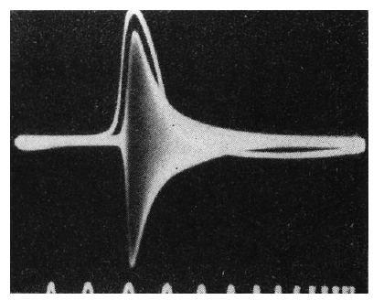
24. Cole, K. S.; Curtis, H. J. Electric impedance of the squid giant axon during activity. J. Gen. Physiol. 22:649–670; 1939.
FIG. 13. The classical demonstration of the increase of conductance in the
squid axon during the discharge of the action potential. Upper line: action
potential; white-dark band: measure of the membrane impedance obtained
with the Wheatstone bridge method by applying a high frequency (20 KHz)
sinusoidal signal to two electrodes placed on the opposite site of a giant
axon. From a measure of the impedance changes obtained at various frequencies (and proportional to the width of the band) the change of conductance was estimated to be approximately 40 times at the peak of the action potential relative to rest. Time marks: 1 ms apart. (From [24]).
Piccolino (98) Brain Research Bulletin, Vol. 46, No. 5, pp. 381–407,

Slide 20
FIG. 14. The first published intracellular recording of the action potential in the squid axon. Time course of the difference between the internal and
external potential, in the resting state and during the discharge of an action potential. Time mark, 500 Hz. Notice the large positive overshoot of the
membrane potential during the action potential, which contrasted with the expectation of the Bernstein’s theory (From [60]).
Fig. 3, which illustrates one of these experiments, shows an
action potential of 86 mV and a resting potential of 45 mV. In their 1939 experiments Curtis and Cole recorded the action potential with a condenser coupled amplifier; later measurements with a d. c. amplifier gave an average action potential of 108 mV and an average resting potential of 51 mV.
Hodgkin Lecture
60. Hodgkin, A. L.; Huxley, A. F. Action potentials recorded from inside
a nerve fibre. Nature 144:710 –711; 1939.
Piccolino (98) Brain Research Bulletin, Vol. 46, No. 5, pp. 381–407,

Slide 21
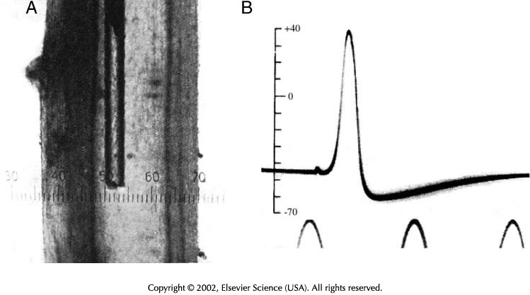

Slide 22
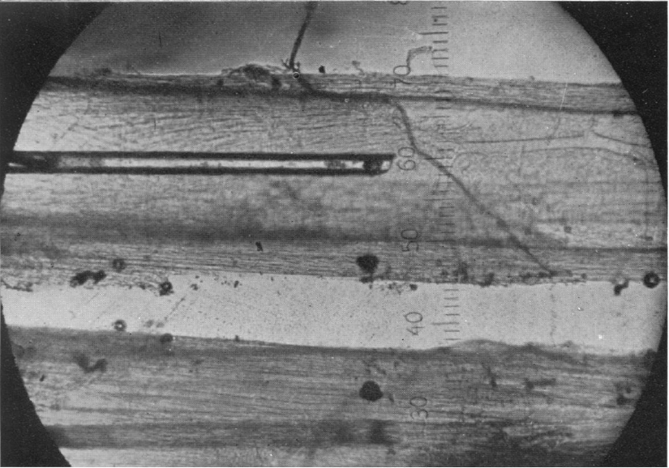
Hodgkin & Huxley (45) J. Physiol. I04, I76-I95

Slide 23
FIG. 14. The first published intracellular recording of the action potential in the squid axon. Time course of the difference between the internal and
external potential, in the resting state and during the discharge of an action potential. Time mark, 500 Hz. Notice the large positive overshoot of the
membrane potential during the action potential, which contrasted with the expectation of the Bernstein’s theory (From [60]).
Fig. 3, which illustrates one of these experiments, shows an
action potential of 86 mV and a resting potential of 45 mV. In their 1939 experiments Curtis and Cole recorded the action potential with a condenser coupled amplifier; later measurements with a d. c. amplifier gave an average action potential of 108 mV and an average resting potential of 51 mV.
Hodgkin Lecture
60. Hodgkin, A. L.; Huxley, A. F. Action potentials recorded from inside
a nerve fibre. Nature 144:710 –711; 1939.
Hodgkin & Huxley (45) J. Physiol. I04, I76-I95

Slide 25
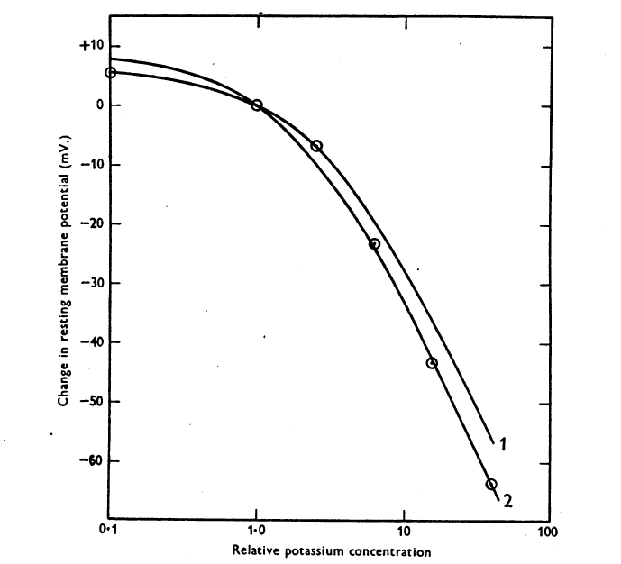

Slide 27
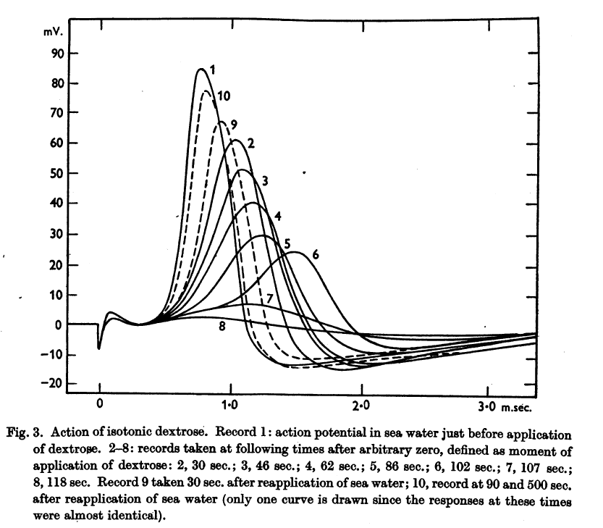
Dextrose perfusion

