Slide 1

Future climate scenarios for phosphorus and nitrogen dynamics in the Gulf of Riga
Bärbel Müller-Karulis, Latvian Institute of Aquatic Ecology
Juris Aigars, Latvian Institute of Aquatic Ecology
In colaboration with Juris Seņņikovs, Laboratory for Mathematical Modelling of Environmental and Technological Processes, Faculty of Physics and Mathematics, University of Latvia
Latvian Institute
of Aquatic Ecology

Slide 2
Gulf of Riga characteristics
Semi-enclosed basin
Connected to Eastern Gotland basin surface waters
Salinity 5.5 – 6.2 PSU
Shallow: average depth 22 m, maximum 56 m
no permament halocline, seasonal thermocline, monomictic circulation
High freshwater and riverine nutrient input
Regular monitoring since 1973
Response to climate change
?

Slide 3
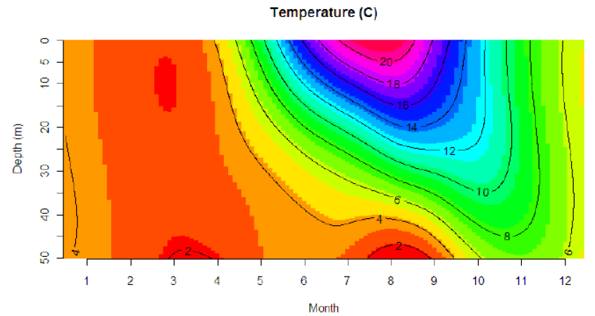
Mean temperature (period 1973-2008)

Slide 4
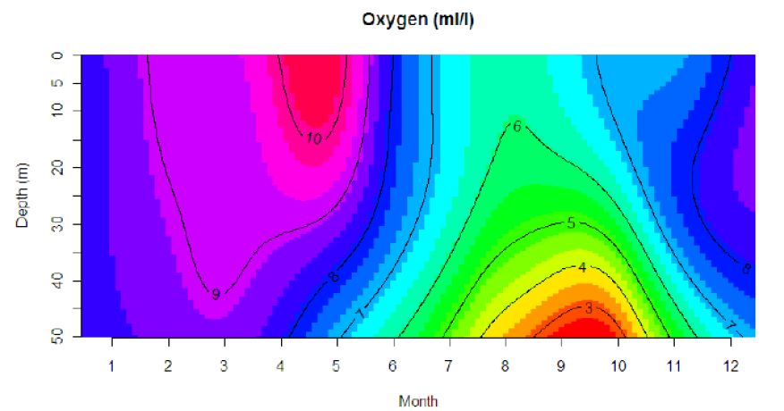
Mean oxygen (period 1973-2008)

Slide 5
Model setup
Biogeochemical model
  phytoplankton, zooplankton and nutrients
  NPZD Box model based on Savchuk 2002
  2 boxes (pelagic, demersal) + sediments
  3 phytoplankton groups
  Zooplankton
  NO₃, NH₄, PO₄, O₂
  Calibrated to 28-year observation series
Physical model (1D)
  vertical temperature distribution in the GoR
  General Ocean Turbulence Model (GOTM)
  Coefficients of second order model: Cheng (2002)
  Dynamic equation (k-ε style) for TKE
  Dynamic dissipation rate equation
Ecosystem response
Temperature change

Slide 6
Climate change scenario
Climate data from PRUDENCE. Control: 1961-1990, Scenario A2: 2070-2100
Extra downscaling of RCM data (bias correction via histogram equalisation):
relative humidity (used variable td2m)
air temperature (used variable t2m)
Original RCM data:
sea level pressure (used variable MSLP)
cloudiness (used variable clcov)
wind speed (used variable w10m)
wind direction (used variable w10dir)
Calculations made for Gulf of Riga (50 m), 30 year period, daily output data – water temperature

Slide 7
Physical model results – I
(mean temperature distribution over depth)
Surface T increase close to air T increase
T increase by 1,5 (bottom) to 3 (surface) degrees

Slide 8
Physical model results – II
(mean daily pycnocline depth and its variation)
... stratification lasts longer
Pycnocline develops earlier...

Slide 9
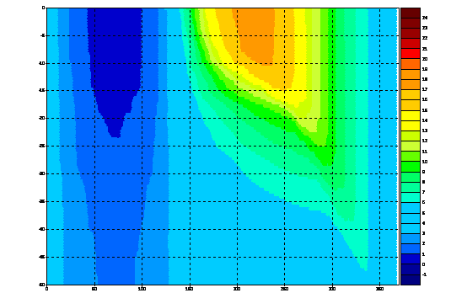
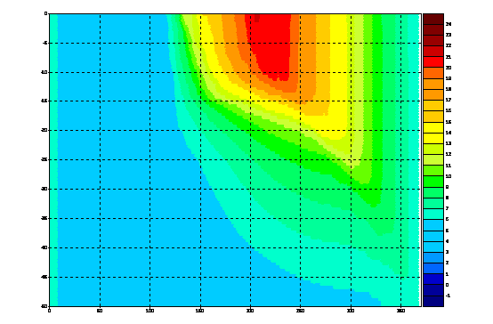
Physical model results – III
(mean time-depth plots of temperature)
Contemporary climate
Climate change scenario A2

Slide 10
Vertical water exchange
decreased vertical water exchange

Slide 11
Demersal oxygen – GR mean

Slide 12
Species succession
earlier and more vigorous spring bloom

Slide 13
Species succession
larger biomass of summer species

Slide 14
Species succession
more cyanobacteria

Slide 15
Pelagic nutrients
larger winter pool
earlier depletion

Slide 16
Demersal nutrients
larger demersal nutrient concentrations in summer

Slide 17
Vertical nutrient flux
increased demersal concentrations compensate stratification effect

Slide 18
Nutrient regeneration
Pronounced increase in nutrient recycling!

Slide 19
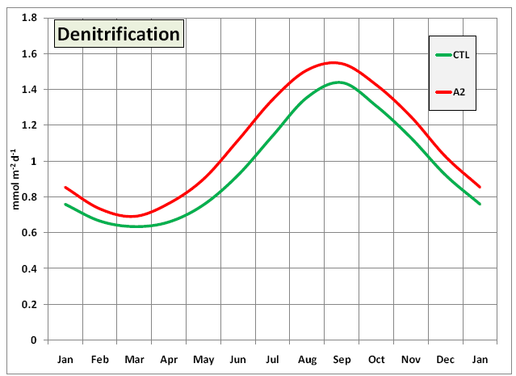
Denitrification

Slide 20
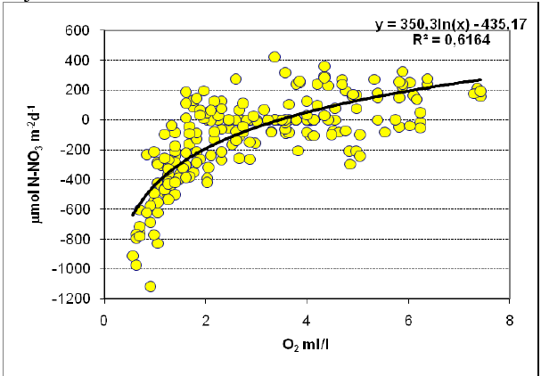
Nitrate uptake/release (oxygen control)

Slide 21
Ammonium versus nitraterelease

Slide 22
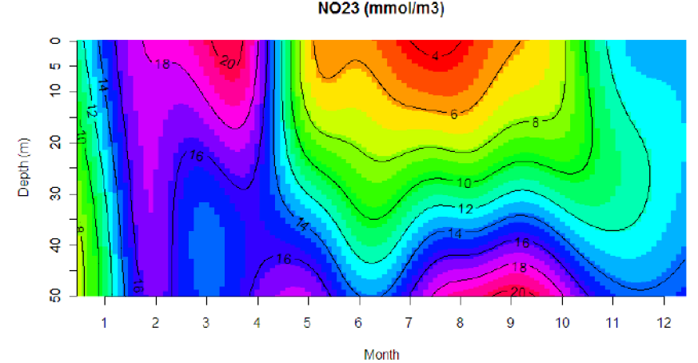
Mean nitrate (period 1973-2008)

Slide 23
Conclusions
Increase in phytoplankton growth and primary productivity caused by increased nutrient regeneration
Slightly increased winter nutrient concentrations
Earlier spring bloom (earlier stratification, no ice cover)
Larger summer phytoplankton biomass, more cyanobacteria because of more intensive nutrient regeneration
Lower demersal oxygen concentration caused by more stable and longer stratification
Denitrification – open question for future research

